Slide 1

TAGORE INTERNATIONAL SCHOOL

Slide 2
TABLE OF CONTENTS
01
03
PROBLEM & SOLUTION
HOW DOES THE PROTOTYPE WORK?
02
04
BUSINESS MODEL
HARDWARE AND SOFTWARE DETAILS

Slide 3
UNDERSTANDING THE PROBLEM
In metropolitan cities we find that all traffic lights are non adaptive i.e run on fixed timings which are not affected by the traffic density
The traffic lights will complete its hard coded cycle before changing the signal for the progressive traffic. Which wastes a lot of time and contributes to global warming
enormously.
Apart from the environmental concern, the traffic on roads results in delay for ambulances, fire engines and police to reach their destinations.

Slide 4
OUR SOLUTIONS
We plan to Introduce self sufficient traffic system infused with AI, Deep ML which will be integrated with a raspberry pi module fitted on each traffic light with an external connection to a camera.
The traffic lights would alter their duration on the basis of an
pre-fed algorithm in the raspberry pi module which in turn
will optimize the availability of routes and reduce congestion.
We will also have the hard-coded version in idle state so
that the light doesn't malfunction in absence of electricity.
Most importantly it will lay down the framework
for a new system of traffic lights, thus implementing
Atma-Nirbhar Bharat

Slide 5
HOW DOES OUR PROTOTYPE WORK?
Open CV
Split Into Frames
STEP 1
STEP 2
STEP 5
Video Stream
From the Camera
Timings Calculated
Classification into
High_Traffic and
Low_Traffic.
STEP 3
STEP 4
Processed By the AI Engine
Checks For Manual Control Request
State of the Traffic Light changed

Slide 6
HOW IS AI IMPLEMENTED?
The video stream received from the camera is passed through our AI engine, then based on the traffic conditions of the road, it is classified into 2 major classes.
High_Traffic and Low_Traffic depending on this the new timings of the traffic light(s) are decided
We have used a SLAM model type for our AI

Slide 7
HARDWARE AND SOFTWARES DETAILS
Hardware Used:
Raspberry Pi 3/0
A USB compatible Camera, preferably weather-proof
Software Details:
The scripts that have to be executed are written in python,
The AI model is stored in a keras file.
Libraries Used:
Keras
OpenCV
PIL
NumPy
Socket

Slide 8
BUSINESS MODEL
IN DELHI
There are approximately 1000 traffic lights in Delhi.
If we plan to install our model on each light for the price of 3,000 per model,
the price for installation throughout Delhi would be Rs. 30,00,000. The profit for the project would be Rs.10,00,000.
IN BANGALORE
There are approximately 750 traffic lights in Bangalore.
If we plan to install our model on each light for the price of 3,000 per model,
the profit for the project would be Rs.7,50,000.
SUBSCRIPTION BASED MODEL
The service would be free for the first year after which the operational cost for the service would be approx. Rs. 5,00,000 per state.

Slide 9
BUSINESS MODEL THE FUTURE
The city of Bangalore requires 5000 traffic lights. If we install our model in each of these lights as well, we could make another profit of Rs. 50,00,000 alone from Bangalore.
The need for traffic lights is always increasing, especially due to urbanization.
TIE IN WITH GOVERNMENT
We would also be joining hands with the Government in order to get direct access to the entire network of traffic signals, and labor which would significantly reduce the Installation Cost. Apart from this we also intend to use the pre-fitted camera at traffic lights in cities like Delhi and Bangalore which can also cut down the need for installation of a camera, thereby bringing down the cost effectively by Rs. 1000.

Slide 10
PRIVACY
HOW WE INTEND TO TACKLE PRIVACY ISSUES:
There will be no servers, yes that is correct. All the data will be shared within the traffic lights through ethernet and discarded as soon as the algorithm is terminated.
Our model can detect and label different objects like person, car, etc and to ensure greater privacy, with the help of OpenCV we can easily blur portions of sensitive data points before feeding the data into the model.

Slide 11
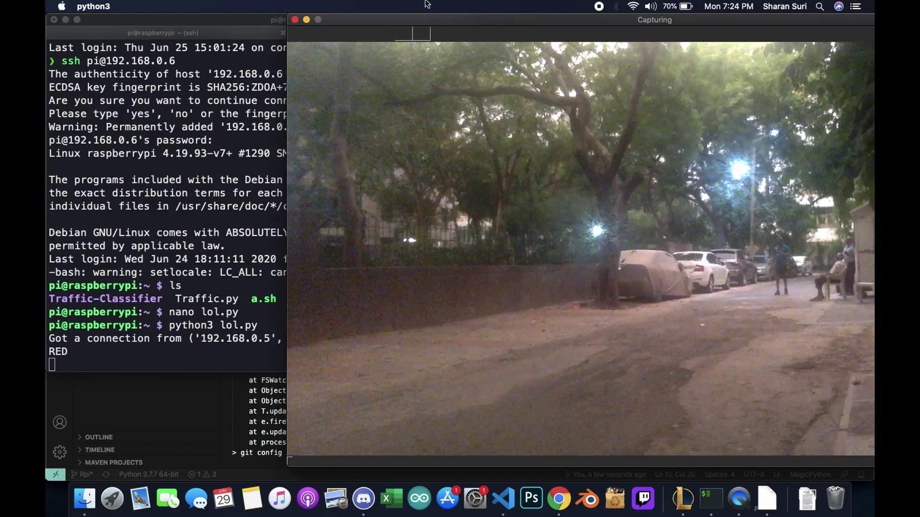
VIDEO SHOWCASE

Slide 12
CONCLUSION
Our model is infused with a special mode that creates a 'green-corridor' for permitted
vehicles which can be enabled via app.
We intend to run a prediction model so that we can predict the
future traffic conditions and make our system more efficient.
Moreover, we also plan to deploy an app that can give the user
average traffic conditions in their surroundings and optimize their
routes accordingly assisting them with ETAs and Shorter routes.
We can expand our model to cover intersections, T-points
and express highways.

