Slide 1
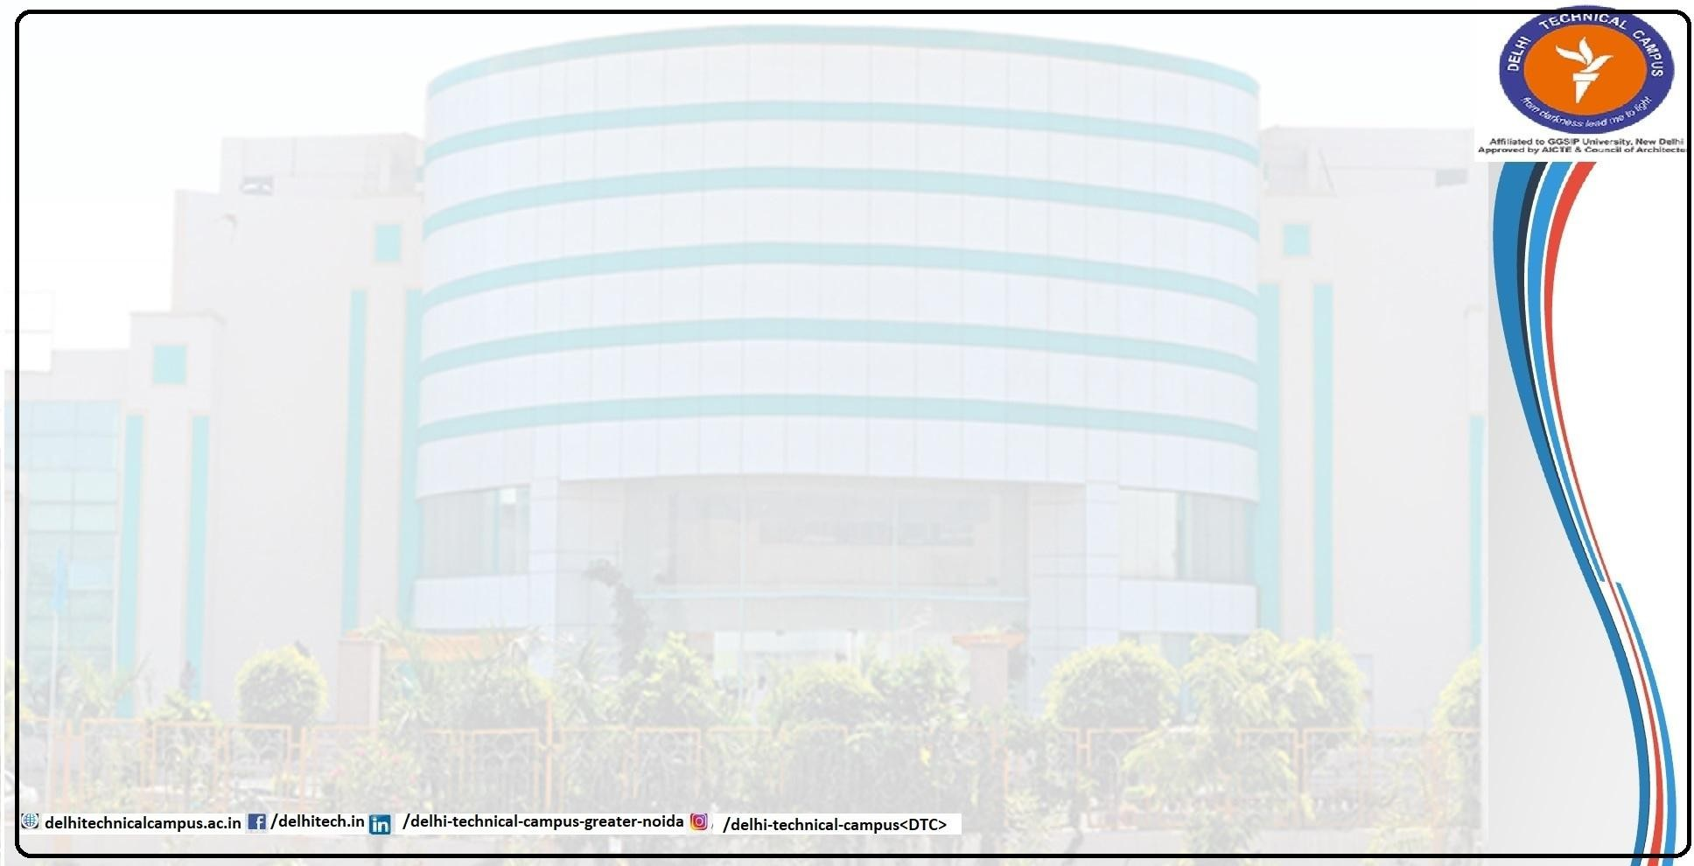
Project Based Learning
ON
Realtime ASL Translator using CNN
BACHELOR OF TECHNOLOGY
in
COMPUTER SCIENCE & ENGINEERING
AT
DELHI TECHNICAL CAMPUS GREATER NOIDA
Submitted to-
Submitted by-
Name – Ms. Preeti Katiyar
Harsh Rathee (00818002722) Mridul Singh (02118002722)
Naman Chandok (03018002722)
Dhruv (03518002722)
Designation – Assistant Professor

Slide 2
Introduction
Sign languages are vital for communication within the Deaf and Hard-of-Hearing communities. However, their usage is limited due to the communication gap with people unfamiliar with them. This project, ASL Translator, bridges that gap using computer vision and machine learning to translate American Sign Language (ASL) gestures into text in real time.
The application utilizes MediaPipe for real-time hand tracking, combined with Keras to classify ASL signs from hand landmarks. It delivers a responsive web-based interface allowing users to perform signs in front of a camera and see their corresponding letters or words instantly.
Project Objective:
Recognize ASL alphabet hand gestures using real-time video feed.
Use MediaPipe for precise hand landmark extraction.
Train and use a Keras-based neural network for gesture classification.
Enable real-time translation of signs to text.

Slide 3
Technologies Used
Languages:
Python
Libraries/Frameworks:
TensorFlow
OpenCV
Keras
MediaPipe
Model:
A CNN trained on ASL alphabet images using Keras.
Dataset:
ASL Dataset acquired from kaggle

Slide 4
System Architecture/Flow
asl_dataset
Kaggle dataset with various images for every character in ASL
main.py
ASL Dataset is loaded and split into test and train data
Images are preprocessed to be sent to model
CNN Model is trained on the dataset
Confusion Matrix is plotted based on model results
Model is saved to local .keras file
cam.py
Model is loaded from local .keras file
Input is taken from webcam using OpenCV
Input is preprocessed
Input sent to CNN Model for evaluation

Slide 5
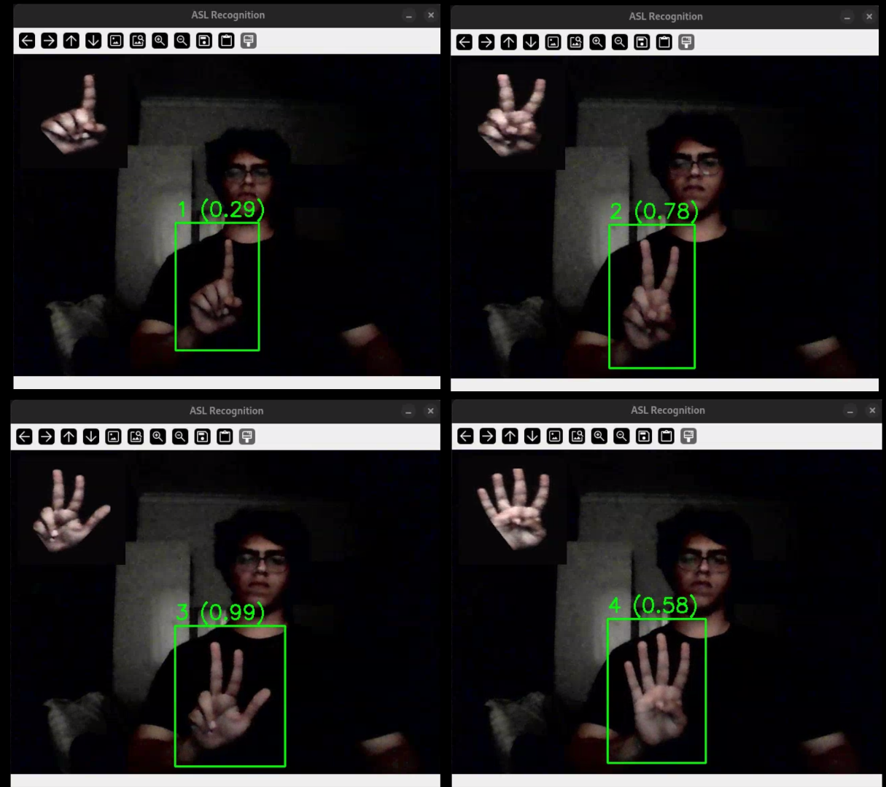
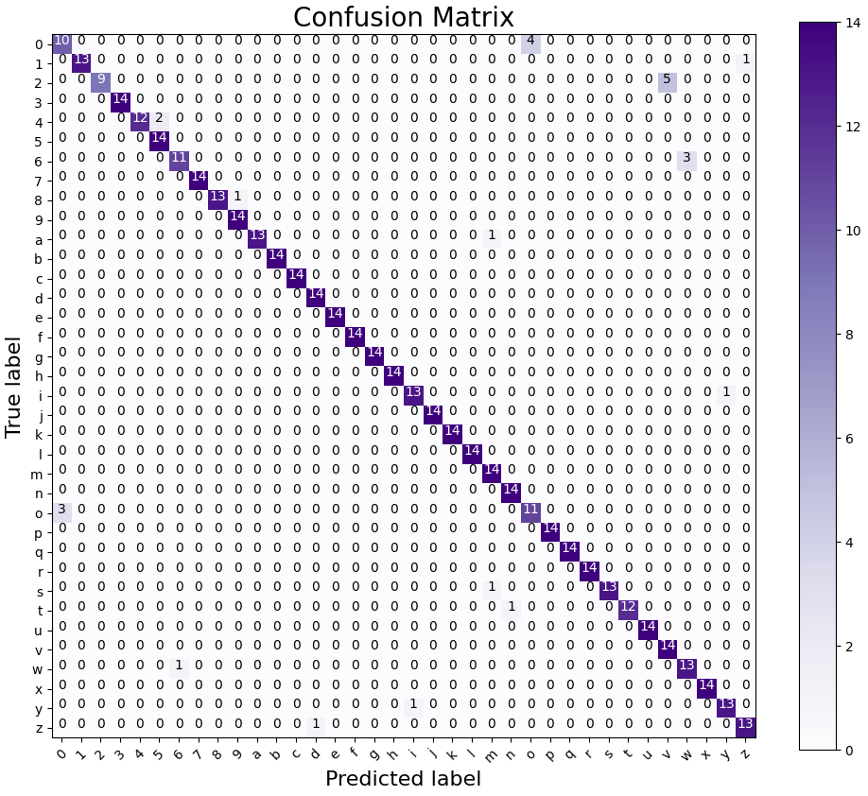
Deployment Screenshots

Slide 6
Key Learning Outcomes
Application of Computer Vision in Real-World Problems: Gained hands-on experience with MediaPipe for real-time hand tracking and computer vision applications.
Model Development with Deep Learning: Understood how to train and evaluate convolutional neural networks (CNNs) using real-world datasets.
Real-Time System Integration: Successfully integrated multiple components (hand tracking, model inference, and UI) to build a responsive, real-time application.
Data Handling and Preprocessing: Developed a dataset using webcam feeds and performed feature extraction using hand landmarks.
Problem-Solving and Debugging: Improved skills in debugging and optimizing the performance of machine learning applications in real-time environments.

Slide 7
Challenges Faced & Solutions
Future Improvements
Challenge: Taking input from webcam Solution: Used OpenCV library and VideoCapture
Challenge: Extracting hand from input Solution: Used MediaPipe solutions to detect and extract hand
The project demonstrates translation of ASL alphabets.
It can be extended to detect full words and phrases.
Future scope includes sentence generation and voice output.

Slide 8
Conclusion
Key Takeaways from the FunkyShop Project:
Feasibility and effectiveness of using open-source tools for impactful social applications.
CNNs are powerful tools for gesture recognition when paired with effective feature extraction techniques like hand landmarks.
MediaPipe provides robust real-time tracking capabilities that are essential for human-computer interaction applications.
Well-structured modular codebases make future scalability (e.g., to full sentences or audio output) achievable.
The PBL approach helped bridge the gap between theory and practice, improving our problem-solving, collaboration, and debugging skills.
Overall, the project served as a comprehensive learning experience, laying a strong foundation for future machine learning projects and enhancing our readiness for real-world challenges.

