Slide 1


Slide 2
PROBLEM
Mental illnesses are not as concrete as physical illnesses, they are often not taken as seriously. Contrary to this popular belief, mental illnesses are actual diseases that must be treated as seriously as a physical disease, such as cancer or heart disease.
Being persistent in looking for a therapist can be extremely difficult, especially when you're experiencing intense emotions and feeling drained of energy.

Slide 3
About Coral

Slide 4
ABOUT CORAL
Coral is highly-prized as a substance believed to be endowed with mysterious sacred properties. It is a symbol of modesty, wisdom, happiness and immortality. Here at coral, we help you connect with different psychologists, therapists and support groups who can help you with the issues you're going through. Here we try to get rid of negativity and help you live a happy and positive life. You can also view nearby psychologists, therapists and support groups and interact with them.

Slide 5
MISSION
VISION
Coral aims to provide people with the best mental health care services
We want coral to become the biggest platform for all health care services.

Slide 6
Services
Support Groups
Psychologists
Physiotherapists
Members with the same issues can come together for sharing coping strategies, to feel more empowered and for a sense of community.
Psychologists at Coral are friendly and always ensure that you are comfortable with sharing your personal issues with them.
Physiotherapists help people affected by injury, illness or disability through movement and exercise, manual therapy, education and advice.

Slide 7
AI Solution
At Coral, you can take a quiz which helps you recognize the issue you’re facing and match you with the perfect psychologist suited for you. We also provide services for physiotherapy to help patients manage pain and prevent disease. Music is the soul of life and gives immense peace to us. We, at Coral recognize this and have created peaceful playlists for you to calm your mind and make your day better.

Slide 8
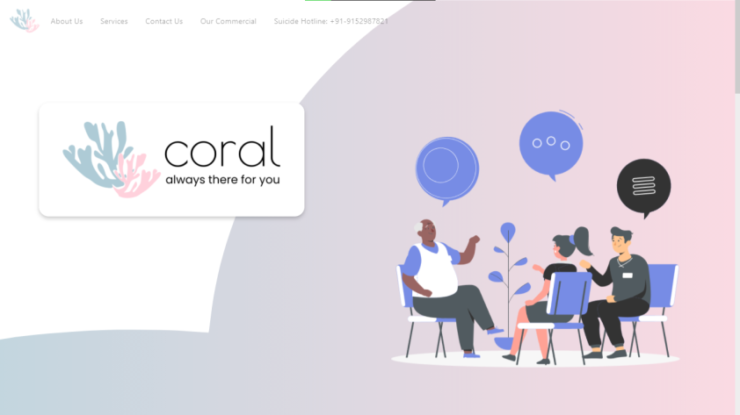
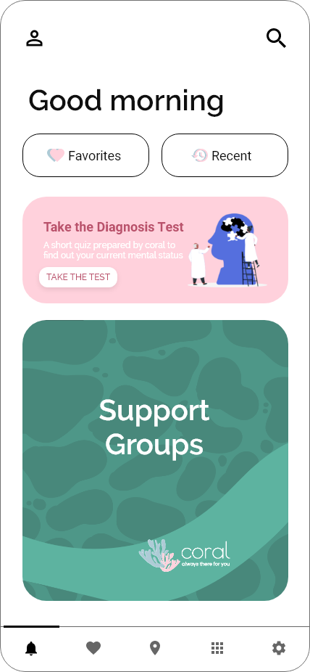
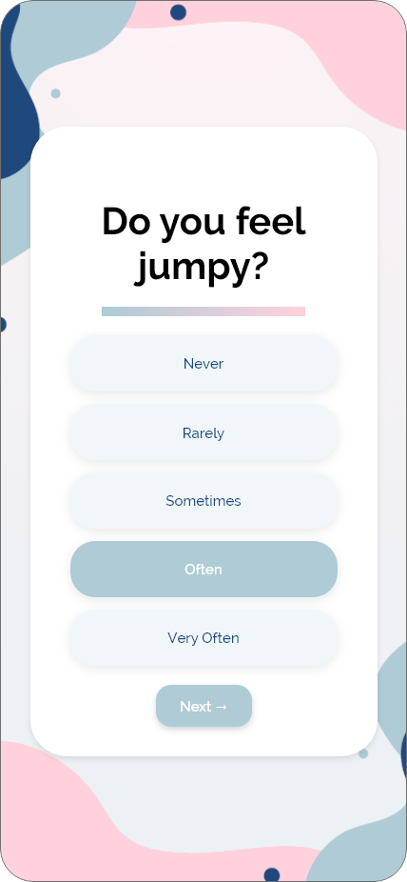
VISIT OUR WEBSITE!
And this is the UI design for the app

