Slide 1
Vessel and Tissue Recognition during Third-­Space Endoscopy using a Deep Learning Algorithm
Authors: Alanna Ebigbo, Robert Mendel, Markus W Scheppach‍, Andreas Probst, Neal Shahidi, Friederike Prinz, Carola Fleischmann, Christoph Römmele‍, Stefan Karl Goelder,4 Georg Braun, David Rauber, Tobias Rueckert, Luis A de Souza Jr, Joao Papa, Michael Byrne, Christoph Palm, Helmut Messmann
Review by Pradeep & Naman
Group 26

Slide 2
What is Endoscopy?
Procedure: Non-surgical examination of internal organs using a flexible tube with a light and camera called a endoscope.
Purpose: Diagnose, treat, or monitor conditions in the digestive or respiratory tract.
Advantages: Minimally invasive, often outpatient with reduced recovery time.
Types: Upper endoscopy (esophagus, stomach), colonoscopy (large intestine), bronchoscopy (airways).
Applications: Detect abnormalities, collect tissue samples, remove polyps, and visualize organ interiors.

Slide 3
Endoscopic procedures considered
Endoscopic submucosal dissection (ESD): It is a minimally invasive procedure used to treat early stage cancers, precancerous lesions, and tumours in esophagus, stomach, or colon.
Peroral Endoscopic Myotomy (POEM): It is a minimally invasive procedure used to treat a condition called achalasia of the esophagus which causes difficulty in swallowing.

Slide 4
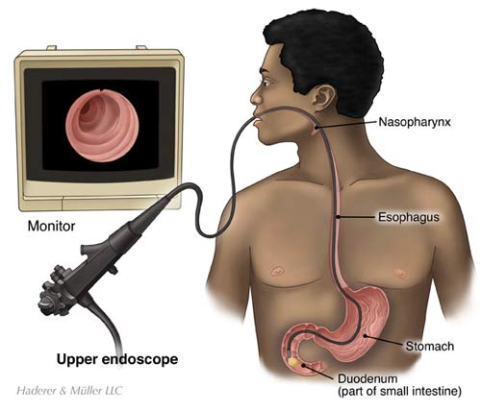
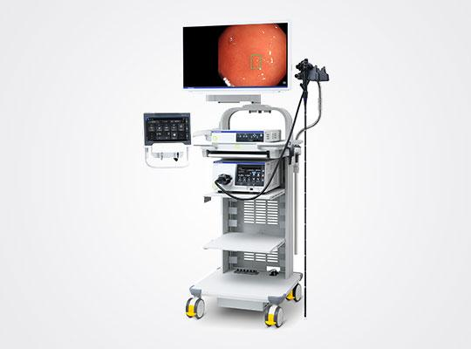
What is an Endoscope?
image source
image source

Slide 5
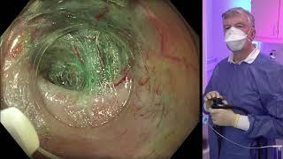

Slide 6
Problem Statement
ESD and POEM procedures entail complexities with an elevated risk of operator-dependent adverse events.
High chances of intraprocedural bleeding and perforation pose significant risks to patient safety and procedural success.
Objective
This study aims to develop an Artificial Intelligence Clinical Decision Support Solution (AI-CDSS) capable of real-time intraprocedural detection and delineation of vessels, tissue structures, and instruments.

Slide 7
About Data
Data used consists of 12 ESD and 4 POEM videos recorded using Olympus EVIS X1 series endoscope in the Augsburg University Hospital.
For training, 2012 images from the videos are annotated using the Computer Vision Annotation Tool (CVAT) by minimally invasive tissue resection experts with experience in more than 500 ESD procedures.
Five classes are annotated using CVAT: submucosal vessels, submucosal layer, muscle layer, electrosurgical knife, and instrument shaft.
Images are resized to 512 x 640.
Internal five-fold cross-validation is used for train-validation split.

Slide 8
About Data
For testing, 453 images are extracted and annotated from 9 ESD and 2 POEM videos (different from the original dataset).
3 full length videos consisting of 1 POEM, 1 rectal ESD, and 1 esophageal ESD videos are used for validation on videos.
31 video clips of length varying between 15 - 100 seconds are extracted.
27 videos contained 52 predefined blood vessels and rest 4 contained no blood vessels.
Videos are then viewed frame-by-frame with an overlay of the model output.
Model is also tested on the video shown before.

Slide 9
Architecture
The Neural Network architecture used is DeepLab3v+ with KSAC pooling layer and a 101 ResNeSt backbone.
DeepLabv3+: DeepLabv3+ is a state-of-the-art CNN architecture designed for semantic segmentation tasks, where the goal is to classify each pixel in an image into predefined classes.
ResNeSt Backbone: The backbone of the network refers to the initial layers responsible for feature extraction. In this case, a 101-layer ResNeSt backbone is utilized.
ResNeSt (Residual Network with Spilt Attention blocks) is an improvement over the popular ResNet architecture.
Kernel-Sharing Atrous Convolution (KSAC): Is a convolutional operation, where the same set of convolutional kernels is shared across input channels to efficiently capture multi-scale contextual information while reducing the number of parameters.

Slide 10
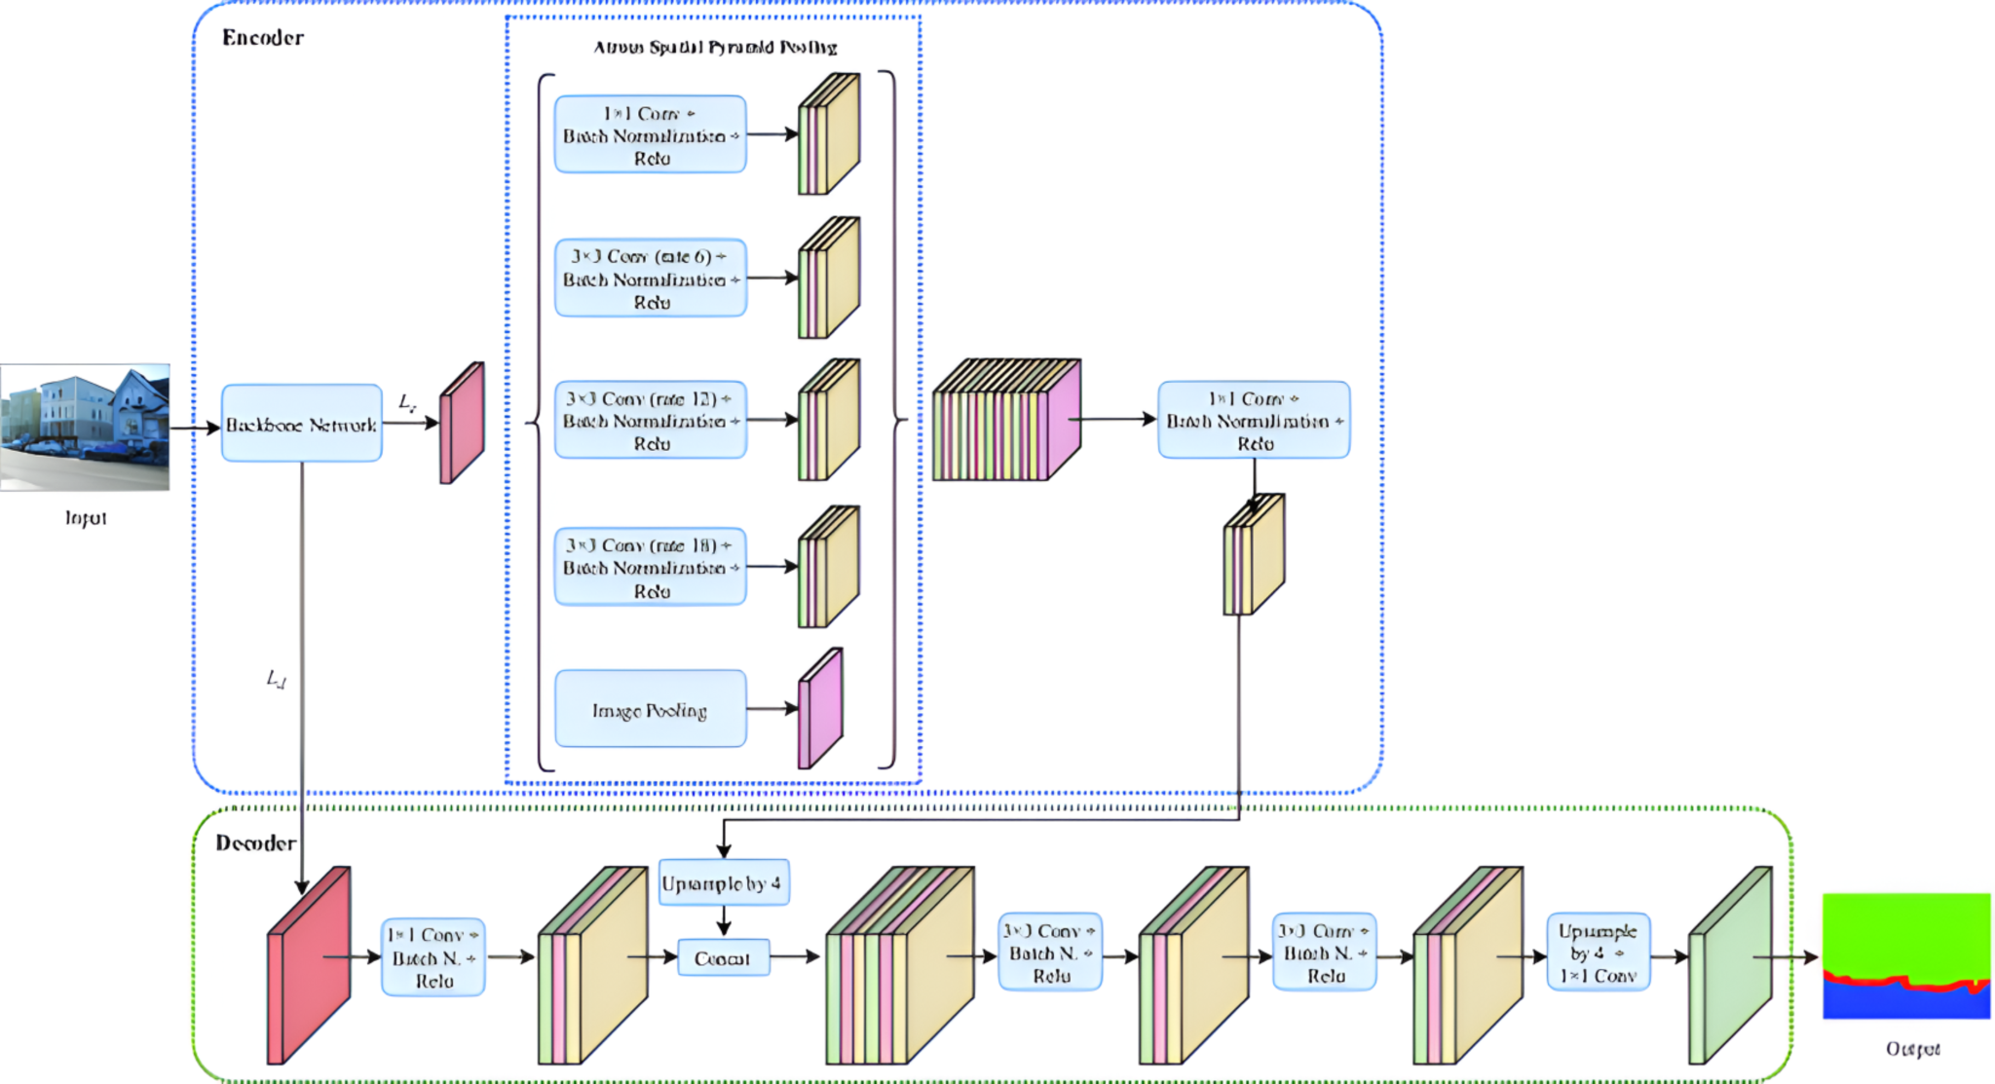
DeepLabv3+
image source

Slide 11
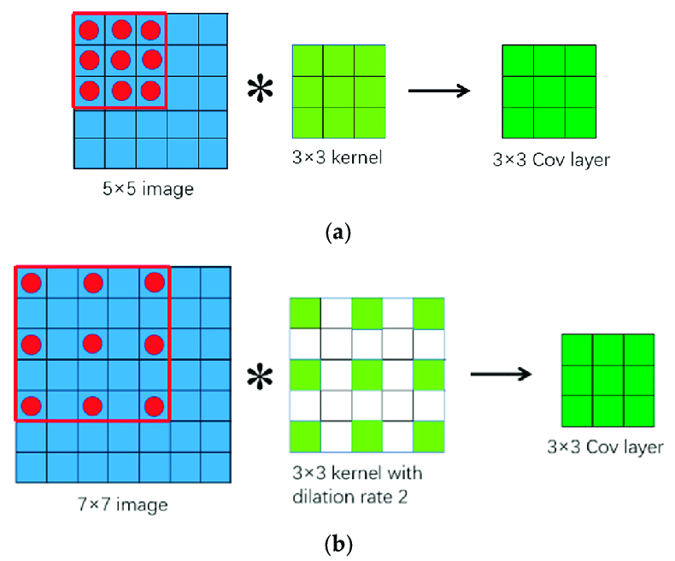
Atrous (Dilated) Convolutions
Conv 3x3, rate=1
Conv 3x3, rate=2
Image source

Slide 12
Kernel-Sharing Atrous Convolution (KSAC)
Kernel-Sharing Atrous Convolution (KSAC) is a variant of atrous convolution.
The same set of convolutional kernels is shared across all input channels.
This reduces the number of parameters and computational cost compared to standard atrous convolutions.
A single 3x3 kernel is shared among multiple parallel branches with different atrous rates.
This allows the kernel to learn both detailed features for small objects and comprehensive features for large objects

Slide 13
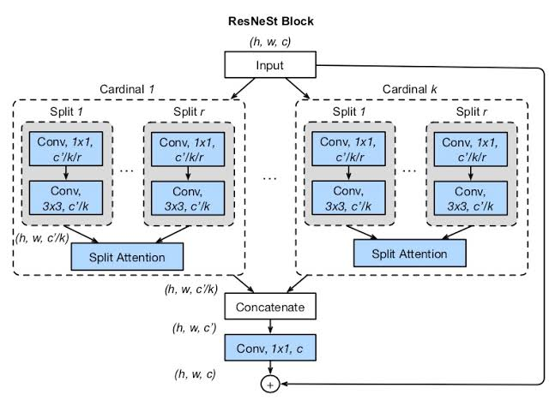
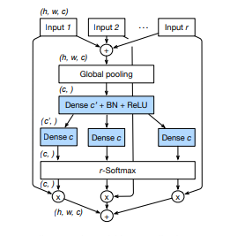
ResNeSt-101 Backbone
ResNeSt-101 is a 101-layer deep neural network that follows the same basic architecture as ResNet-101, with the addition of Split-Attention blocks.
These blocks are designed to capture cross-feature interactions and learn diverse representations, which leads to better performance in various computer vision task.
image source

Slide 14
Model Training
The model is trained for 72000 iterations with a batch size of 8.
Loss function used is Cross Entropy Loss.
Initial learning rate for Stochastic Gradient-Descent is set to 0.01 with polynomial decay over the training iterations.
During training we randomly crop the input to equal height and width, apply horizontal and vertical flipping as well as slight alterations to brightness, hue, saturation, and contrast and add gaussian noise with a probability of 0.25.

Slide 15
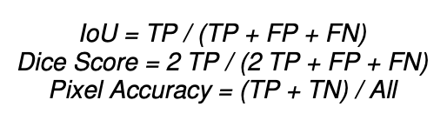
Metrics used
Intersection over Union (IoU): It is defined as the ratio of area of intersection to area of union of predicted region and truth region.
Dice score: It is similar to IoU, but gives more weight to true positive labels.
Pixel accuracy: It is the fraction of correctly predicted pixels.

Slide 16
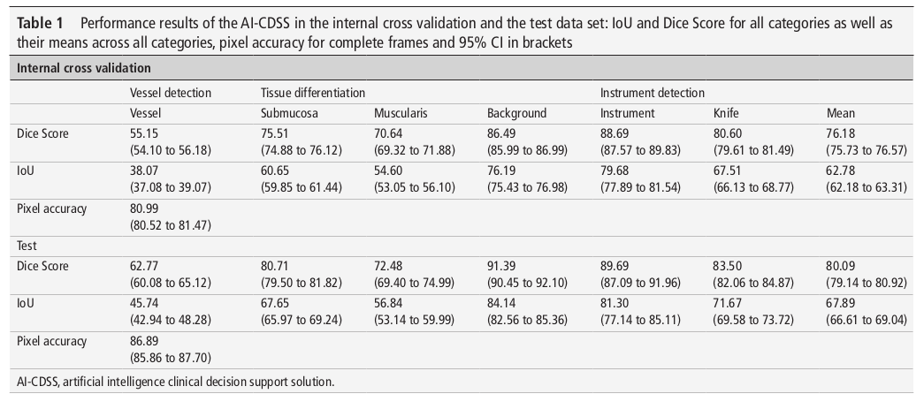
Experimental Results

Slide 17
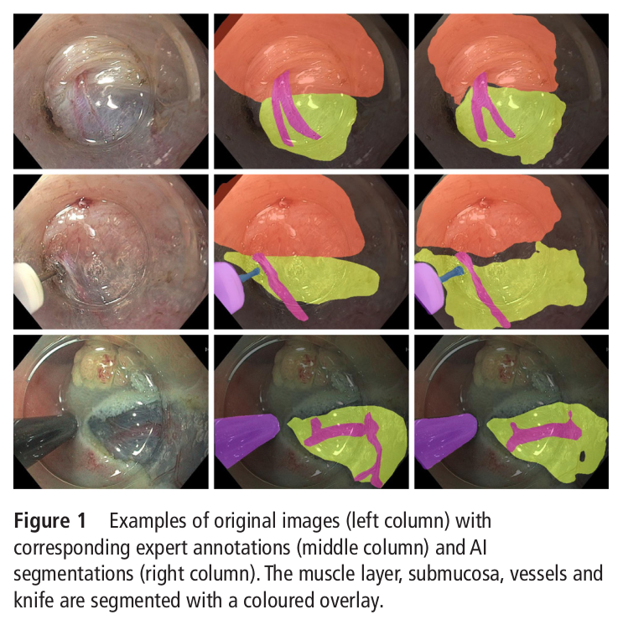
Experimental Results
The mean VDR (Vessel Detection Rate) was 85%
The VDR for rectal ESD, esophageal ESD and POEM were 70%, 95% and 92%, respectively.
The mean false-­positive rate was 0.75 /min.
The algorithm spotted 7 out of 9 vessels, which caused intraprocedural bleeding.
* image is taken from paper

Slide 18
Conclusion
The algorithm delineates structures in frames taken from endoscopic videos with a high overlap to the gold standard provided by expert endoscopists.
The lower performance in rectal ESD compared to esophageal ESD and POEM might be explainable by poorer visualization of the structures and more intraprocedural bleeding, which is in agreement with clinical experience.
AI model is able to recognise submucosal vessels and the cutting plane.
Model detects some vessels which bled later during procedures, this gives rise to the conclusion that these complications might have been preventable by the application of the AI-­CDSS.

Slide 19
Limitations
Small number of videos used for training and validation.
AI model was tested only on externally generated video sequences.
Not yet tested in a real-life setting.
Future work possibilities
Use of other backbone networks like ResNet50, ResNet101, Xception65, and EfficientNetB5, etc.
Use of other semantic segmentation models like U-Net, ESPNet, etc.
Feel free to give more suggestions!

