Slide 1

The Impact of Quantization on Swedish Language Understanding
- Evaluation and Mitigation via QLoRA
Name: | Email:
Naman Dhaval Desai | namand@chalmers.se
Noah Márquez Vara | noahmar@chalmer.se
Yingjue Ma | yingjue@chalmers.se

Slide 2


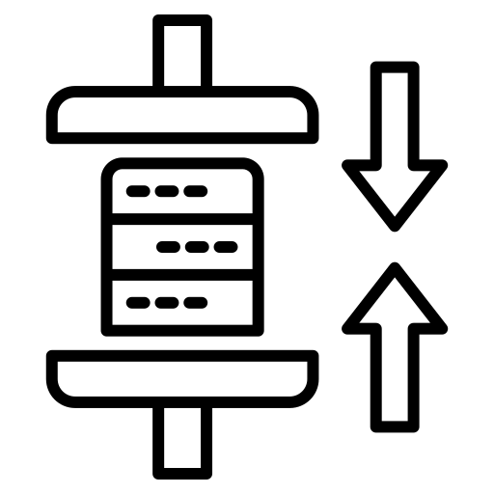

MOTIVATION
INDEX:
1) MOTIVATION
2) SOLUTION - QUANTIZATION
3) HYPOTHESIS
4) EVALUATION
5) IMPACT OF QUANTIZATION
Goal: Compress the state-of-the-art models by reducing memory footprint.
Risk: Does compressing the model "lobotomize" its ability to understand complex non-English languages like Swedish?
Problem: Modern LLMs are massive. Llama-3-8B [1] requires ~16GB to 19GB VRAM to load.
Constraint: Most consumer GPUs and edge devices have 8GB to 12GB VRAM.
6) MITIGATION - QLoRA
7) FINE - TUNING
8) RESULTS
9) CONCLUSION

Slide 3
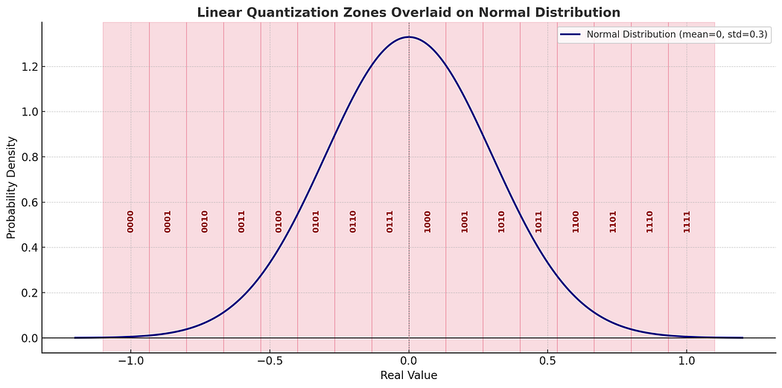

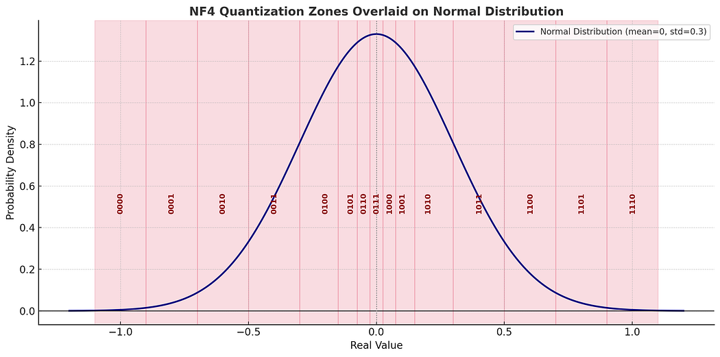
SOLUTION - QUANTIZATION
INDEX:
1) MOTIVATION
2) SOLUTION - QUANTIZATION
Concept: Reducing the precision of model weights from 16-bit to 4-bit.
3) HYPOTHESIS
4) EVALUATION
Analogy: 'Rounding’ precise numbers to the nearest whole 'bucket’ or simply discretizing.
For example:
16-bit: 0.12345678 (high precision, high memory)
4-bit: 0.1 (low precision, low memory)
5) IMPACT OF QUANTIZATION
6) MITIGATION - QLoRA
Method Used: NF4
7) FINE - TUNING
8) RESULTS
9) CONCLUSION
[2]

Slide 4



HYPOTHESIS
INDEX:
1) MOTIVATION
2) SOLUTION - QUANTIZATION
3) HYPOTHESIS
4) EVALUATION
Premise: Multi-language LLMs like Meta Llama-3-8B are pre-trained primarily on English data.
Hypothesis: We predict that quantization would disproportionately damage Swedish performance.
Reasoning: Swedish is a lower-resource language in the training set and hence its representations might be more fragile and susceptible to errors when we discretize.
5) IMPACT OF QUANTIZATION
6) MITIGATION - QLoRA
7) FINE - TUNING
8) RESULTS
9) CONCLUSION

Slide 5
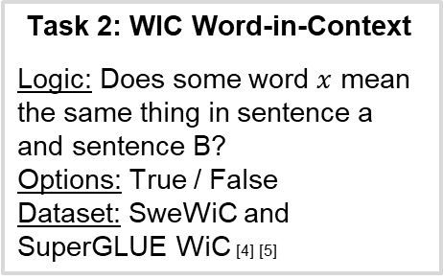
EVALUATION
INDEX:
1) MOTIVATION
2) SOLUTION - QUANTIZATION
Model Used: Meta Llama-3-8B-Instruct
Original 16-bit representation
Quantized 8-bit representation
Quantized 4-bit representation
3) HYPOTHESIS
4) EVALUATION
Task 1: NLI (Natural Language Inference)
Logic: Does sentence A imply sentence B ?
Options: Entailment / Contradiction / Neutral
Dataset: SweNLI and MNLI [3] [5]
Task 2: WIC Word-in-Context
Logic: Does some word $x$ mean the same thing in sentence a and sentence B?
Options: True / False
Dataset: SweWiC and SuperGLUE WiC [4] [5]
5) IMPACT OF QUANTIZATION
6) MITIGATION - QLoRA
7) FINE - TUNING
8) RESULTS
Output: Confusion matrix - per model representation (3) - per task (2) - per language (2). [For 500 samples each]
9) CONCLUSION

Slide 6
IMPACT OF QUANTIZATION
INDEX:
1) MOTIVATION
2) SOLUTION - QUANTIZATION
F1 - Score
 | NLI |  | WIC
 | English | Swedish | English | Swedish
16-bit representation | 60.79% | 62.29% | 62.88% | 60.77%
8-bit representation | 59.02% | 60.22% | 63.14% | 58.29%
4-bit representation | 52.69% | 54.52% | 64.58% | 64.18%
Accuracy:
 | NLI |  | WIC
 | English | Swedish | English | Swedish
16-bit representation | 69.80% | 69.20% | 63.40% | 61.80%
8-bit representation | 69.20% | 68.20% | 63.80% | 59.80%
4-bit representation | 66.00% | 65.20% | 64.60% | 64.20%
3) HYPOTHESIS
4) EVALUATION
5) IMPACT OF QUANTIZATION
Observation: Quantization dropped performance, but did so symmetrically as shown in the tables above.
Modern quantization (NF4) hurts reasoning (NLI) and shockingly improves contextual awareness (WIC) equally across both the languages.
Conclusion: Our hypothesis was refuted.
6) MITIGATION - QLoRA
7) FINE - TUNING
8) RESULTS
9) CONCLUSION

Slide 7
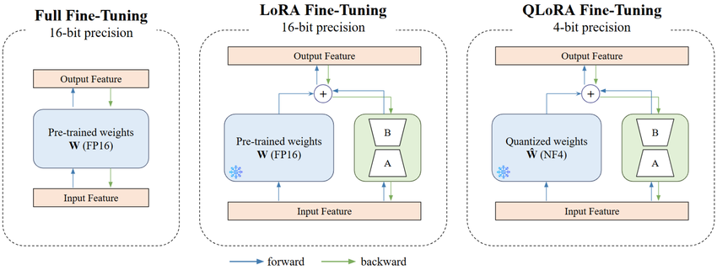
MITIGATION - QLoRA
INDEX:
1) MOTIVATION
Question: Can we recover the lost reasoning capabilities without regaining the memory cost?
2) SOLUTION - QUANTIZATION
Method: QLoRA (Quantized Low-Rank Adaptation). [6]
How it works:
3) HYPOTHESIS
Freeze & Quantize: The base model is loaded in 4-bit precision and strictly frozen (read-only).
Inject Adapters: We add tiny, trainable low-rank matrices (LoRA) in 16-bit precision alongside the frozen layers.
Mixed-Precision Compute: During calculation, 4-bit weights are temporarily dequantized to 16-bit, combined with the adapter and then discarded.
Efficient Training: Gradients are backpropagated through the frozen 4-bit weights, but they only update the 16-bit adapters.
4) EVALUATION
5) IMPACT OF QUANTIZATION
6) MITIGATION - QLoRA
[7]
7) FINE - TUNING
Because the base model is frozen and we only update the adapter weights (~1% of the parameters), the computational requirements are much lower, resulting in faster training and reduced memory usage.
8) RESULTS
9) CONCLUSION

Slide 8
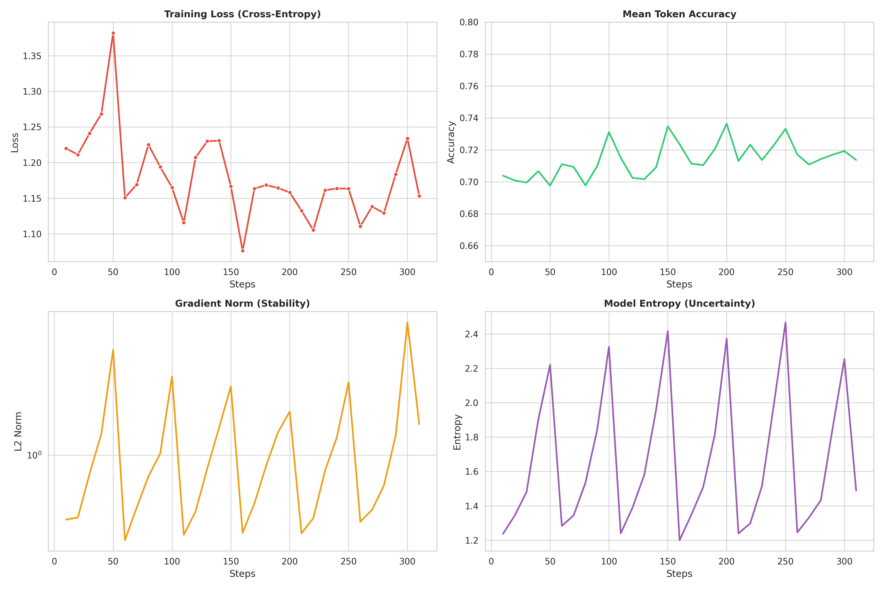
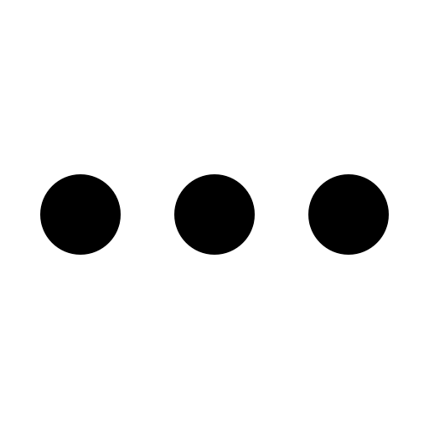
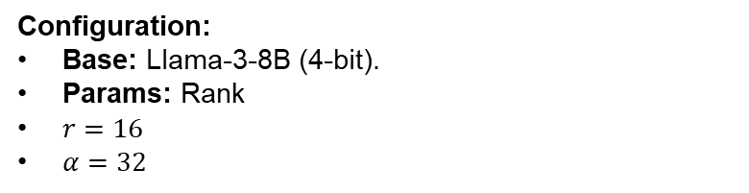
FINE - TUNING
INDEX:
1) MOTIVATION
Goal: Force the model to realign its latent features toward Swedish understanding.
2) SOLUTION - QUANTIZATION
Dataset: Alpaca-Swedish-Refined (Instruction Tuning – 5000 samples).
Dataset Examples: (2)
Instruction | Input | Output
Vilka är de tre primära färgerna? |  | De tre primära färgerna är rött, blått och gult. Dessa färger kallas primära eftersom de inte kan skapas genom att blanda andra färger, och alla andra färger kan göras genom att kombinera dem i olika proportioner. I det additiva färgsystemet, som används för ljus, är de primära färgerna rött, grönt och blått (RGB).
Identifiera den udda. | Twitter, Instagram, Telegram | Den udda är Telegram. Twitter och Instagram är sociala medier som främst används för att dela information, bilder och videor medan Telegram är en molnbaserad snabbmeddelande- och röst-över-IP-tjänst.
3) HYPOTHESIS
4) EVALUATION
5) IMPACT OF QUANTIZATION
6) MITIGATION - QLoRA
7) FINE - TUNING
Configuration:
Base: Llama-3-8B (4-bit).
Params: Rank
$r=16$
$α=32$
[8]
8) RESULTS
9) CONCLUSION

Slide 9
Results
INDEX:
1) MOTIVATION
2) SOLUTION - QUANTIZATION
F1 - Score
 | NLI |  | WIC
 | English | Swedish | English | Swedish
16-bit representation | 60.79% | 62.29% | 62.88% | 60.77%
8-bit representation | 59.02% | 60.22% | 63.14% | 58.29%
4-bit representation | 52.69% | 54.52% | 64.58% | 64.18%
4-bit QLoRA | 54.46% | 63.13% | 53.09% | 63.22%
Accuracy:
 | NLI |  | WIC
 | English | Swedish | English | Swedish
16-bit representation | 69.80% | 69.20% | 63.40% | 61.80%
8-bit representation | 69.20% | 68.20% | 63.80% | 59.80%
4-bit representation | 66.00% | 65.20% | 64.60% | 64.20%
4-bit QLoRA | 58.00% | 66.20% | 58.20% | 63.40%
3) HYPOTHESIS
4) EVALUATION
5) IMPACT OF QUANTIZATION
As we can see, the fine-tuned QLoRA 4-bit model actually performed equally or better than the original 16-bit baseline on Swedish tasks.
6) MITIGATION - QLoRA
But as the model specialized in Swedish, it overwrote some English capabilities as the F1 score and the accuracy of the QLoRA model is worse compared to the NF4 4-bit quantized model for the English tasks.
7) FINE - TUNING
8) RESULTS
9) CONCLUSION

Slide 10
Conclusion
INDEX:
1) MOTIVATION
2) SOLUTION - QUANTIZATION
Quantization is viable but degrades reasoning capabilities (NLI) but does not impact contextual awareness (WIC) as much in all languages.
The impact of quantization on Swedish language as compared to that of English language is of course negative but also is almost equal.
QLoRA is definitely effective to restore Swedish language performance in quantized models and may even sometimes improve it as compared to the performance of the original 16-bit model representation.
3) HYPOTHESIS
4) EVALUATION
5) IMPACT OF QUANTIZATION
6) MITIGATION - QLoRA
7) FINE - TUNING
8) RESULTS
9) CONCLUSION

Slide 11
REFERENCES
A. Grattafiori et al., “The LLaMA 3 Herd of Models,” arXiv preprint arXiv:2407.21783, 2024. [Online]. Available: https://arxiv.org/abs/2407.21783
C. Turner, “Fine tuning Hugging Face LLM’s with QLoRA,” Medium, Jun. 3, 2025. [Online]. Available: https://medium.com/@clturner23/fine-tuning-hugging-face-llms-with-qlora-31be90a49a41. [Accessed: Jan. 9, 2026].
A. Wang, A. Singh, J. Michael, F. Hill, O. Levy, and S. Bowman, “GLUE: A Multi-Task Benchmark and Analysis Platform for Natural Language Understanding,” Proc. Int. Conf. Learn. Representations (ICLR), 2019. [Online]. Available: https://gluebenchmark.com/
A. Wang, Y. Pruksachatkun, N. Nangia, A. Singh, J. Michael, F. Hill, O. Levy, and S. Bowman, “SuperGLUE: A Stickier Benchmark for General-Purpose Language Understanding Systems,” Adv. Neural Inf. Process. Syst. (NeurIPS), vol. 32, 2019. [Online]. Available: https://super.gluebenchmark.com/
A. Efrat, A. Dagan, Y. Goldberg, and R. Reichart, “SuperLIM: A Diagnostic Dataset for Evaluating the Linguistic Knowledge of Hebrew NLP Models,” Proc. Conf. Empirical Methods in Natural Language Processing (EMNLP), 2022. [Online]. Available: https://github.com/allenai/superlim

Slide 12
REFERENCES
T. Dettmers, A. Pagnoni, A. Holtzman, and L. Zettlemoyer, “QLoRA: Efficient Finetuning of Quantized LLMs,” arXiv preprint arXiv:2305.14314, 2023. [Online]. Available: https://arxiv.org/abs/2305.14314
D. Park, B. Min, S. Lim, and B. Kim, “ATIRS: Towards Adaptive Threat Analysis with Intelligent Log Summarization and Response Recommendation,” Electronics, vol. 14, no. 7, article 1289, 2025. [Online]. Available: https://doi.org/10.3390/electronics14071289
N. Neph et al., “Alpaca-Lora-GPT4-Swedish-Refined Dataset,” Hugging Face Datasets, 2025. [Online]. Available: https://huggingface.co/datasets/neph1/Alpaca-Lora-GPT4-Swedish-Refined

Slide 13
THANK YOU THE END

