Slide 1


AI Practice Hackathon
Team Vector 5 Presents
PharmRebalance
Team Members:
Kashish Bhagat (TL), Shivam Tyagi
Hrishiraj Mallick, Naman Navneet

Slide 2


Slide 3






Problem Statement Overview
now
PROBLEM STATEMENT
GOING FROM DATA TO DECISION
Traditional SCM Operations are siloed in nature. Transfer team decides transfers. Supply team decides orders. Expiry team tries to prevent wastes. No one talks to each other.
Agentic Approach Steps in
The System is fed 11 datasets containing information on SKUs, Supply Elements, Demand Elements, Forecast, Route Maps and Plans
Agents ingest the data, then debate real-world supply chain trade-offs. Just like real teams do, but in seconds
Provides a unified and intelligent platform where all these functions talk to each other in real time, optimize and resolve conflicts
CONSTRAINTS WE ARE OPTIMIZING FOR
MEET THE AGENTS
Transfer vs Expiry
Cold Chain Constraints vs Optimal Route
Therapeutic Criticality vs Inventory Balance
Cost vs Waste Prevention
HOW DO WE RESOLVE IT ?
Transfer Optimizer
Supply Adjuster
Expiry Manager
Simulation Engine
PharmRebalance doesn't find the cheapest solution or the fastest one. It finds the one that works best across every constraint that matters in pharma
Each agent represents a critical part of SCM !

Slide 4
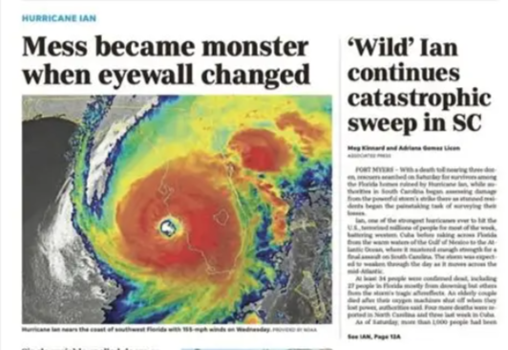
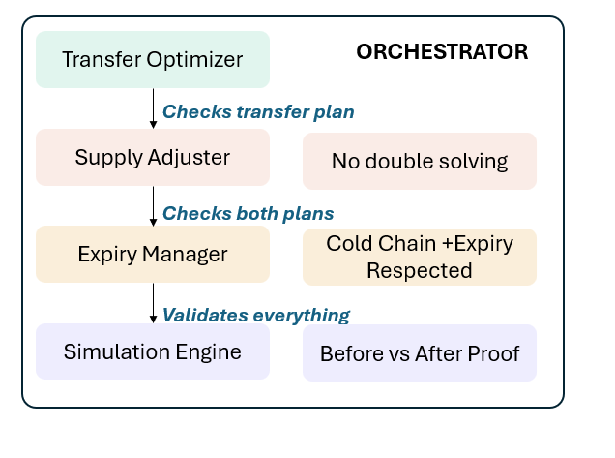



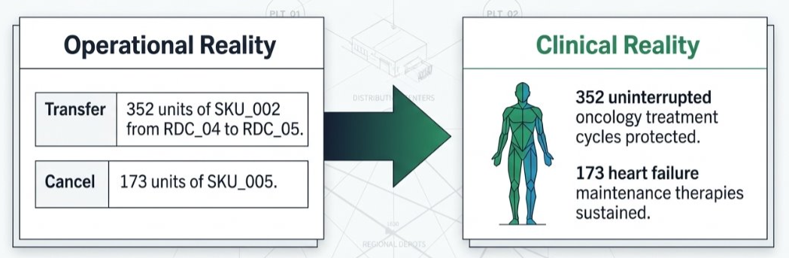
Solution Overview
now
REAL TIME RISK SENSING
MULTI CONSTRAINT OPTIMIZATION
PATIENT AND PLANET IMPACT
Hurricane threatening the Gulf Coast ? The Network Adapts to the situation instantly !
How do we find the smartest solution? By making every agent accountable to every other agent
You don't just see what to do. You see who it helps and what it costs the planet.
IMPACT METRICS
This way , we translate operational reality into clinical reality !
Patients Saved
CO₂ Footprint
Waste Eliminated
Live events in.
Affected locations, at-risk SKUs, patient impact, and recommended actions out
All before disruption even hits !
No agent works alone. Every recommendation is pressure-tested by all four perspectives before it reaches you

Slide 5

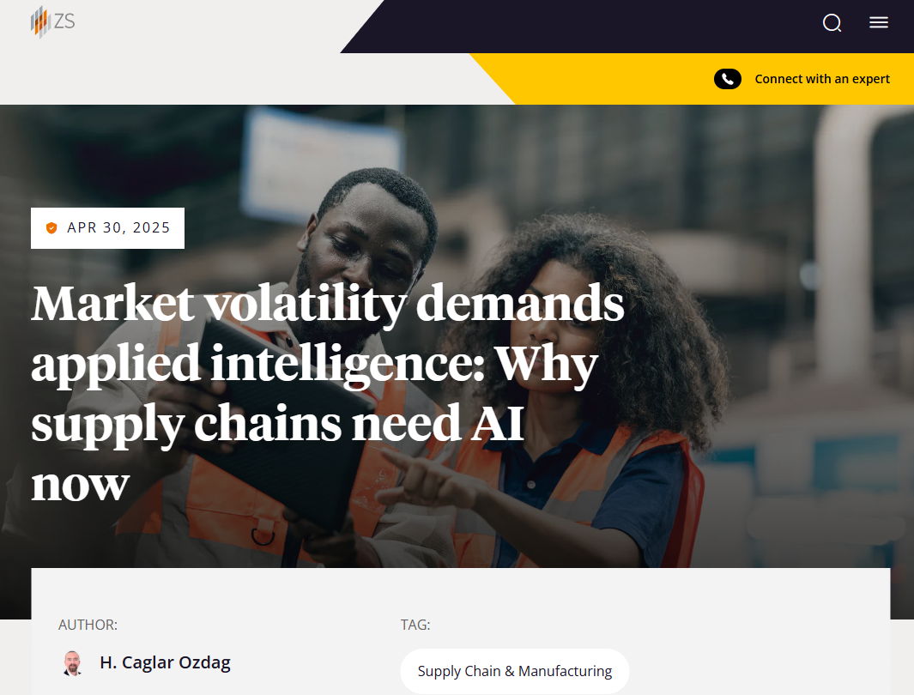

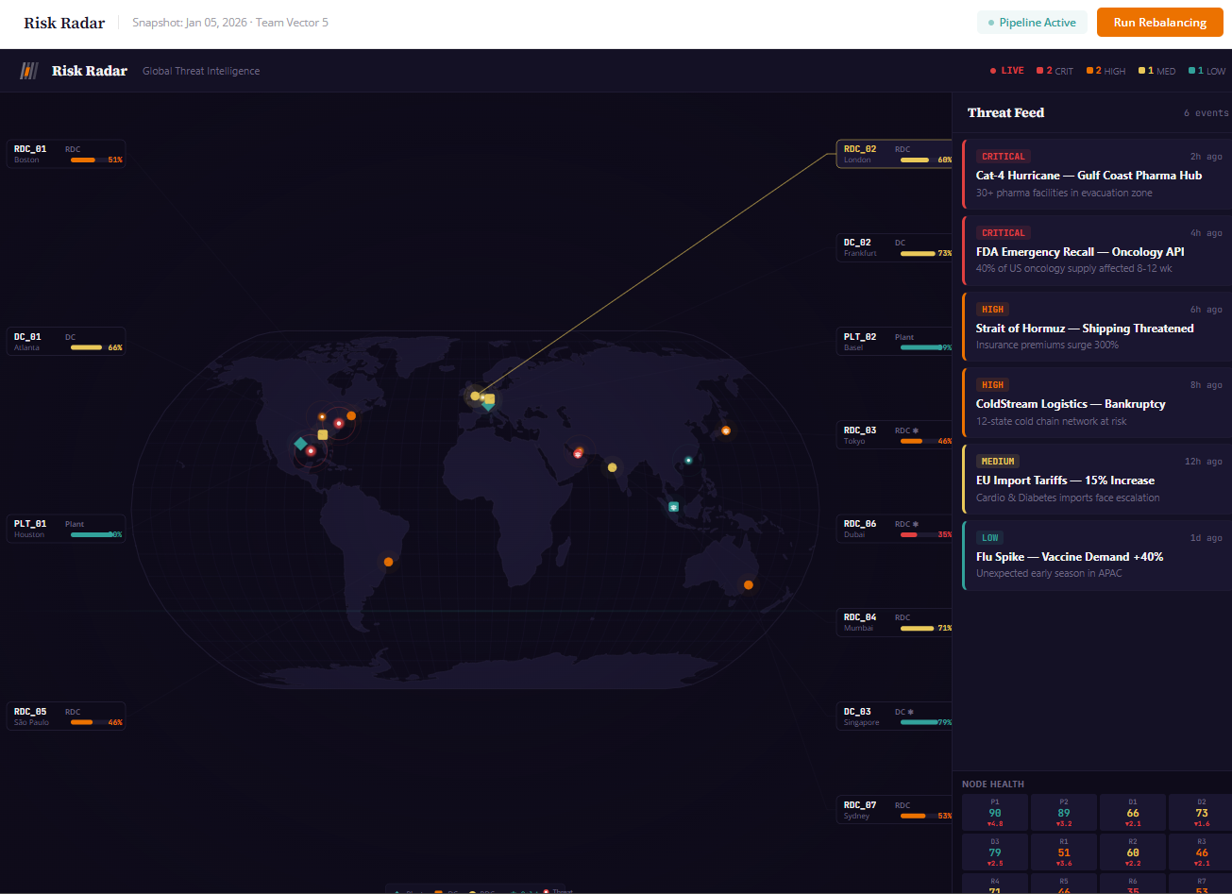
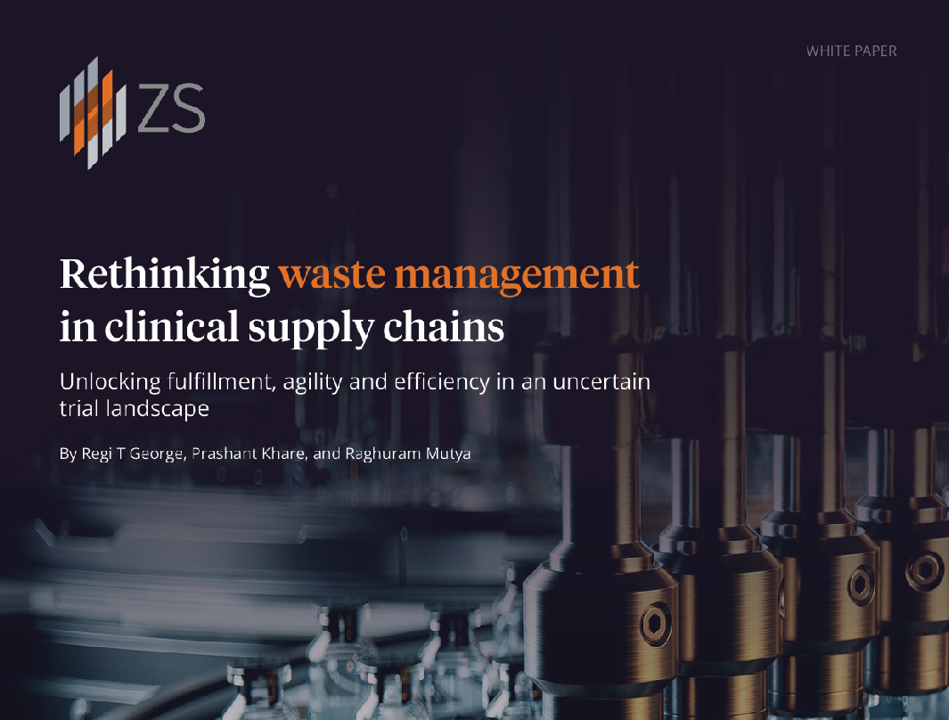
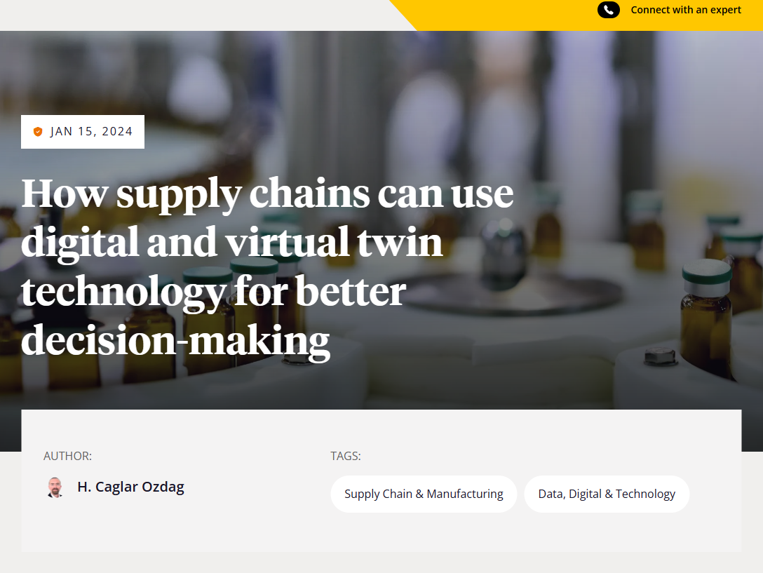
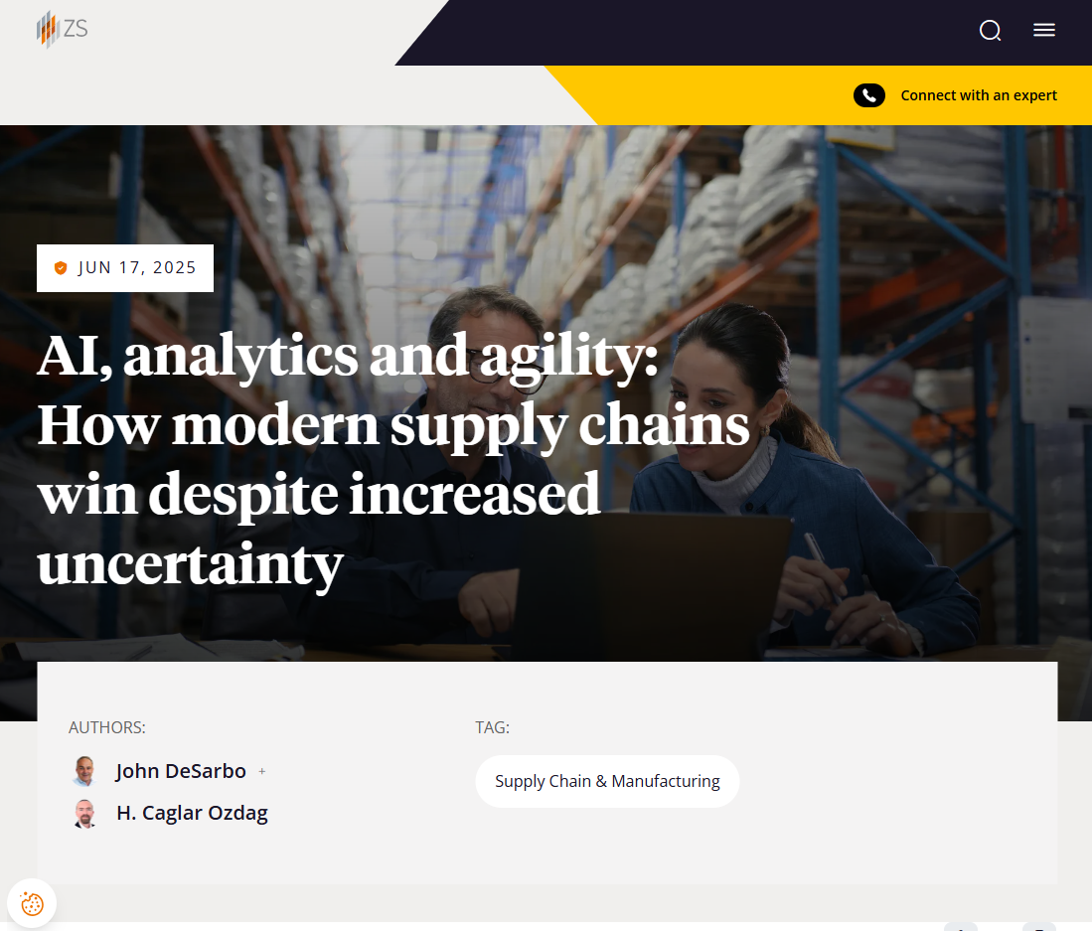

Built on a Legacy of ZS’s SCM Innovation
now
PharmRebalance is a natural evolution of ZS's deep expertise in pharma supply chain intelligence
Kartik Sourirajan,
Arun Shastri, Jessica Jarvis
H. Caglar Ozdag
John DeSarbo
Regi T George, Prashant Khare
and Raghuram Mutya
H. Caglar Ozdag
H. Caglar Ozdag and John DeSarbo

Slide 6
Architecture Diagram
now

Slide 7
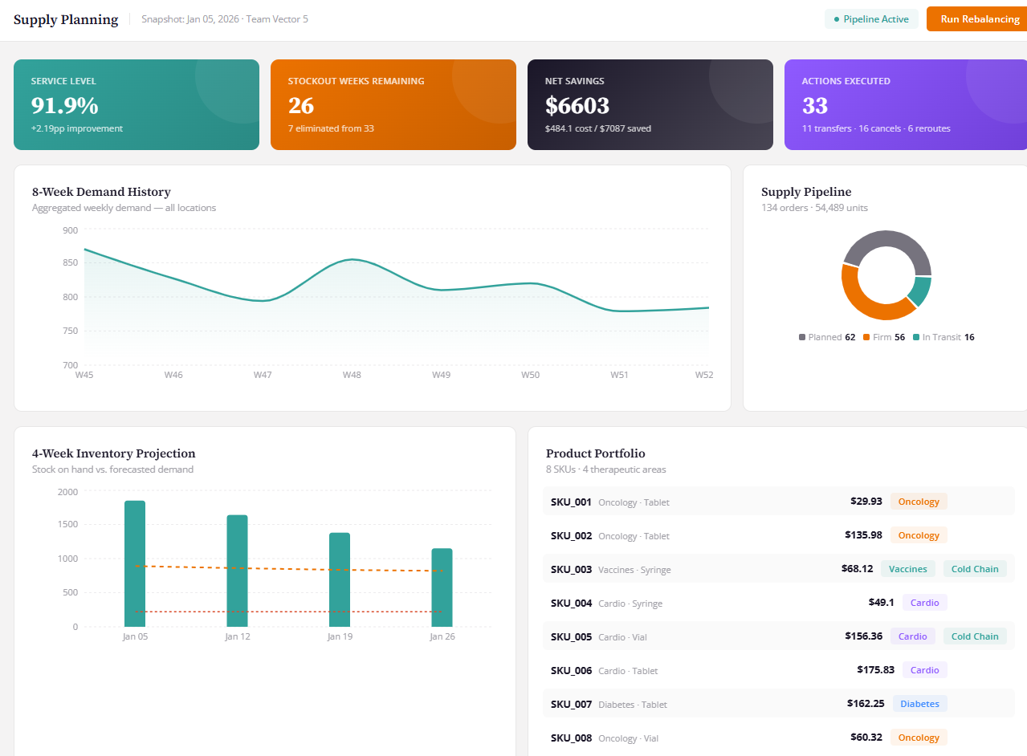
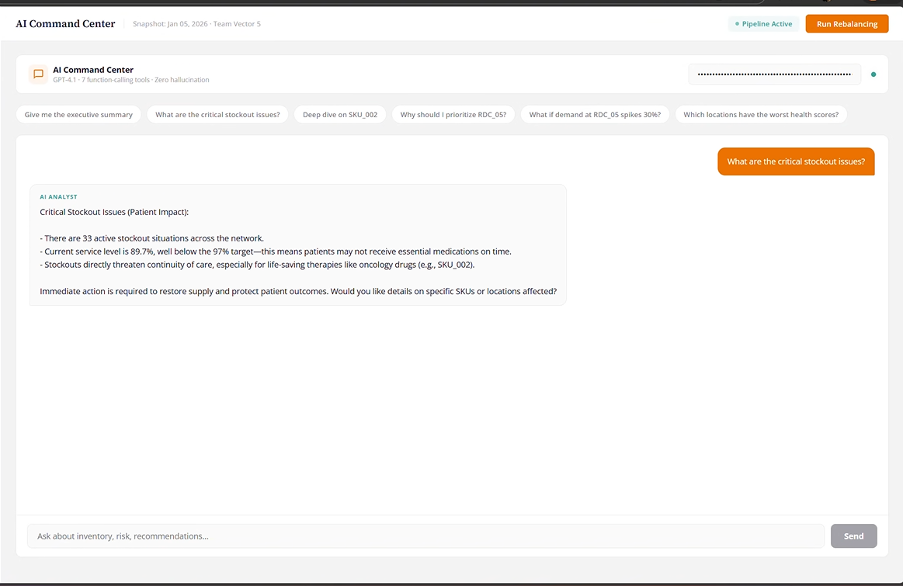
Key Product Goals – Explainable AI
now
Every decision made by PharmRebalance is visible, auditable, and explainable
CONSOLIDATED DASHBOARD
AI COMMAND CENTER
RISK RADAR
Single-pane view of service level, stockouts, cost savings, and actions executed. 8-week demand trends, 4-week inventory projections, and supply pipeline status. All in real time.
Ask any question in plain English. The system queries your real optimization data through deterministic function calls and returns precise, data-backed answers.
Live global events mapped to your network. This view instantly shows affected locations, at-risk SKUs, and recommended countermeasures before disruption hits

Slide 8
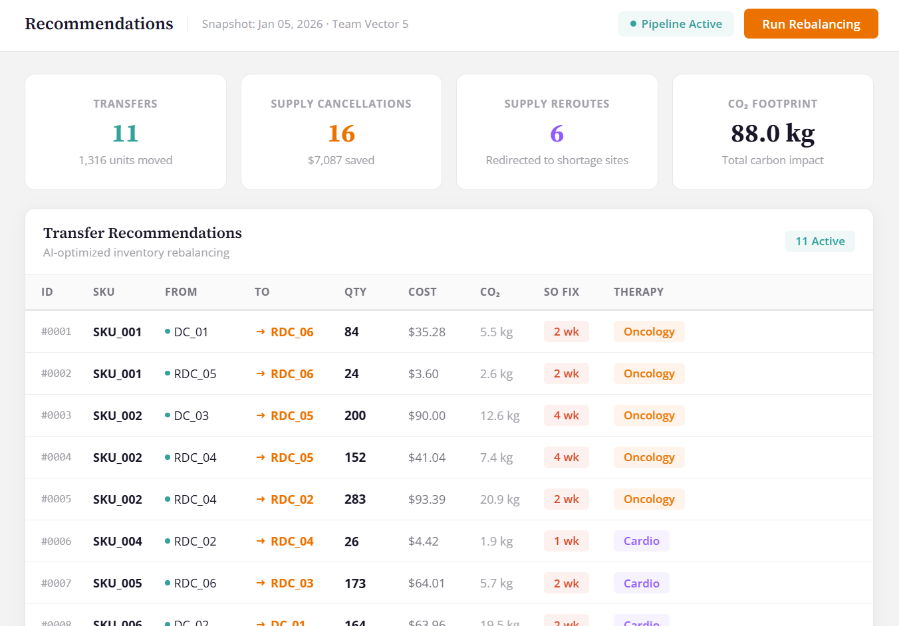
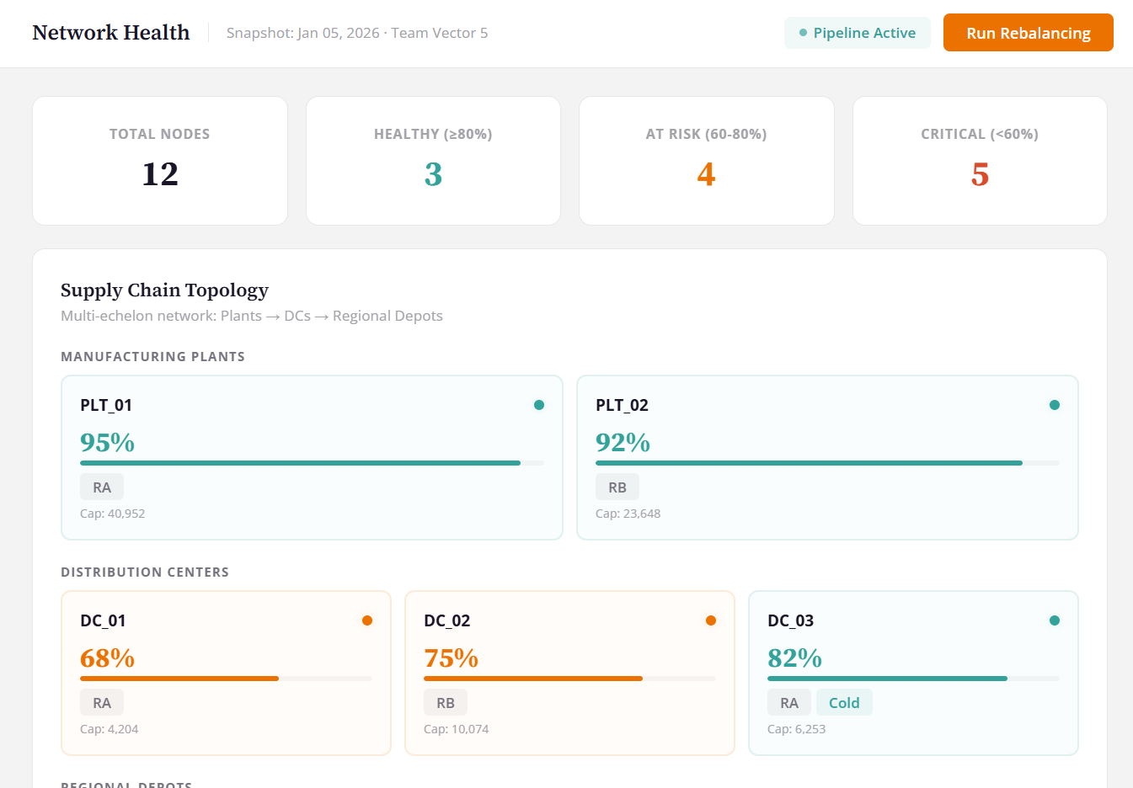
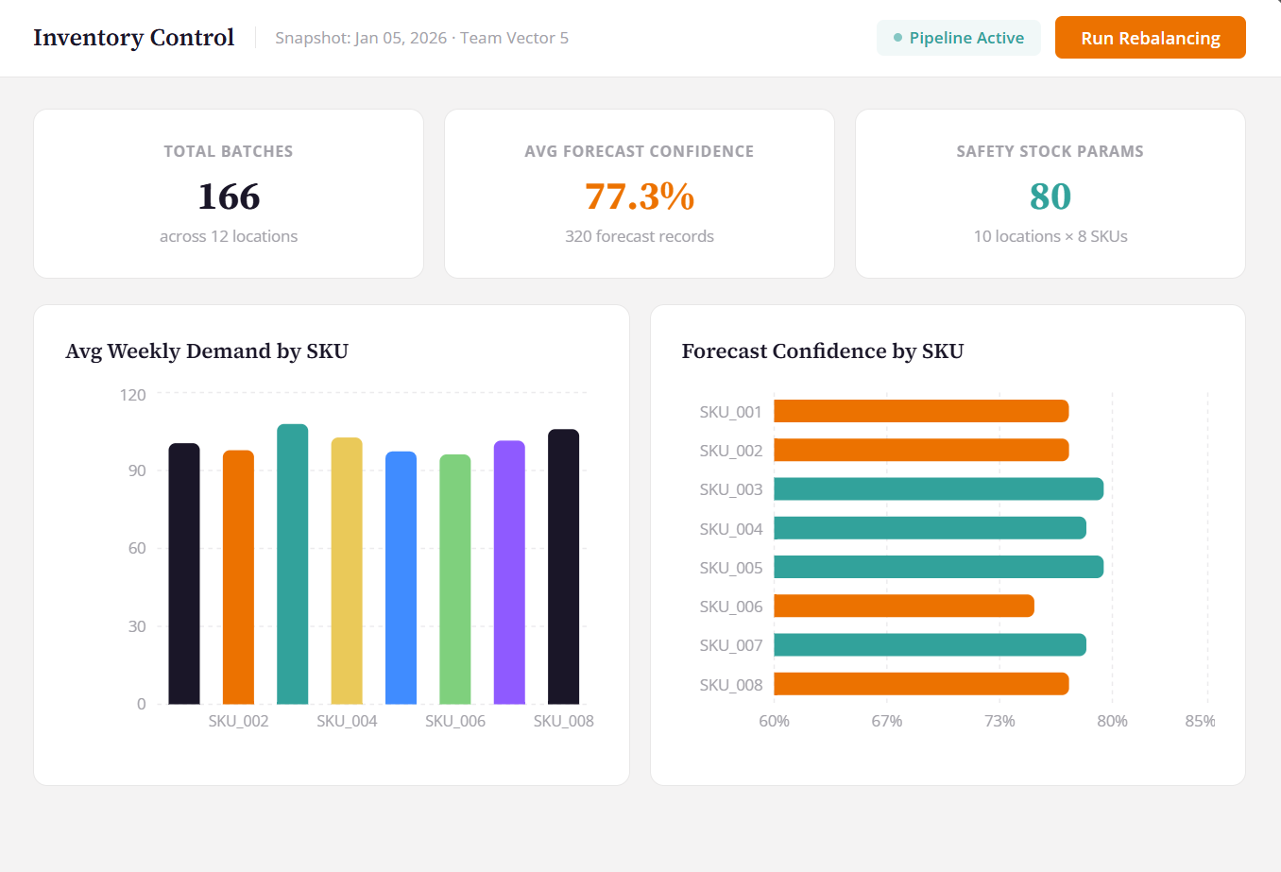
Key Product Goals – Explainable AI
now
Every decision made by PharmRebalance is visible, auditable, and explainable
INVENTORY PLANNING
RECOMMENDATIONS
NETWORK HEALTH
Batch-level visibility across every location. Demand patterns and forecast confidence broken down by SKU , so you know where your data is reliable and where to be cautious
Every action the system recommends comes with its cost, carbon footprint, stockout impact, and therapeutic area. Nothing is a black box, every recommendation is fully traceable
Every node in the supply chain scored and color-coded by health. Full topology view from plants to depots, you see exactly where the network is strong and where it's breaking down

Slide 9
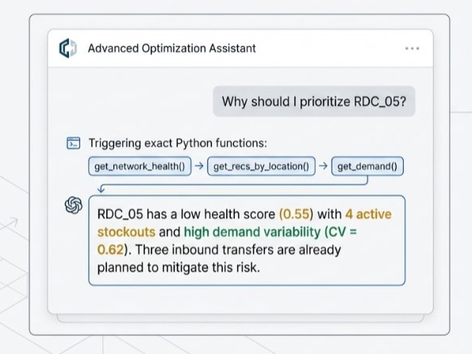
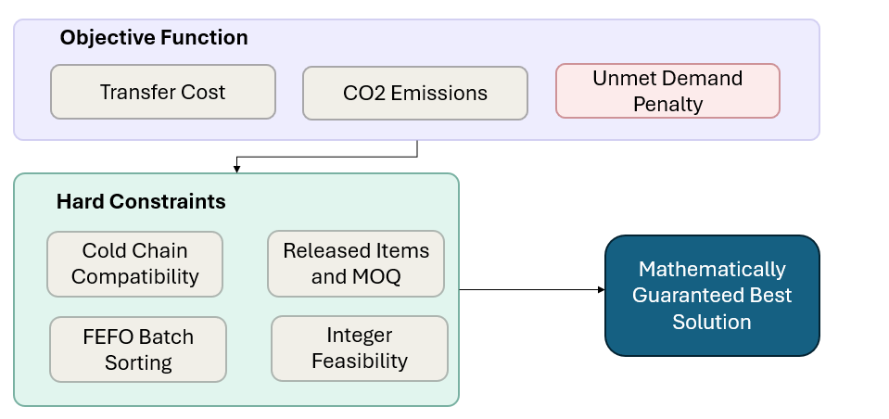
Key Product Goals – Determinism
now
LP BASED SOLVER FOR TRANSFER COST
LLM FUNCTION CALLING IN COMMAND CENTER
We constrain FEFO, Cold Chain Compatibility and Integral Solutions. There is a penalty in the optimizer for unmet demand weighed by therapeutic criticality (E.g. Unmet demand for cancer drugs are penalized more )
The LLM selects from 9 deterministic Python functions that query real pipeline data. The answers come from computed optimization outputs, not probabilistic generation
Every recommendation is mathematically proven, not probabilistically guessed
The LLM decides what to ask. Deterministic Python functions provide the answers. No hallucination. Full audit trail.

Slide 10
Diagram Sandbox
now
Transfer Optimizer
ORCHESTRATOR
Checks transfer plan
Supply Adjuster
No double solving
Checks both plans
Expiry Manager
Cold Chain +Expiry Respected
Validates everything
Simulation Engine
Before vs After Proof

Slide 11
Diagram Sandbox
now
Input Variables
Excess Map
Shortage Map
Transport Lanes
Batch Inventory
Objective Function
Transfer Cost
CO2 Emissions
Unmet Demand Penalty
Hard Constraints
Cold Chain Compatibility
Released Items and MOQ
Mathematically Guaranteed Best Solution
FEFO Batch Sorting
Integer Feasibility

Slide 12
now
Notes:
At ZS, one of our core philosophies is — Impact where it matters.“ But in a world where stockouts cost lives and supply chains move at the speed of news, it's not just about where it matters… it's about acting now. Every satisfactory order cycle that goes unmet, Introducing PharmRebalance — a real-time, news-driven engine that detects supply chain disruptions as they happen and rebalances stock before the gap hits the shelf.

Slide 13
now
Notes:
At ZS, one of our core philosophies is — Impact where it matters.“ But in a world where stockouts cost lives and supply chains move at the speed of news, it's not just about where it matters… it's about acting now. Every satisfactory order cycle that goes unmet, Introducing PharmRebalance — a real-time, news-driven engine that detects supply chain disruptions as they happen and rebalances stock before the gap hits the shelf.

