Slide 1

Loan Approval Prediction System
Using IBM SPSS Modeler
MACHINE LEARNING PROJECT
Student Names · Aditya Pratap Singh, Dipti Narware, Naman Patidar ·
II - Year , IV - Semester

Slide 2

Introduction & Problem Statement
Loan approval prediction uses machine learning to automate credit decisions — reducing risk and processing time for banks.
Manual Systems Are Flawed
Human-driven reviews are slow, inconsistent, and prone to bias — causing delays and financial losses.
ML Automation Is the Answer
Classification algorithms analyze applicant data objectively, delivering faster, more accurate, and scalable decisions.

Slide 3
Objectives & Dataset
Project Objectives
Dataset Features
Predict loan approval status (Approved / Rejected)
Compare ML algorithms for best accuracy
Improve decision-making speed and consistency
Gender & Marital Status — Demographics
Education — Graduate / Not Graduate
ApplicantIncome & LoanAmount — Financials
Credit_History — Key risk indicator
Property_Area — Urban / Semiurban / Rural
Loan_Status — Target variable
Dataset Source: Kaggle Loan Prediction Dataset

Slide 4
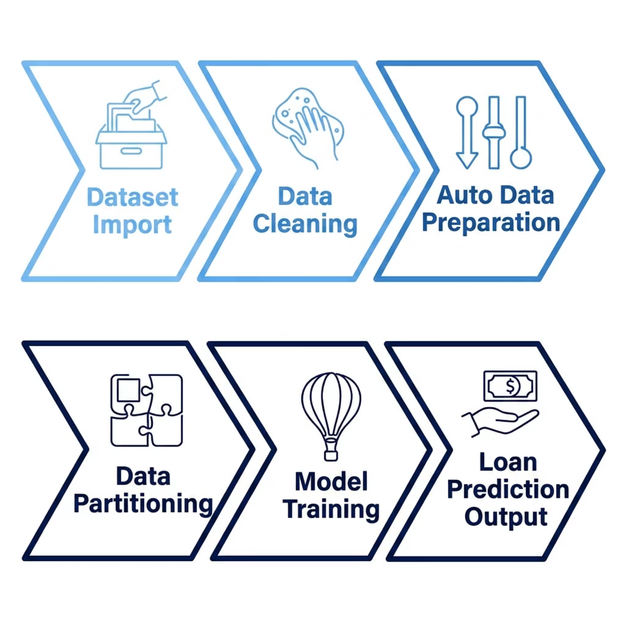

Technology Stack & Workflow
Technologies Used
IBM SPSS Modeler
Machine Learning
Visual ML platform
Supervised classification
Data Preprocessing
Classification Algorithms
Cleaning & transformation
Logistic Regression & C5.0

Slide 5

Data Preprocessing
Clean, structured data is the foundation of reliable ML models. SPSS Modeler automates key preprocessing steps.
Data Audit
Identify data types, distributions, and anomalies across all fields.
Missing Value Handling
Impute gaps using mean, median, or mode based on field type.
Auto Data Preparation
Auto-detects and applies transformations for model readiness.
Feature Engineering
Encode categoricals, normalize numerics, and prepare inputs.

Slide 6


Logistic Regression Model
How It Works
Performance Results
Logistic Regression is a binary classification algorithm that estimates the probability of loan approval using the sigmoid function:
Training Accuracy
Testing Accuracy
80.75% — on training partition
82.45% — on held-out test data
Output ranges between 0 (Rejected) and 1 (Approved)
Trained on preprocessed applicant data
Interpretable coefficients for each feature
Testing accuracy exceeds training — indicating good generalization with no overfitting.

Slide 7

Decision Tree — C5.0 Algorithm
C5.0 builds rule-based, human-readable classification trees. Credit_History emerged as the dominant splitting feature.
Rule-Based Logic
Generates clear if-then rules explaining every prediction.
Top Feature: Credit_History
Strongest predictor — clean history greatly increases approval odds.
Training Accuracy
80.05% on training data
Testing Accuracy
82.98% on test data — Best Overall

Slide 8
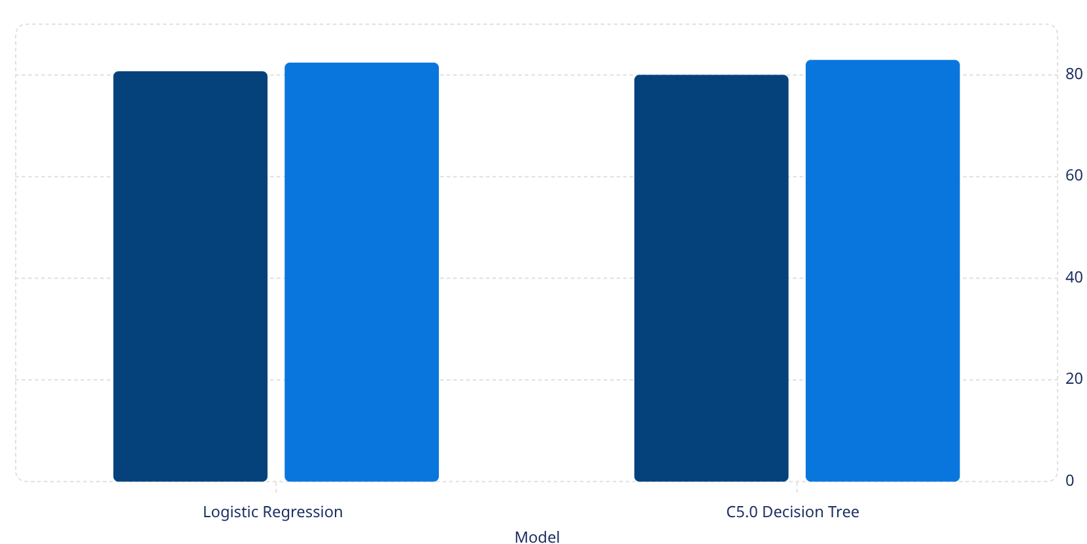

Model Comparison & Results
Training Accuracy (%)
Testing Accuracy (%)
Key Findings
80.8
82.5
80.1
83
Metric
Logistic Regression
C5.0 Tree
Training Accuracy
80.75%
80.05%
Testing Accuracy
82.45%
82.98%
Overfitting
None
None
Interpretability
Moderate
High
C5.0 Decision Tree achieved the highest test accuracy at 82.98% — selected as the best-performing model.

Slide 9
User Input Prediction Demo
Example applicant input fed into the trained C5.0 model for a real-time loan decision.
Applicant Profile
Prediction Result
Applicant Income
₹ 58,000 / month
✅ Loan Approved
Loan Amount
₹ 12,00,000
C5.0 model predicts Approval with high confidence.
Credit History
1.0 (Clean)
Key factors: clean credit history, stable income, and urban property location.
Education
Graduate
Property Area
Urban
Marital Status
Married

Slide 10
Conclusion
1
ML-Based System Built Successfully
2
Multiple Models Compared
3
High Accuracy Achieved
Both models exceeded 80%; C5.0 Decision Tree led at 82.98% test accuracy.
End-to-end loan approval pipeline implemented in IBM SPSS Modeler.
Logistic Regression and C5.0 Decision Tree evaluated on identical data.
Thank You
Open for Questions & Answers
IBM SPSS MODELER
MACHINE LEARNING
LOAN PREDICTION

