Slide 1
F1 Assistant Chatbot – Powered by IBM Watson
Bringing the World of Formula 1 to Your Fingertips with AI
Presented by: Naman Saxena
11-07-2025

Slide 2
Problem Statement
Formula 1 has a vast global fanbase, but data is scattered.
New fans struggle to learn about circuits, drivers, or rules.
Need for an interactive and intelligent assistant for F1 fans.

Slide 3
Solution Overview
F1 Assistant Chatbot built using IBM Watson Assistant.
Features:
- Circuit and driver information
- Stats, trivia, and F1 history
- Chat interface for real-time Q&A
- Responsive, engaging UI with animations

Slide 4
Technology Stack
Frontend:
- HTML5, CSS3, Bootstrap
- Custom animations and gradients
Backend / AI Engine:
- IBM Watson Assistant for NLP and dialog management
- Webhooks and workspace integration
Hosting:
- GitHub Pages

Slide 5
Intents
What is an Intent? An intent represents the goal or purpose behind a user’s input.
Example: When a user asks: “Who won the last F1 race?” — it triggers an intent like #race_winner_query.
Purpose: Watson uses intents to understand what the user wants, so it can provide a relevant response.

Slide 6
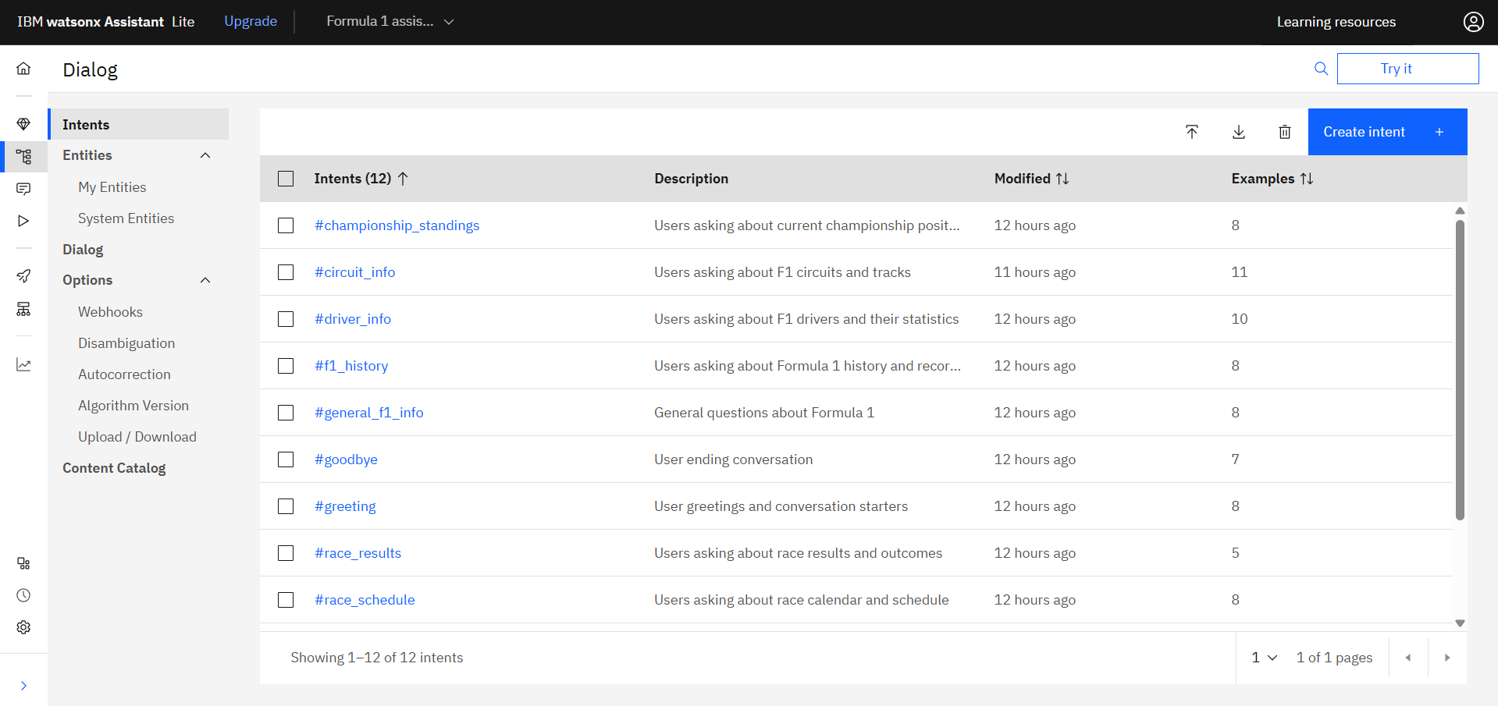
Intents Created - 12

Slide 7
Entity
What are Entities? Entities help identify specific data in a user’s message — such as names, locations, or teams.
Example: In the question “Tell me about the Monaco circuit”, “Monaco” is recognized as the entity @circuit.
Purpose: Entities allow the chatbot to give personalized answers by extracting context.

Slide 8
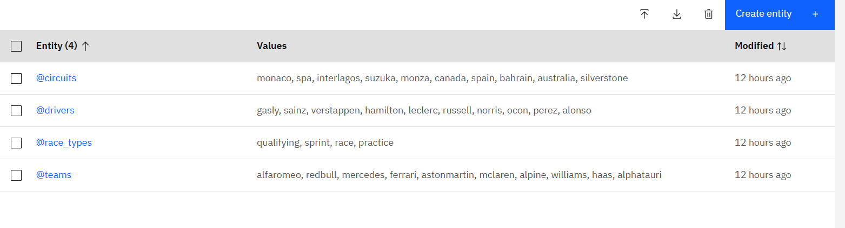
Entity Created - 4

Slide 9
Dialog Flow
What is Dialog Flow? Dialog Flow defines how the conversation progresses after detecting intents and entities.
Functionality:
Connects intents to specific responses
Manages follow-up questions
Maintains context for smooth, multi-turn conversations
Example: If the intent is #team_info and entity is @team: Ferrari, the bot replies with Ferrari’s team details.

Slide 10
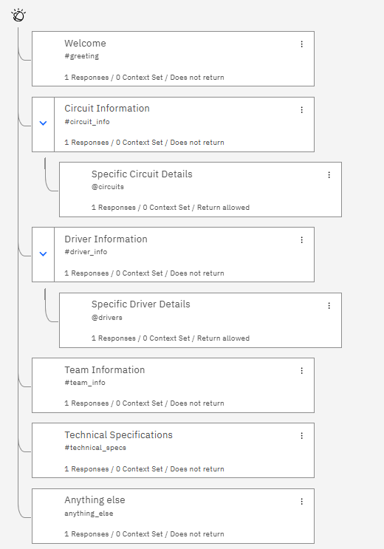
Dialog flow

Slide 11
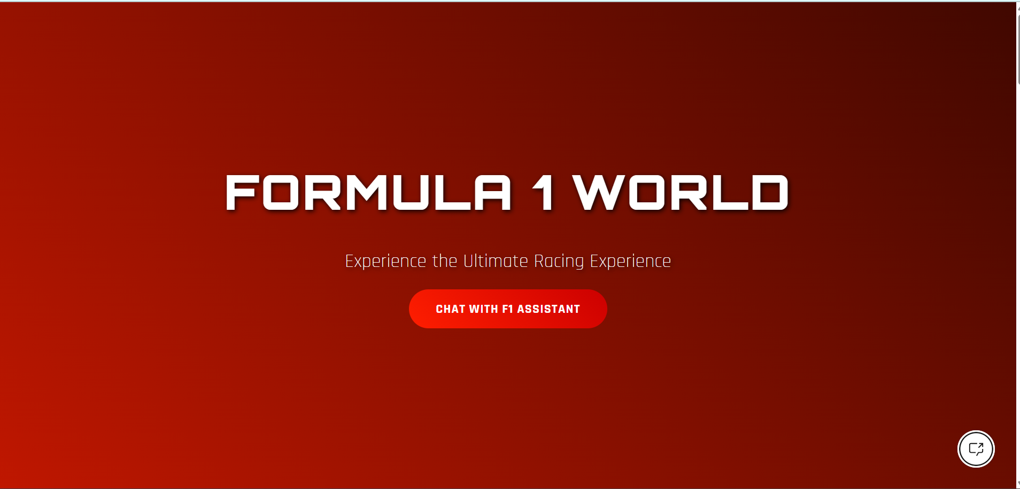
Welcome Screen

Slide 12
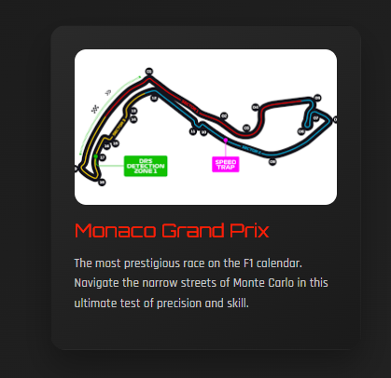
Monaco Circuit Card

Slide 13
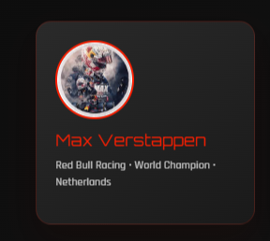
Driver Card – Max Verstappen

Slide 14
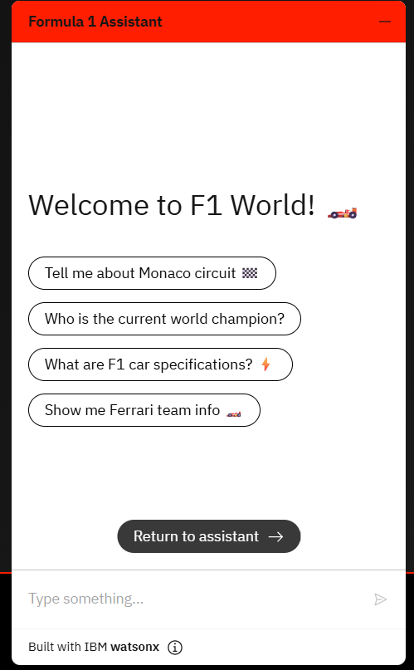
IBM Watson Chat Interface

Slide 15
Impact & Future Work
Impact:
- Enhances F1 fan experience
- Educates users interactively
- Potential integration in official F1 platforms
Future Plans:
- Voice-based assistant (Watson Speech APIs)
- Live race data integration
- Multi-language and personalization features

Slide 16
Thank You

