Slide 1

AI-Powered
DEV CHAT ROOMS
Architecting Seamless Collaboration & LowEntropyAI

Slide 2
The Problem & Value Proposition
The Gap in Developer Collaboration:
Context switching between code editors, chat apps, and AI tabs breaks flow.
Our Value Proposition:
A unified workspace where context is king. Developers collaborate in real-time rooms.
LowEntropyAI sits intimately within the chat, reading exact context to solve bugs instantly.

Slide 3
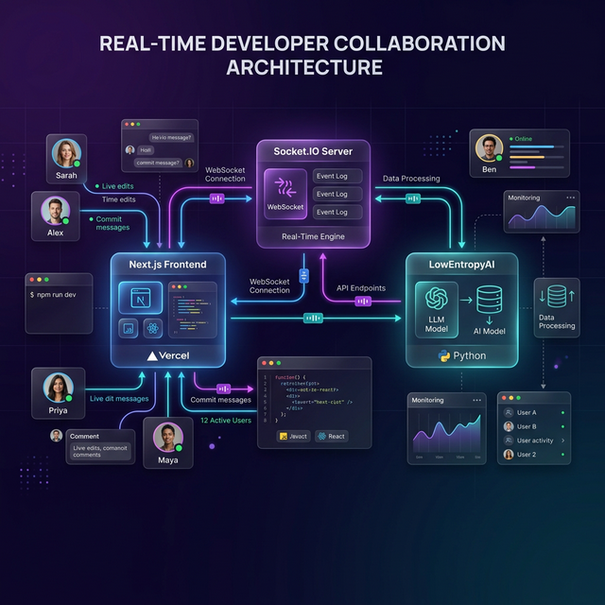
System Architecture & Workflow
Next.js Frontend connects via Socket.IO directly to the AI Core.

Slide 4
UX Principle: Glassmorphism
Why Glassmorphism?
Creates depth without clutter. By using blurred, translucent backgrounds (backdrop-blur), users maintain spatial awareness without being distracted.
Dark Mode Defaults:
Reduces eye strain for developers working long hours in low-light environments.
High Contrast Actions:
Primary call-to-actions utilize strict #3b82f6 (Blue) ensuring AAA contrast ratings.

Slide 5
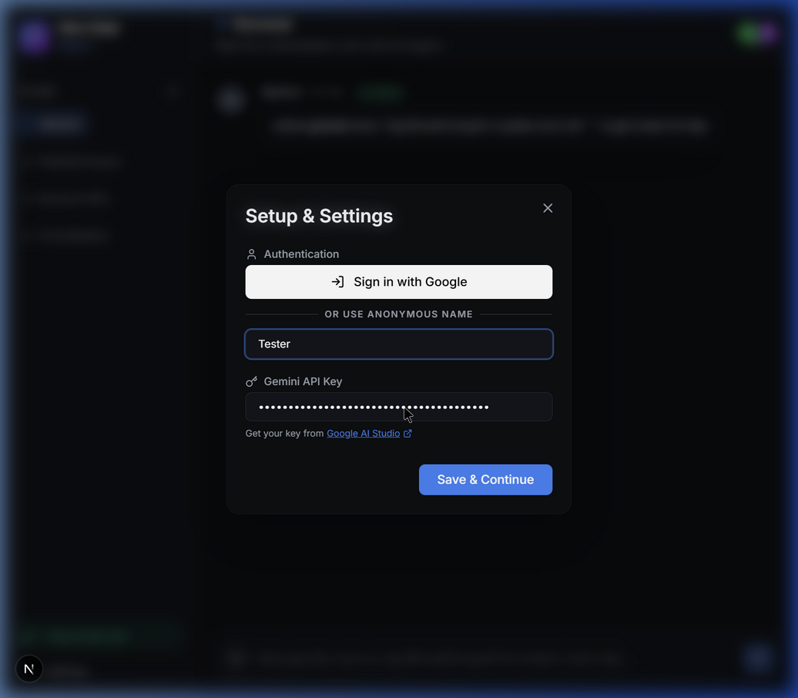
Frictionless Authentication UI
Modal-Driven Auth
Captures Display Name & API Key gracefully without heavy page redirects.
Clear error boundaries and link to Google AI Studio for key generation.

Slide 6
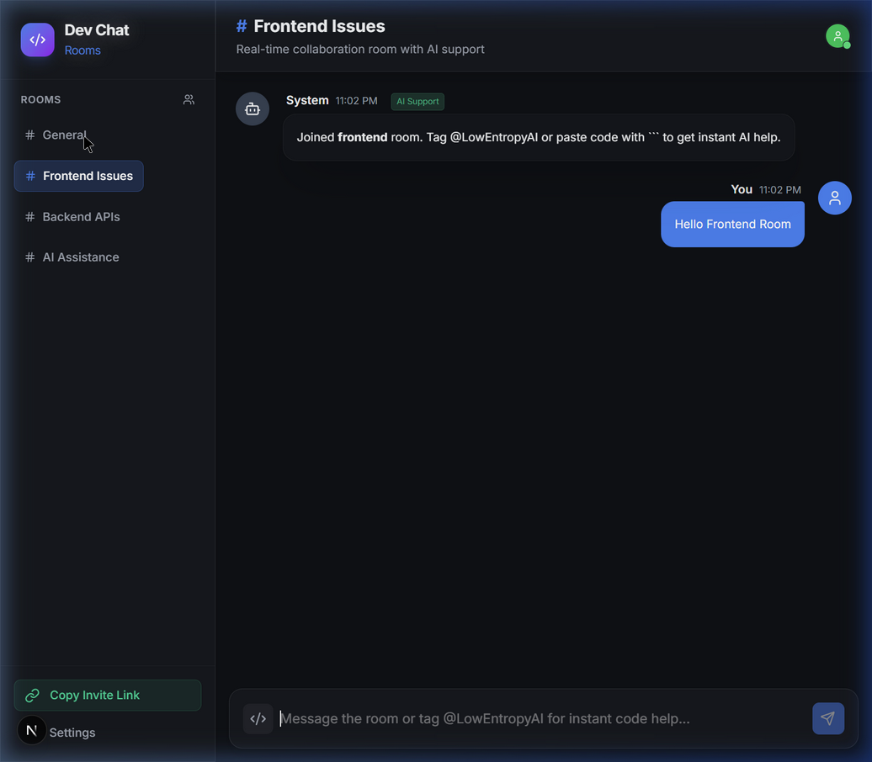
Core UI: The Collaboration Room
Real-Time Workspace
Socket.IO chat interface featuring instantaneous broadcast to all clients.
Markdown rendering and syntax highlighting built directly into the UI.

Slide 7
Streamlined User Flow (A -> B -> C)
[A] Secure Onboarding
User lands on app. Chat is visible but disabled. Click "Kindly Login" -> Modal opens.
[B] Contextual Routing
User selects 'Frontend Issues' room. Socket.IO emits join, fetches historical messages.
[C] AI Invocation
User tags @LowEntropyAI. AI reads entire room context and streams markdown response.

Slide 8
Technical Feasibility & Deployment
Tech Stack:
Next.js 15, Tailwind CSS V4, Socket.IO, @google/genai
Dual-Mode Flexibility:
Local: Custom Node.js server handles WebSockets.
Vercel: Falls back to Next.js serverless API routes for production stability.
Cascading AI Fallback:
Automatically shifts from gemini-3-flash -> gemini-2.5-pro -> flash if rate limits are hit.

Slide 9
THANK YOU
Ready for Deployment

