Slide 1
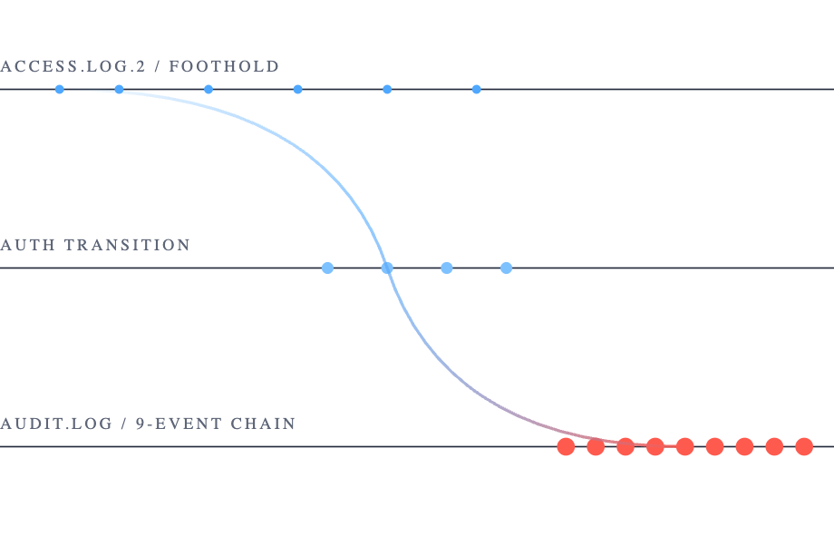
DATA 201 / FINAL PRESENTATION / GROUP 5
SAN JOSÉ STATE UNIVERSITY · SPRING 2026
CASE FILE // AIT-LDS V2.0 / RUSSELLMITCHELL
Reconstructing a privilege escalation attack from raw logs.
A 3NF PostgreSQL schema turns an access.log.2 foothold into a 9-event su + sudo chain on intranet_server.
TEAM
INSTRUCTOR
DELIVERABLES
Naman Sudan River Roseveare-Hunt Ishaan Shetty
Dr. Liu
22-table schema 23 SQL queries 9-panel dashboard 10-section report
STACK
PostgreSQL 16 · Alembic SQLAlchemy · Streamlit · Plotly
01 / 11 · NAMAN · 0:15
SECURITY LOG ANALYSIS · GROUP 5
Notes:
Slot 0:15. Hi everyone, I am Naman, and with River and Ishaan we are Group 5. Our project is a security log analysis. We took the russellmitchell slice of the AIT Log Data Set V2.0, loaded it into a 3NF PostgreSQL schema, and used SQL plus a Streamlit dashboard to reconstruct one specific attack: a web foothold that becomes a privilege escalation chain on a host called intranet_server. The whole story today fits inside 9 audit events on one host on one day. I cover tech stack and project management first, then Ishaan walks the dataset and the schema, River covers the SQL portfolio and the NTILE deep dive, I take two deep dives on the saved view and on EXPLAIN ANALYZE, Ishaan covers EXISTS and demos the dashboard, and River closes with findings.

Slide 2






01 / PROJECT MANAGEMENT & DEV STACK
SECTION 02 OF 11
How we built it.
GitHub
Linear
Slack
Version control with reviewed pull requests.
Sprint planning against rubric line items.
Task tracking and ownership.
Day-to-day team communications.
Single source of truth for schema, queries, dashboard.
github.com/NamanSudan/ data‑201‑security‑log‑analysis
Docker
Alembic
Streamlit + Plotly
Reproducible PostgreSQL 16 environment.
One-command database rebuild from scratch.
Schema migrations versioned in Git.
Every table change ships as a migration.
Interactive dashboard layer.
Hits PostgreSQL directly via SQLAlchemy.
STACK · POSTGRESQL 16 + SQLALCHEMY + PYTHON LOADERS FOR THE DATA PLANE.
02 / 11 · NAMAN · 0:45
PROJECT MANAGEMENT & STACK
Notes:
Slot 0:45. Quick word on how we built this. Github for version control with PRs reviewed before merge. Linear for sprint planning and task tracking against the rubric line items. Slack for day-to-day. Docker for a reproducible PostgreSQL 16 environment so any of us can rebuild the database from scratch in one command. Alembic for schema migrations, every table change is a migration in the repo. Streamlit plus Plotly for the dashboard layer hitting Postgres. Project management is a rubric line item, so this slide is partly that evidence. Hand to Ishaan for the dataset.

Slide 3
02 / DATASET
SECTION 03 OF 11
A 22-table 3NF schema over the russellmitchell testbed.
22
8
61,862
~439K
HOSTS IN INVENTORY
SOURCE LOG FILES
LABELED ATTACK LINES
LOADED ROWS
SOURCE DATA, THREE DOMAINS
Host inventory: 7 tables, including host, fqdn, ip_address, distribution.
Audit events: 10 tables, with audit_event as the supertype and 8 subtype tables for the audit-type families.
STORY SETUP
Attack labels: 5 tables, including attack_phase, attack_label, labeled_line, plus a per-rule annotation table.
An access.log.2 foothold leads into the audit.log su then sudo chain on intranet_server.
TWO LOG FAMILIES. ONE HOST. NINE AUDIT EVENTS.
03 / 11 · ISHAAN · 1:00
DATASET & STORY SETUP
Notes:
Slot 1:00. Thanks River. The dataset is the AIT Log Data Set V2.0, russellmitchell testbed, a published academic intrusion dataset. Inside that slice there are 22 hosts in the inventory, 8 distinct source log files, and 61,862 lines that researchers labeled as attack activity. We loaded it into PostgreSQL 16 in third normal form, about 439,000 rows total across 22 tables in 3 domains: host inventory, audit events, and attack labels. The story we will tell today crosses all three domains: a foothold on access.log.2 leads into the audit.log su and then sudo chain on intranet_server. Next slide shows the schema.

Slide 4
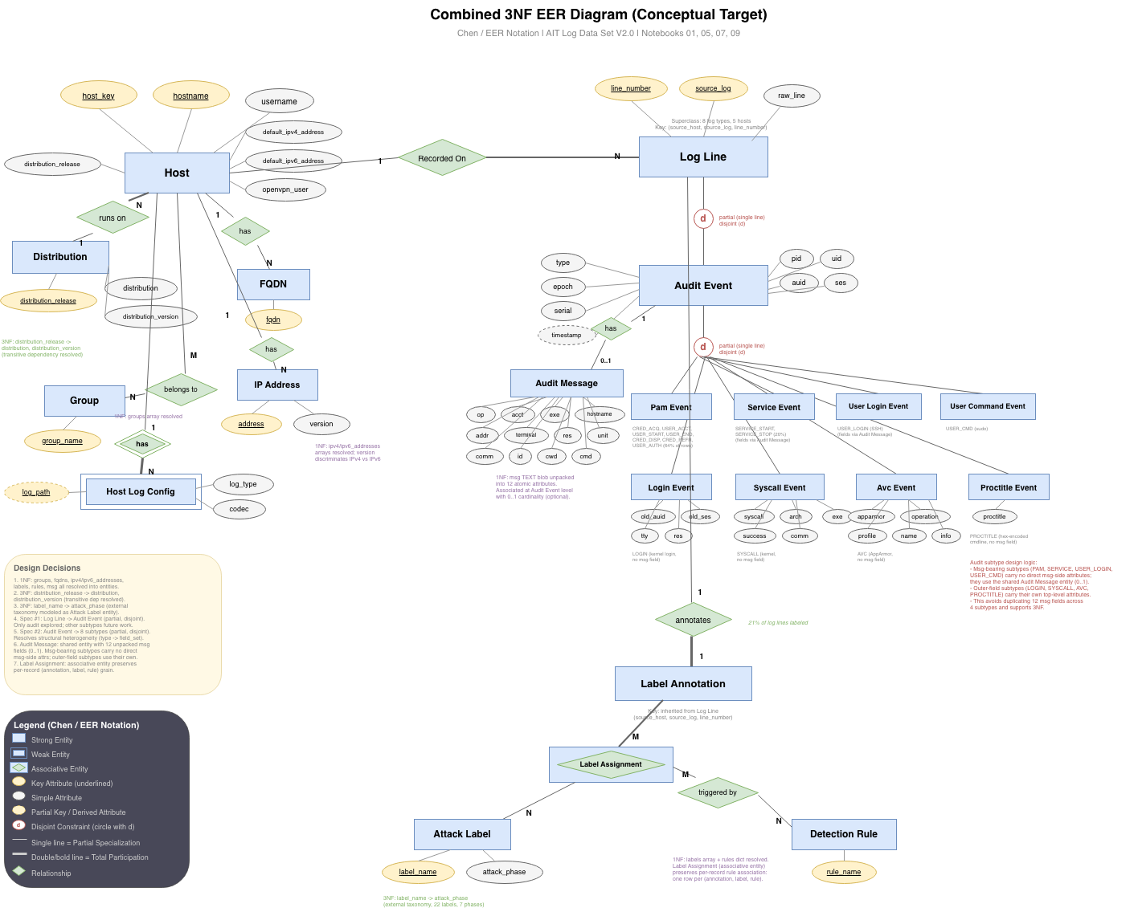
03 / CONCEPTUAL SCHEMA
SECTION 04 OF 11
A 22-table 3NF schema over the russellmitchell testbed.
CONCEPTUAL 3NF SCHEMA · EER DIAGRAM
SCHEMA SUMMARY
22
3
3NF
TABLES
DOMAINS
NORMAL FORM
DOMAINS
Host inventory · 7 tables host, fqdn, ip_address, distribution, …
Audit events · 10 tables audit_event supertype + 8 subtypes, audit_message
Attack labels · 5 tables attack_phase, attack_label, labeled_line, labeled_line_label, labeled_line_rule
CHEN NOTATION · PKS UNDERLINED · FK CONSTRAINTS ARROWED
04 / 11 · ISHAAN · 0:55
CONCEPTUAL 3NF SCHEMA
Notes:
Slot 0:55. This is the official EER diagram for the schema, Chen notation, primary keys underlined, FK constraints arrowed. Three takeaways before we move on. One, audit_event is a supertype: it joins host on host_id and decomposes into 8 subtype tables, one per audit type family, plus audit_message for the PAM payload. That is the key normalization decision. Two, labeled_line gives provenance into both access.log and audit.log via source_host plus source_log plus line_number, which is how we tie attack labels to either log family. Three, the join we use across the deck is audit_event to host on host_id, plus audit_event to labeled_line on the line_number key, plus labeled_line to attack_label and attack_phase through the M-to-N junction. Hand back to River for the SQL portfolio.

Slide 5
04 / SQL PORTFOLIO
SECTION 05 OF 11
23 queries in the repo. The slides spotlight four.
Full portfolio lives in GitHub and report section 6. The spotlight rows below are the deep dives that drive the next four slides.
AUTHOR
QUERY
TECHNIQUE TAGS
River
Foothold-to-escalation journey
CTE
NTILE WINDOW
river_foothold_to_escalate_journey.sql
Foothold accumulation across access.log.2
CUMULATIVE SUM
WINDOW
Source spread per host, host and label baselines
RANK
JOIN ≥3
BASIC
Ishaan
Audit types in privilege escalation
EXISTS
SUBQUERY
ishaan_audit_types_in_privilege_escalation.sql
Detection rules ranked, top rule per label
RANK WINDOW
CORRELATED SUBQUERY
Phase and rule baseline counts
BASIC
Naman
EXPLAIN ANALYZE + composite index
EXPLAIN ANALYZE
INDEX
naman_explain_index_improvement.sql
Saved view
v_privilege_escalation_timeline
SAVED VIEW
JOIN ≥8
naman_view_privilege_escalation_timeline.sql
Audit-type density per phase, service baselines
DENSE_RANK
WINDOW
BASIC
05 / 11 · RIVER · 0:50 · ● SPOTLIGHT ON SLIDES 6 TO 9
23 QUERY ITEMS · 7 BASIC + 16 ADVANCED · 6 SQL CATEGORIES
Notes:
Slot 0:50. We wrote 23 SQL items total, 7 basic and 16 advanced, across 6 SQL categories. The full portfolio is in the GitHub repo and section 6 of the technical report. We are not going to walk every query. We picked four deep dives that map to the attack story and show diverse advanced SQL across the three of us. Mine, CTE plus NTILE on the foothold log. Naman, the saved view that builds the privilege escalation timeline, plus EXPLAIN ANALYZE with a composite index for incident-response performance. Ishaan, EXISTS subquery on which auditd types fire during the chain. Everything else lives in the repo. Next is my deep dive.

Slide 6
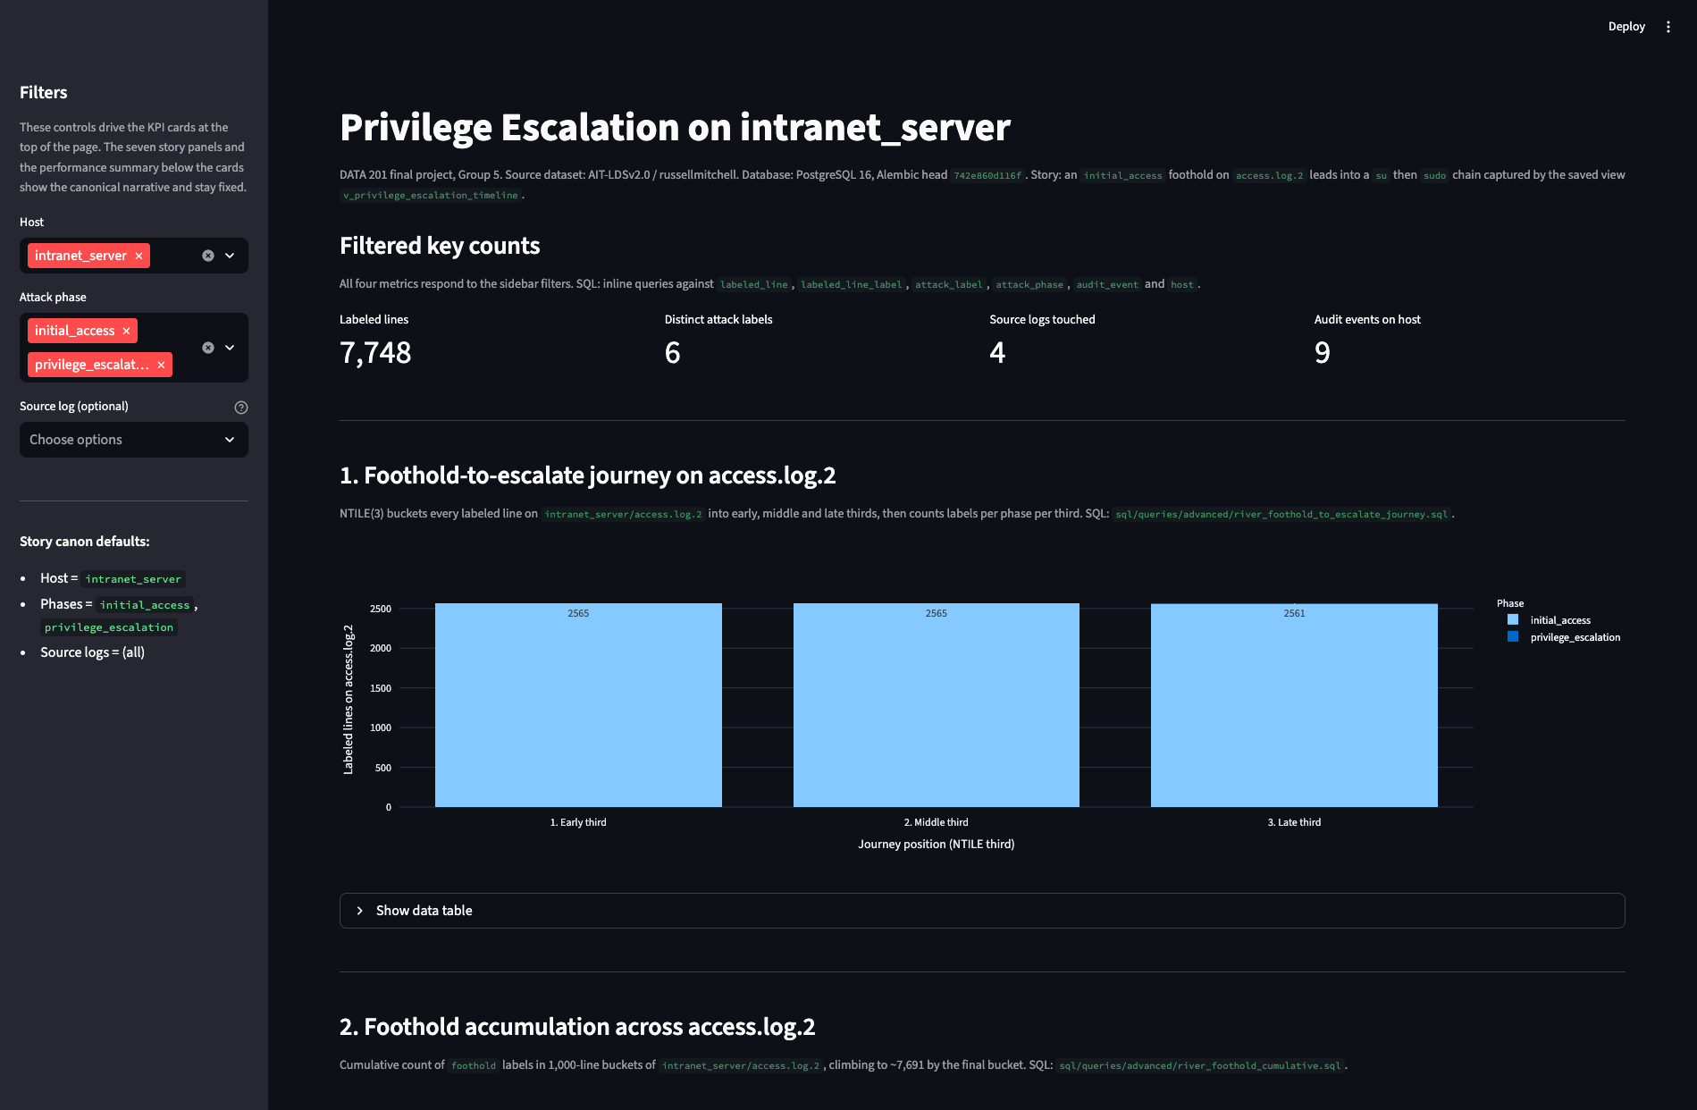
DEEP DIVE 01 / CTE + NTILE WINDOW
RIVER · RIVER_FOOTHOLD_TO_ESCALATE_JOURNEY.SQL
Where in access.log.2 does the foothold turn into escalation evidence?
WITH access_labels AS (
SELECT ll.line_number,
al.label_name,
ap.phase_name,
NTILE(3) OVER (ORDER BY ll.line_number) AS journey_third
FROM labeled_line ll
JOIN labeled_line_label lll ON lll.labeled_line_id = ll.labeled_line_id
JOIN attack_label al ON al.label_id = lll.label_id
JOIN attack_phase ap ON ap.phase_id = al.phase_id
WHERE ll.source_host = 'intranet_server' AND ll.source_log = 'access.log.2' AND ap.phase_name IN ('initial_access', 'privilege_escalation' )
)
SELECT journey_third, phase_name, COUNT(*) AS labeled_lines FROM access_labels GROUP BY journey_third, phase_name ORDER BY journey_third, phase_name;
PANEL 1 · NTILE BUCKETS · LABELED LINES PER THIRD
Foothold spreads across all three thirds of access.log.2. Privilege-escalation evidence appears only in the late third. NTILE turns raw line position into a readable attack journey.
METHOD
SCOPE
SOURCE
NTILE(3)
2 phases
access.log.2
06 / 11 · RIVER · 1:15
DEEP DIVE 01 · CTE + NTILE
Notes:
Slot 1:15. Question: where in access.log.2 does the foothold turn into escalation evidence. The query uses a CTE that joins labeled_line, the M-to-N junction labeled_line_label, attack_label, and attack_phase, scoped to source_host intranet_server, source_log access.log.2, and the two phases initial_access and privilege_escalation. NTILE of 3 over line_number buckets the log into thirds. The result has phase split by third. Initial-access foothold lines spread across all three thirds. Privilege-escalation evidence appears only in the late third. So the inflection point is in the access log itself, you just need a window function to see it. NTILE turns raw line position into a readable attack journey. Hand to Naman.

Slide 7
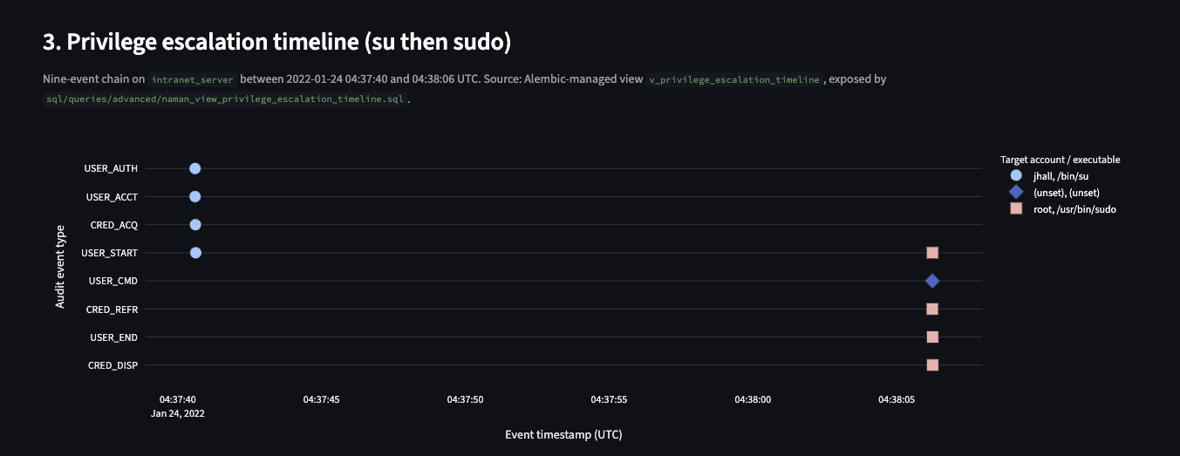
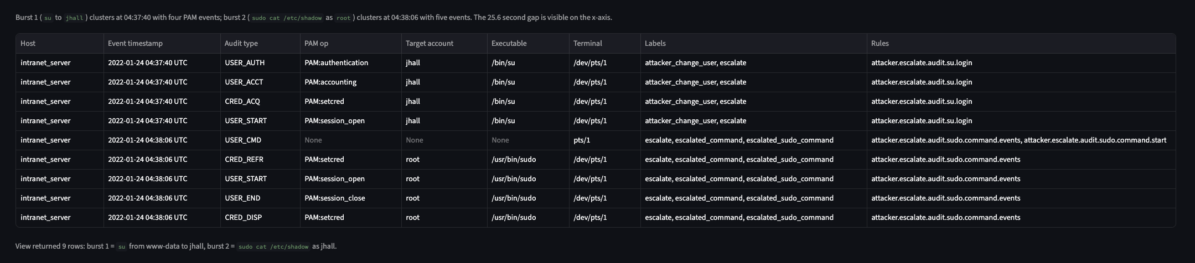
DEEP DIVE 02 / SAVED VIEW + STRING_AGG
NAMAN · NAMAN_V_PRIVILEGE_ESCALATION_TIMELINE.SQL
An 8-table saved view that becomes the privilege-escalation timeline.
CREATE OR REPLACE VIEW v_privilege_escalation_timeline AS SELECT h.host_key AS host,
ae.timestamp,
ae.type
AS audit_type,
am.op
AS pam_operation,
am.acct
AS target_account,
am.exe
AS executable,
am.terminal,
string_agg(DISTINCT al.label_name, ', ' ORDER BY al.label_name) AS labels,
string_agg(DISTINCT llr.rule_name, ', ' ORDER BY llr.rule_name) AS rules FROM audit_event ae JOIN host h ON h.host_id = ae.host_id LEFT JOIN audit_message am
ON am.event_id = ae.event_id JOIN labeled_line ll
ON ll.source_host = h.host_key
AND ll.source_log = 'audit.log' AND ll.line_number = ae.line_number JOIN labeled_line_label lll
ON lll.labeled_line_id = ll.labeled_line_id JOIN attack_label al
ON al.label_id = lll.label_id JOIN attack_phase ap
ON ap.phase_id = al.phase_id LEFT JOIN labeled_line_rule llr
ON llr.labeled_line_id = ll.labeled_line_id
AND llr.label_id = al.label_id WHERE ap.phase_name = 'privilege_escalation' GROUP BY h.host_key, ae.timestamp, ae.type,
am.op, am.acct, am.exe, am.terminal;
DASHBOARD PANEL 3 · SCATTER
DASHBOARD PANEL 3 · 9-ROW TABLE
Burst 1: su from www-data to jhall at 04:37:40 (4 PAM events). Burst 2: sudo cat /etc/shadow as root at 04:38:06 (5 events). 25.6 second gap. The dashboard reads from this view, not from a giant ad-hoc join.
07 / 11 · NAMAN · 1:15
DEEP DIVE 02 · SAVED VIEW
Notes:
Slot 1:15. Hi, I am Naman. My contribution is a saved view that builds the privilege escalation timeline as a single relation the dashboard can query. The view joins audit_event to host, left joins audit_message for the PAM payload, then joins labeled_line and the M-to-N path to attack_label and attack_phase, filtered to phase_name privilege_escalation. string_agg with DISTINCT and ORDER BY collapses many labels per event into one readable column, and a left join to labeled_line_rule does the same for rule names. Eight tables, one view, group-by on the seven non-aggregated columns. The screenshot on the right is panel 3 of the live dashboard reading from this view: scatter on the top, the 9-row table underneath. Burst 1 at 04:37:40 UTC is the su attempt, www-data to jhall, four PAM events. Burst 2 at 04:38:06 UTC is sudo cat /etc/shadow as root, five events. The 25.6 second gap between bursts is the social-engineering breath. That is the saved view as a reusable abstraction. Hand to Ishaan.

Slide 8
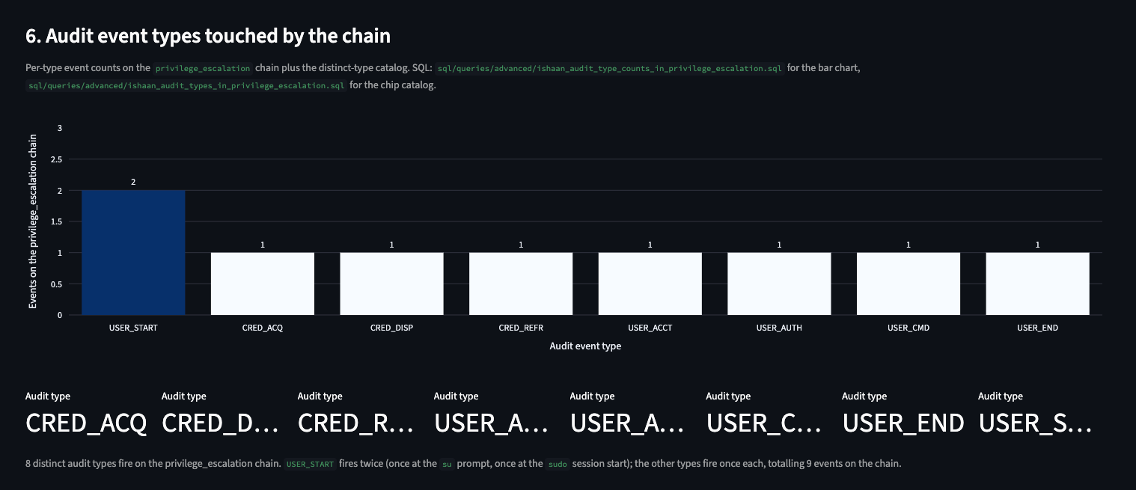
DEEP DIVE 03 / EXISTS SUBQUERY + DISTINCT
ISHAAN · ISHAAN_AUDIT_TYPES_IN_PRIVILEGE_ESCALATION.SQL
Which audit types fire on intranet_server lines that carry a privilege_escalation label?
SELECT DISTINCT ae.type AS audit_type FROM audit_event ae JOIN host h ON h.host_id = ae.host_id WHERE h.host_key = 'intranet_server' AND EXISTS (
SELECT 1 FROM labeled_line ll
JOIN labeled_line_label lll ON lll.labeled_line_id = ll.labeled_line_id
JOIN attack_label al ON al.label_id = lll.label_id
JOIN attack_phase ap ON ap.phase_id = al.phase_id
WHERE ll.source_host = h.host_key
AND ll.source_log = 'audit.log' AND ll.line_number = ae.line_number
AND ap.phase_name = 'privilege_escalation' ) ORDER BY audit_type;
DASHBOARD PANEL 6 · AUDIT EVENT TYPES TOUCHED BY THE CHAIN
PATTERN
DISTINCT TYPES
TOTAL EVENTS
EXISTS · 4-tbl body
8
9
8 distinct audit types fire on the chain. USER_START fires twice (once at the su prompt, once at the sudo session start); the other seven fire once each, totalling 9 events. A detector subscribed to those 8 types catches the chain without the full auditd firehose.
08 / 11 · ISHAAN · 1:10
DEEP DIVE 03 · EXISTS SUBQUERY
Notes:
Slot 1:10. Question: which audit event types fire on the same intranet_server lines that carry a privilege_escalation label. The query is an EXISTS subquery with a 4-table body, joining labeled_line, labeled_line_label, attack_label, attack_phase, correlated to audit_event by host_key plus line_number. The outer query is DISTINCT type from audit_event filtered by host_key intranet_server. Result: 8 distinct types. The bar chart on the right is panel 6 of the dashboard. USER_START fires twice, once at the su prompt and once at the sudo session start; the other seven types each fire once. That sums to 9 events on the chain. The point: the chain triggers a specific subset of the auditd taxonomy, only credential and user-session events plus one USER_CMD, not arbitrary host noise. A detector subscribed to those 8 types catches the chain without the full auditd firehose. Hand back to me.

Slide 9
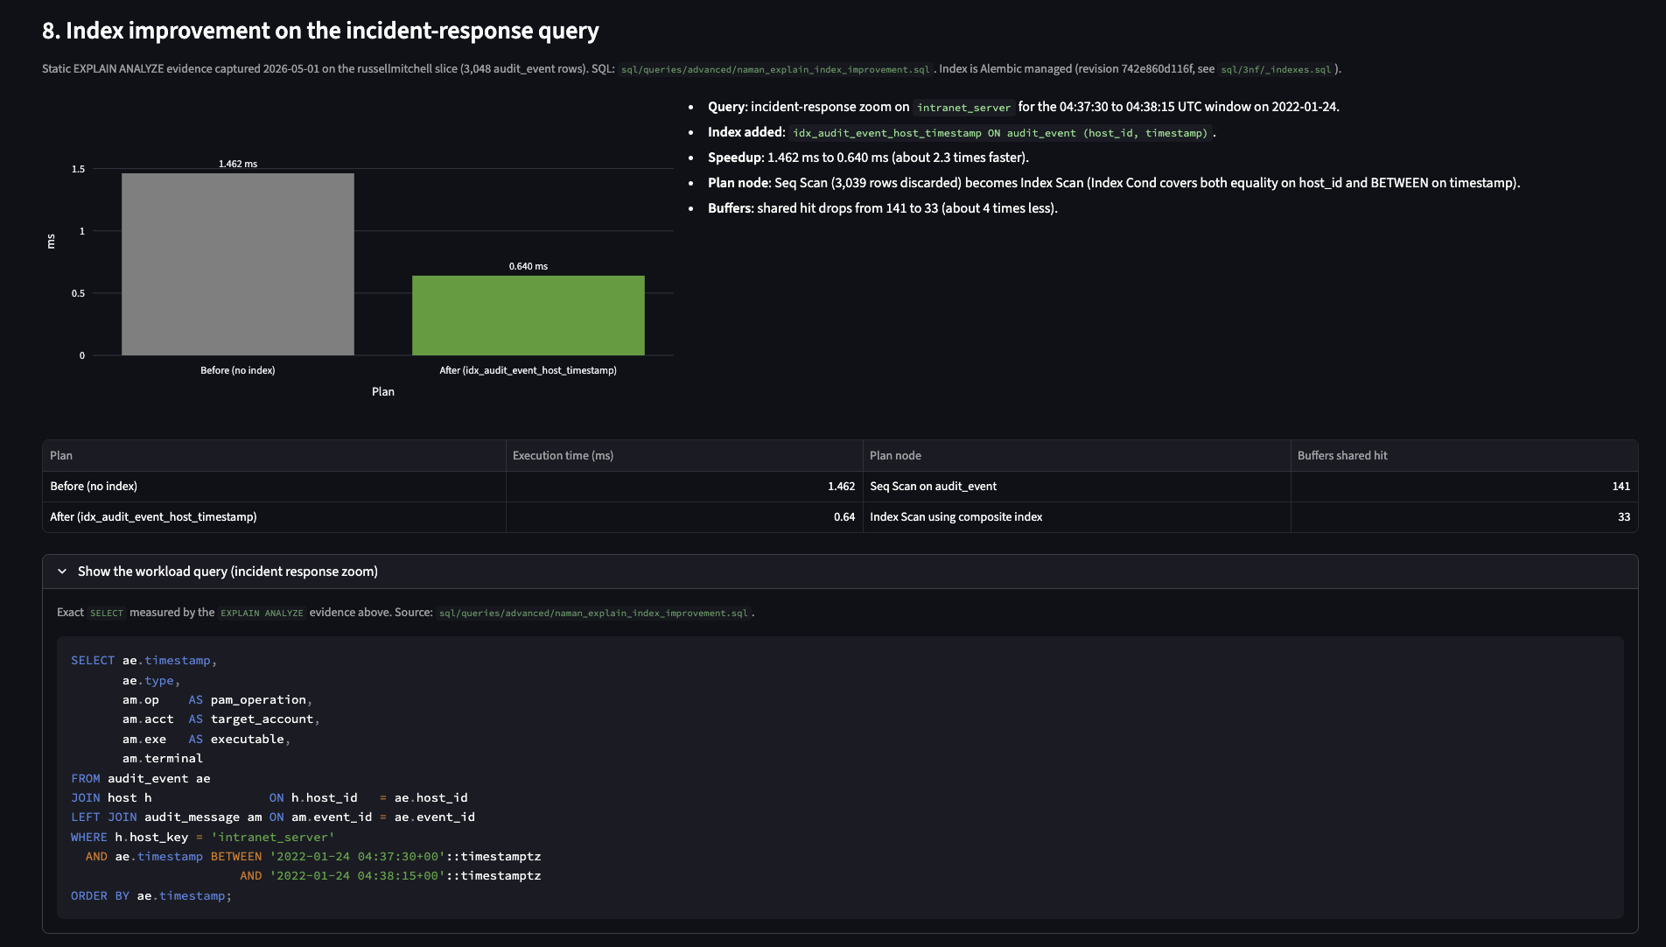
DEEP DIVE 04 / EXPLAIN ANALYZE + COMPOSITE INDEX
NAMAN · NAMAN_EXPLAIN_INDEX_IMPROVEMENT.SQL
Sequential scan to index scan on the incident-response zoom.
Workload: h.host_key = 'intranet_server', ae.timestamp in 2022-01-24 04:37:30 to 04:38:15 UTC. Index: idx_audit_event_host_timestamp ON audit_event (host_id, timestamp), migration 742e860d116f. Composite index column order matches query shape: equality on host_id first, range on ae.timestamp second.
DASHBOARD PANEL 8 · INDEX IMPROVEMENT ON THE INCIDENT-RESPONSE QUERY
09 / 11 · NAMAN · 1:20
DEEP DIVE 04 · EXPLAIN ANALYZE
Notes:
Slot 1:20. Naman again, post-midterm material, weighted heavily on the rubric. Workload is a triage zoom: one host, intranet_server, on a 45-second timestamp window covering both bursts. EXPLAIN ANALYZE on the unindexed query: sequential scan of audit_event, 1.462 milliseconds, 141 shared buffers, planner cost 171.22. We added a composite index on host_id and timestamp in that order, migration 742e860d116f. Index scan instead of sequential scan, 0.640 milliseconds, 33 shared buffers, planner cost 24.79. About 2.3 times faster on execution, about 4 times fewer buffers, about 7 times lower planner cost. The design lesson: composite index column order must match the query shape, equality first, range second. Hand to Ishaan for the dashboard.

Slide 10
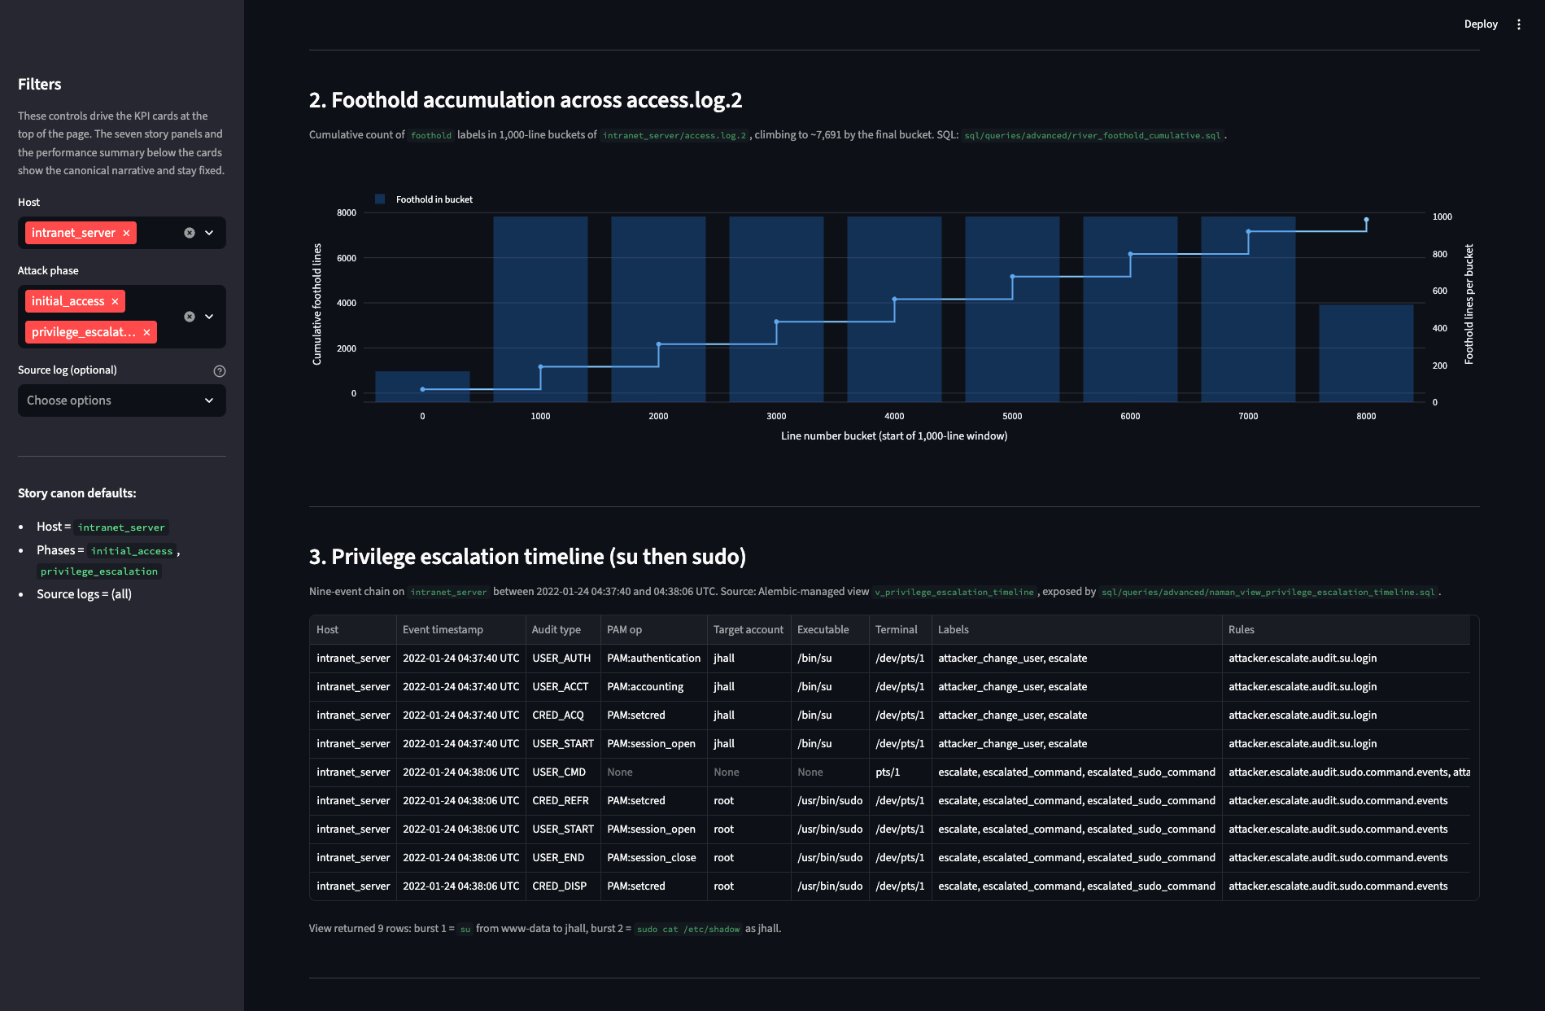
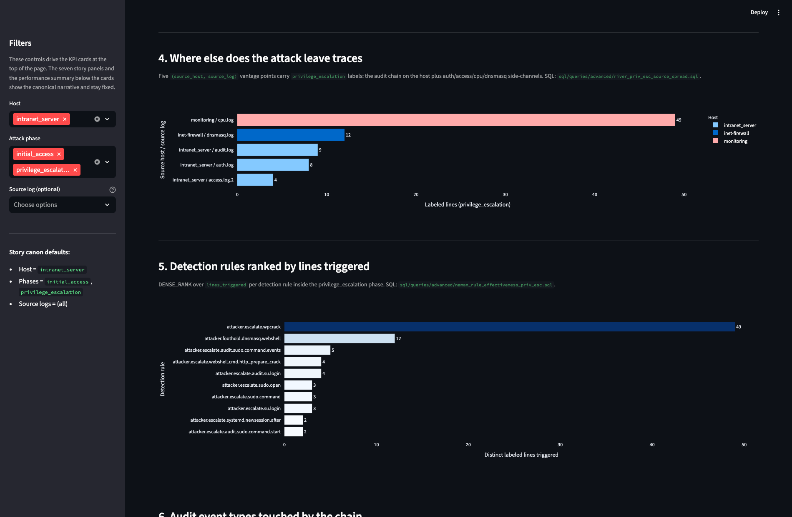
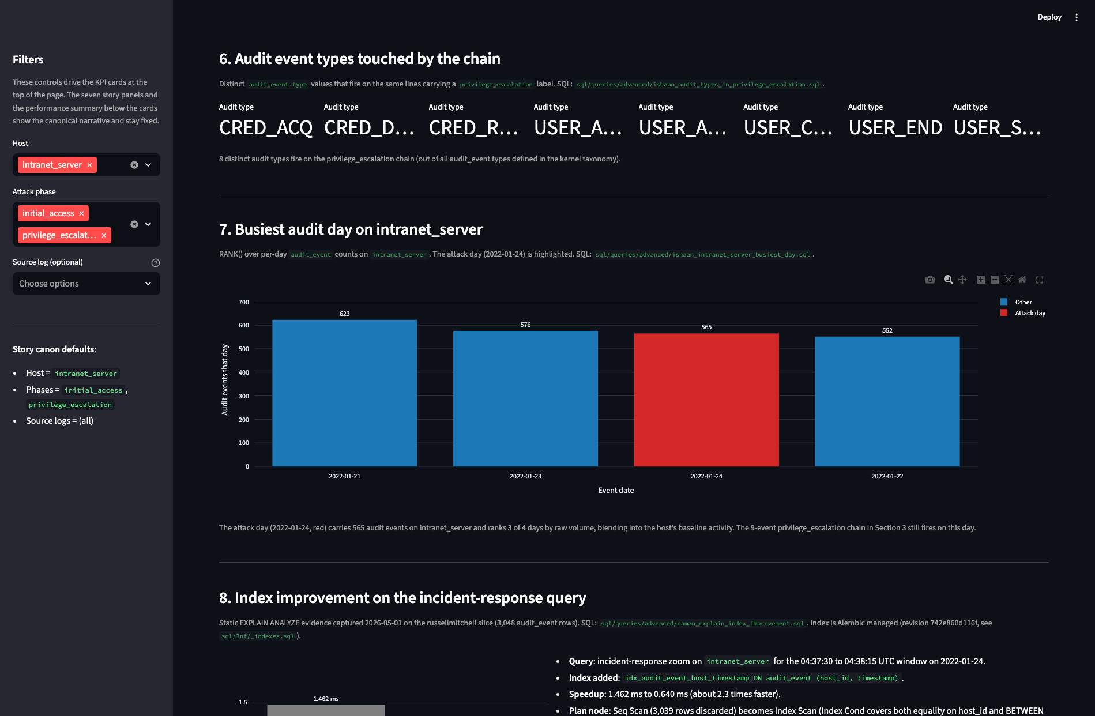
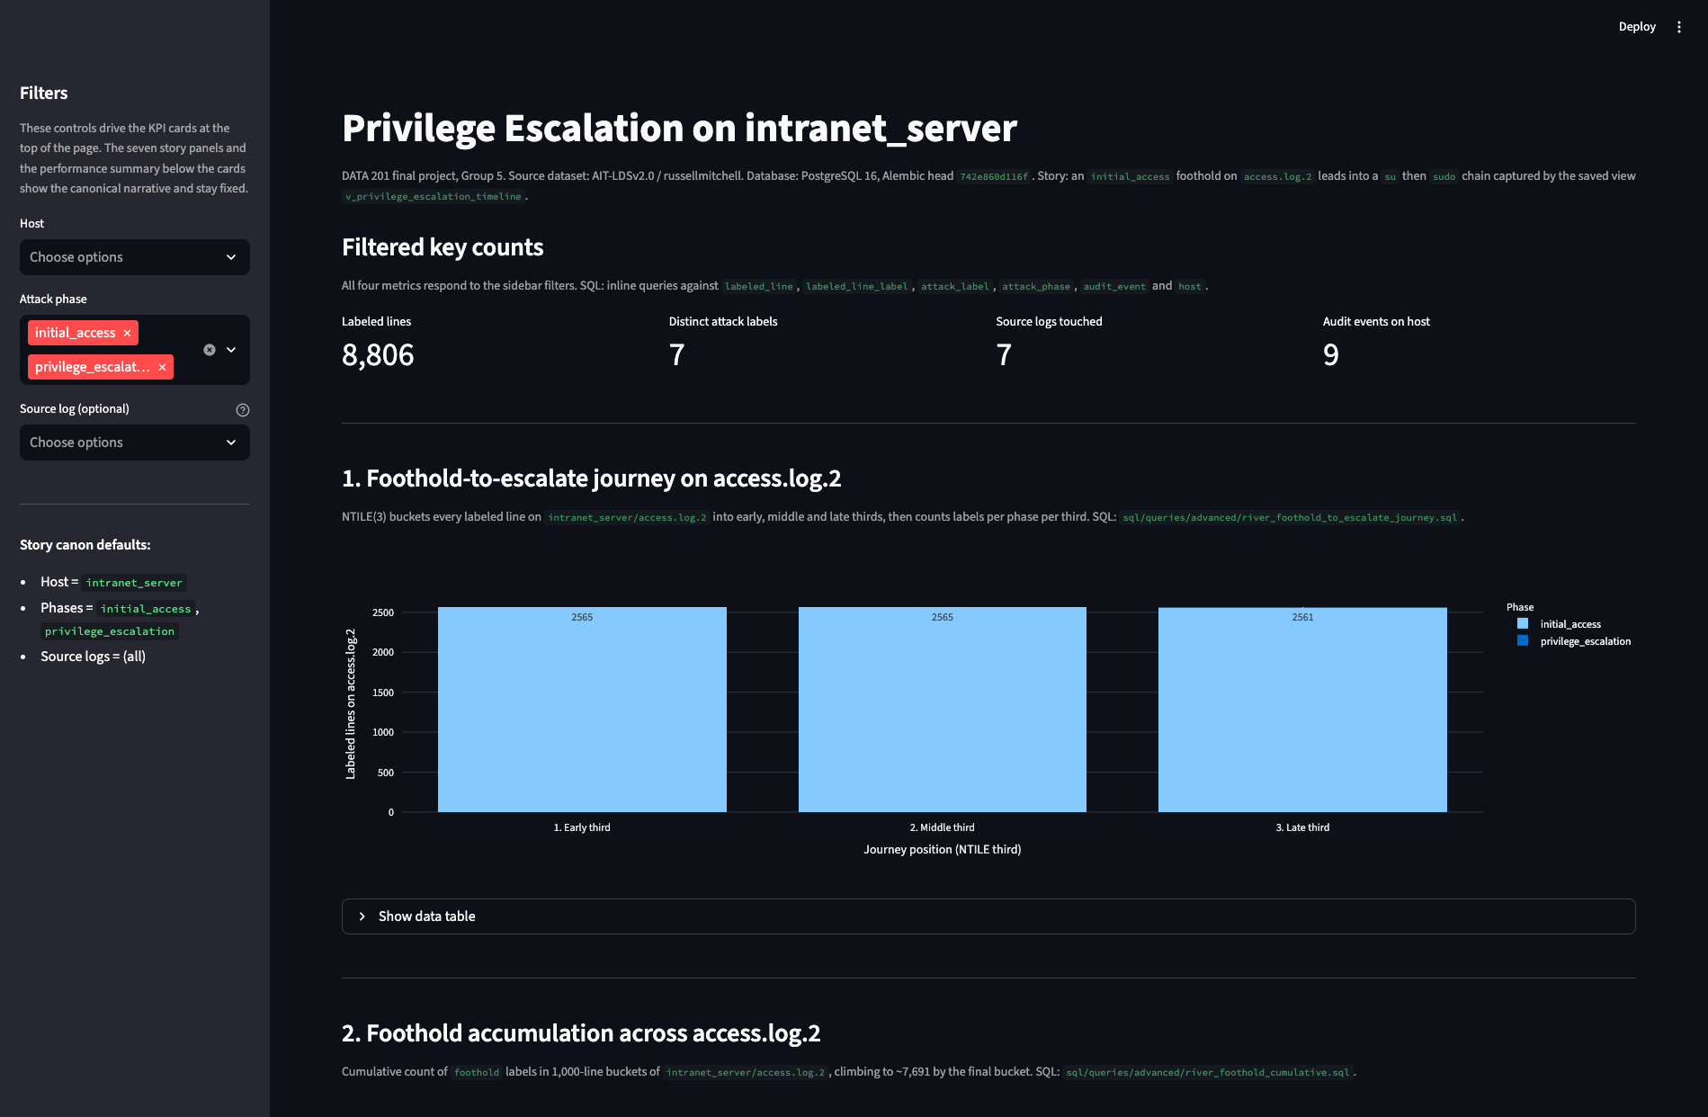
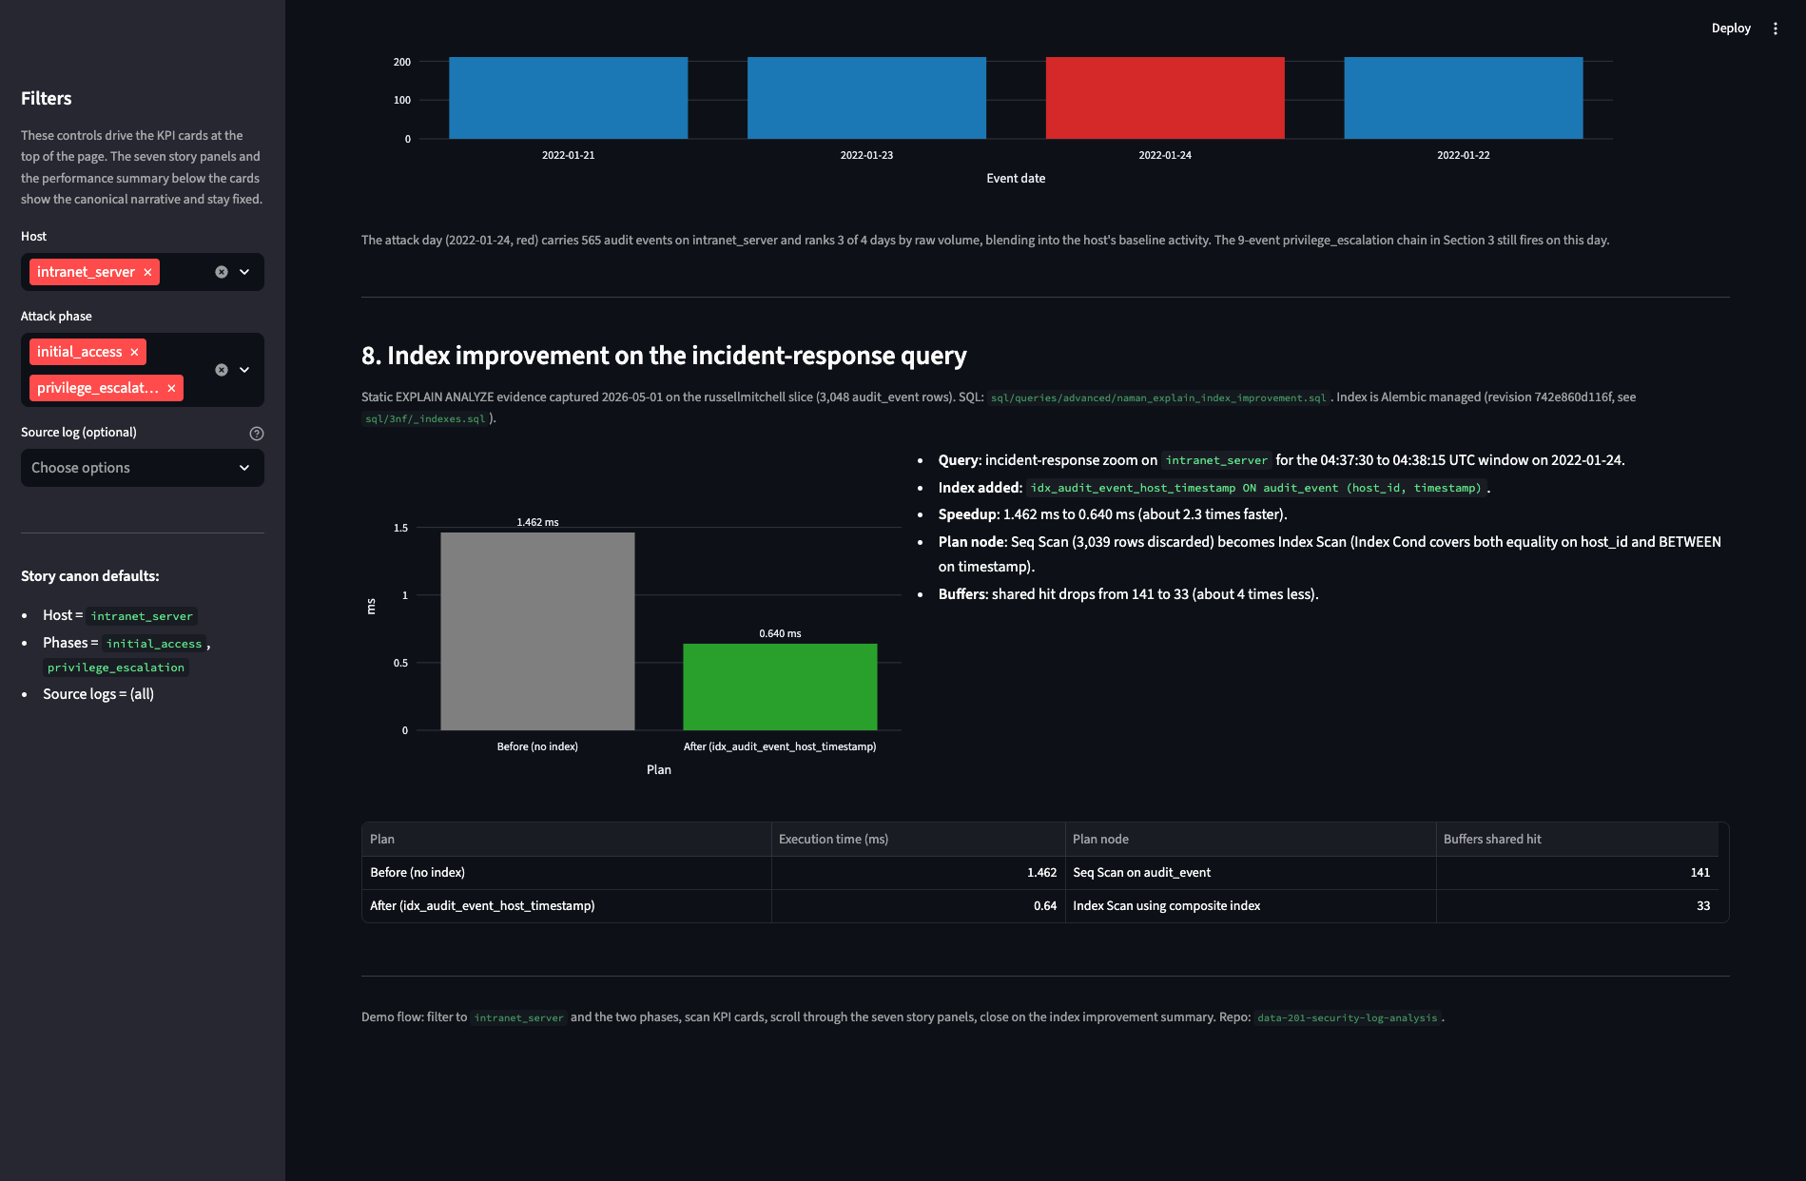
05 / INTERACTIVE DASHBOARD
SECTION 10 OF 11
Streamlit + SQLAlchemy + Plotly, hitting PostgreSQL directly.
Sidebar filters: host (default intranet_server), attack phase (default initial_access + privilege_escalation), source log (multi-select).
● DEFAULT FILTERS · HOST = INTRANET_SERVER
● HOST FILTER CLEARED · ALL HOSTS
7,748
6
4
9
8,806
7
7
9
LABELED LINES
DISTINCT LABELS
SOURCE LOGS
AUDIT EVENTS
LABELED LINES
DISTINCT LABELS
SOURCE LOGS
AUDIT EVENTS
PANELS 4 TO 5 · CROSS-HOST TRACES & RULE RANK
PANEL 7 · BUSIEST AUDIT DAY · ATTACK DAY = 3/4
PANELS 2 TO 3 · CUMULATIVE FOOTHOLD & SU-THEN-SUDO TIMELINE
FILTER DEMO · HOST CLEARED · KPIS UPDATE LIVE
PANEL 8 · INDEX IMPROVEMENT · EXPLAIN SUMMARY
Attack day on intranet_server ranks 3 of 4 days by raw audit volume. Volume-only detection misses it; the dashboard surfaces the chain anyway.
10 / 11 · ISHAAN · 1:30
INTERACTIVE DASHBOARD
Notes:
Slot 1:30. The dashboard is the demo layer on top of the SQL. Streamlit plus SQLAlchemy plus Plotly, queries PostgreSQL directly, no static export. 9 visuals: one KPI panel with four metrics, plus 8 story panels, one per major query. Sidebar filters: host, attack phase, source log. Default canon: host intranet_server, both phases selected. KPIs read 7,748 labeled lines, 6 distinct labels, 4 source logs touched, 9 audit events on host. If I clear the host filter, labeled lines goes to 8,806, source logs to 7, but audit events on host stays at 9. The attack day on intranet_server ranks 3 of 4 days by raw audit volume; volume-only detection misses it. Hand to River.

Slide 11
06 / FINDINGS & CLOSE
SECTION 11 OF 11
Three findings the schema lets us defend.
01
02
03
Volume is not coverage.
Volume-only detection misses the attack.
Relational design enables cross-source reconstruction.
Privilege escalation has only 9 audit events, yet it is the most consequential phase of the attack.
Attack day ranks 3 of 4 by raw audit volume on intranet_server. The chain hides inside baseline noise.
Host inventory + audit events + labels + rules in one query is what made the 9-event chain readable.
DELIVERABLES
GITHUB REPO
22-table 3NF schema · Alembic migrations · 23 SQL queries · Streamlit dashboard · README run steps.
FLOOR OPEN
TECHNICAL REPORT
10-section PDF; full SQL portfolio in section 6.
Questions?
DASHBOARD DEMO
Live Streamlit app with screen-recording fallback.
Naman Sudan River Roseveare-Hunt Ishaan Shetty
WHAT HAPPENED NEXT
Exfiltration on internal_share is documented in the report appendix.
11 / 11 · RIVER · 0:55
FINDINGS, REPO & Q&A
Notes:
Slot 0:55. River closing. Three findings. One, volume is not coverage. Privilege escalation has only 9 audit events but it is the most consequential phase. Two, volume-only detection misses this attack: attack day ranks 3 of 4 by audit volume on intranet_server, the chain hides inside baseline noise. Three, relational design matters: pulling host inventory, audit events, labels, and rules into one shape is what made cross-source reconstruction possible. What happened next, exfiltration on internal_share, is in the report appendix. Deliverables: GitHub repo with the schema, migrations, 23 queries, and the dashboard; the technical report PDF; and the live dashboard demo. Happy to take questions.

