Slide 1

Starbucks
DATA 202 · FINAL PRESENTATION
Statistical Analysis of Customer Spending at Starbucks.
"Every great solution starts with a good cup of coffee."
PRESENTED BY
Naman Sudan · Priya Venugopal Nair
Sanjana Vivek Phalke · Varuna Vyomessh
FINAL SUBMISSION · MAY 2026
Notes:
Welcome everyone. Today we're presenting our final analysis on what really drives customer spending at Starbucks. We worked with a hundred thousand orders, applied every major statistical concept from DATA 202, and we have some clear answers. Our team is Naman, Priya, Sanjana, and Varuna. Let's dive in.

Slide 2
CHAPTER ONE · THE DATASET
A behavioral map of 100,000 Starbucks orders.
Why customer spend matters - and what we can ask of this data.
100,000
14,988
WHY THIS MATTERS
Spend per order is the single revenue lever that ties together channel strategy, loyalty design, and the in-store experience.
orders
unique customers
Order-level transactions, no missing values
Repeat-purchase history captured
With zero missing values and twenty rich behavioral variables, this dataset lets us go beyond averages to ask what actually drives a higher ticket.
500
20
stores
variables
Urban, suburban & rural locations
Channel, cart, customizations, satisfaction…
02 / 16
Starbucks
Notes:
Our dataset is a Kaggle Starbucks transactional dataset. One hundred thousand orders, just under fifteen thousand unique customers, five hundred stores, and twenty variables per order - channel, cart size, customizations, fulfillment time, satisfaction, rewards membership, age group, and more. Crucially there are zero missing values, so we could focus on analysis instead of cleaning. Customer spend matters because it directly drives revenue, and the channels and behaviors behind it are exactly what Starbucks' loyalty and mobile teams optimize against.

Slide 3
CHAPTER TWO · THE QUESTION
What factors drive customer spending at Starbucks?
A central question, broken into five DATA 202 lenses.
Which segments spend more? Channel, rewards, age, store type.
How do cart size and customizations relate to spend? Correlation & covariance.
Are Mobile and Rewards differences statistically real? Two-sample & paired tests.
How likely are high-spender orders - and who places them? Probability & Bayes.
Can linear algebra and optimization model spend? Normal equations & gradient descent.
03 / 16
Starbucks
Notes:
Our central research question is simple to state and rich to answer: what factors drive customer spending at Starbucks? We broke it into five sub-questions, each mapped to a DATA 202 concept area. Which segments spend more. How cart size and customizations relate to spend. Whether the Mobile and Rewards differences are statistically real. How likely high-spender orders are and who places them. And finally, can we use linear algebra and gradient descent to actually model spend.

Slide 4
CHAPTER THREE · DATA EXPLORATION
The shape of an average order.
MEAN SPEND BY SEGMENT
$14.87
$14.17
Segment
Mean spend
Mobile App
$18.08
mean total_spend
median
Drive-Thru
$12.48
In-Store Cashier
$12.51
$5.51
$7.34
Kiosk
$12.49
std. deviation
interquartile range
Rewards member
$15.72
Outliers above $29.19 · just 1.42% of orders.
Non-rewards
$14.09
Mobile App leads every other channel by ~$5.58.
04 / 16
Starbucks
Notes:
Starting with descriptive statistics. The average order is fourteen dollars and eighty-seven cents, median fourteen-seventeen, standard deviation five-fifty-one. The interquartile range is seven-thirty-four and only one-point-four percent of orders are outliers above twenty-nine dollars. The big finding is the channel gap - Mobile App orders average eighteen-oh-eight, while Drive-Thru, In-Store, and Kiosk all sit right around twelve-fifty. That five-and-a-half dollar gap on Mobile is the single most important pattern in the entire dataset. Rewards members spend about a dollar-sixty-three more than non-members.

Slide 5
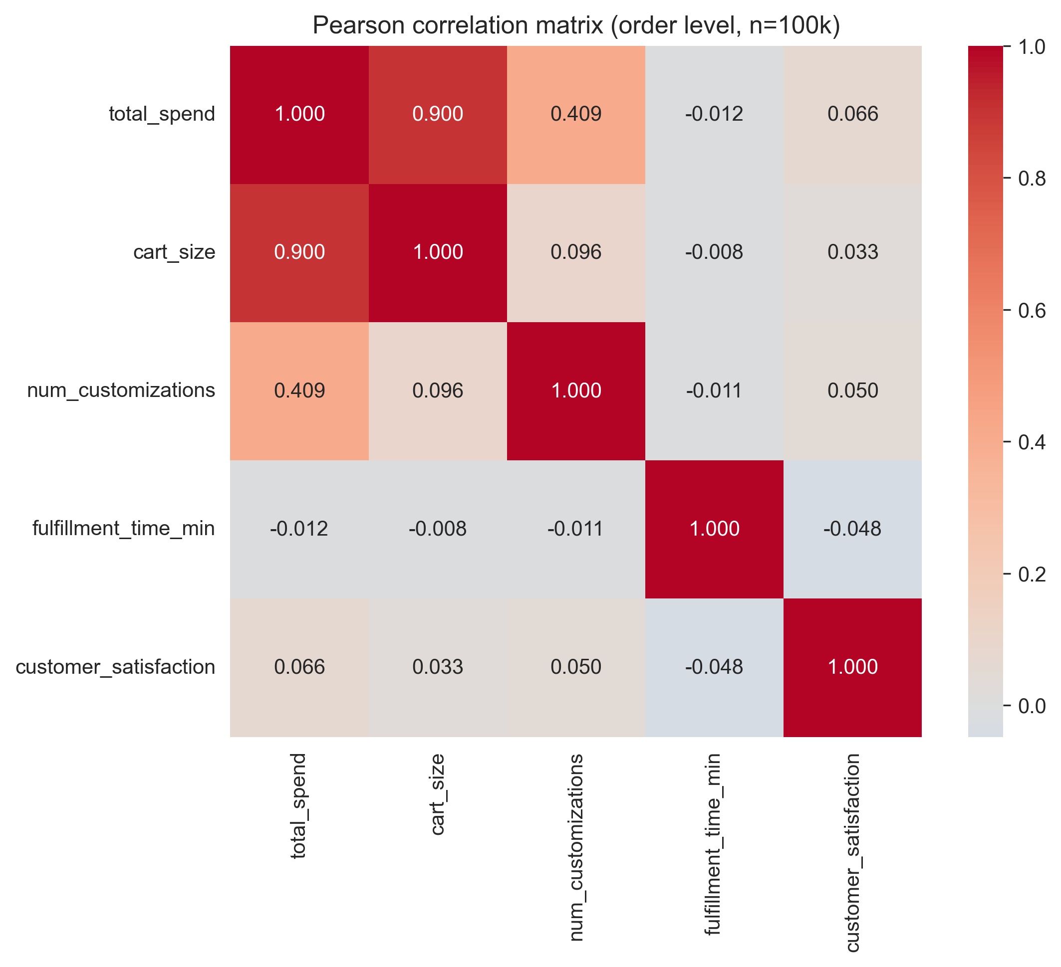
CHAPTER FOUR · CORRELATION
Cart size, not customizations, is the dominant driver.
cart_size
r = 0.900
num_customizations
r = 0.409
customer_satisfaction
r = 0.066
fulfillment_time_min
r = -0.012
Cart size is near-deterministic for spend. Customizations matter, but only secondarily. Fulfillment time and satisfaction are essentially uncorrelated with spend.
05 / 16
Starbucks
Notes:
Moving to correlation. The order-level Pearson correlation tells a clean story. Cart size versus total spend is point-nine-zero-zero - that's the dominant numerical driver, almost a deterministic relationship. Number of customizations is secondary at point-four-zero-nine, still meaningful but much weaker. Fulfillment time and customer satisfaction are essentially uncorrelated with spend. So if you want to predict how much someone will spend, ask how many items are in their cart.

Slide 6
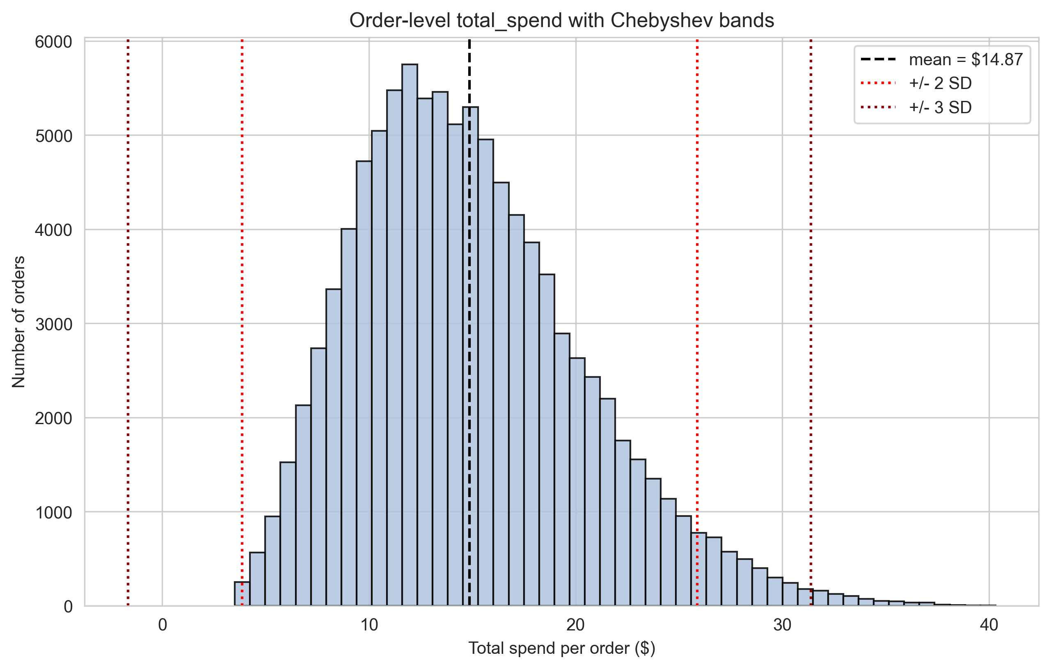
CHAPTER FIVE · DISTRIBUTION
Tighter than Chebyshev, but not quite normal.
95.83%
99.34%
of orders within ±2 SD
within ±3 SD
Empirical
Empirical
≥75%
right-skew
Chebyshev floor at 2 SD
moderate
Distribution-free
Normal underestimates the right tail
Because normality is imperfect, we use empirical probabilities - not the normal approximation - for tail events.
06 / 16
Starbucks
Notes:
Next, distribution shape and Chebyshev. Total spend is moderately right-skewed - the normal overlay misses the right tail, and the QQ plot bends upward. Empirically, ninety-five-point-eight-three percent of orders fall within two standard deviations of the mean, and ninety-nine-point-three-four percent within three. Chebyshev's inequality only guarantees seventy-five percent within two SDs, so our data is far tighter than the worst case. But because normality isn't perfect, we use empirical probabilities - not the normal approximation - for tail events.

Slide 7
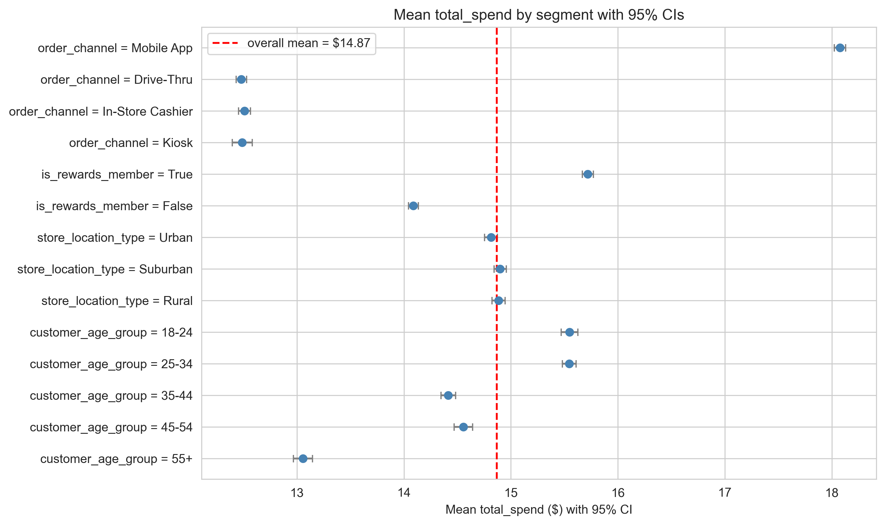
CHAPTER SIX · 95% CONFIDENCE INTERVALS
Mobile and Rewards bands don't overlap with the rest.
Segment
95% CI
Overall mean
[14.83, 14.90]
Mobile App
[18.02, 18.13]
Rewards
[15.67, 15.77]
Non-Rewards
[14.04, 14.13]
With n ≈ 100,000, intervals are narrow. The Mobile band sits well above every other channel - previewing the hypothesis tests.
07 / 16
Starbucks
Notes:
Confidence intervals make these segment differences concrete. The overall mean is between fourteen-eighty-three and fourteen-ninety with ninety-five percent confidence. Mobile App is eighteen-oh-two to eighteen-thirteen - a tight band well above everyone else. Rewards is fifteen-sixty-seven to fifteen-seventy-seven, non-Rewards is fourteen-oh-four to fourteen-thirteen. The intervals don't overlap, which previews what hypothesis testing will confirm.

Slide 8
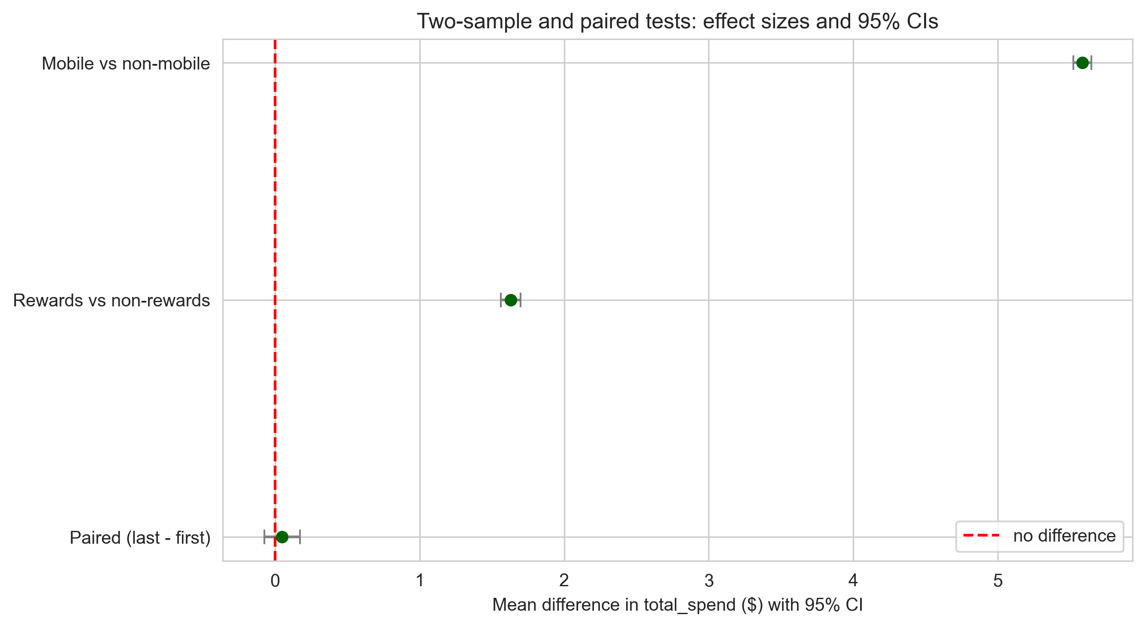
CHAPTER SEVEN · HYPOTHESIS TESTING
Four tests, four verdicts.
Test
Diff
Stat
p
Decision
Mobile vs Non-Mobile
$5.58
t=175.91
≈ 0
REJECT H₀
Rewards vs Non-Rewards
$1.63
t=47.08
≈ 0
REJECT H₀
First vs Latest (paired)
~ 0
-
0.44
FAIL TO REJECT
>$20 high-spender Rewards vs Non
+8.6pp
z = 35.92
≈ 0
REJECT H₀
Mobile and Rewards differences are statistically significant . Repeat-customer spend is stable over time.
08 / 16
Starbucks
Notes:
Hypothesis testing - four tests, all decisive in the same direction. Mobile versus non-Mobile shows a five-dollar-fifty-eight average difference, t equals one-seventy-five-point-nine-one, p essentially zero - reject the null. Rewards versus non-Rewards shows a one-sixty-three difference, t equals forty-seven, p essentially zero - reject. The paired test on each customer's first versus latest order gives p equals point-four-four, so we fail to reject - repeat customers don't systematically drift up or down over time. Finally, a two-proportion z-test on whether an order is a high-spender - defined as more than twenty dollars - gives Rewards members an eight-point-six percentage-point higher rate than non-Rewards, with z equals thirty-five-point-nine-two and p essentially zero - clearly reject. Same direction, same conclusion across every test we ran.

Slide 9
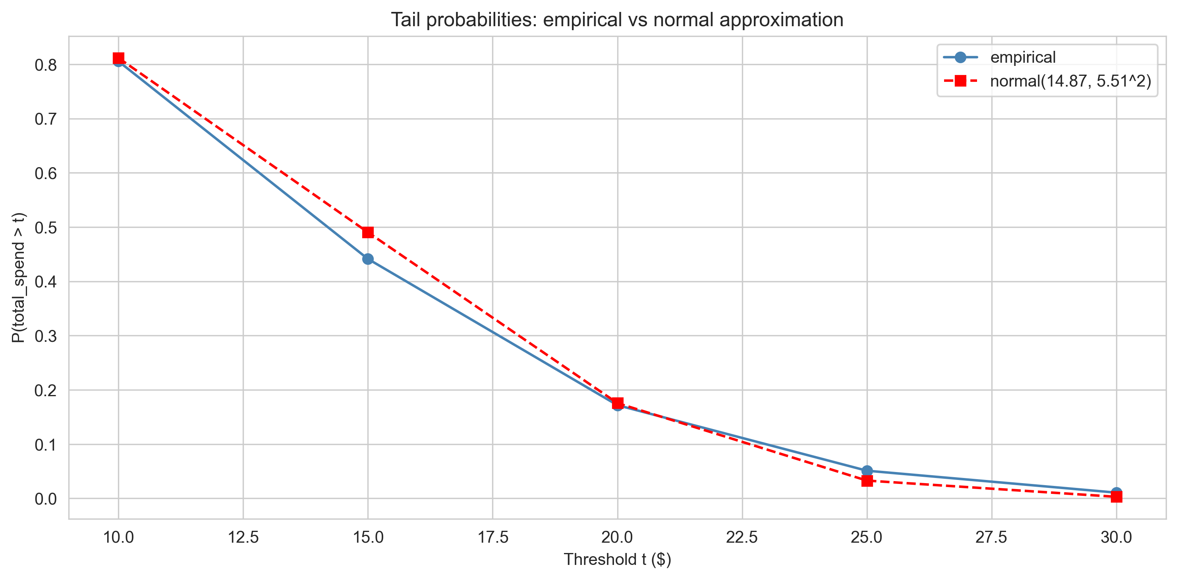
CHAPTER EIGHT · PROBABILITY & BAYES
High spenders are almost always Mobile.
5.11%
3.29%
P(spend > $25) empirical
Normal approximation (underestimates tail)
11.27%
93.85%
P(spend > $25 | Mobile)
P(Mobile | spend > $25) Bayes
And P(Rewards | spend > $25) = 62.74% - high spenders are disproportionately Mobile, Rewards customers.
09 / 16
Starbucks
Notes:
Probability and Bayes. Empirically, about five-point-one percent of all orders exceed twenty-five dollars. The normal approximation says three-point-three percent - it underestimates the right tail because of skew. Conditional on Mobile App, that probability jumps to eleven-point-three percent. And by Bayes' theorem, given an order is over twenty-five dollars, there's a ninety-four percent chance it came through the Mobile App, and a sixty-three percent chance the customer is a Rewards member. High-spender orders are overwhelmingly a Mobile phenomenon.

Slide 10
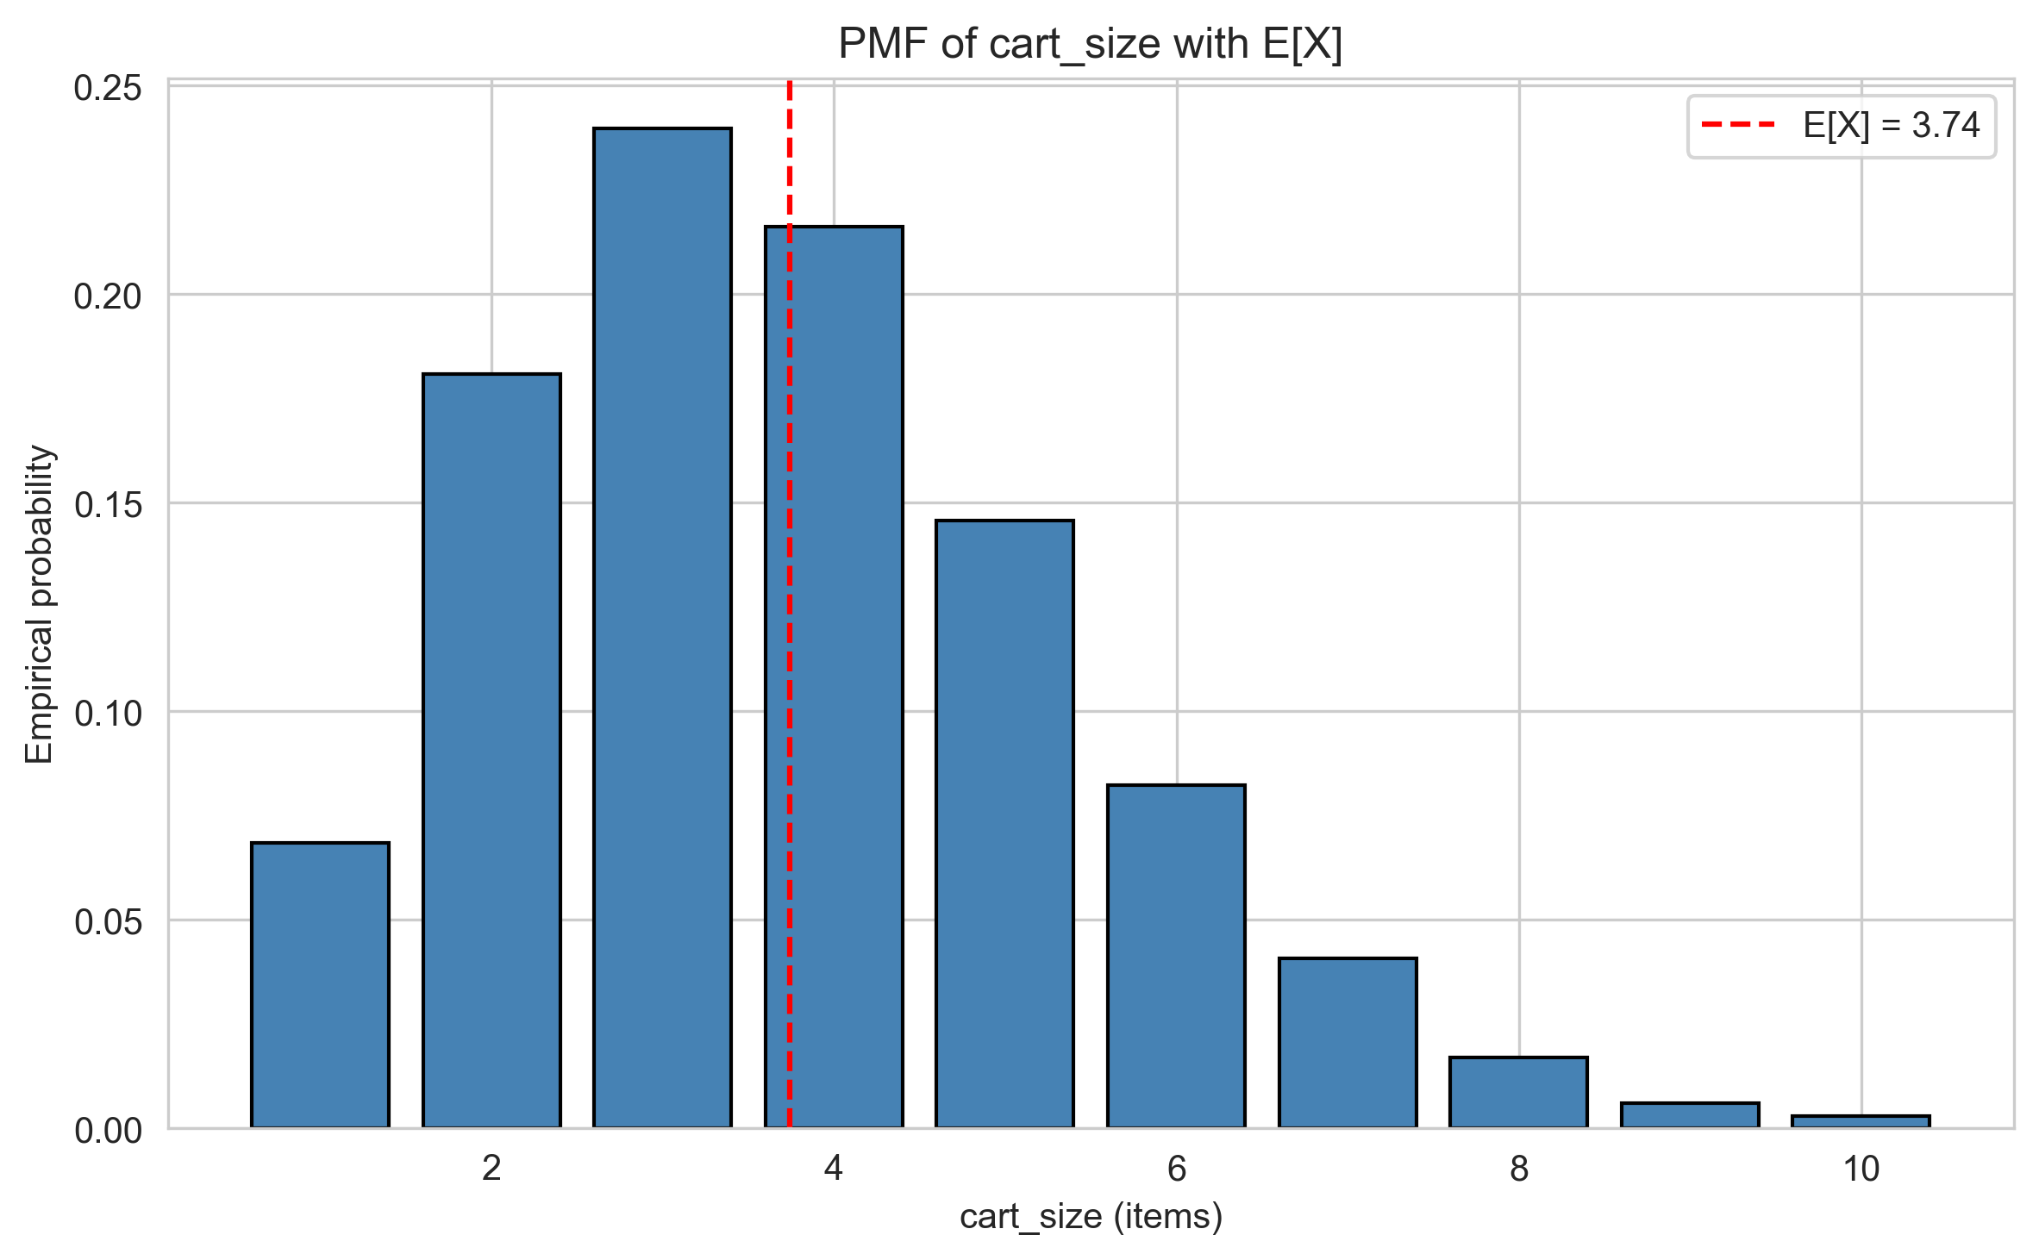
CHAPTER NINE · A DISCRETE RANDOM VARIABLE
Cart size, formally.
A discrete RV over {1, 2, … 10} - the unit of work behind every dollar of spend.
3.7415
E[cart_size] · expected items per order
2.8826
Var(cart_size)
Mode at 3 items, right-skewed tail to 10. Treating cart size as an RV ties the descriptive picture directly to the linear model on the next slide.
10 / 16
Starbucks
Notes:
We also treat cart size as a discrete random variable over the integers one through ten. The probability mass function peaks at three items, with an expected value of three-point-seven-four and a variance of two-point-eight-eight. This connects directly to the linear model coming up next - every additional item in the cart corresponds to a predictable bump in spend.

Slide 11
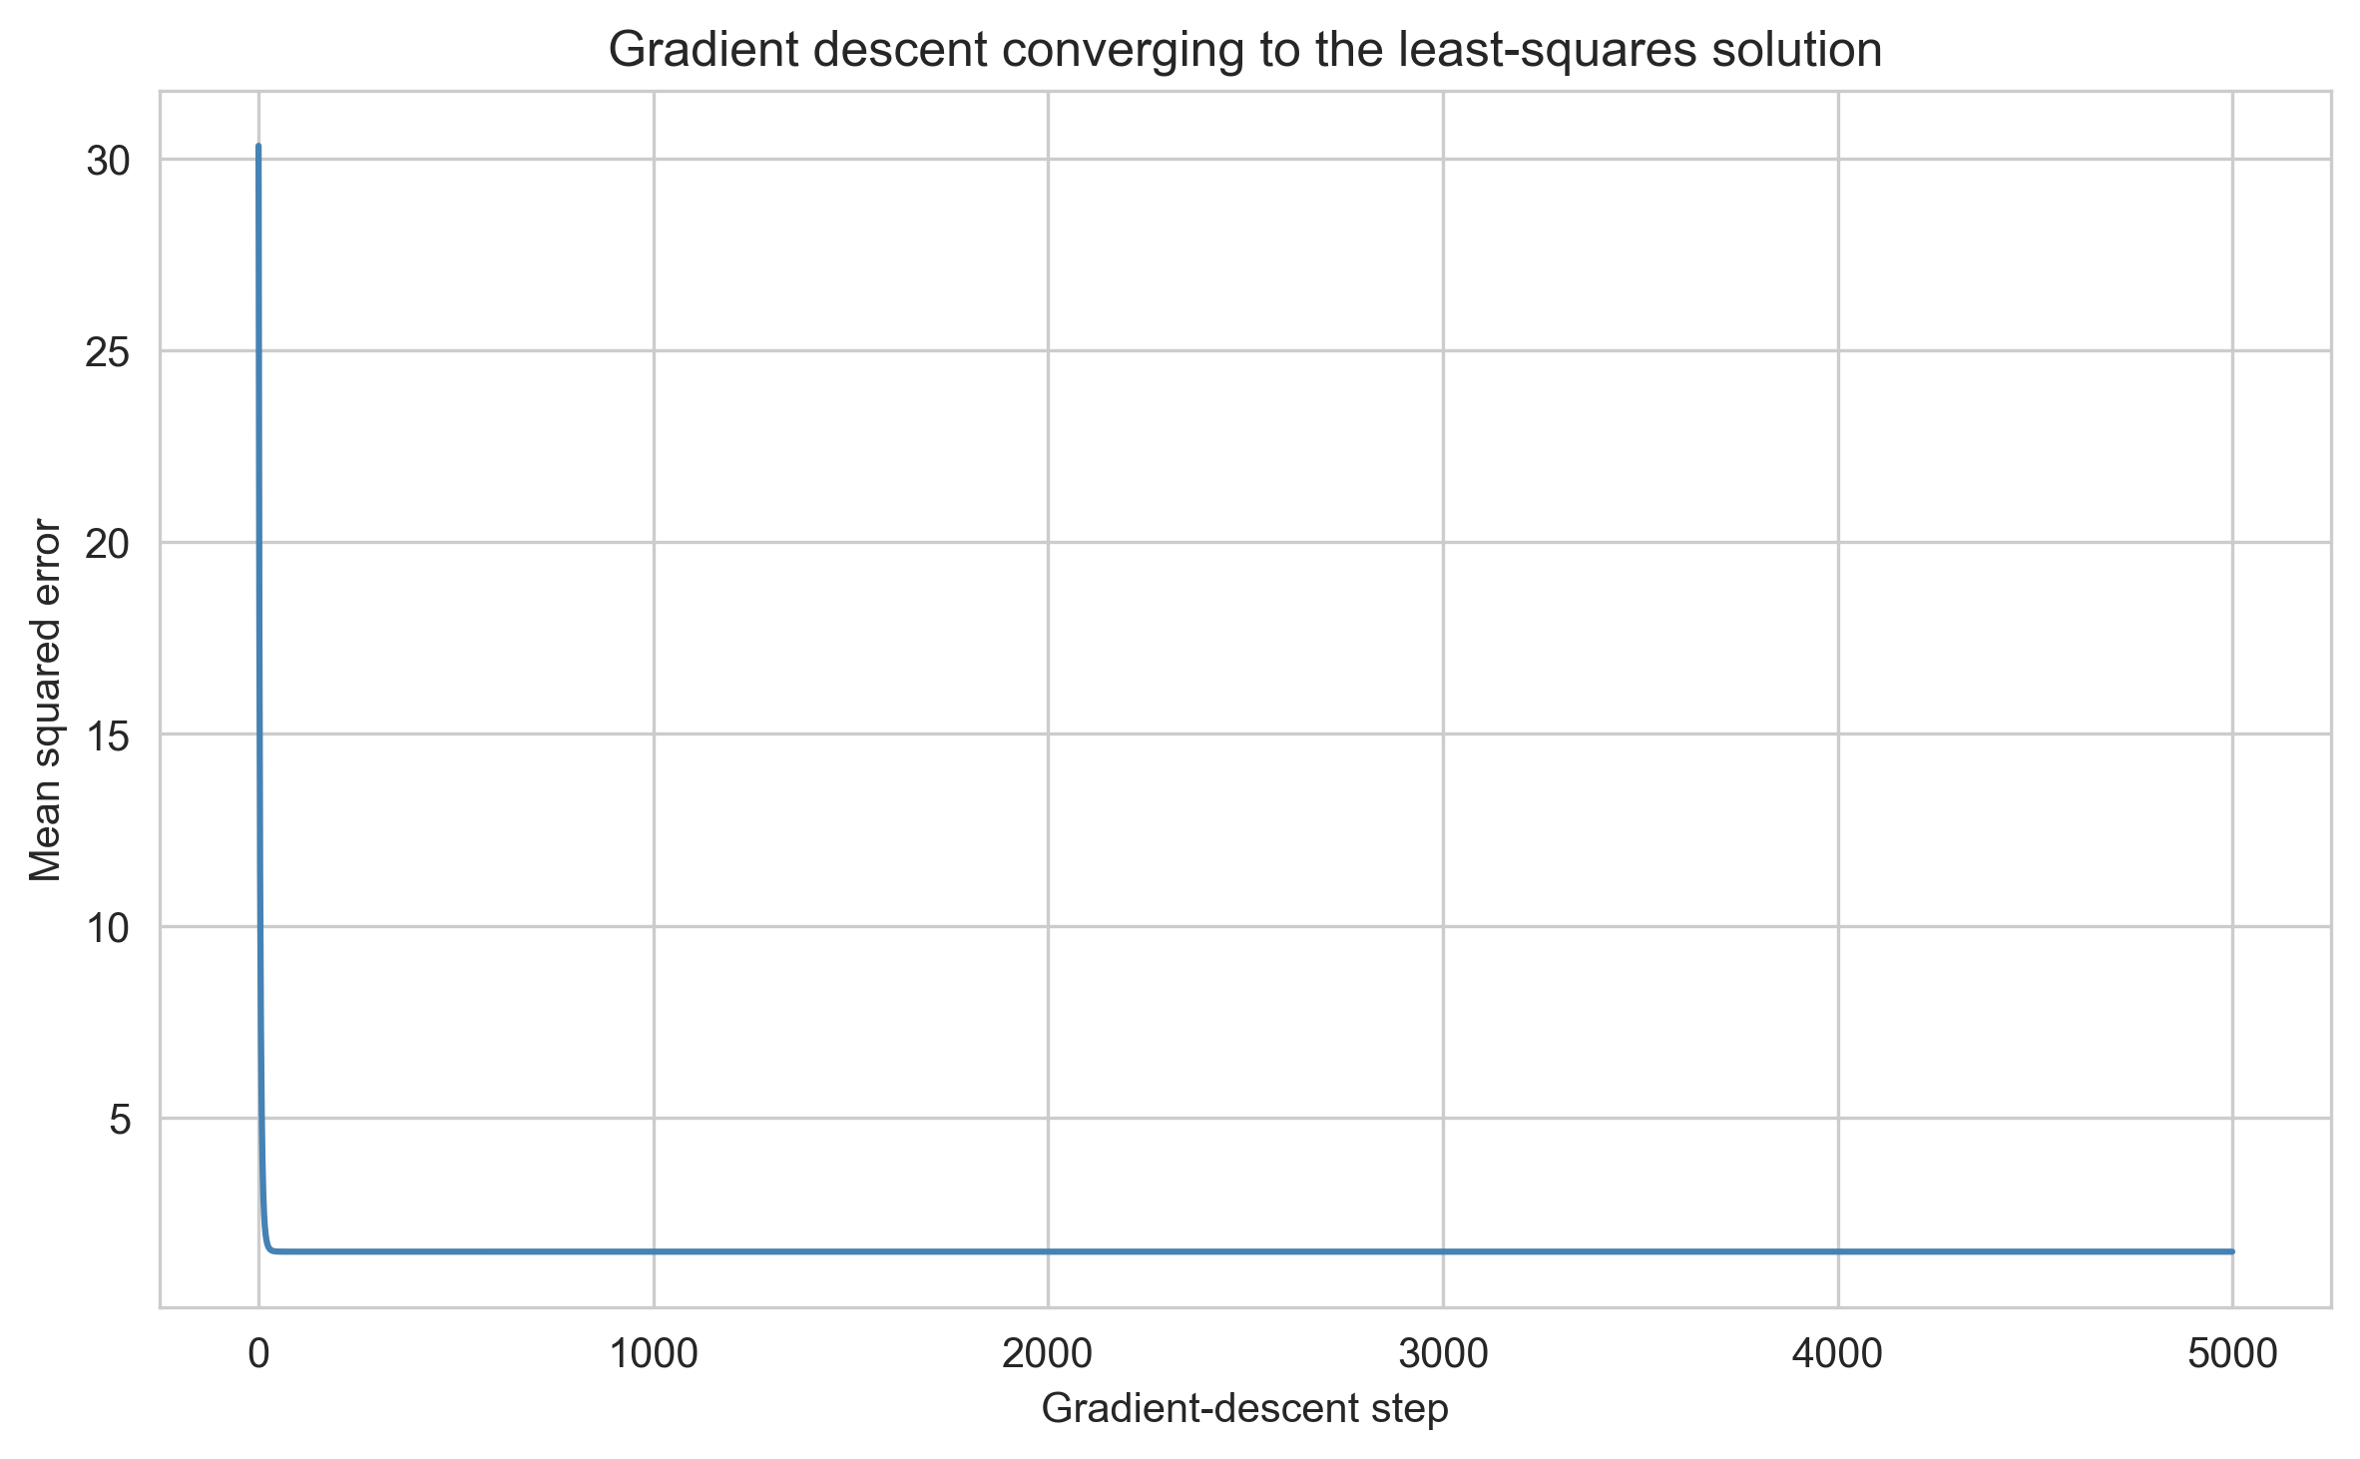
CHAPTER TEN · LINEAR ALGEBRA & OPTIMIZATION
A 3-feature model that explains 95% of spend.
ŷ = β₀ + β₁·cart_size + β₂·customizations + β₃·mobile_app
intercept (β₀)
+ 2.16
cart_size
+ 2.69 / item
num_customizations
+ 0.92 / mod
mobile_app
+ 2.33
R² = 0.9505
95% of variance in total_spend explained
Solved two ways - closed-form via the normal equations, iteratively via gradient descent. Both converge to the same coefficients.
11 / 16
Starbucks
Notes:
Linear algebra and optimization. We fit a linear model for total spend on cart size, number of customizations, and a Mobile App indicator. The intercept is two-sixteen, cart size adds two-sixty-nine per item, each customization adds ninety-two cents, and Mobile App membership alone adds two-thirty-three on top. R-squared is point-nine-five-zero-five - the model explains ninety-five percent of variance. We solved this two ways: closed-form via the normal equations, and iteratively via gradient descent. Both converge to the same coefficients, which is exactly the linear-algebra-meets-optimization story DATA 202 builds toward.

Slide 12
CHAPTER ELEVEN · BUSINESS INTERPRETATION
From coefficients to revenue levers.
Mobile App is the largest lever.
Cart size is the strongest predictor.
+$5.58 vs every other channel. 93.85% of high-spender orders come through Mobile.
r = 0.900 with spend. Each extra item adds $2.69 in the linear model.
Rewards is smaller but real.
High spenders are a Mobile phenomenon.
+$1.63 per order, statistically significant. Rewards members are 62.74% of high spenders.
Channel mix - not just menu - is what unlocks above-$25 orders.
12 / 16
Starbucks
Notes:
Putting business interpretation on top of the math. Mobile App is the largest revenue lever - bigger than rewards, bigger than store type, bigger than age. Cart size is the strongest numerical predictor, so anything that increases items per order matters. Rewards membership has a smaller but statistically significant effect. And high-spender orders - the most valuable segment - are overwhelmingly Mobile App orders.

Slide 13
CHAPTER TWELVE · DEPLOYMENT
From notebook to production.
01
02
03
04
Batch refresh
Online scoring
Drift monitoring
Scale
Recompute descriptive stats and refit the model on a regular cadence.
Predict expected spend at order time to drive personalized upsells.
Track Mobile share, Rewards effect, and high-spender probability over time.
Re-fit by store or region; same recipe, finer granularity.
The same three coefficients that explained 95% of variance in our notebook can power live recommendations in the Starbucks app.
13 / 16
Starbucks
Notes:
How would Starbucks actually deploy this? Batch refresh of the descriptive statistics and the model coefficients. Online scoring of expected spend at order time, which lets the app surface targeted upsells. Drift monitoring on the Mobile share, the Rewards effect, and the high-spender probability. And the whole pipeline scales naturally by store or by region.

Slide 14
CHAPTER THIRTEEN · LIMITATIONS
Honest about what we can't claim.
Sample representativeness. Kaggle data may not cover every real Starbucks store or geography.
Tail estimation. The Normal approximation underestimates the right tail of spend.
Independence. Repeat customers weaken strict independence assumptions in t-tests.
Paired test. Compares first vs latest order, ignoring unequal time gaps between them.
Normality testing. Shapiro–Wilk uses a 5,000-row subsample because of its sample-size cap.
Model simplicity. Three predictors only - intentionally course-aligned, not state of the art.
14 / 16
Starbucks
Notes:
We're honest about the limitations. The Kaggle dataset may not represent every Starbucks store. Repeat customers weaken strict independence assumptions in the t-tests. The Shapiro-Wilk normality test had to use a five-thousand-row subsample because of its size limit. The normal approximation underestimates the right tail. The paired test ignores unequal time gaps between a customer's first and latest order. And our linear model is intentionally simple - three predictors - to stay aligned with course concepts.

Slide 15
CHAPTER FOURTEEN · CONCLUSION
Mobile App and cart size drive spend.
Four findings that hold across every method we ran.
Mobile App and cart size are the dominant drivers of spend per order.
Rewards membership is a smaller but statistically significant lift.
Empirical tail probabilities are more honest than the normal approximation for high spenders.
Methods align with DATA 202 - descriptives, correlation, hypothesis tests, Bayes, RVs, linear algebra, gradient descent.
Same conclusion from five different lenses - that's what makes the result trustworthy.
15 / 16
Starbucks
Notes:
To conclude. Mobile App and cart size drive spend. Rewards is a real but smaller effect. For high spenders, empirical tail probabilities are more honest than the normal approximation. Every method we used - descriptive statistics, correlation, Chebyshev, hypothesis tests, Bayes, PMFs, linear algebra, gradient descent - comes straight out of DATA 202. The story holds together end to end.

Slide 16

- END OF PRESENTATION -
Thanks a latte.
QUESTIONS · DISCUSSION
Naman · Priya · Sanjana · Varuna
DATA 202 · Final Submission · May 2026
Notes:
Thanks a latte. Happy to take any questions.

