Slide 1
GROUP 6 · DATA 230 · LECTURES 4 AND 5
Same season,
12 charts.
The 2026 Formula 1 season through color scales and chart choice.
Tara · Eliza · Naman · Steven | September 30, 2026
Notes:
Who we are, what we cover: Lecture 4 (color scales) and Lecture 5 (directory of visualizations), all on one real dataset.

Slide 2
THE SEASON SO FAR
Two teammates, one title
302
236
vs
Kimi Antonelli, Mercedes
George Russell, Mercedes
15 of 23
330
469
23
races run, through Azerbaijan
race results
pit stops
circuits on 5 continents
Group 6 · F1 2026 · DATA 230
2
Notes:
Hook: after 15 races Antonelli leads his own teammate by 66 points. How do you show a season like that? Data: F1DB, open source, CC BY 4.0, updated after every race.

Slide 3
ACT 1 · LECTURE 4
Color has three jobs.
Distinguish
Represent values
Highlight
4.1 qualitative scales
4.2 sequential and diverging
4.3 accent colors
Group 6 · F1 2026 · DATA 230
3
Notes:
We start with the colors F1 itself uses, show they fail, fix them, then use color for values and for highlighting.

Slide 4
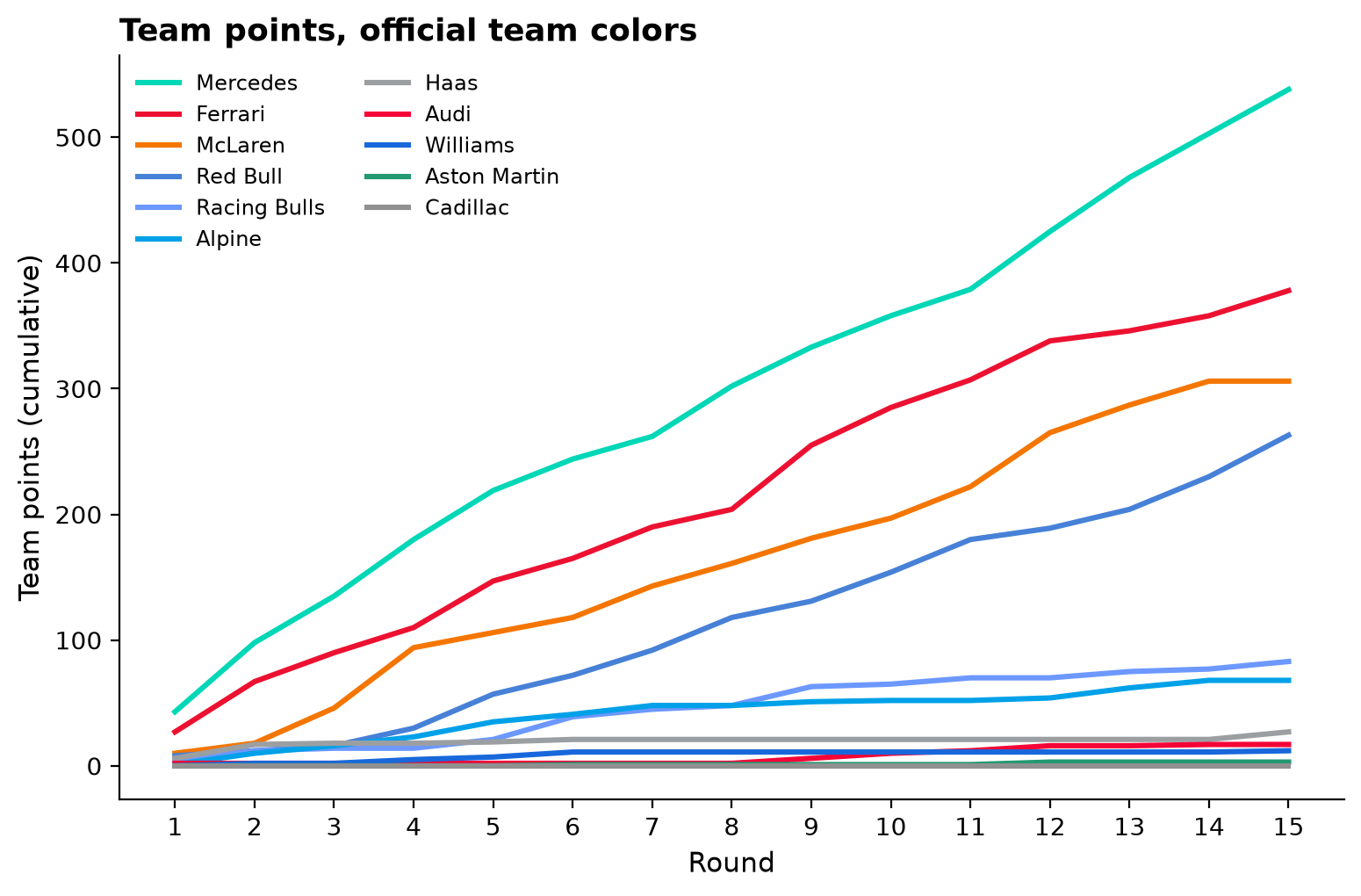
4.1 DISTINGUISH
The official team colors clash
CONCEPT
Qualitative scale, one color per team.
RESULT
Four blues, two reds, two grays. Matching the lower lines to the legend is guesswork.
SO WHAT
Brand colors are for marketing, not for telling groups apart.
Group 6 · F1 2026 · DATA 230
4
Notes:
Point at the bottom lines and ask the room which blue is Williams. Four blues: Red Bull, Racing Bulls, Alpine, Williams. Two reds: Ferrari, Audi. Two grays: Haas, Cadillac.

Slide 5
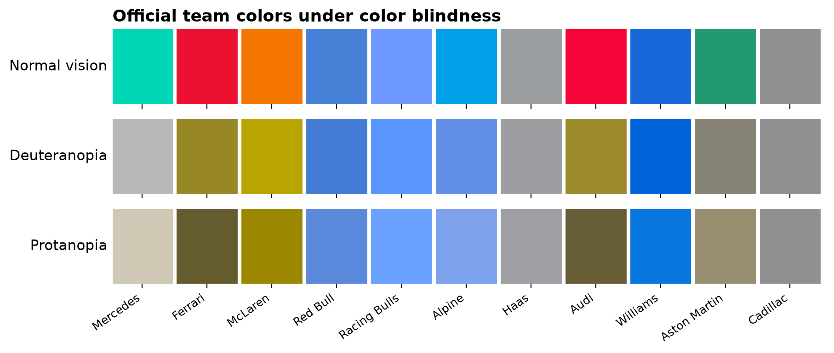
4.1 DISTINGUISH
And they fail for colorblind viewers
CONCEPT
A qualitative scale must work for everyone.
RESULT
Under deuteranopia Ferrari and Audi merge, Mercedes turns gray.
SO WHAT
About 1 in 12 men gets roughly 5 usable colors for 11 teams.
Group 6 · F1 2026 · DATA 230
5
Notes:
Simulated with the Machado 2009 model. Merge this slide with the previous one if we run long.

Slide 6
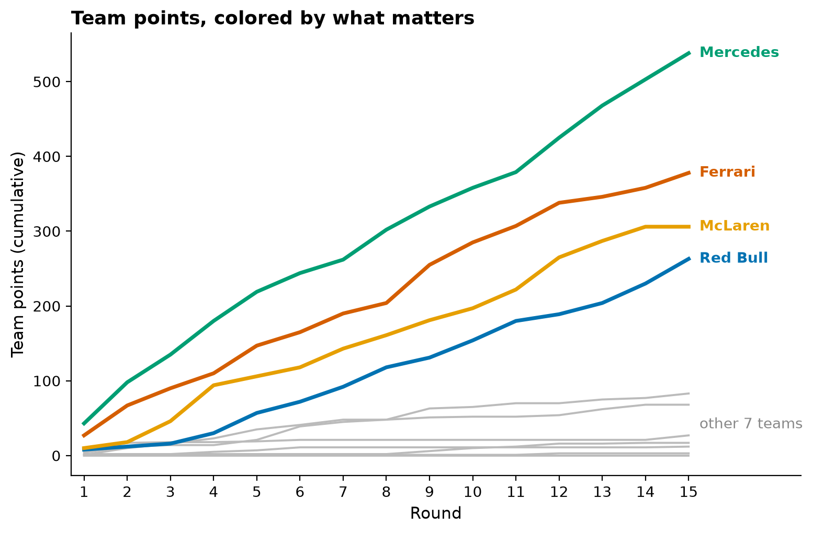
4.1 + 4.3
Fewer colors tell the story better
CONCEPT
Okabe-Ito for the top 4, gray for 7, direct labels.
RESULT
Mercedes pulls away. Ferrari and McLaren fight for P2. Red Bull closing. The rest stay under 90 points.
SO WHAT
Removing color made it clearer.
Group 6 · F1 2026 · DATA 230
6
Notes:
Same data, same chart type as slide 4. Okabe-Ito has 8 colors, 11 teams is too many anyway. Direct labels replace the legend.

Slide 7
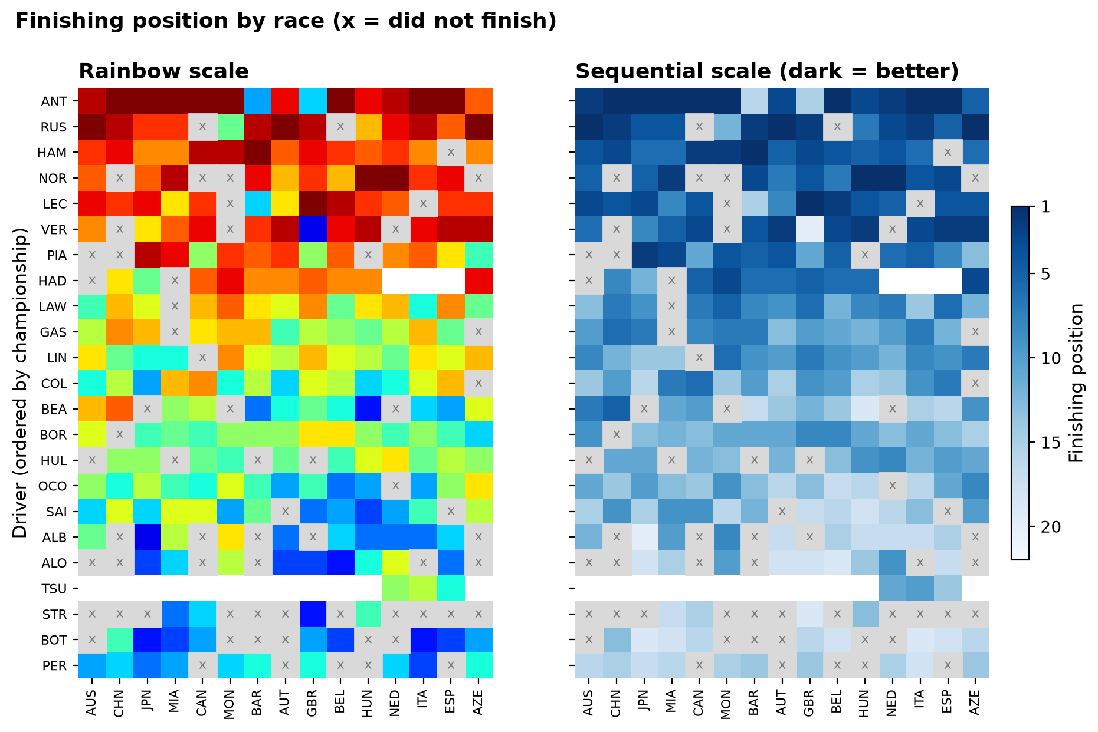
4.2 REPRESENT VALUES
Rainbow scales invent boundaries
CONCEPT
Sequential scale for ordered data.
RESULT
Rainbow makes P8 to P14 look special. Single-hue reads top to bottom. Gray x = did not finish.
SO WHAT
Sequential also exposes reliability: Stroll failed to finish 11 of 15.
Group 6 · F1 2026 · DATA 230
7
Notes:
Heatmap because 22 drivers x 15 races = 330 values; a line chart would be spaghetti. Drivers sorted by championship.

Slide 8
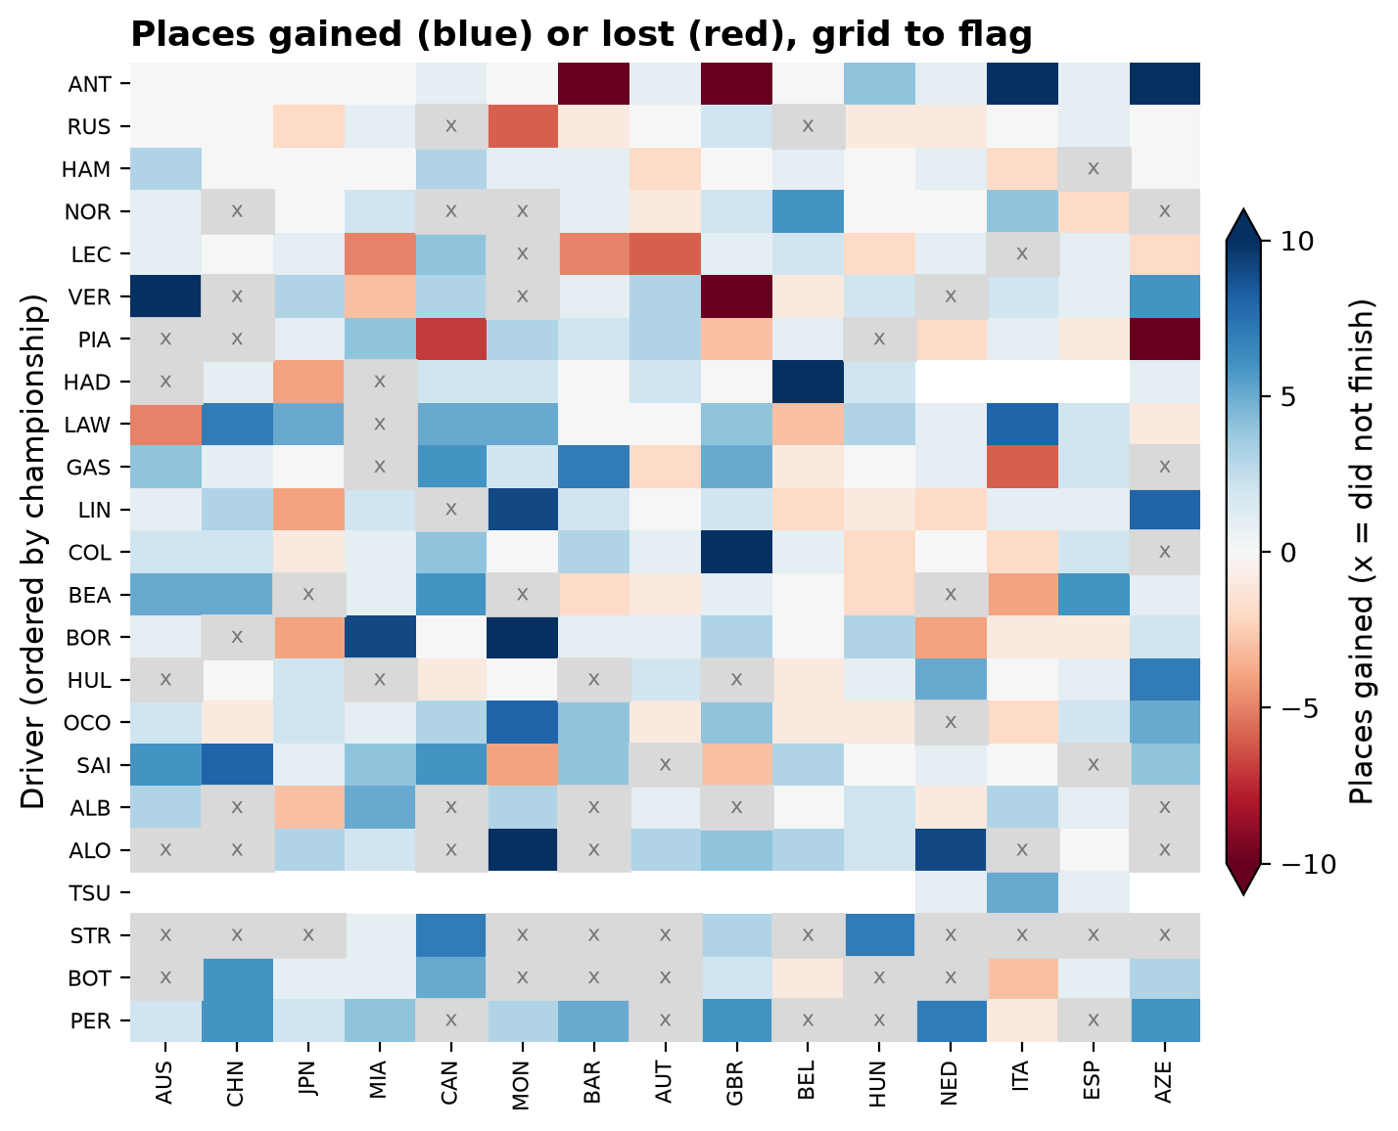
4.2 REPRESENT VALUES
Diverging splits gains from losses
CONCEPT
Diverging scale, because 0 = no change is a real midpoint.
RESULT
Blue = comebacks: Antonelli P19 to P1 at Italy, Hadjar P21 to P6 at Belgium. Front runners are white.
SO WHAT
You cannot gain places from pole.
Group 6 · F1 2026 · DATA 230
8
Notes:
Red-blue not red-green, for colorblind viewers. Capped at 10 places so a few big swings do not wash out the rest.

Slide 9
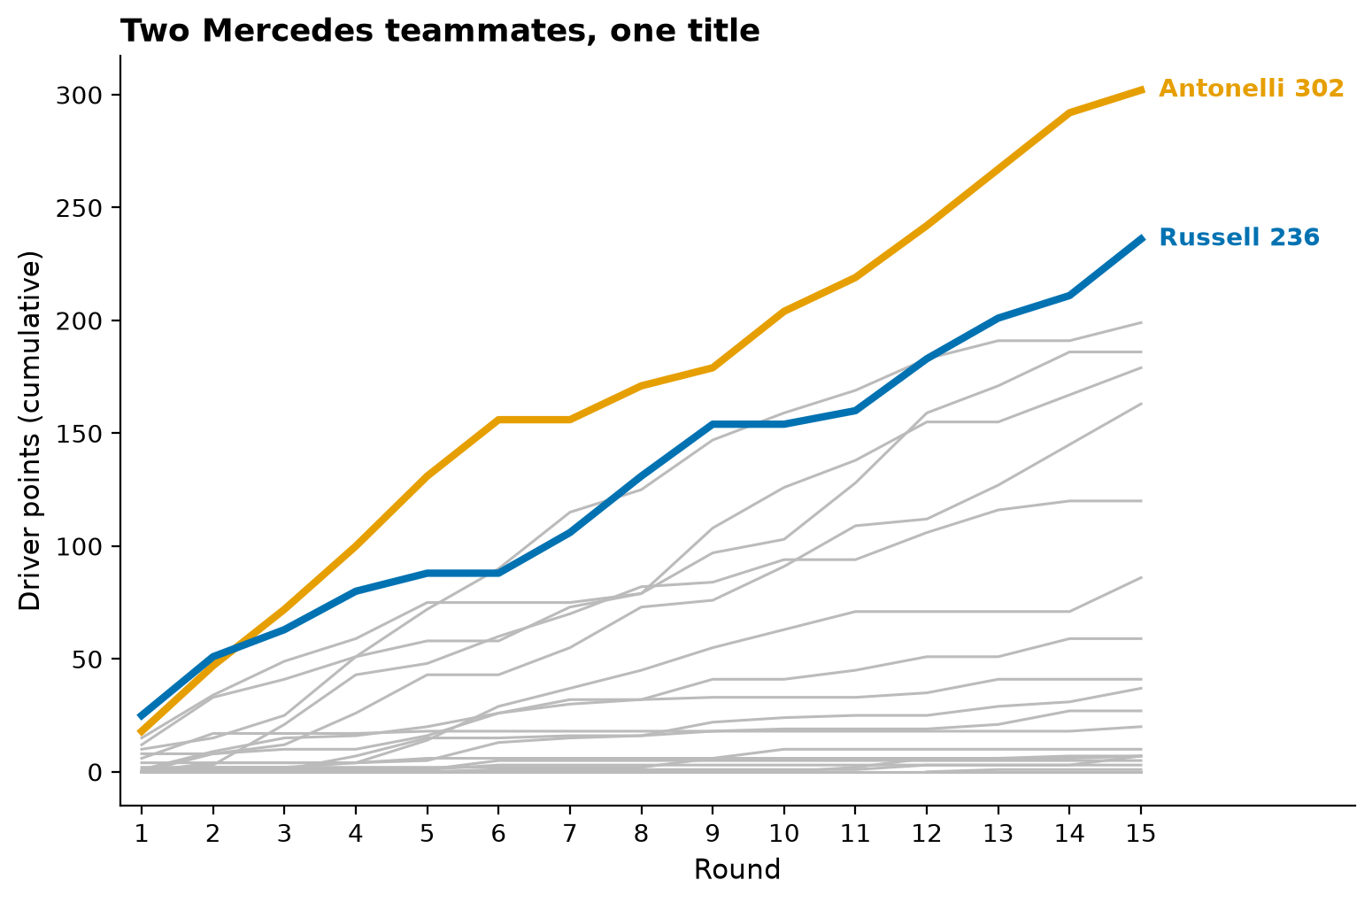
4.3 HIGHLIGHT
Gray is a color too
CONCEPT
Accent colors on gray context.
RESULT
Russell led rounds 1 and 2. Antonelli every round since, now 302 to 236.
SO WHAT
Pick the story first, then color it.
Group 6 · F1 2026 · DATA 230
9
Notes:
Both are Mercedes, so team color would make them identical. Orange and blue are the most separable Okabe-Ito pair.

Slide 10
LECTURE 4 TAKEAWAYS
Pick the job, then the scale
Distinguish
Represent values
Highlight
Colors people can tell apart, colorblind viewers included. Brand colors fail. Okabe-Ito and fewer groups fix it.
Ordered data: sequential. A meaningful middle: diverging. Rainbow adds fake structure.
Gray out the context, color the story, label directly.
Group 6 · F1 2026 · DATA 230
10
Notes:
Quick recap before Act 2. Keep it to 20 seconds.

Slide 11
ACT 2 · LECTURE 5
The question picks the chart.
Amounts
Distributions
Proportions
sorted bars
box + strip
stacked bars
x-y
Geospatial
Uncertainty
scatter + x = y
dot map
mean + 95% CI
Group 6 · F1 2026 · DATA 230
11
Notes:
Six questions a fan asks, six chart families from Lecture 5. The data type plus the question decides the chart.

Slide 12
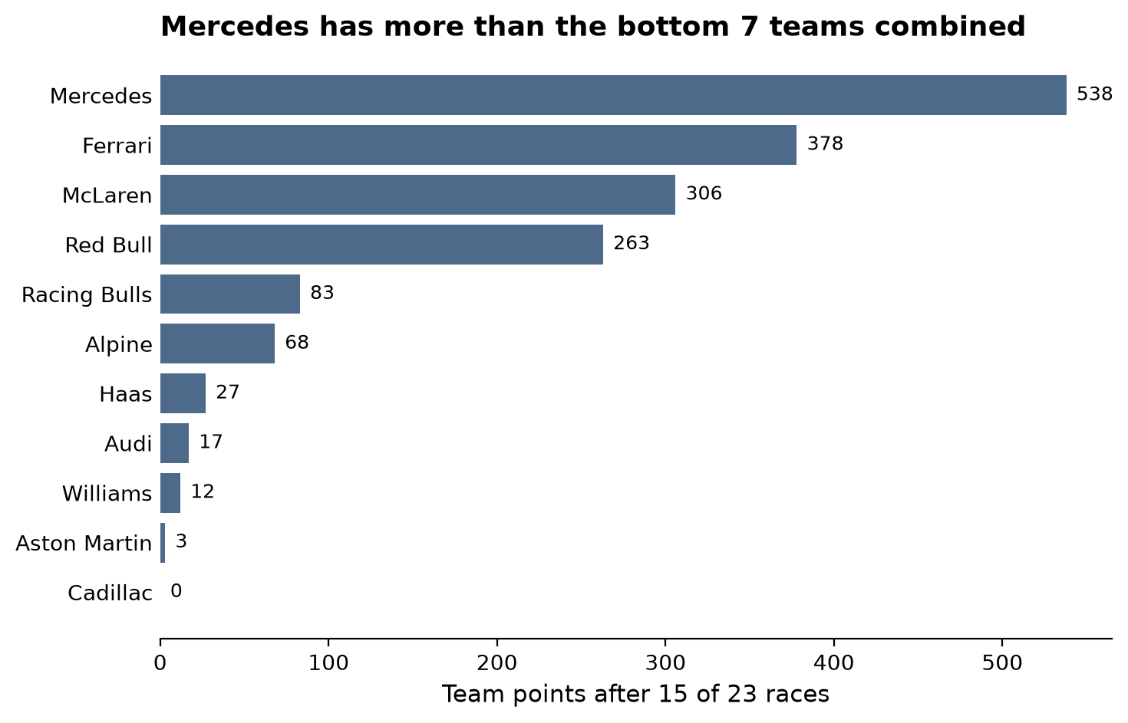
5.1 AMOUNTS
A four team championship
CONCEPT
Sorted horizontal bars, one color.
RESULT
Mercedes 538. A cliff after P4: the bottom 7 teams have 210 combined.
SO WHAT
The cliff after P4 is the headline.
Group 6 · F1 2026 · DATA 230
12
Notes:
Horizontal so team names read easily, sorted so the ranking is instant. One color, since color adds nothing here.

Slide 13
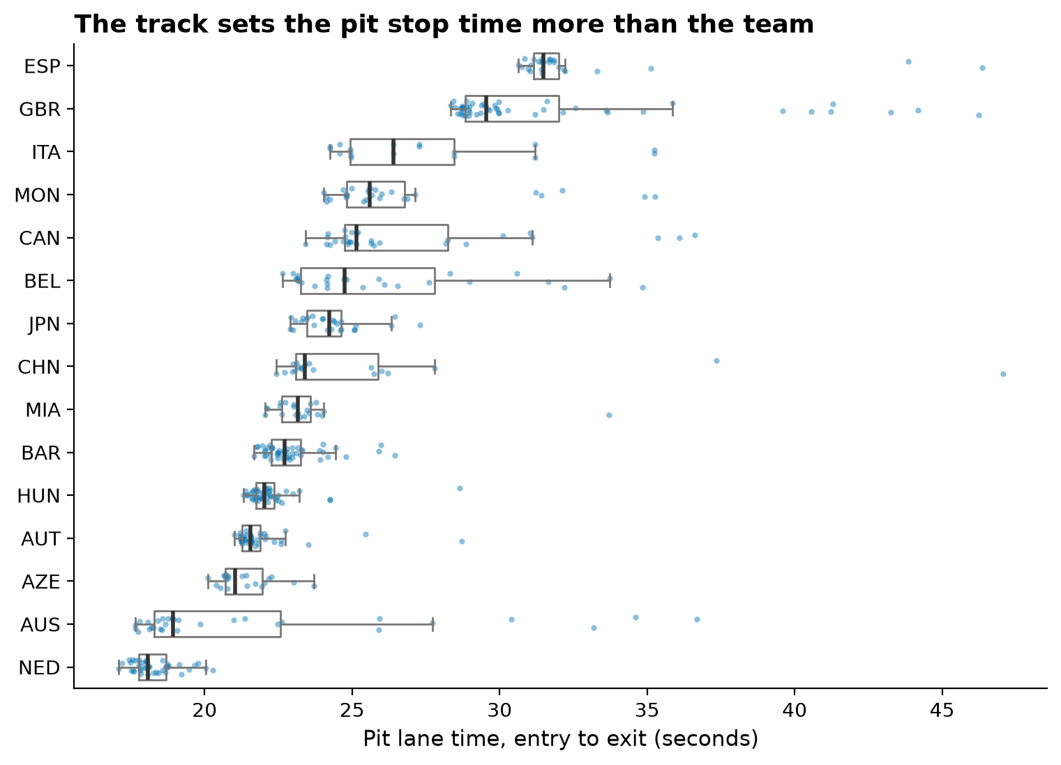
5.2 DISTRIBUTIONS
The track sets the pit stop time
CONCEPT
Many distributions at once: box + strip.
RESULT
Medians run 18 s (Netherlands) to 31 s (Spain). Within a race, most stops are within about 1.3 s.
SO WHAT
Pit lane length matters more than the crew.
Group 6 · F1 2026 · DATA 230
13
Notes:
These are pit lane times, entry to exit, not the 2 second tyre change. Dots show every stop so the box hides nothing. Sets up slide 17.

Slide 14
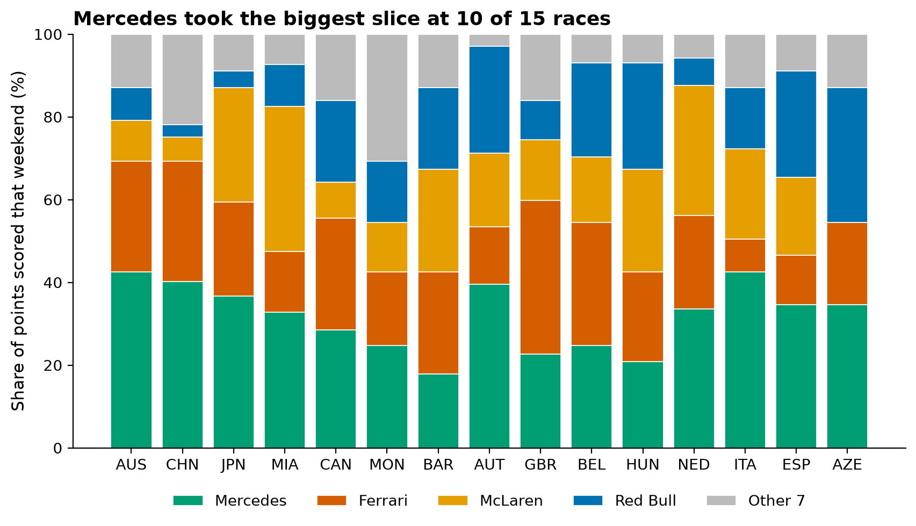
5.3 PROPORTIONS
Mercedes took the biggest slice
CONCEPT
100% stacked bars; 15 races is too many for pies.
RESULT
Biggest share at 10 of 15 weekends, about 32% on average. Red Bull stronger late.
SO WHAT
Stacked bars follow one team across all 15 races.
Group 6 · F1 2026 · DATA 230
14
Notes:
Mercedes sits at the bottom so it has the common baseline. 15 pies would make the comparison impossible.

Slide 15
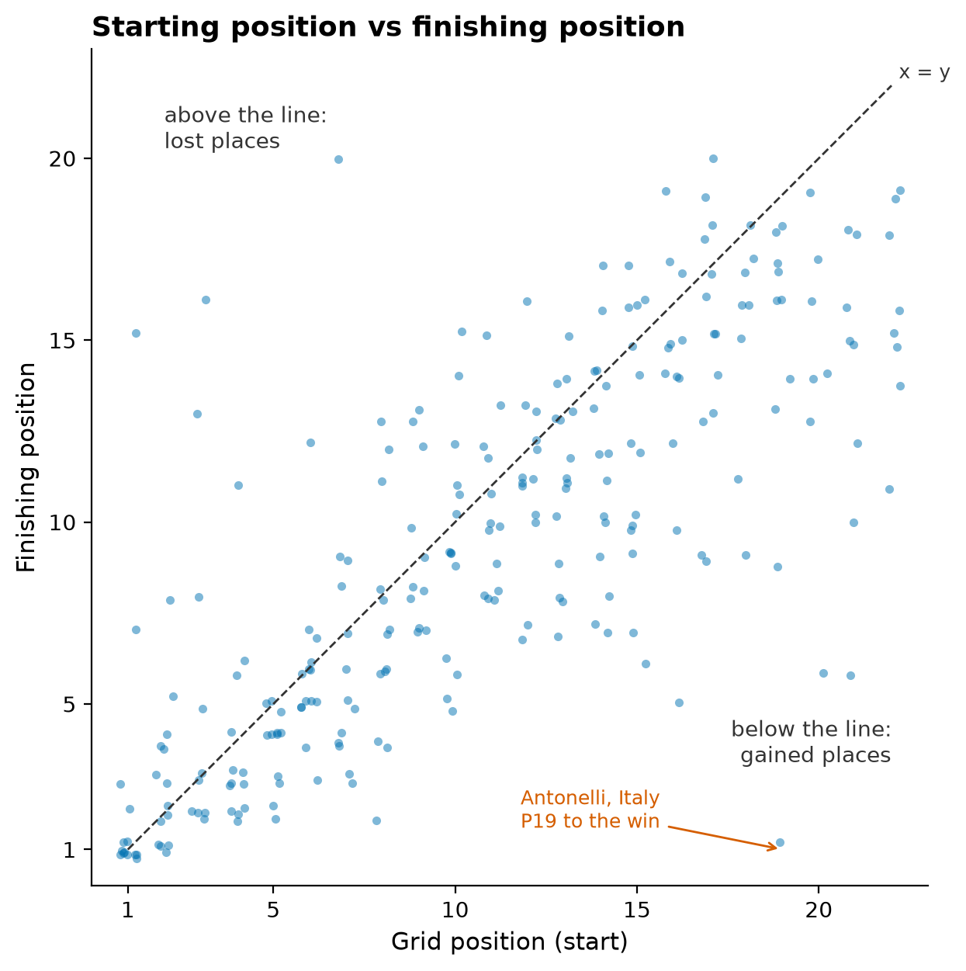
5.4 X-Y RELATIONSHIPS
Where you start mostly decides where you finish
CONCEPT
Scatter for paired data, with an x = y line.
RESULT
Spearman rho 0.78. Pole won 10 of 15. 61% finish within 2 places of their grid slot.
SO WHAT
Qualifying matters most at the front.
Group 6 · F1 2026 · DATA 230
15
Notes:
Below the line = gained places. Small jitter because positions are whole numbers. Antonelli at Italy, P19 to the win, is the outlier.

Slide 16
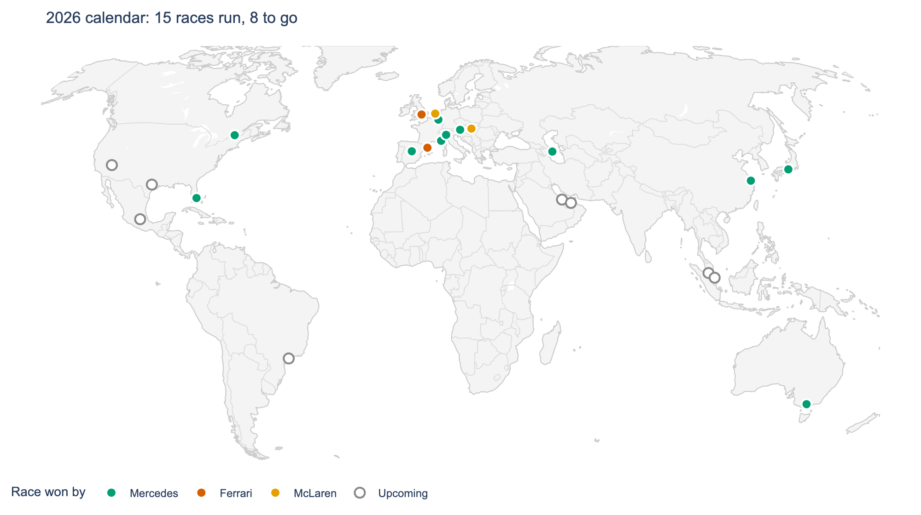
5.5 GEOSPATIAL
Mercedes wins everywhere
CONCEPT
Dot map (circuits are points), Robinson projection.
RESULT
Mercedes won on every continent so far. Ferrari and McLaren only in Europe. 8 races left, none in Europe.
SO WHAT
A map answers where; bars cannot.
Group 6 · F1 2026 · DATA 230
16
Notes:
Dot map not choropleth: a choropleth would color the whole US for 3 races and hide Monaco. The interactive version is in the demo.

Slide 17
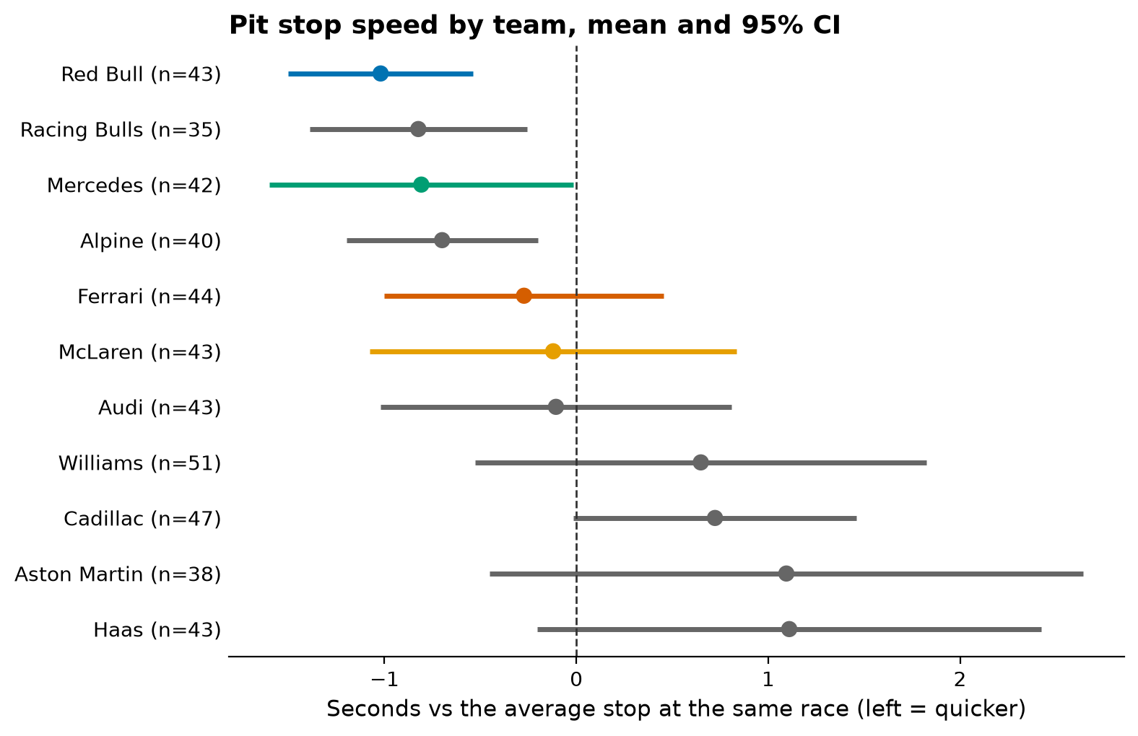
5.6 UNCERTAINTY
Only the ends of the ranking are real
CONCEPT
Mean + 95% confidence interval.
RESULT
Red Bull about 1 s quicker than average. Most teams' intervals cross 0.
SO WHAT
Without error bars we would rank all 11.
Group 6 · F1 2026 · DATA 230
17
Notes:
Each stop compared to the average stop at that same race, because slide 13 showed the track sets the time. 35 to 51 stops per team.

Slide 18
DEMO
Try the argument yourself
[screen recording plays here]
Pick any team or driver
Highlight it, everything else goes gray.
Flip to official colors
Watch the blues merge.
See it colorblind
Every chart, simulated.
Group 6 · F1 2026 · DATA 230
18
Notes:
Play the screen recording (about 60 to 90 seconds). Built with Streamlit plus a single offline HTML page, same clean data as the notebooks.

Slide 19
THREE TAKEAWAYS
Color has a job. Pick it first.
Less color is often better.
The question picks the chart.
Questions?
Data: F1DB v2026.15.1 (CC BY 4.0) · Python, pandas, matplotlib, plotly, Streamlit
Notes:
Close in 30 seconds, then open Q&A. The Q&A prep doc has short answers for the likely questions.

