Slide 1
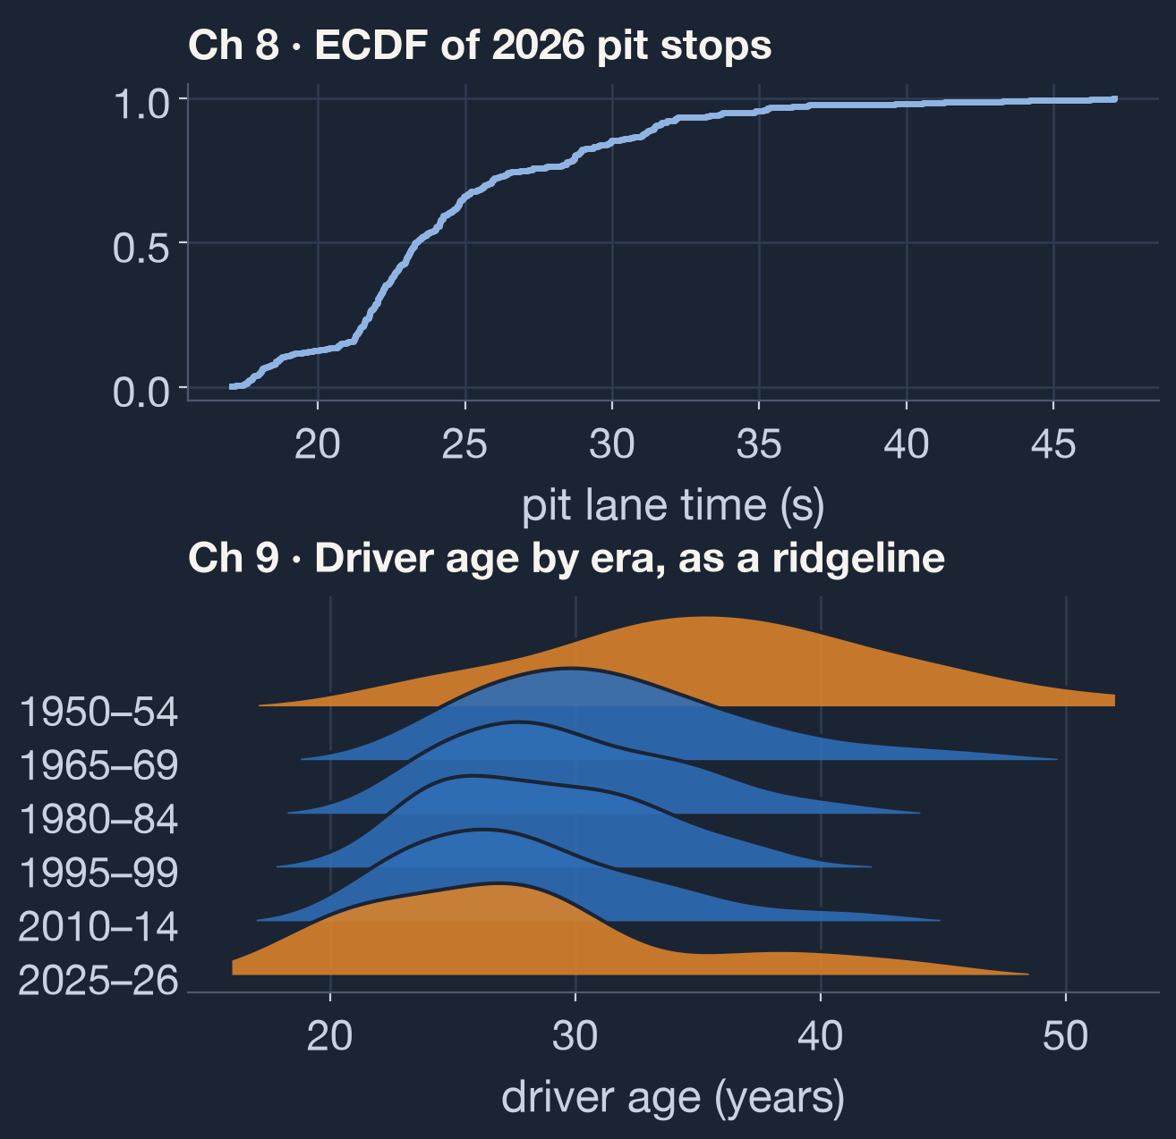
Visualizing Distributions
DATA 230 · WILKE, FUNDAMENTALS OF DATA VISUALIZATION
Chapter 8: ECDFs and Q-Q plots
Chapter 9: Many distributions at once
Applied to the 2026 Formula 1 season
Notes:
This deck covers chapters 8 and 9 of Claus Wilke's Fundamentals of Data Visualization. For each graph type we show how it is built, how to read it, and when it misleads, using real F1 data.

Slide 2
How do you show a distribution honestly?
ROADMAP
CHAPTER 8
CHAPTER 9
One distribution, every point
Many distributions side by side
ECDFs
Log–log ECDFs for skewed data
Q-Q plots
Boxplots and violin plots
Strip charts, jitter and sina plots
Ridgeline plots
Notes:
Chapter 8 covers a single distribution with plots that need no parameter choices. Chapter 9 covers comparing many distributions, here one per race.

Slide 3
The 2026 season, through Azerbaijan
OUR DATASET · F1DB V2026.15.1
469
15
917
pit stops, timed from pit entry to exit
races, Australia to Azerbaijan
drivers in F1 history since 1950
Same open dataset as our Lecture 4–5 deck. Charts made in Python with pandas and matplotlib.
Notes:
We reuse the F1DB release from our previous presentation. Pit lane times from 2026 are the main variable: one distribution for chapter 8 and fifteen, one per race, for chapter 9. Career totals for every driver give the heavy-tailed example in section 8.2.

Slide 4
Histograms and density plots interpret the data. ECDFs and Q-Q plots show it.
CHAPTER 8 · ECDFS AND Q-Q PLOTS
Change the bin width or bandwidth and the picture changes. ECDFs and Q-Q plots have nothing to tune and show every observation. The catch: they take more effort to read.
Notes:
A histogram depends on bin width and a density plot on bandwidth. Both summarize. ECDFs and Q-Q plots show all the data with no free parameters.

Slide 5
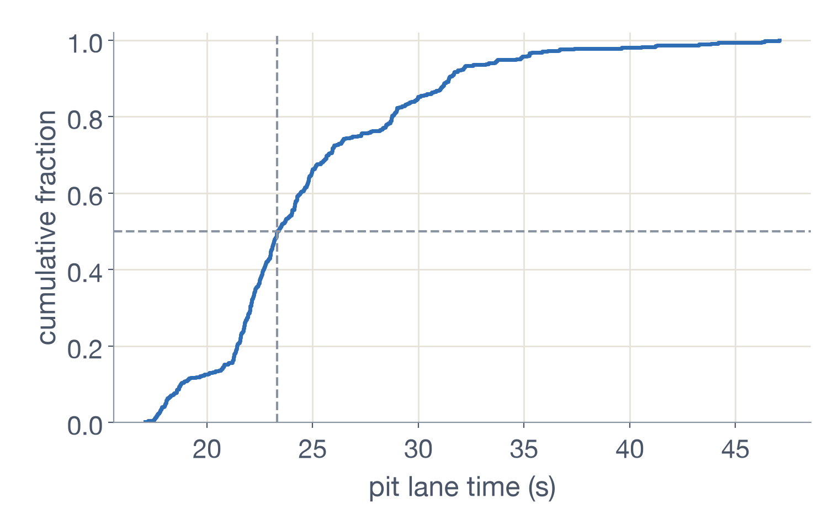
Building and reading an ECDF
8.1 · ECDF
How it's built
Sort all 469 pit stops from fastest to slowest.
Rank them 1 to 469 and plot rank against time.
Connect the points as a step line.
Divide each rank by 469, so the y axis shows the share of stops at or under each time.
Reading it
25%
23.3 s
20%
under 21.7 s
median stop
over 28.7 s
Notes:
Wilke's Figure 8.3 construction, applied to every 2026 pit stop. Read any percentile off the y axis: a quarter of stops took under 21.7 s, the median is 23.3 s (dashed lines), and a fifth took longer than 28.7 s. The flat stretches and jumps show the season mixes circuits with very different pit-lane lengths.

Slide 6
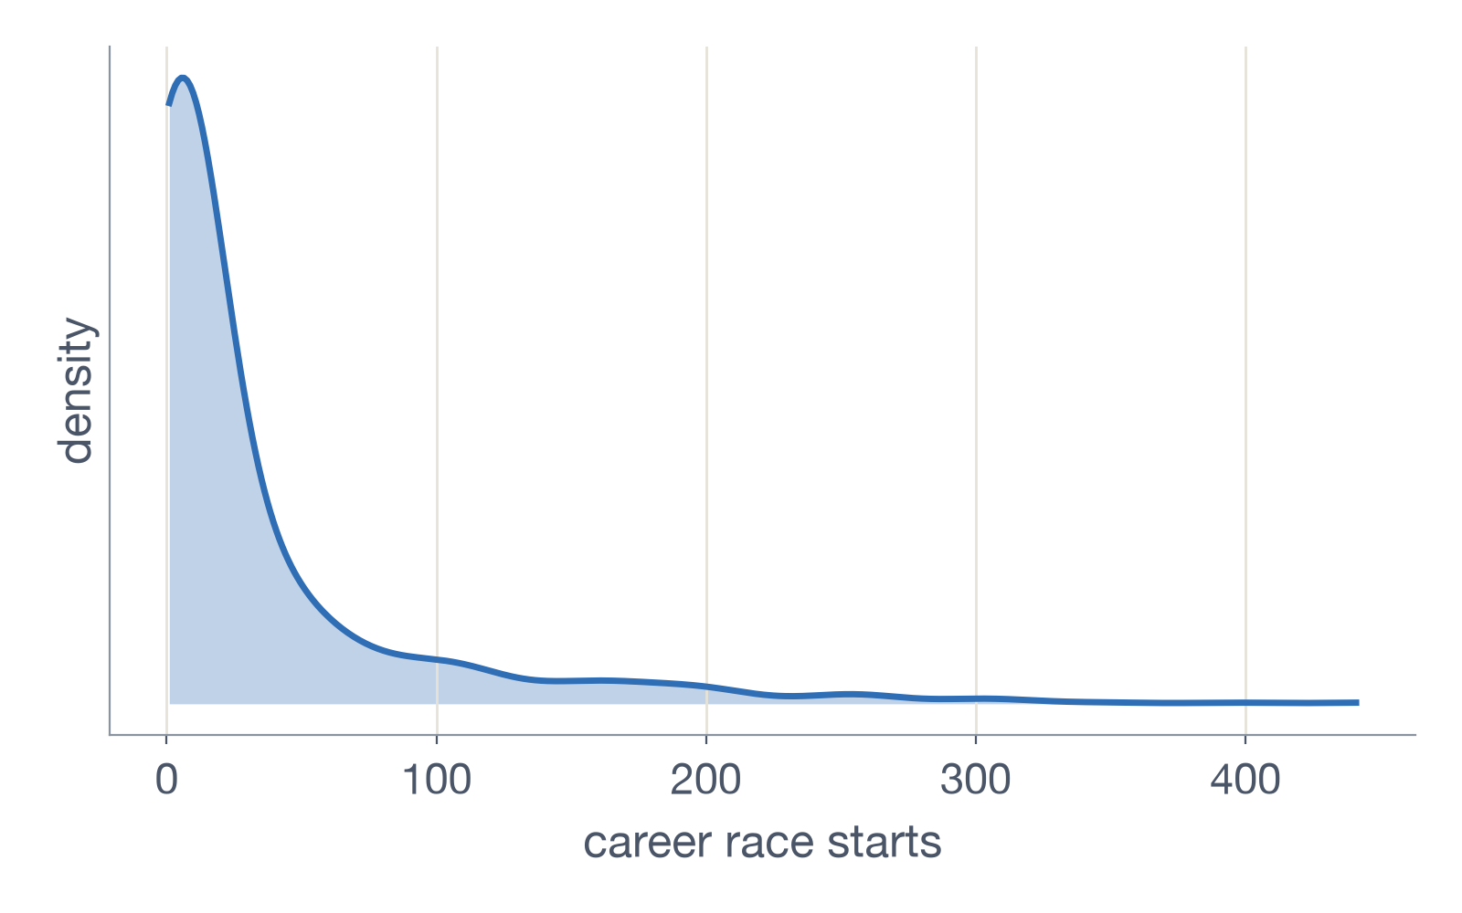
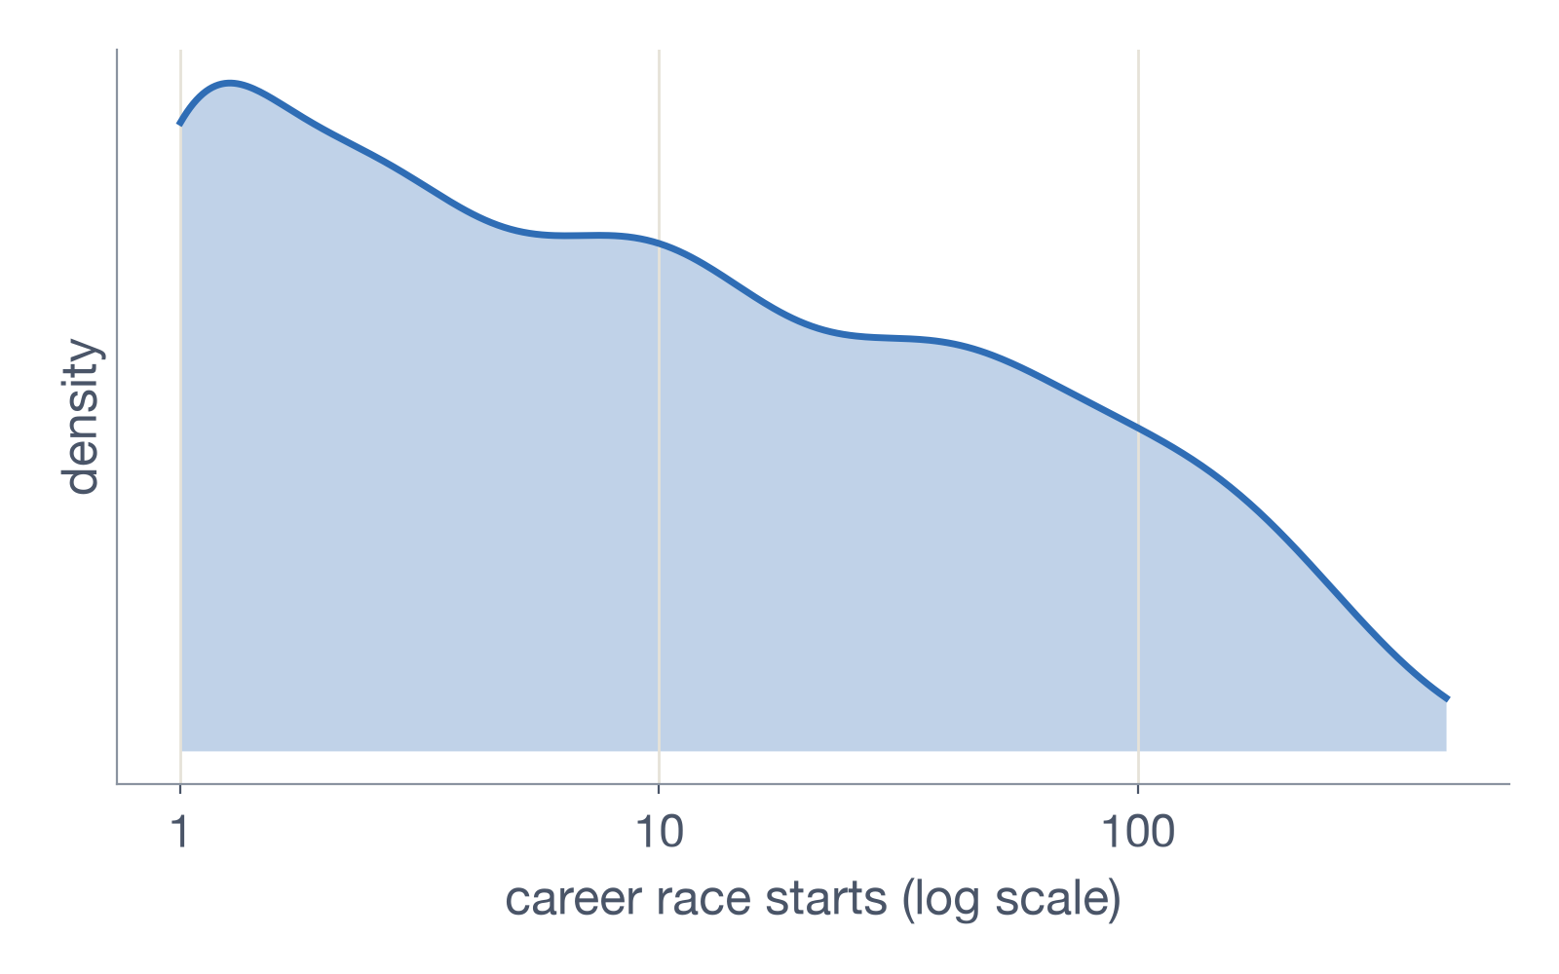
F1 careers have a heavy right tail
8.2 · HIGHLY SKEWED DISTRIBUTIONS
Linear scale: crammed near zero
Fix 1, log scale: readable, but not a bell curve
Notes:
The maximum is about 110 times the median. Career points are even more extreme: Lewis Hamilton has 5,217.5, while the median driver has zero. On a linear axis almost every driver is crammed near zero. A log scale makes it readable, but it is not a bell curve, unlike Wilke's counties, so careers are not log-normal. Drivers with zero starts are left out because log(0) is undefined.

Slide 7
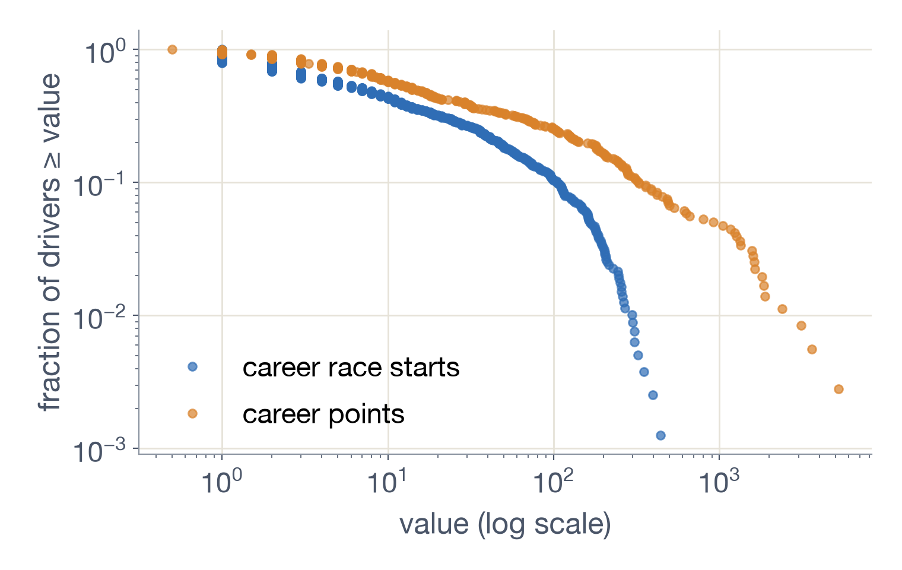
Fix 2: a log–log ECDF
8.2 · REMEDY 2
Plot the share of drivers with at least x, with both axes on a log scale.
Career starts drop off sharply past 100.
Career points stay straighter, but bend at the top too.
792 drivers with a start · 357 with points
Notes:
On log-log axes a power law is a straight line. Both F1 curves bend down, so the biggest careers are rarer than a power law predicts; the number of races a driver can enter limits career length.

Slide 8
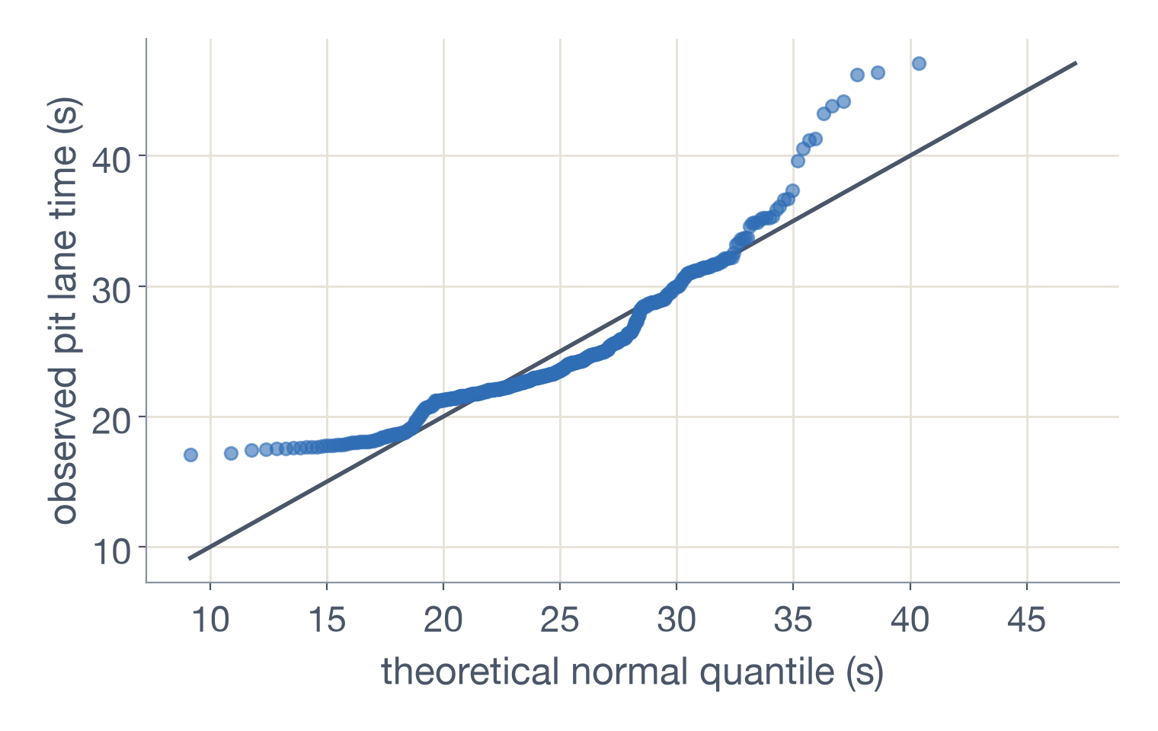
Q-Q plots: where points leave the line
8.3 · Q-Q PLOTS
What it shows
Bottom: flattens near 17 s. A normal curve expects 10 s stops, which never happen.
Top: slow stops shoot above the line, up to 47 s.
Middle: wiggles where whole races cluster.
Notes:
A Q-Q plot is an ECDF whose ranks are translated into the values expected under a reference distribution, here a normal curve with the stops' own mean (24.8 s) and SD (5.1 s). The line is a reference, not a fit. The story is where points leave it: a hard floor near 17 s and a long tail of slow stops. Log career starts show a flat run at 0 (162 one-race drivers) and a short top, so careers are not log-normal either.

Slide 9
Put the response on one axis and the groups on the other.
CHAPTER 9 · MANY DISTRIBUTIONS AT ONCE
RESPONSE VARIABLE
GROUPING VARIABLE
RUNNING EXAMPLE
Pit lane time (s), on the x axis
Each Grand Prix, on the y axis so the names are easy to read
469 stops across 15 races
Notes:
Wilke's running example is Lincoln, Nebraska temperatures by month; ours is pit lane time by race. Races go on the y axis because fifteen names are hard to read rotated on an x axis.

Slide 10
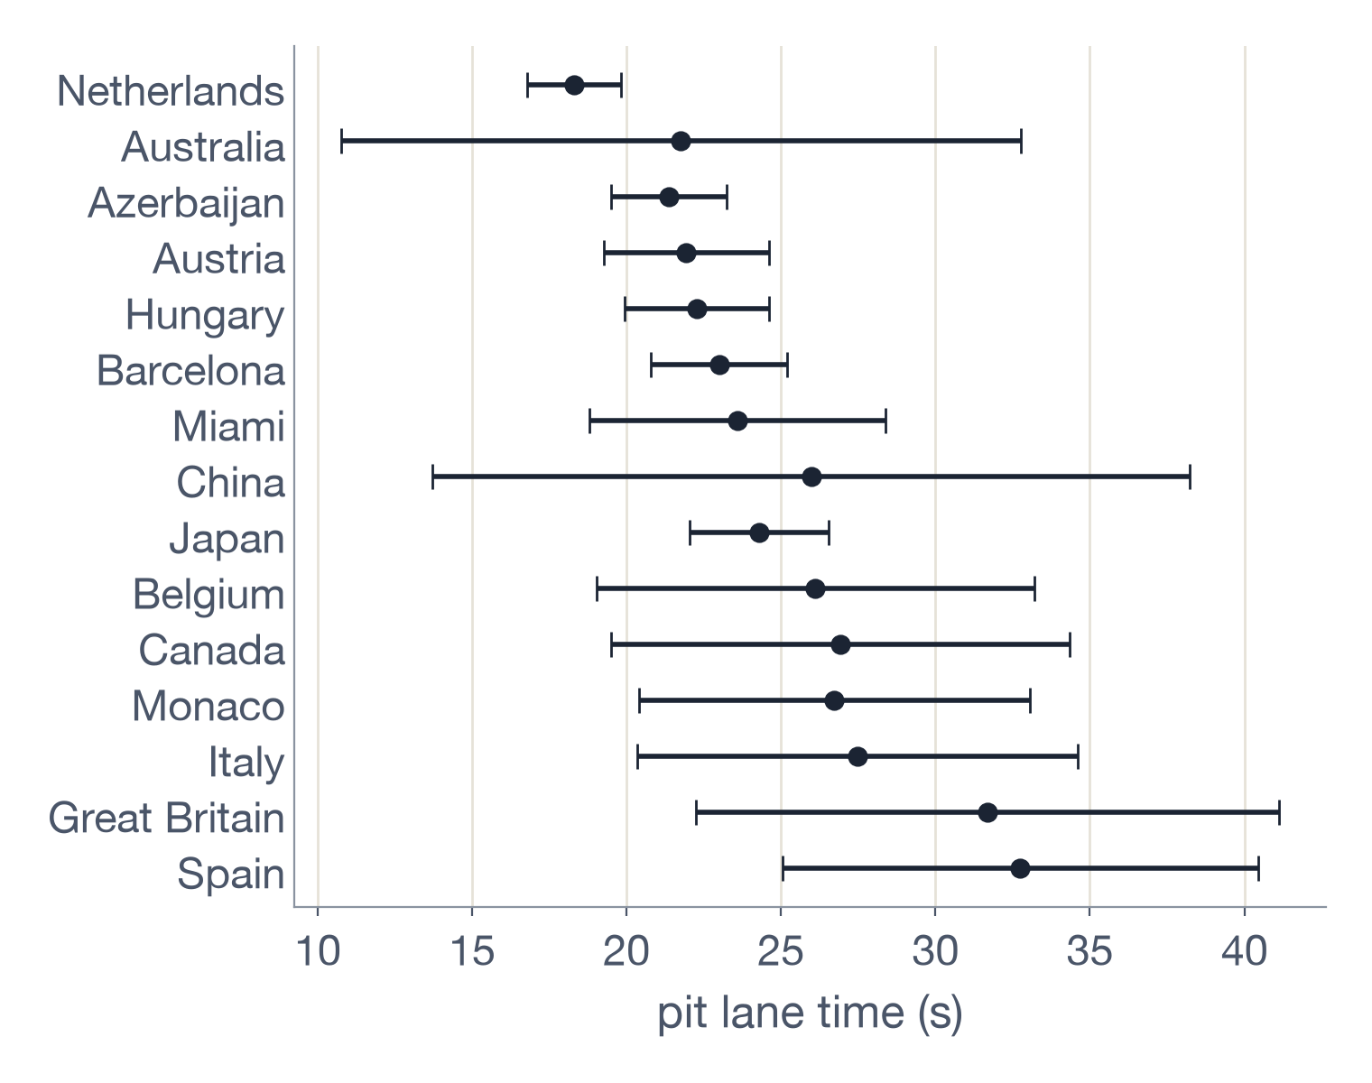
Error bars hide the distribution
9.1 · THE PLOT TO AVOID (FIG 9.1)
Throws data away
Up to 50 stops become a dot and two lines.
Mean or median?
The dot doesn't say.
Unclear bars
SD, SE or confidence interval? Readers mix them up.
Symmetric bars, skewed data
Australia's bar dips to 10.8 s. Its fastest stop was 17.6 s.
Notes:
This reproduces Wilke's 'bad' Figure 9.1 with our data. A few very slow stops inflate Australia's standard deviation, and the symmetric bar then implies impossibly fast stops. Error bars normally signal uncertainty in an estimate, not spread.

Slide 11
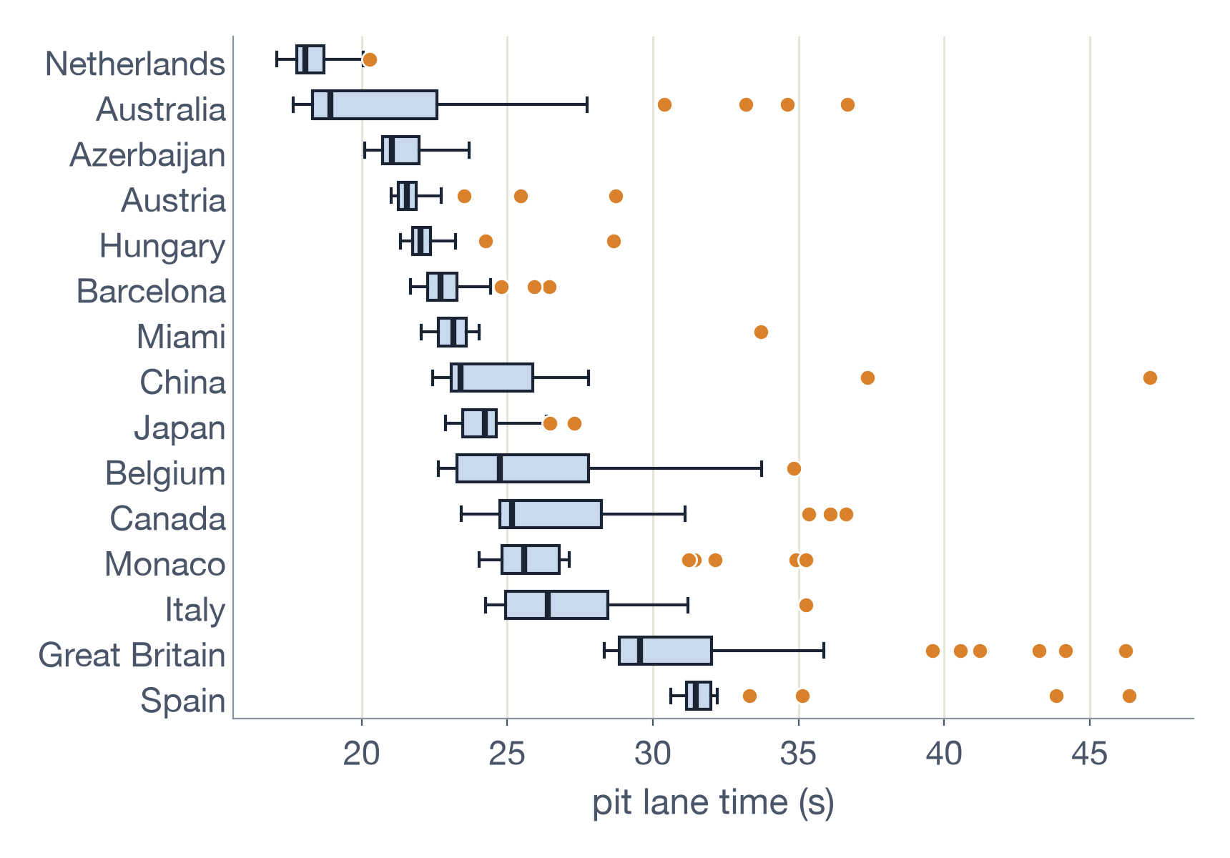
Boxplots sum up each race in five marks
9.1 · BOXPLOT (FIGS 9.2–9.3)
How it's built
Box: the middle 50%, line at the median.
Whiskers: out to 1.5 × the box length.
Beyond that: outliers, drawn in orange.
Invented by John Tukey, early 1970s.
In the 2026 data
Most races are tight; the Netherlands' middle 50% fits in under a second. Australia's median hugs the left edge of a long box: strong skew. Great Britain has the most slow stops.
Notes:
Unlike error bars, a boxplot shows skew. Its weakness: a box cannot show whether the data have one peak or two.

Slide 12
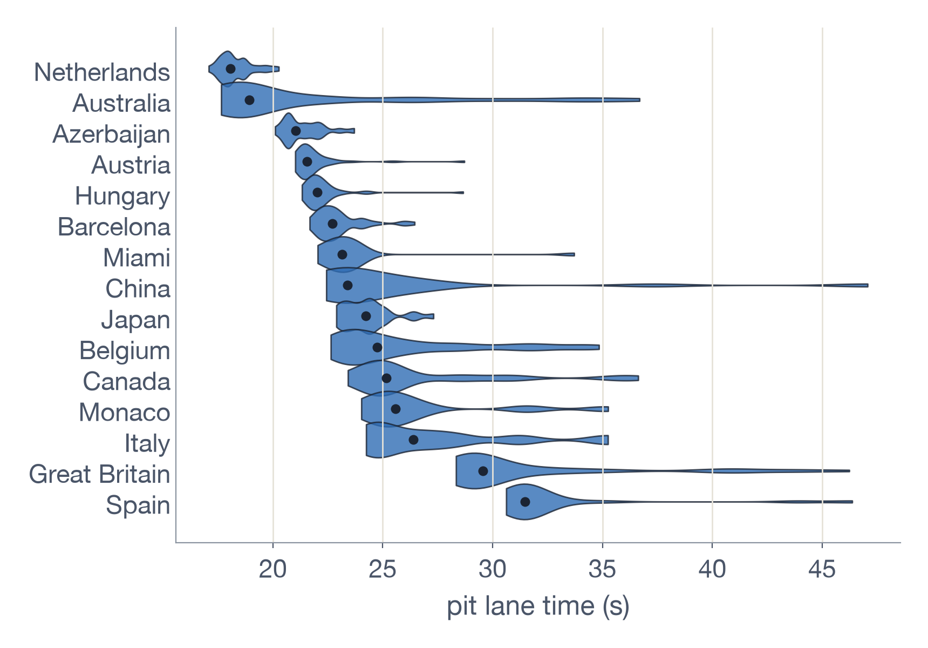
Violins show the shape that a box hides
9.1 · VIOLIN PLOT (FIGS 9.4–9.5)
How it's built
A density curve, mirrored.
Thicker means more stops at that time.
Dots mark the median.
In the 2026 data
Most races have one main bulge and a thin tail of slow stops.
Caveat: with only 18–50 stops per race, smoothing can stretch a few slow stops into a tail.
Notes:
A violin is a density plot turned sideways and mirrored. Wilke warns violins need enough data per group; several races here have fewer than 25 stops.

Slide 13
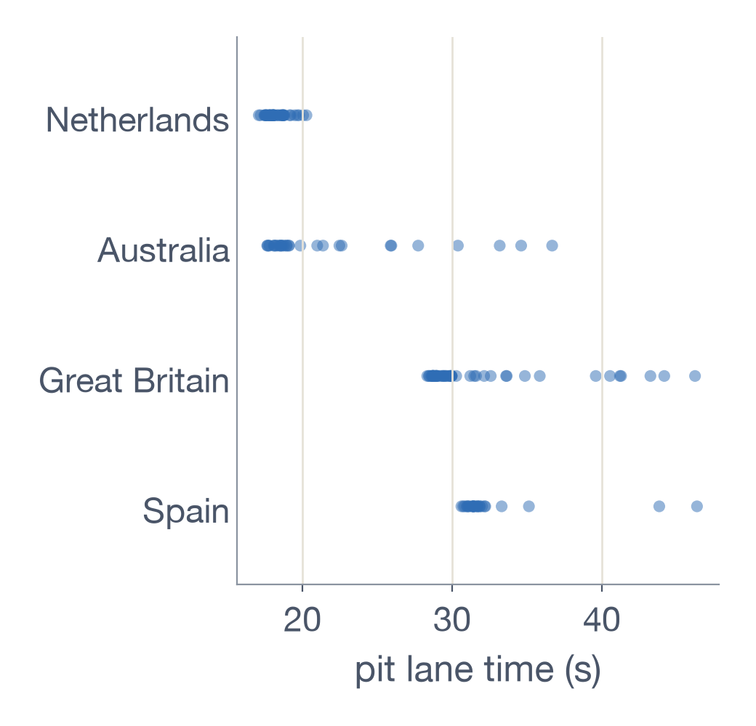
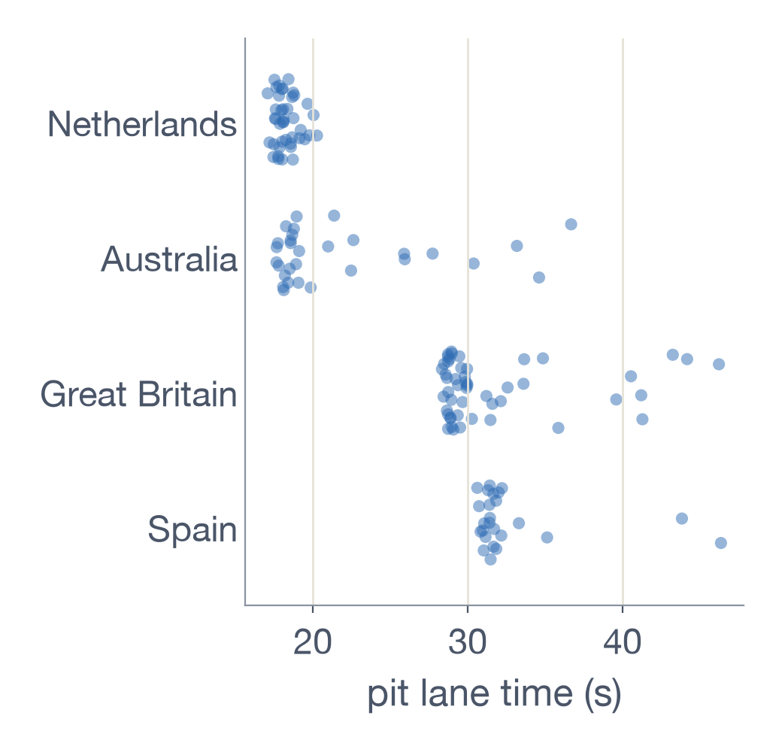
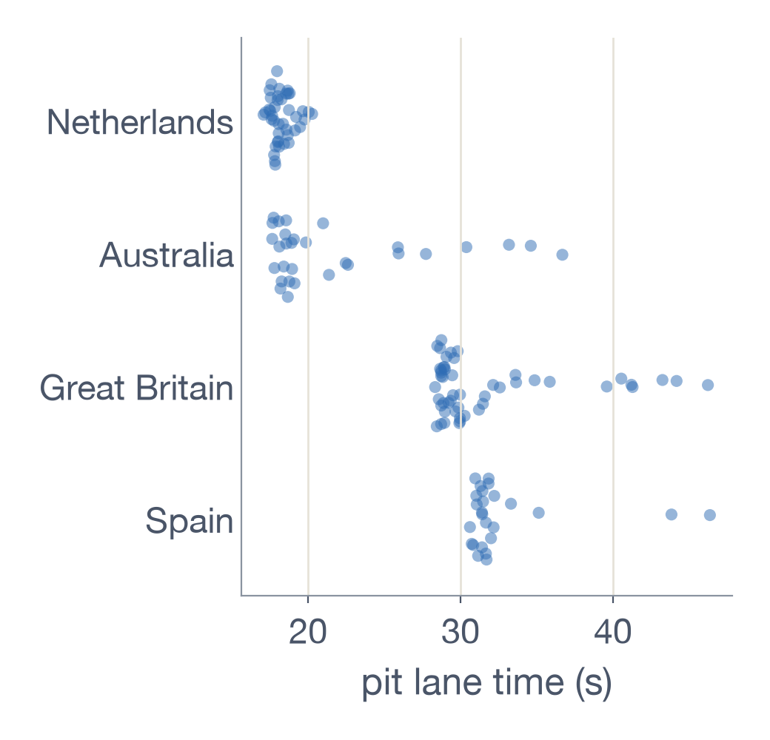
Three ways to plot the raw points
9.1 · SHOWING EVERY POINT (FIGS 9.6–9.8)
Strip chart (avoid)
Jittered points
Sina plot
Dots pile on top of each other. The Netherlands' 42 stops become one smear.
A little random noise spreads the dots out. Works well for small groups like these.
Dots spread out where they're dense, so each race traces a violin.
Notes:
Same four races in each panel. The sina plot comes from Sidiropoulos et al., 2018, and is named for Sina Hadi Sohi.

Slide 14
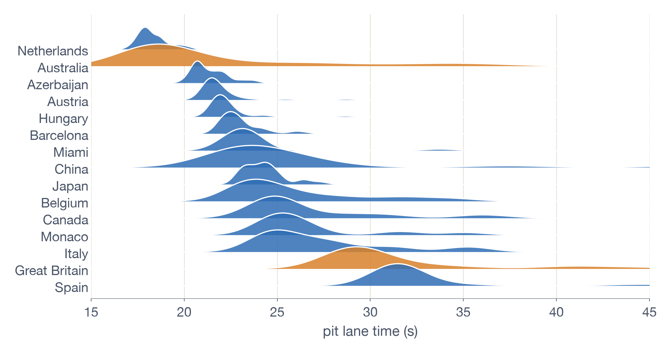
Ridgelines: stacked density ridges
9.2 · ALONG THE HORIZONTAL AXIS (FIGS 9.9–9.10)
In the 2026 data
Orange: Australia (most skewed) and Great Britain (most slow stops).
18.1 s
Netherlands median, the narrowest ridge
31.5 s
Spain median, the slowest pit lane of the season
Notes:
Ridgelines put the response on the horizontal axis and stack the groups, so race names read naturally. Overlap is fine because only shapes matter.

Slide 15
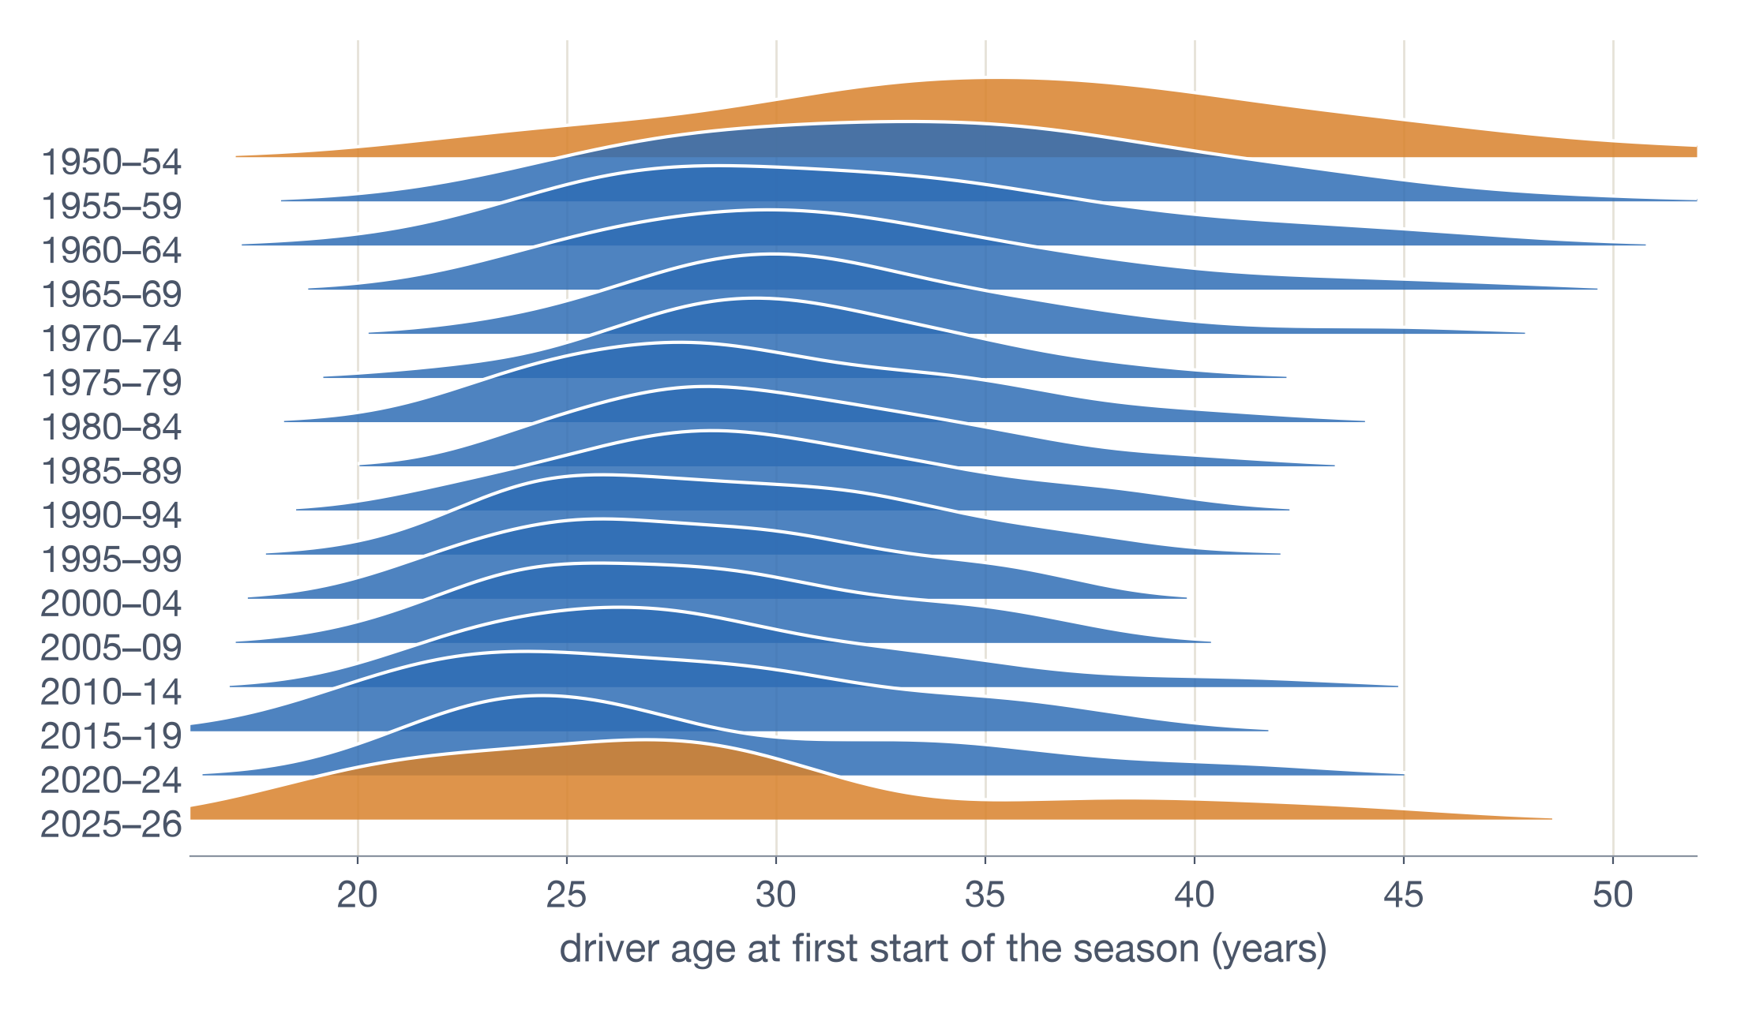
F1 drivers have gotten younger
9.2 · RIDGELINES AT SCALE (FIG 9.11)
1950–54:
median age 35.8, spread from 20 to 50+
1980s:
median about 29
2015–24:
median 26.4, a younger and tighter field
One age per driver per season, 1950–2026
Notes:
Our version of Wilke's movie-length ridgeline (Figure 9.11). Each driver counts once per season, at their age on their first start that year, grouped into 5-year periods. The peak slides left and drivers in their 40s mostly disappear. The 2025–26 ridge has only 44 driver-seasons, so its second bump is noisy.

Slide 16
SUMMARY
Plot | How it's built | Best for | Avoid
ECDF | Sort, rank, plot cumulative fraction | One distribution, every point | Less intuitive for lay readers
Log–log ECDF | Descending ECDF, both axes logged | Spotting power laws | Log-normal tails bend away
Q-Q plot | Observed vs theoretical quantiles | Testing fit to a distribution | x = y is not a regression
Error bars | One point ± spread per group | Uncertainty of an estimate | Hides shape; meaning unclear
Boxplot | Median, quartiles, 1.5× fences | Compact comparison, skew | Hides multiple peaks
Violin | Mirrored density estimate | Shape and multiple peaks | Needs enough data per group
Jitter / sina | Raw points spread sideways | Sparse data, every point | Unjittered strips overplot
Ridgeline | Densities stacked vertically | Many groups, time trends | No density axis; avoid histograms
Notes:
The first three rows are chapter 8 and the rest chapter 9. Error bars are included as the cautionary example.

