Slide 1

AEGIS-C2
Unified battlefield management and drone reconnaissance center
HACKATHON PRESENTATION
FALLING SUN 2026 × IMSEC GHAZIABAD
Web Development · Tactical coordination · Reconnaissance · Decision support
Notes:
Source: AEGIS-C2 project README and source code. Generated visuals are conceptual illustrations.

Slide 2
Operational awareness breaks when information stays fragmented
AEGIS-C2 consolidates planning, sensing and response workflows into one browser-based command view
Geospatial context
A shared satellite map anchors every asset, route and contact to the same operating picture.
Drone operations
Waypoint planning, live telemetry and CSV export keep each flight traceable.
Time-critical alerts
Interactive threat injection and response cues let teams rehearse decisions during a demo.
Design goal: one operating picture for tactical coordination and reconnaissance.
AEGIS-C2 | FALLING SUN 2026 × IMSEC GHAZIABAD
02
Notes:
Source: AEGIS-C2 project README and source code. Generated visuals are conceptual illustrations.

Slide 3
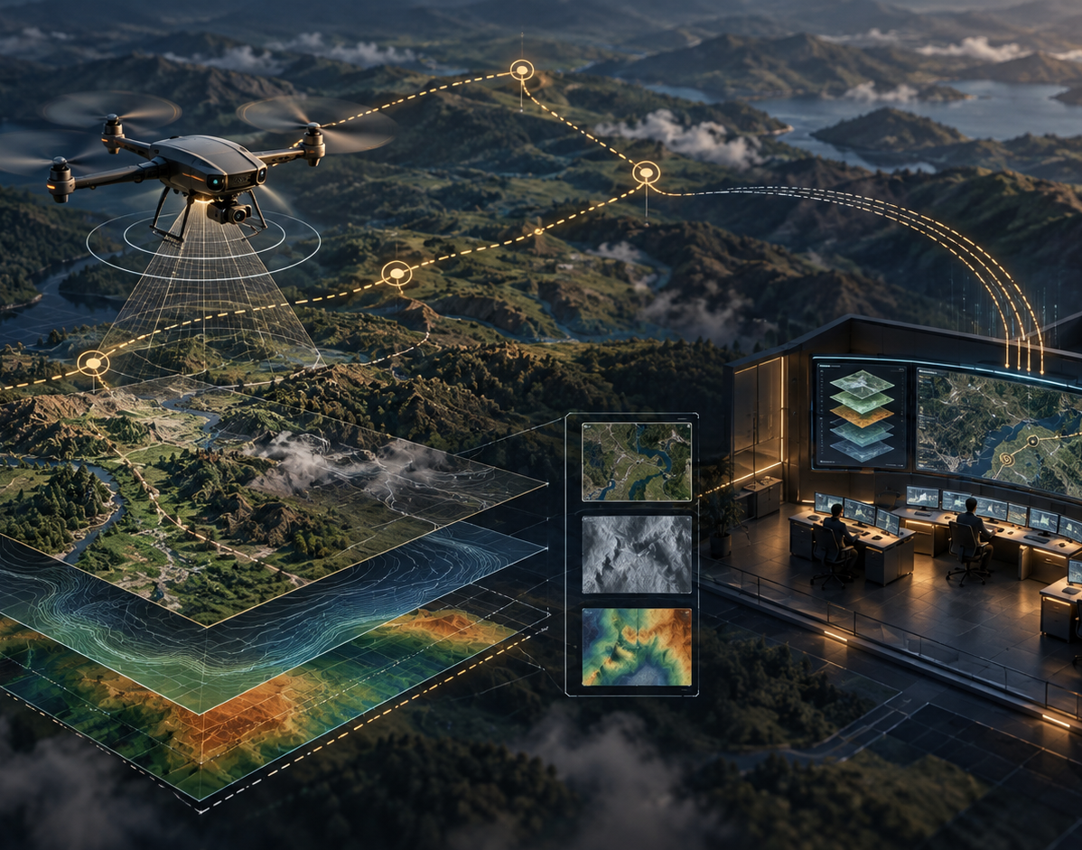
One interface connects planning, sensing and action
AEGIS-C2 combines map-led coordination with live operational controls
01
02
03
PLAN
OBSERVE
RESPOND
Plot sequential flight corridors and select mission assets.
Review camera feeds, map tracks and telemetry signals.
Inject contacts, calculate grid location and initiate an intercept workflow.
The interface makes the workflow visible on a single geospatial canvas.
AEGIS-C2 | FALLING SUN 2026 × IMSEC GHAZIABAD
03
Notes:
Source: AEGIS-C2 project README and source code. Generated visuals are conceptual illustrations.

Slide 4
Core modules support the full mission loop
A browser application built for interactive demonstration and operational rehearsal
Flight Corridor Planner
Electronic Warfare Console
Optical Sensor View
Sequential waypoint plotting with autonomous route execution.
Band, technique and power controls with an estimated envelope radius.
Browser webcam input with thermal false-color and NVG filters.
Telemetry Export
Threat Injection
Interceptor Simulation
CSV output for timestamp, position, altitude, speed and signal metrics.
Map click creates a hostile contact and calculates the MGRS grid.
VAJRA-02 can track and intercept an active aerial contact.
AEGIS-C2 | FALLING SUN 2026 × IMSEC GHAZIABAD
04
Notes:
Source: AEGIS-C2 project README and source code. Generated visuals are conceptual illustrations.

Slide 5
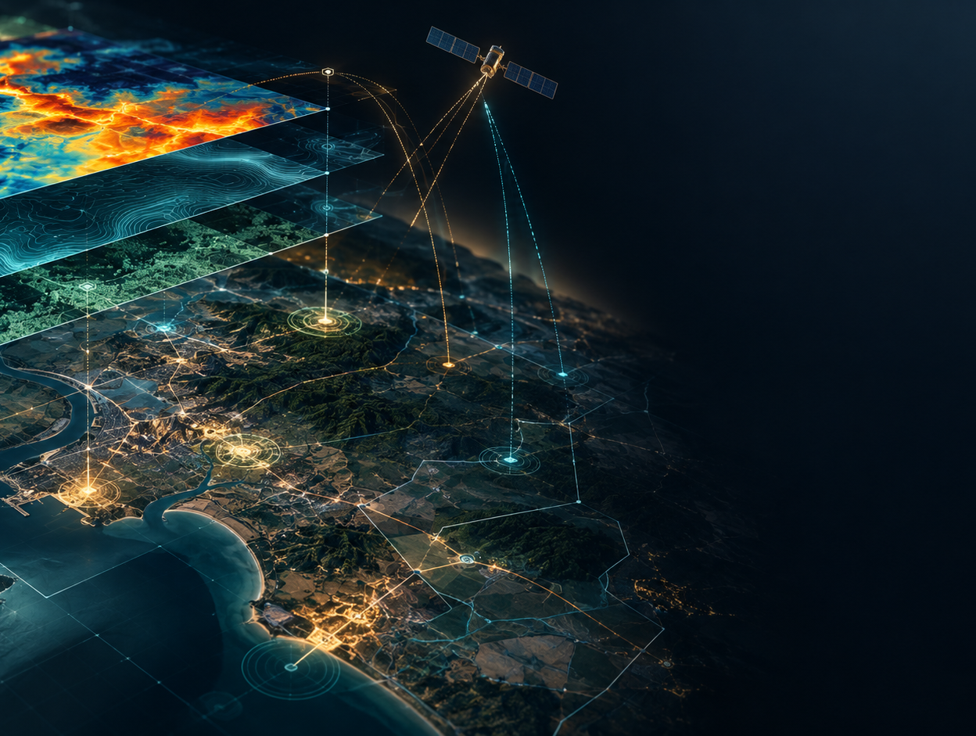
Sensor data becomes an interpretable operating picture
Layered visual inputs give operators a common spatial reference
Visual processing
Live camera toggle for real-time capture
Thermal false-color shader view
NVG phosphor-green shader view
Satellite imagery in the Ghaziabad sector
NavIC health indicators and GDOP status
The visuals in this deck are conceptual illustrations. The project provides the actual interactive interface.
AEGIS-C2 | FALLING SUN 2026 × IMSEC GHAZIABAD
05
Notes:
Source: AEGIS-C2 project README and source code. Generated visuals are conceptual illustrations.

Slide 6
A browser-native tactical simulation stack
The demo runs in a web interface with geospatial rendering, local device input and generated outputs
Input layer
Decision layer
Output layer
Esri World Imagery
Webcam capture
Map clicks
Synthetic telemetry
Waypoint state
Contact state
EW parameters
Prediction math
Interactive map overlays
Audio notifications
CSV flight logs
Situation report export
No external credentials are required for the base geospatial experience described in the project README.
AEGIS-C2 | FALLING SUN 2026 × IMSEC GHAZIABAD
06
Notes:
Source: AEGIS-C2 project README and source code. Generated visuals are conceptual illustrations.

Slide 7
Live demonstration sequence
A short, judge-friendly flow showcases interactivity in under three minutes
01
02
03
04
05
Acquire
Plan
Observe
Respond
Report
›
›
›
›
Open the shared map and inspect available friendly assets.
Plot a multi-waypoint corridor and start an autonomous mission.
Enable an optical filter and review changing telemetry.
Inject a map contact, display the grid reference and scramble VAJRA-02.
Export flight telemetry and generate a situation report.
This sequence proves both the interface depth and the system narrative without needing external equipment.
AEGIS-C2 | FALLING SUN 2026 × IMSEC GHAZIABAD
07
Notes:
Source: AEGIS-C2 project README and source code. Generated visuals are conceptual illustrations.

Slide 8
AEGIS-C2
A unified command view for tactical coordination, drone reconnaissance and decision support
Ready for live demonstration
FALLING SUN 2026 × IMSEC GHAZIABAD
Notes:
Source: AEGIS-C2 project README and source code. Generated visuals are conceptual illustrations.

