Slide 1
VOx Memristor: First-Principles Electro-Thermal Compact Model
Comprehensive Design, Derivation, and Validation
Name: _________________ | Course: _________________ | Date: _________________

Slide 2
Aims & Objectives
Derive a 3-ODE system coupling thermodynamics, phase kinetics, and parasitics.
Implement a modular Python simulator utilizing implicit numerical solvers (Radau).
Reproduce key experimental observations (NDR, pinched hysteresis, thermal loops).
Validate the model against data for both voltage-biased and current-biased modes.

Slide 3
Physical Mechanism
Voltage/Current → Joule Heating → Temperature Rise → Metal-Insulator Transition (MIT) → Metallic Growth → Resistance Change
Key Transitions: T_IMT = 315 K, T_MIT = 298 K

Slide 4
Governing Equations
Thermal Conservation (First Law of Thermodynamics):
C_th * (dT/dt) = P_joule - G_th * (T - T_amb) - L * (dφ/dt)
Phase Kinetics (KJMA-motivated):
dφ/dt = (φ_eq(T) - φ) / τ_φ
Resistance Model (Bruggeman Effective Medium Theory):
R = f(R_insulating(T), R_metallic(T), φ)

Slide 5
Model Evolution Overview
Ideal Model: Proof-of-concept for fundamental physical mechanism.
Real Model: Adds non-ideal semiconductor physics (Arrhenius, TCR, contact resistance).
Advanced Model: Adds Bruggeman geometric percolation and circuit parasitics.

Slide 6
Codebase Architecture
vox_parameters.py: Central dataclass for physical and simulation parameters.
vox_model.py: Core physics equations for the ideal 2-ODE model.
vox_real_model.py: Non-ideal real model with Arrhenius conduction and metallic TCR.
vox_advanced_model.py: 3-ODE system with Bruggeman EMT and parasitic capacitance.
vox_solver.py: Radau implicit solver handling stiff system integration.
vox_waveforms.py: Generators for voltage and current stimulation waveforms.

Slide 7
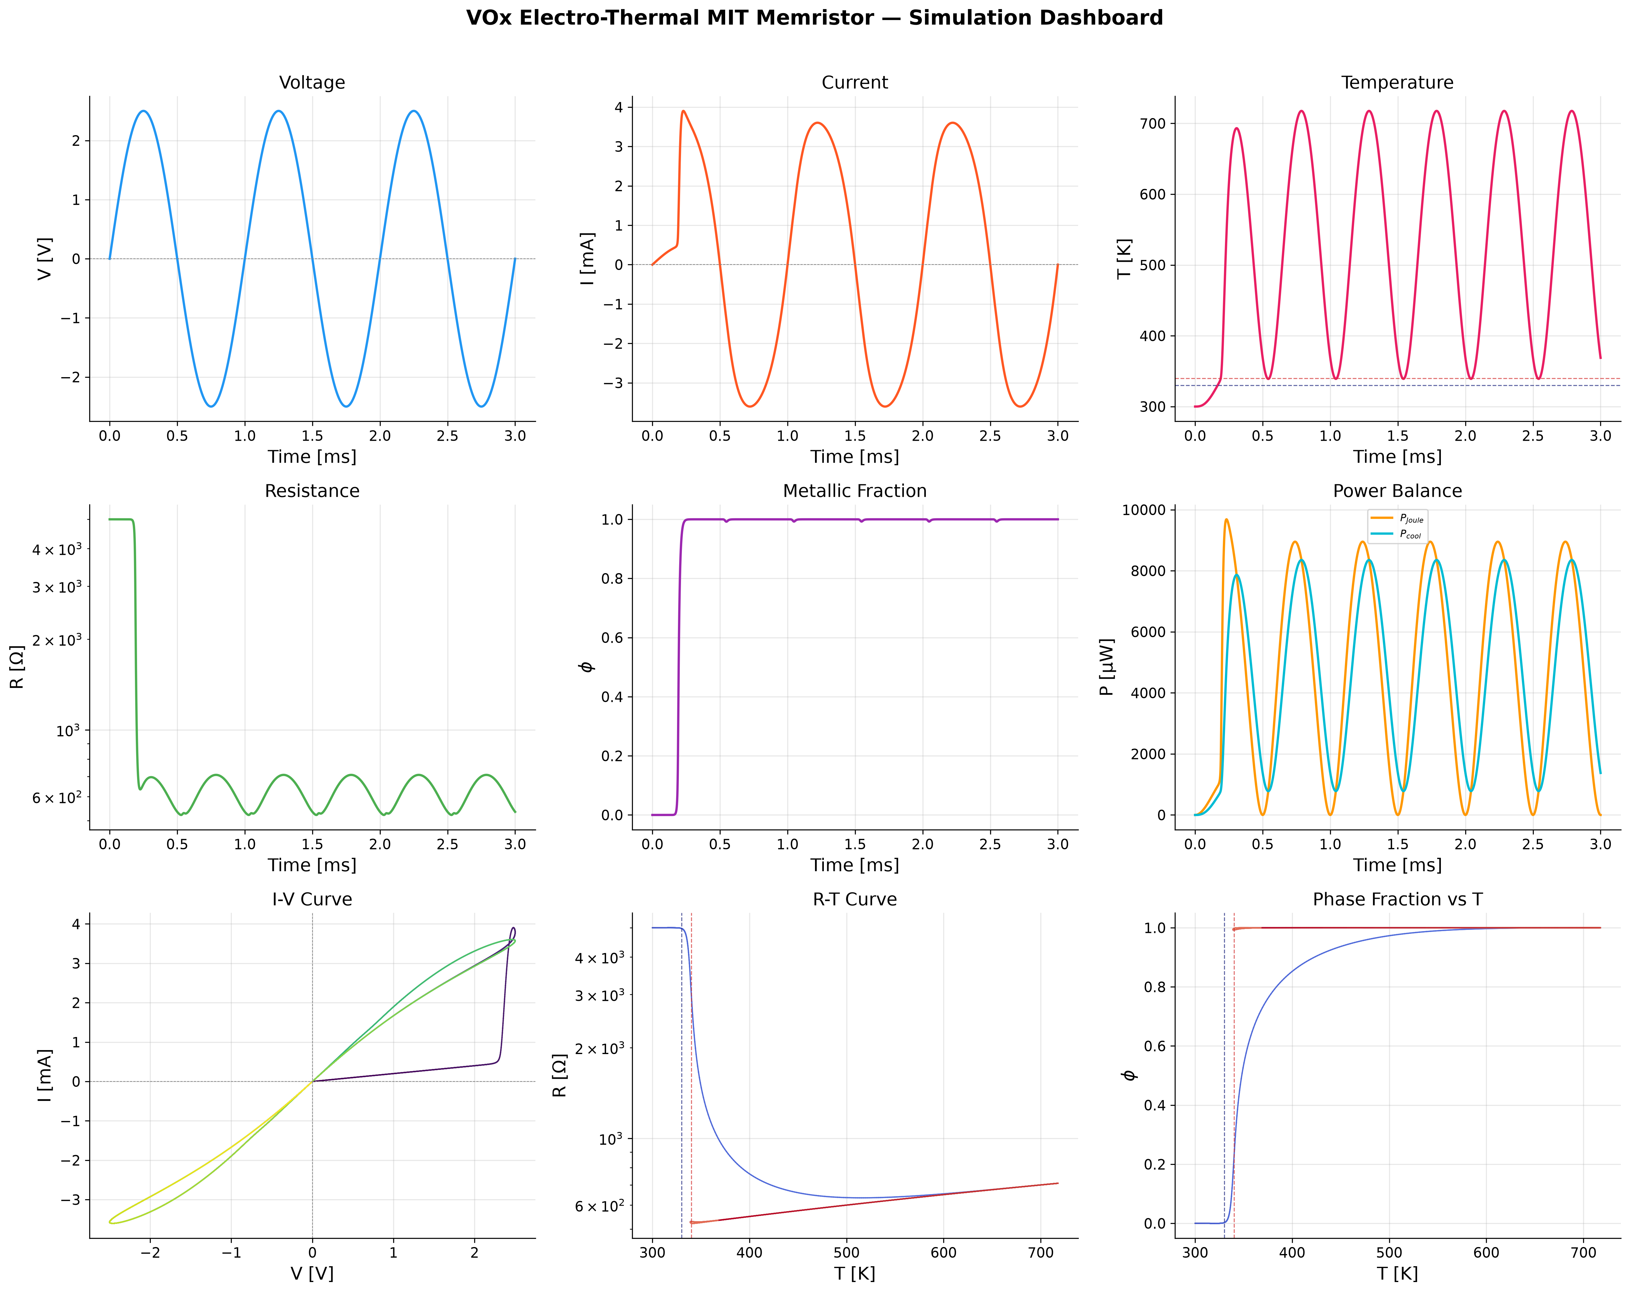
Ideal Model Results
The 4-panel dashboard demonstrates the fundamental phase transition and temperature cycling under voltage bias.

Slide 8
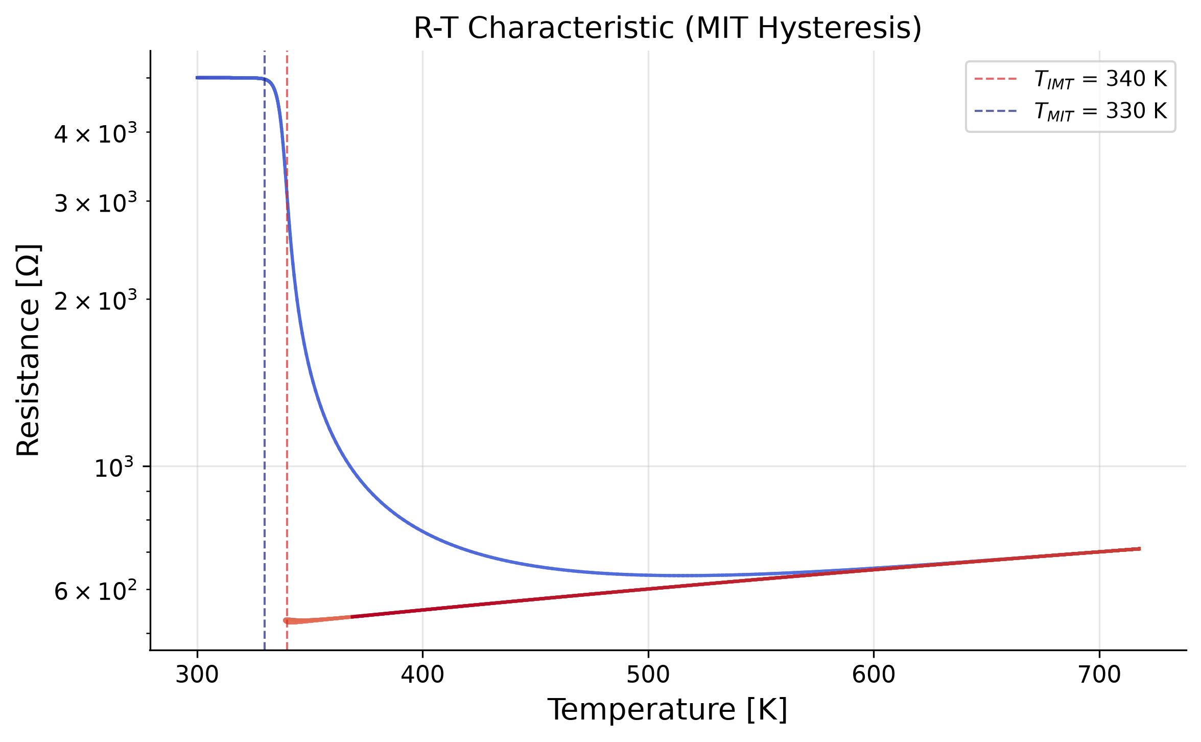
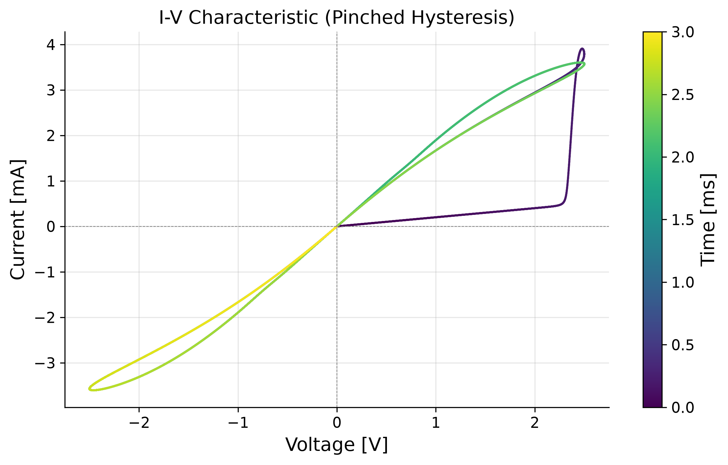
Ideal Model: R-T and I-V
R-T loop correctly captures the metal-insulator transition.
I-V curve exhibits classic asymmetric pinched hysteresis.

Slide 9
Real Model: Physics Corrections
Arrhenius R_i: Exponentially dropping insulating resistance.
TCR R_m: Metallic resistance increases with temperature.
Contact Resistance: Imposes a minimum series resistance floor.
Arrhenius τ_φ: Temperature-dependent phase relaxation time.
Nonlinear G_th: Enhanced heat dissipation at high temperatures.

Slide 10
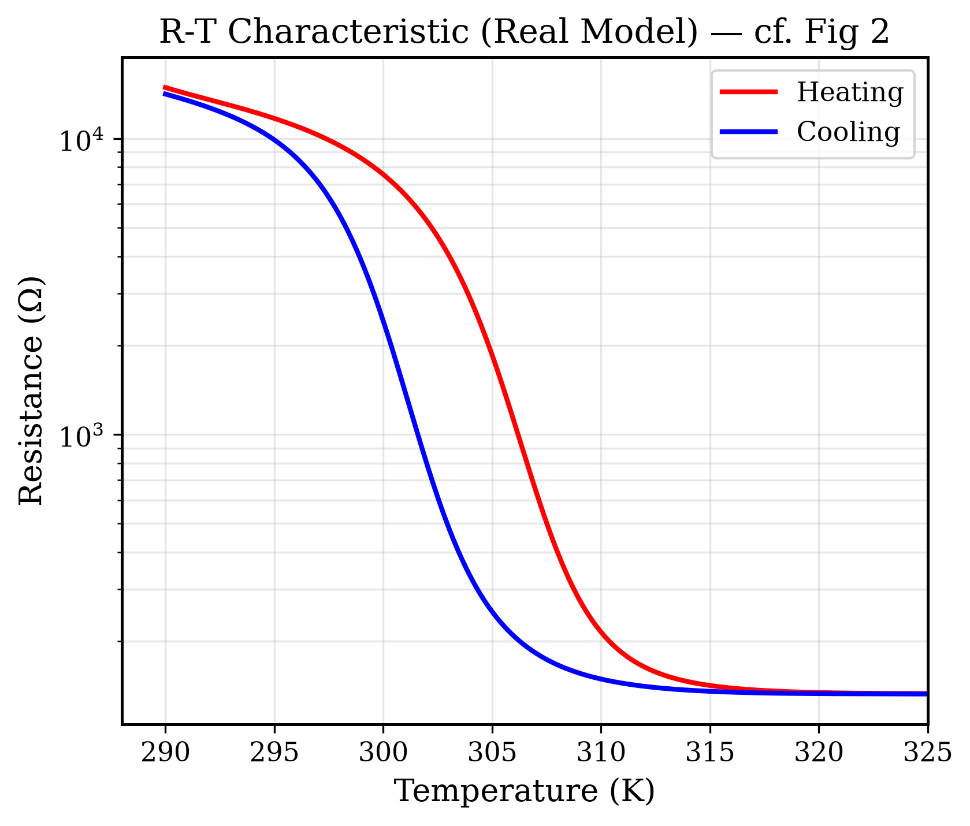
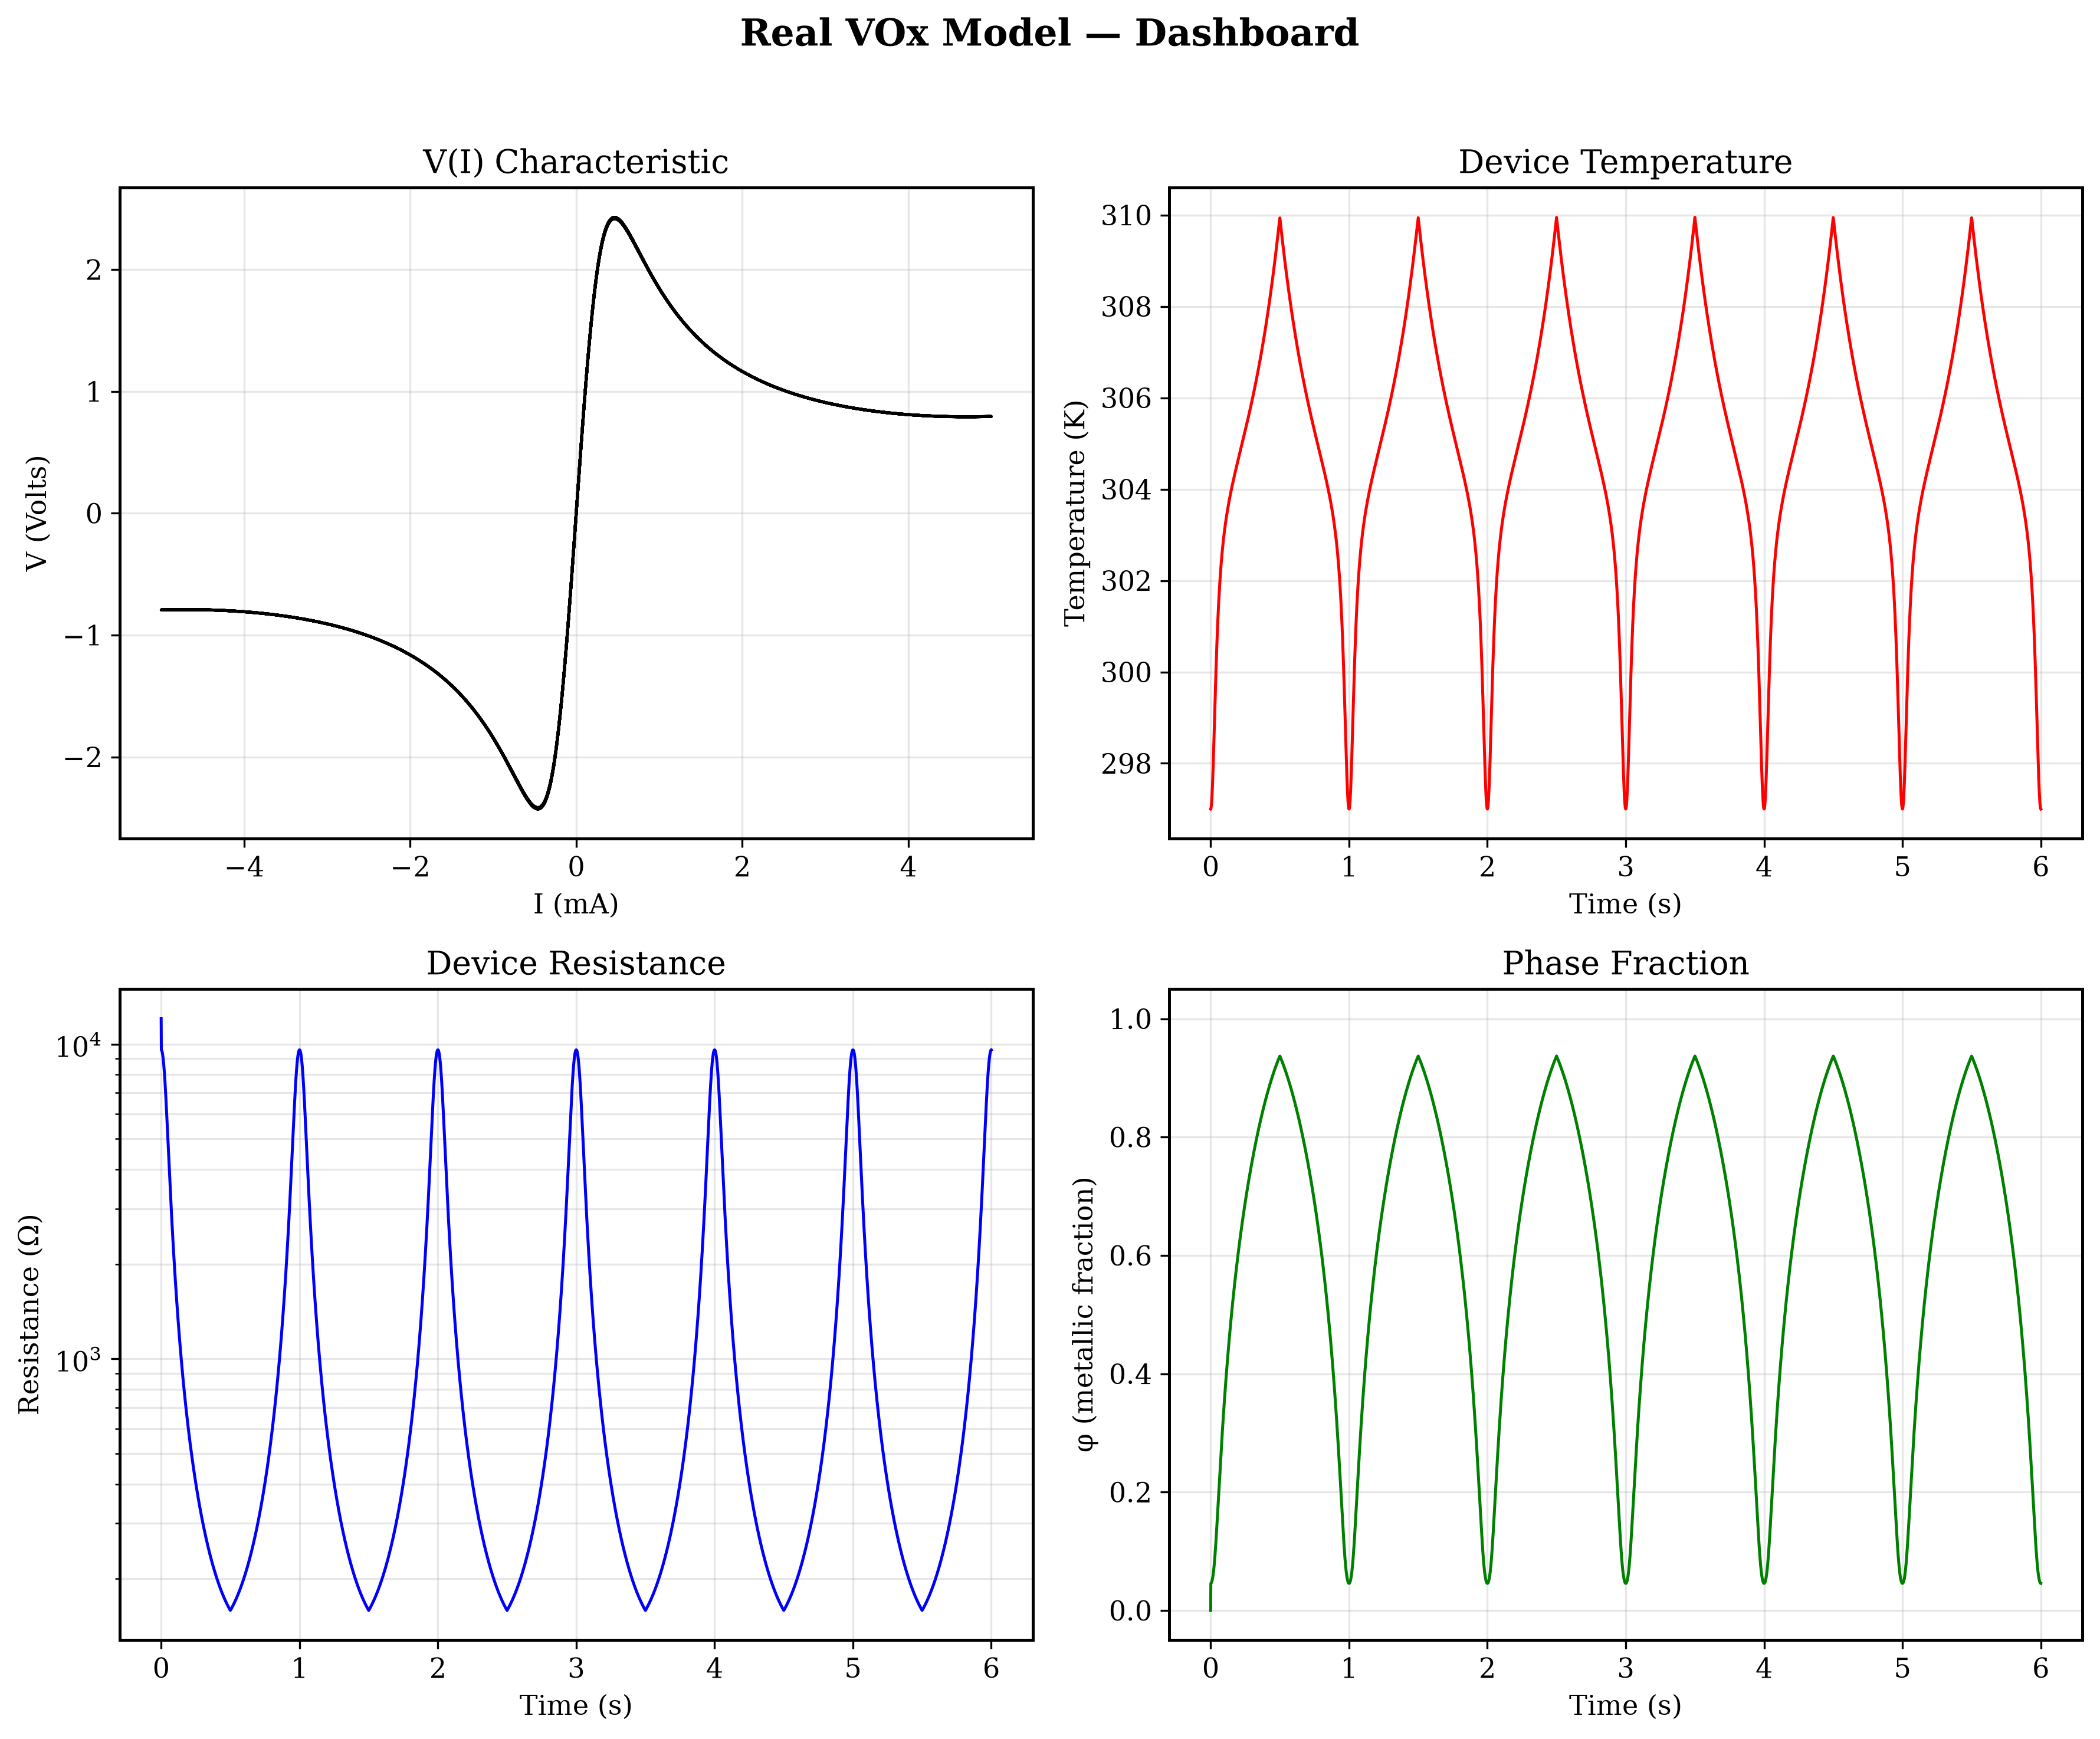
Real Model Results
Curved, non-linear pre-switching behavior introduced by Arrhenius conduction.
The Real Model properly bounds high-current and steady-state thermal behavior.

Slide 11
Advanced Model: Why It Was Needed
Bruggeman Percolation: Replaces simplified mixing with geometric percolation thresholds.
Circuit Parasitics: Introduces parasitic capacitance in a stiff 3-ODE system, producing sharp snap-backs.

Slide 12
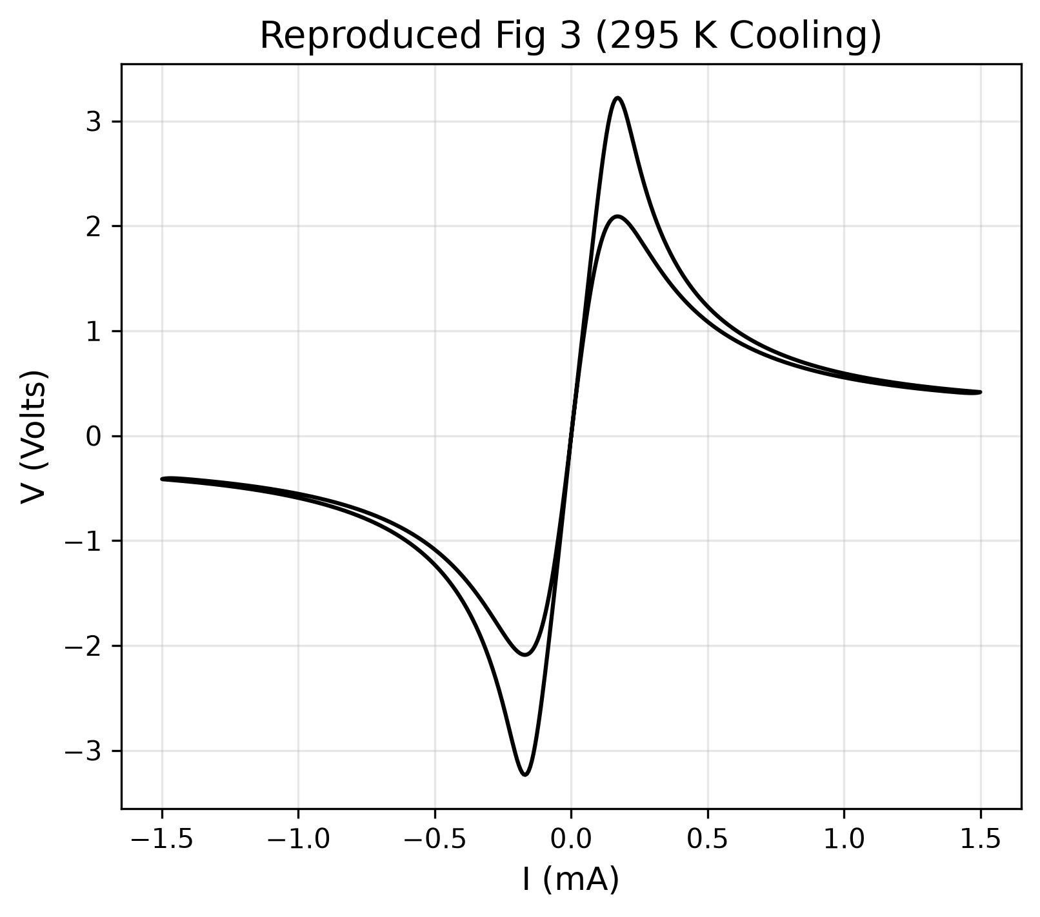
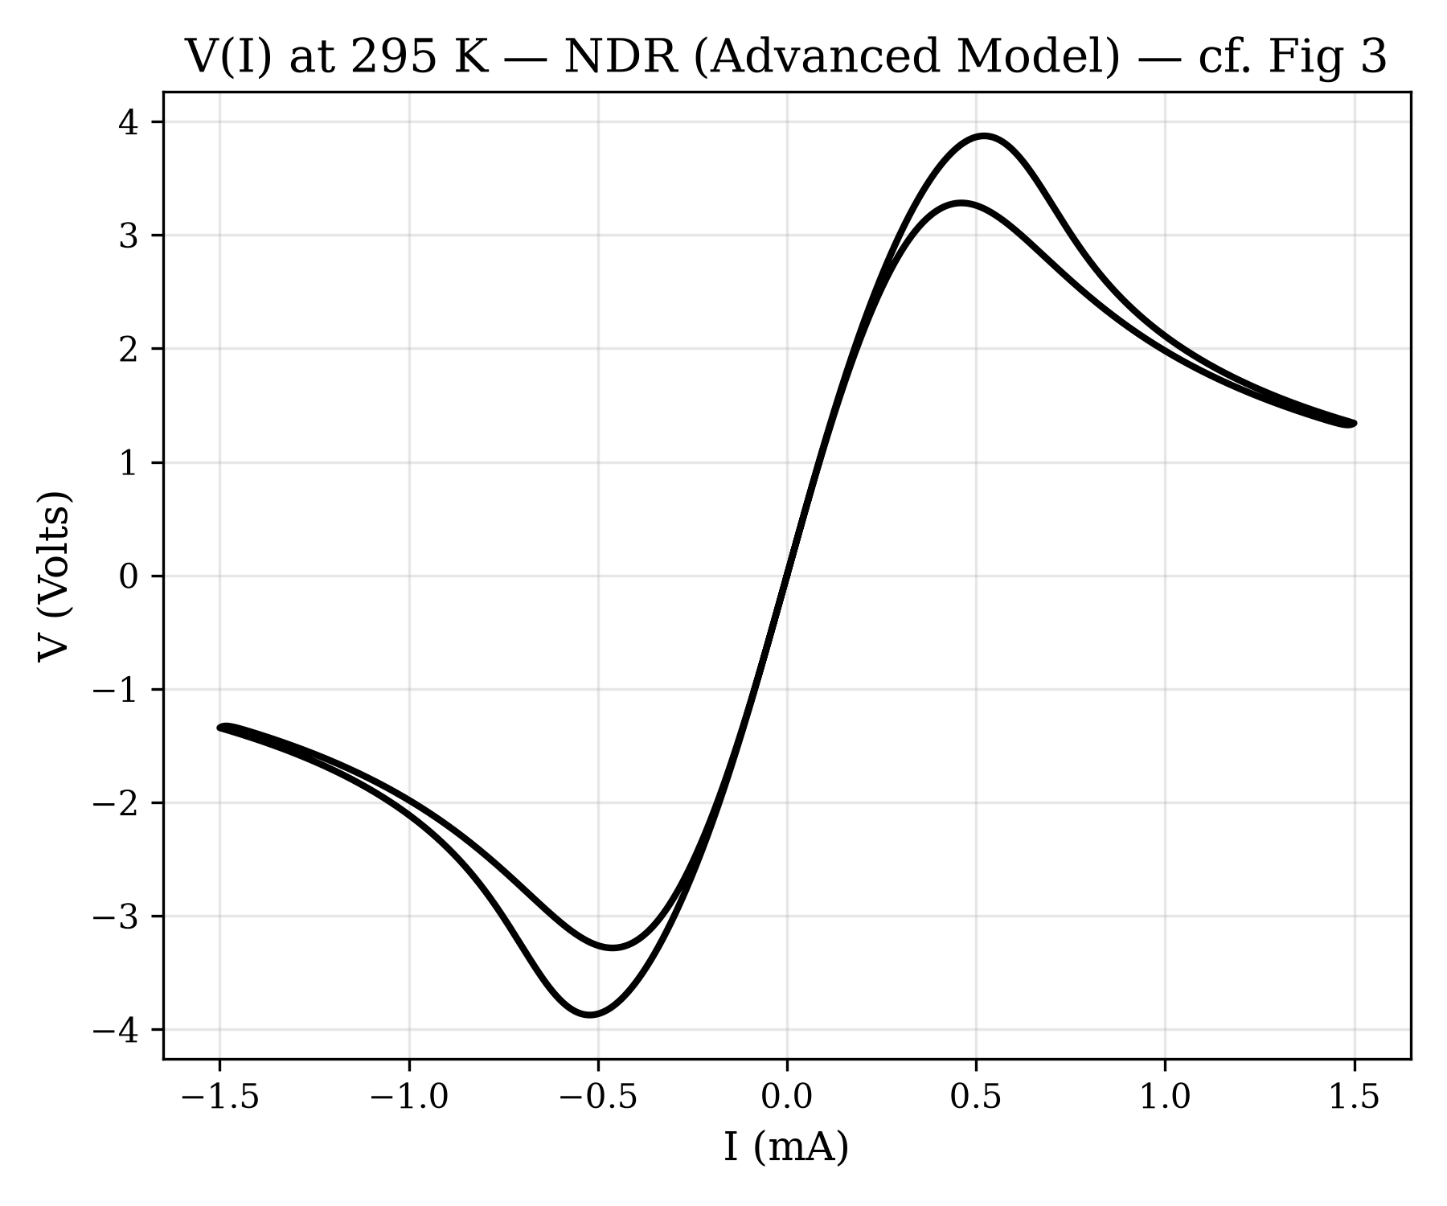
Advanced Model Results: NDR
Model closely reproduces the experimental S-shaped NDR curve.
Phase kinetics lag triggers the sharp snap-back hysteresis under current bias.

Slide 13
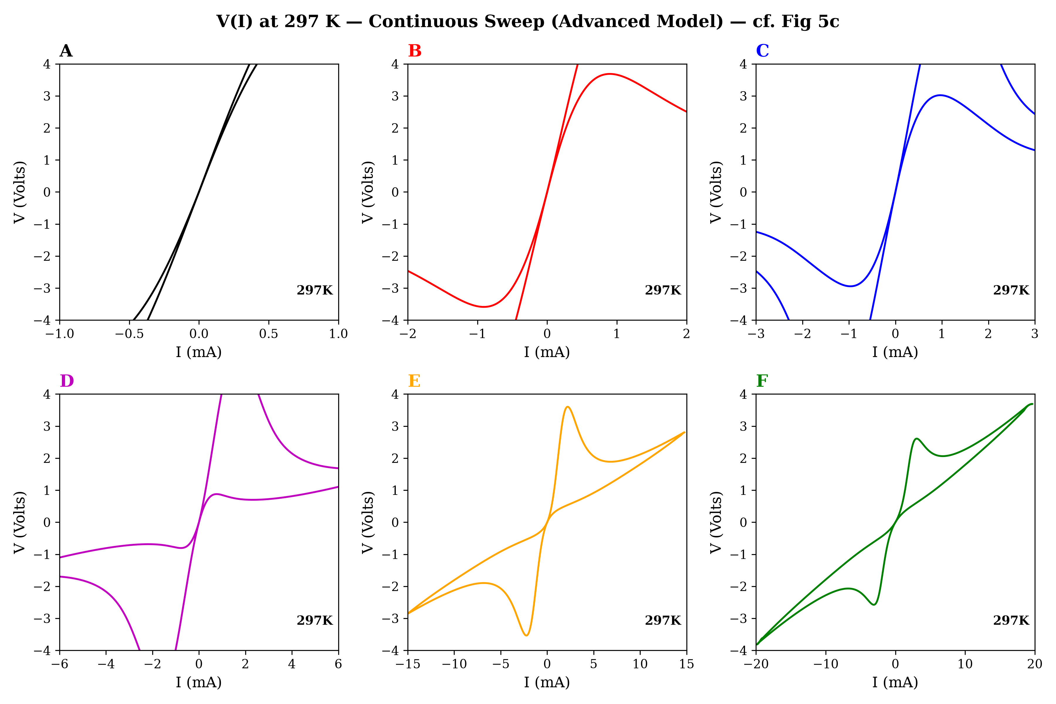
Advanced Model Results: Amplitude Sweeps
Amplitude-dependent progression effectively captures saturation at ~3-4V under varying current limits.

Slide 14
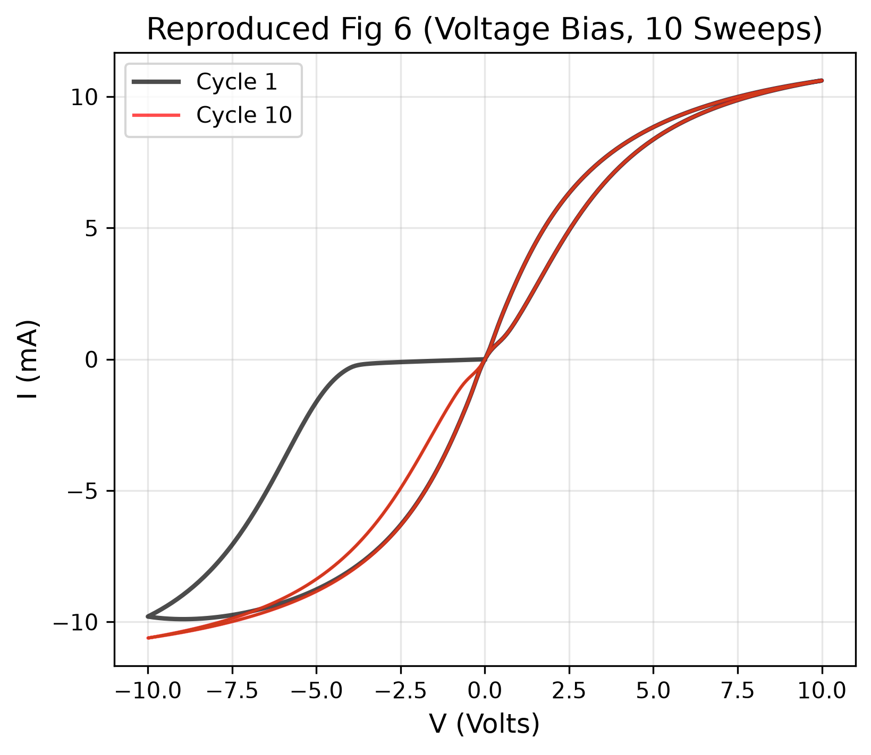
Advanced Model Results: Cycle-to-Cycle Memory
Cycle 1 traces a wider outer loop due to phase memory; cycles 2-10 cluster tightly inside.

Slide 15
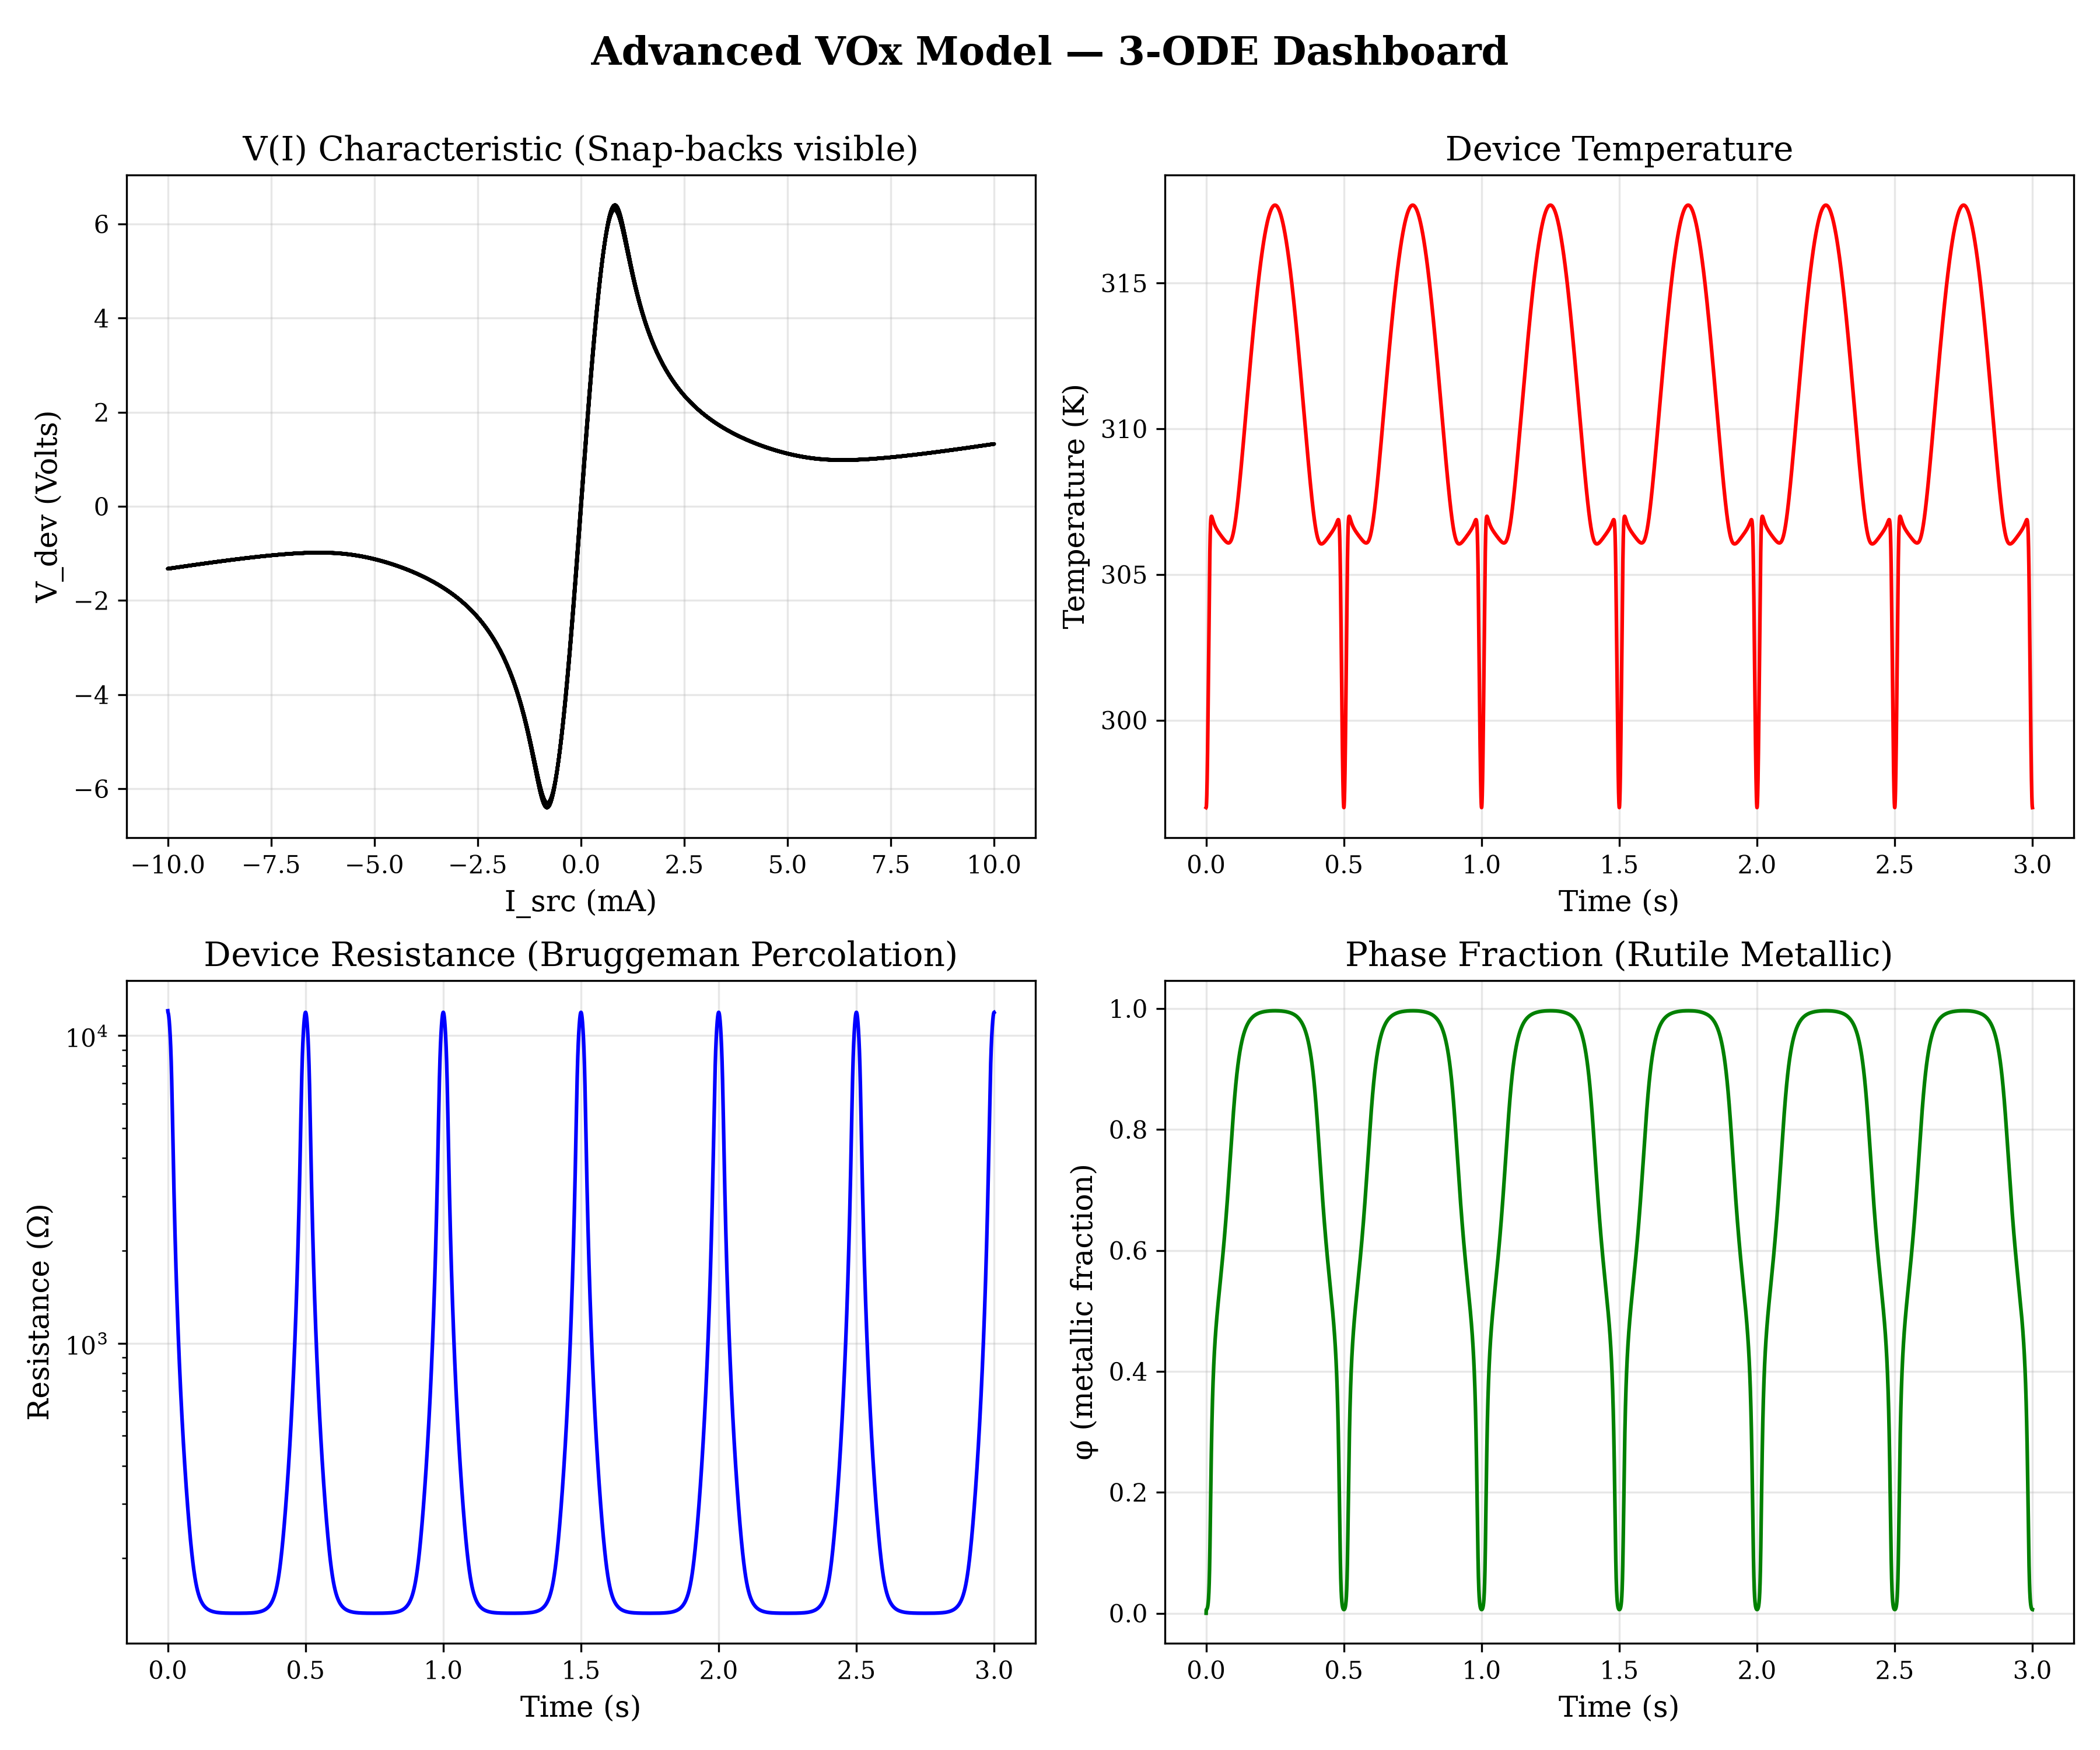
Advanced Dashboard
The 3-ODE Advanced Model incorporates percolation and parasitic capacitance to capture experimental measurement conditions.

Slide 16
Quantitative Validation
Metric | Paper Observation | Model Performance
Voltage Saturation | ~3-4 V at 20 mA | ~3 V at 20 mA
Hysteresis Width | 15-20 K span | 17 K span (315 K to 298 K)
Switching Threshold | NDR snap-back near ~0.5 mA | Closely reproduces near ~0.5 mA

Slide 17
Known Limitations
Resistance Span Trade-off: Model captures ~2.5 orders of magnitude vs. the paper's ~3 to prioritize accurate 2-4V switching thresholds.
Geometric Simplifications: 0D lumped-element approach lacks spatial filament expansion, making mathematical transitions sharper than reality.
Semiconducting Pre-Conduction: The ideal model lacks Arrhenius conduction, yielding a perfectly linear pre-switching curve.

Slide 18
Conclusion
Ideal Model: Validates the fundamental physical mechanism utilizing minimal assumptions.
Real Model: Incorporates non-ideal semiconductor physics to achieve quantitative experimental agreement.
Advanced Model: Leverages Bruggeman percolation and circuit parasitics to mimic non-linear measurement realities.

Slide 19
References
Rana, A.S., del Valle, J. et al., "Symmetric and tunable resistive switching in VO2 memristors," Scientific Reports 10, 3293 (2020), https://doi.org/10.1038/s41598-020-60373-z

