Slide 1
HKN EECS Day: Single Pixel Camera
EECS 16A: Designing Information Devices and Systems I, Spring 2016

Slide 2
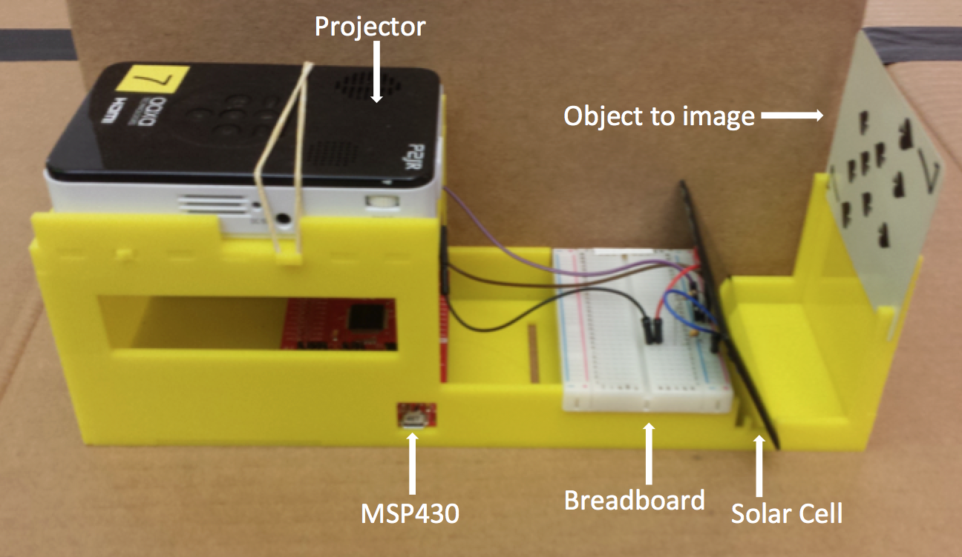
What’re we making?
Camera that produces a 40x30 image

Slide 3
How does it work
Projector to light up one “pixel” of the object at a time
Solar panel detects the light intensity of the pixel
Scan every “pixel”, then reconstruct the image!

Slide 4
Key Materials
MSP430 – Pocket-sized computer
Breadboard – Build your circuit here
Projector
Circuit Elements
Solar panel
Wires
Resistor
Capacitor

Slide 5
How to use Ipython
We’ll provide you a notebook of code: ee16a_imaging_lab2.ipynb
It’s already written for you
Open it up via the command line – instructions on next slide
To run a section of code, select the box of code and click the black triangle at the top!

Slide 6
How to use Windows CMD line
Open the command line by searching for “cmd” in the start menu
cd [folder-name]
Navigate to a folder in the current directory
dir
List the folders in the current directory
ipython notebook
Open the iPython notebook in your browser

Slide 7
Tips
Work efficiently — the cool part is at the end, and the lab is kind of long
To check the COM port of your MSP, search for “Device Manager” and look under Ports
Close the serial port before running capture_image.py or it won't recognize the COM port

