Slide 1



Team Details
  Team name: Scam Shield
  Team leader name: Naman Shrimal
  Problem Statement:
  BFSI: Intelligent Risk, Fraud & Financial Experiences
  People in India lose crores to scam messages, QR codes and calls that look real. Scam Shield lets anyone check what they were sent in seconds, then act: a complaint draft, a shared scam list that warns the next person, and a WhatsApp card for the family. Community benefit: fewer people lose their savings, and every report protects the next one.
Notes:
Team: Scam Shield. Team leader: Naman Shrimal. Track: BFSI: Intelligent Risk, Fraud & Financial Experiences. Community benefit: a free, plain-language check for anyone in India, in English or Hindi, and a shared scam list so each report warns the next person. The statement 'lose crores' is backed by slide 4 (about Rs 19,813 crore reported lost to cyber fraud in 2025, I4C data; see docs/submission/sources.md).

Slide 2

Note: Please download this template to make your edits and submit the final version.
To download, go to File > Download > Microsoft PowerPoint (.PPTX). Kindly refrain from sending edit requests.
Notes:
Organisers' instruction slide, kept exactly as in the template. Nothing to present here; the next slide starts the pitch.

Slide 3
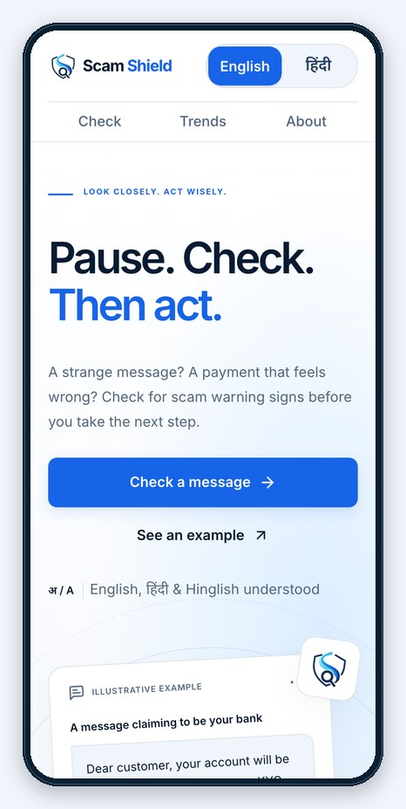
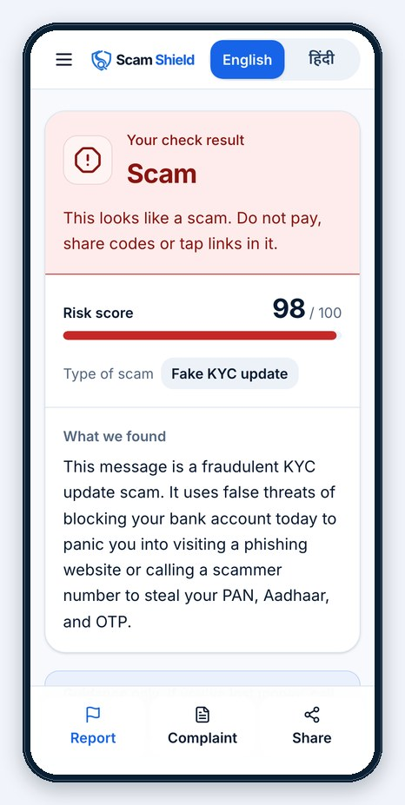



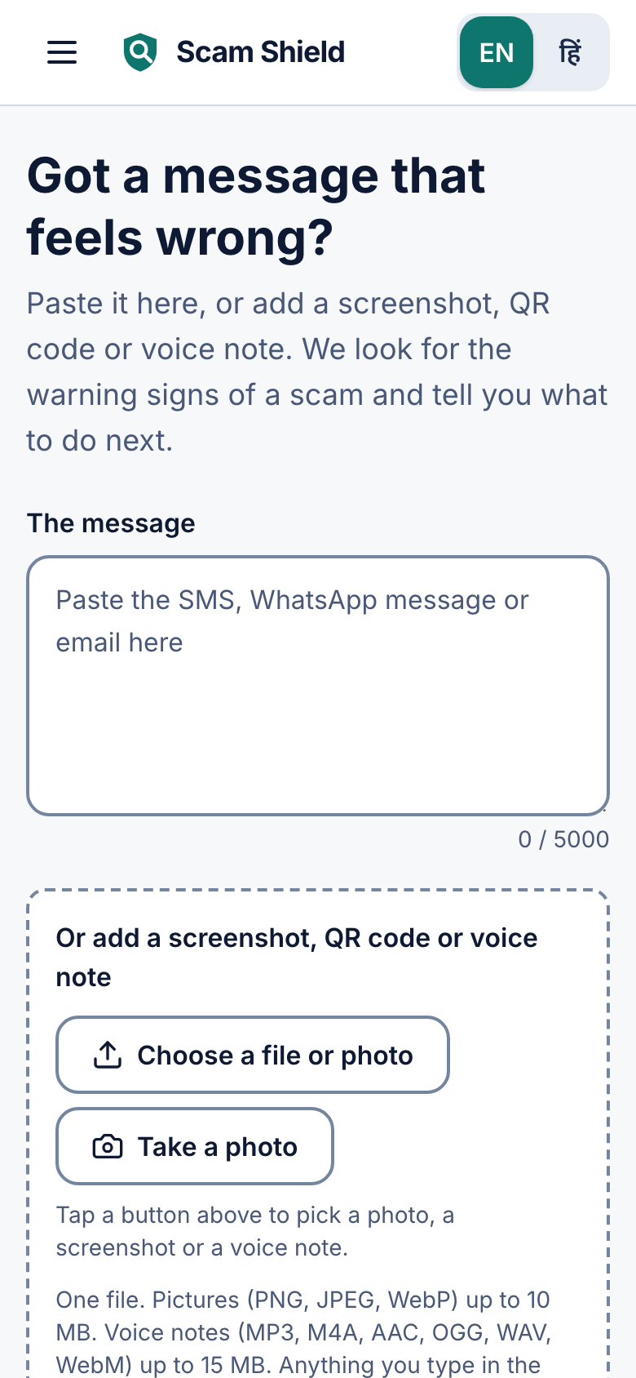
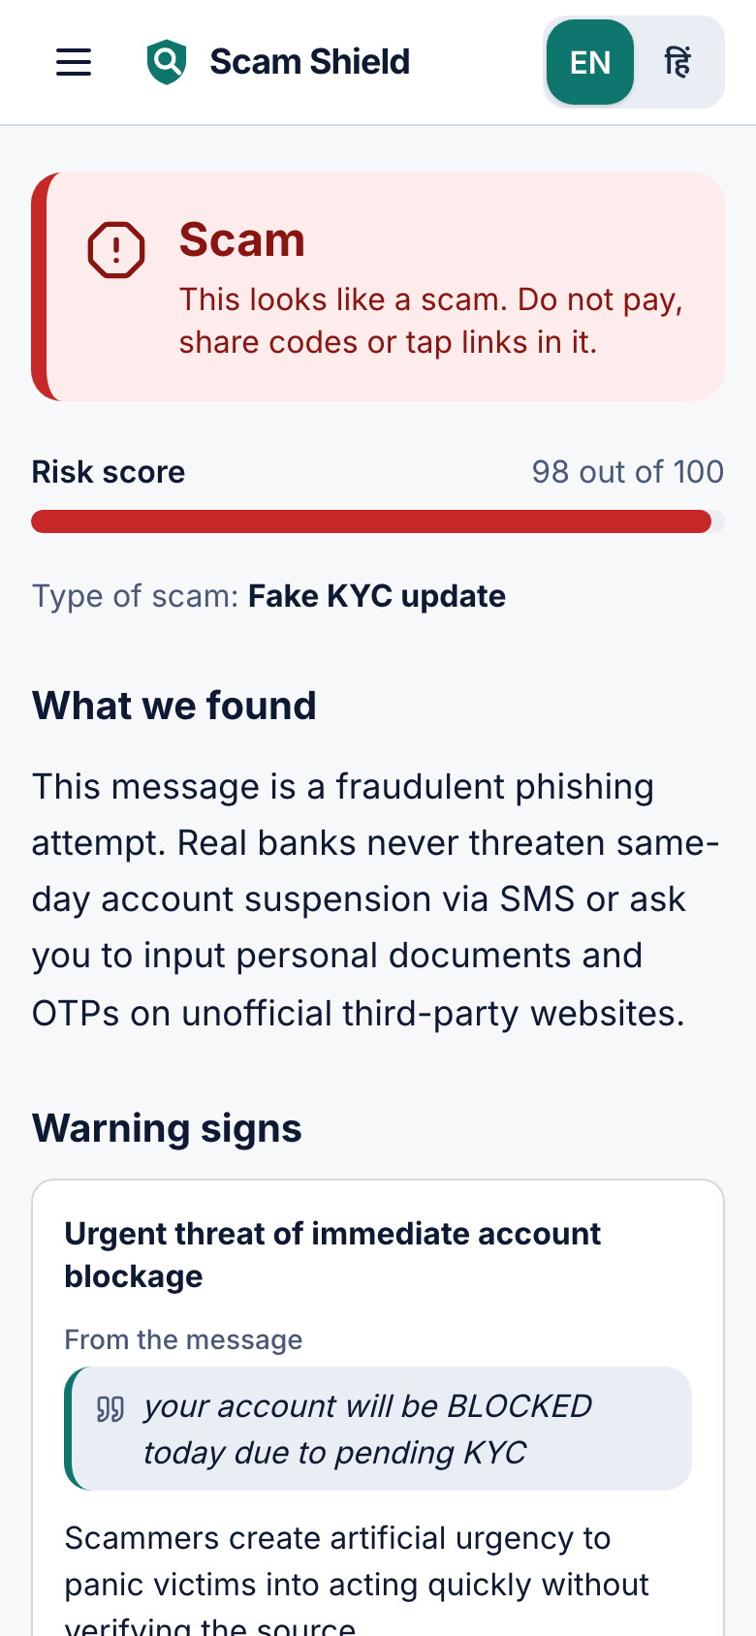
Brief about the idea
Check what you were just sent before you act on it.
Free for anyone in India, and built for the scams people meet here: fake payment receipts, "digital arrest" calls and UPI QR tricks.
One multimodal Gemini call
Text, screenshots, QR codes, links and Hinglish voice notes are read together by Gemini on Vertex AI.
A verdict you can check
Scam, Suspicious or No scam signs found. Every red flag quotes the exact words. English or Hindi.
From verdict to action
A complaint draft for 1930 and cybercrime.gov.in, a shared scam list and a WhatsApp warning card.
Careful by design: links open in an isolated browser, never on your phone. It never says "safe": it gives guidance and you decide.
The live app, as seen on a phone.
Notes:
Gen AI (the heart of the idea): one multimodal call to Gemini on Vertex AI reads the text, a screenshot or an audio clip together (Hinglish voice notes are transcribed and judged in the same call). The answer is schema-validated structured output, every red flag quotes evidence from the input, and the answer comes back in English or Hindi. Deterministic checks (scam-list hits, a QR that asks you to pay while the text says receive) can only RAISE a verdict. What Gemini does that rules cannot: judge scams nobody has reported yet, and read images and voice. India-specific scam types covered by the benchmark and the examples: fake payment receipts, 'digital arrest' calls, fake KYC messages, UPI QR tricks. Careful by design: links are opened only in an isolated scanner (a private Cloud Run service), never on the person's phone; verdicts are Scam, Suspicious or No scam signs found, the app never says 'safe', and it gives guidance only. Screenshots are from the live production app, captured by scripts/screenshots.ts.

Slide 4
Opportunities
Rs 19,813 crore
reported lost to cyber fraud in 2025, across about 21.78 lakh complaints (I4C data, National Cyber Crime Reporting Portal)
How different is it from existing ideas?
How will it solve the problem?
Truecaller Scam Checker (Sep 2026): checks links, numbers and messages against community reports; screenshot upload is only planned.
Checks before you pay, scan or click
Quotes every red flag from the message
Turns a scam into action: complaint, shared list, family warning
Google scam detection: Messages on Pixel 6 and newer, and calls on Pixel 9 and newer, in India.
USP of the proposed solution
Chakshu (Sanchar Saathi): a reporting facility for suspicious calls, SMS and WhatsApp messages.
Catches scams nobody has reported yet
Made for India: fake payment receipts, "digital arrest" calls, UPI QR tricks
Understands Hinglish voice notes
Scam Shield: reads the content itself, so it can flag scams nobody has reported yet, from text, screenshots, QR codes, links and voice notes.
Notes:
Sources (all checked 18 Oct 2026, see docs/submission/sources.md): Rs 19,813 crore and about 21.78 lakh complaints reported for 2025, I4C / National Cyber Crime Reporting Portal (https://ianslive.in/indians-lose-over-rs-52976-crore-to-cyber-frauds-over-six-years-report--20260103154943; a separate Home Ministry reply is quoted as about Rs 22,495 crore, so the figure is labelled I4C data). Truecaller Scam Checker launched in India on 28 Sep 2026: checks links, numbers and messages against community reports; screenshot upload is planned, not available (https://www.techrepublic.com/article/news-truecaller-scam-checker-apac-india/). Google scam detection: Messages on Pixel 6 and newer reached India in Sep 2026; on-device call scam detection in India is limited to Pixel 9 and newer (https://androidauthority.com/pixel-scam-detection-google-messages-global-3711361, https://techcrunch.com/2025/11/20/google-steps-up-ai-scam-protection-in-india-but-gaps-remain). Chakshu (Sanchar Saathi) is a reporting facility (https://sancharsaathi.gov.in; wording to be re-verified). No recovery percentage is quoted: no national recovery rate is published. USP wording: fake payment receipts and 'digital arrest' calls are scam types in the benchmark and the examples; UPI QR pay-vs-receive is a hard check. The three card headings are the organisers' standard prompts for this slide (the original prompt text was lost from the template file).

Slide 5







List of features offered by the solution
5 input types
Text, screenshot, QR code, link and voice note.
Clear verdict
Scam, Suspicious or No scam signs found, with a risk score.
Evidence quoted
Each red flag points to the exact words in the message.
English + Hindi
Hinglish understood; answers in the language you pick.
Complaint draft
Ready text for 1930 and cybercrime.gov.in.
Shared scam list
"Reported N times", with linked numbers, UPI IDs and sites.
Warning card
One tap shares a warning with the family WhatsApp group.
Agent tools
WebMCP tools let AI agents check and report.
Also: trends, history, one-tap examples, an installable app and the Android share menu.
Notes:
All features are live in the production app (https://scam-shield-live.web.app). The WebMCP tools check_message and report_scam are registered in web/src/webmcp/registerTools.ts; report_scam needs a person signed in with Google. Verdict names are Scam, Suspicious and No scam signs found.

Slide 6

Process flow diagram or Use-case diagram
1
2
3
4
Input
Text, screenshot, QR, link or voice note
Guardrails
Anonymous sign-in; per-user, per-IP and daily limits
Extract
Pulls out phones, UPI IDs, links; blanks OTPs and cards
Scam-list lookup
Firestore: "Reported N times" and linked IDs
5
6
Gen AI
7
8
Isolated link scan
A private Cloud Run service opens it: URL, text, screenshot
Gemini verdict
One call reads text, image or audio; evidence quoted
Hard checks
Scam-list hits and QR pay-vs-receive only raise the verdict
Result and action
Verdict, complaint draft, shared list, warning card
Why Gen AI: rules cannot read a screenshot or a Hinglish voice note, or judge a scam nobody has reported. Gemini does. The hard checks can only raise its verdict, never lower it.
If Gemini fails or times out, the person sees a clear retry message; no verdict is invented and nothing is stored.
Notes:
Flow as implemented in api/src/app.ts. Step 6 is a single multimodal Gemini call on Vertex AI (default gemini-3.7-flash, fallback gemini-2.5-flash) that returns schema-validated structured output with quoted evidence in English or Hindi. Step 7: deterministic checks (scam-list hits, a QR that asks you to pay while the text says receive) can only RAISE the verdict. If Gemini fails or times out the person sees a clear retry message; no verdict is invented and nothing is stored. Limits: 30 checks per user per day, 60 per IP per minute, 3,000 per day overall.

Slide 7
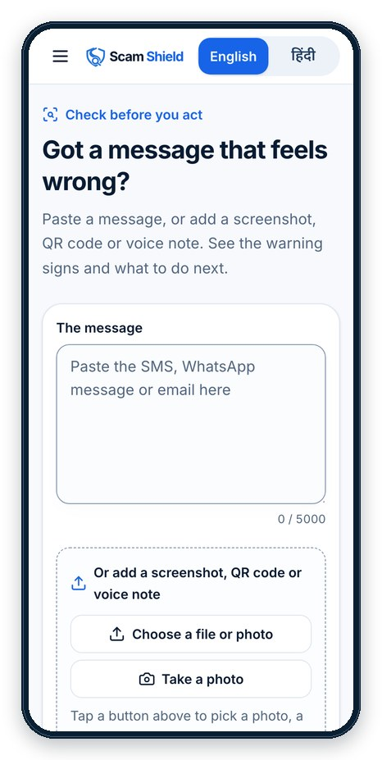
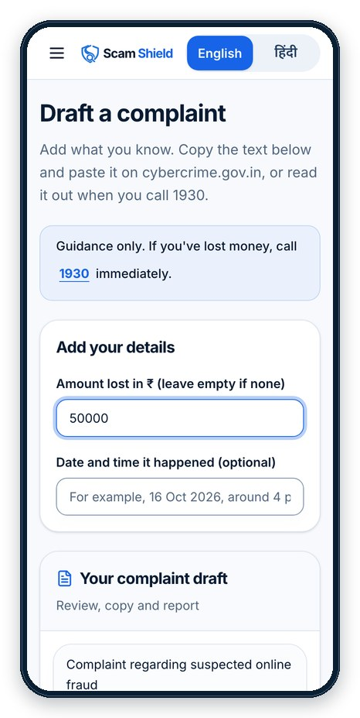
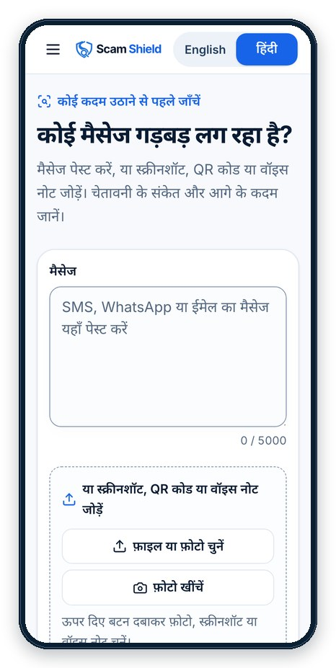
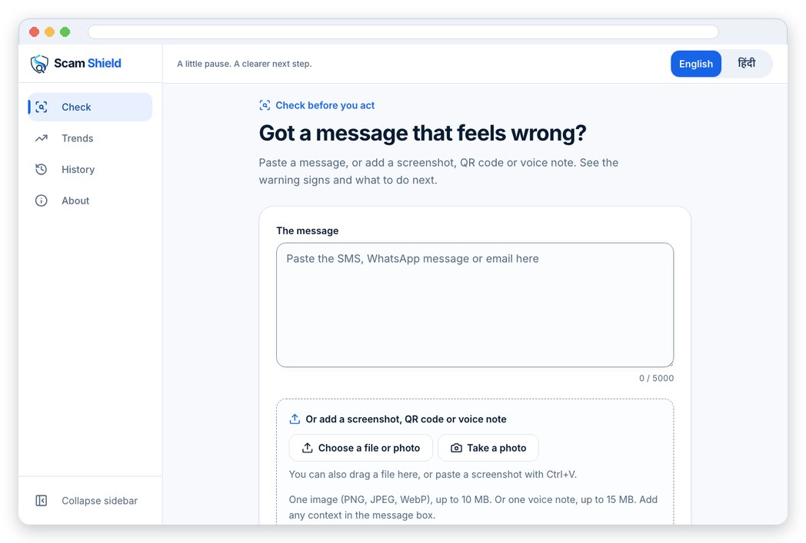
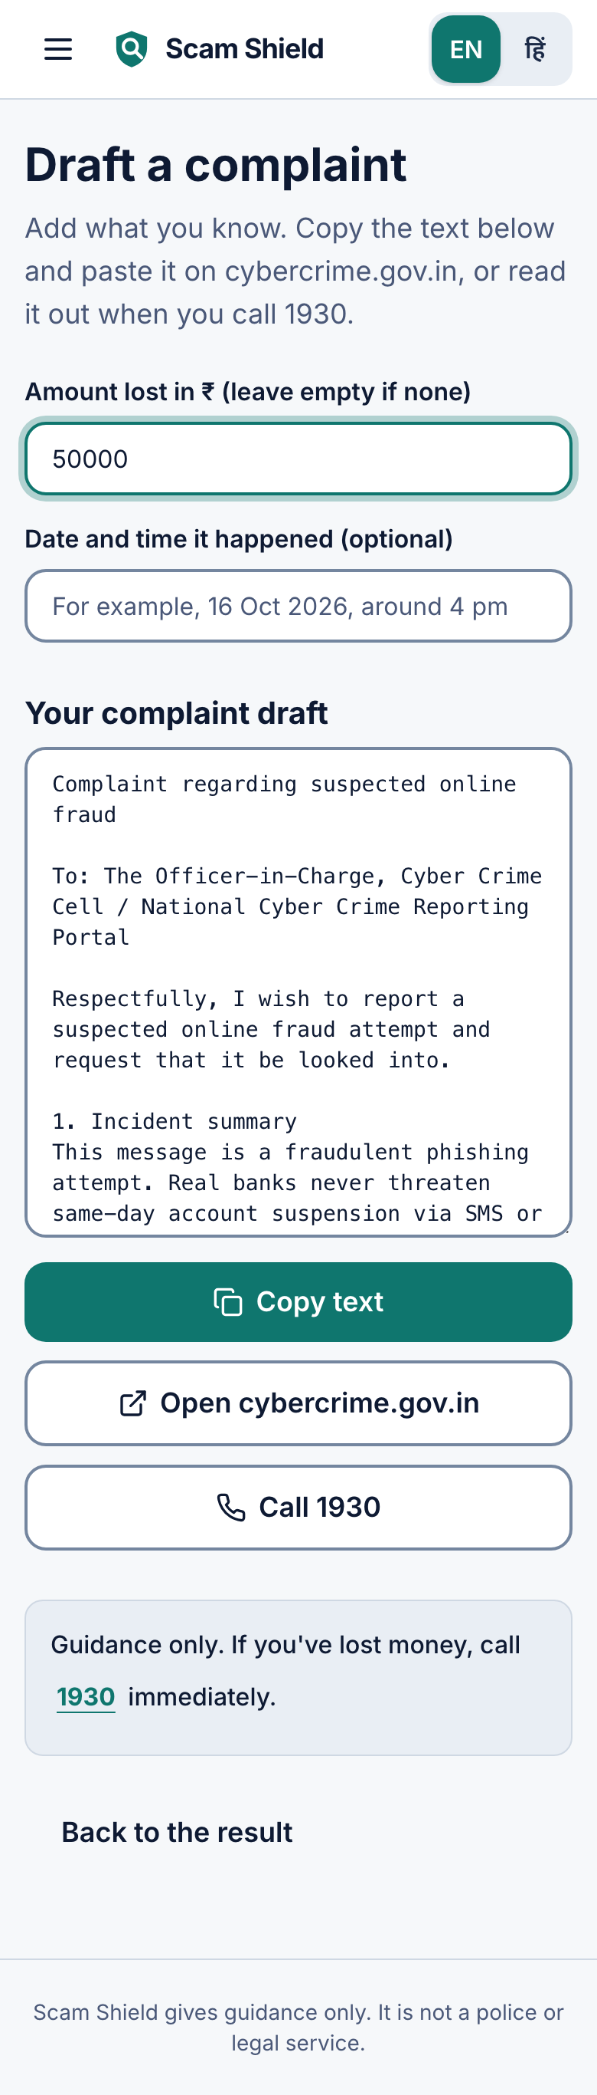
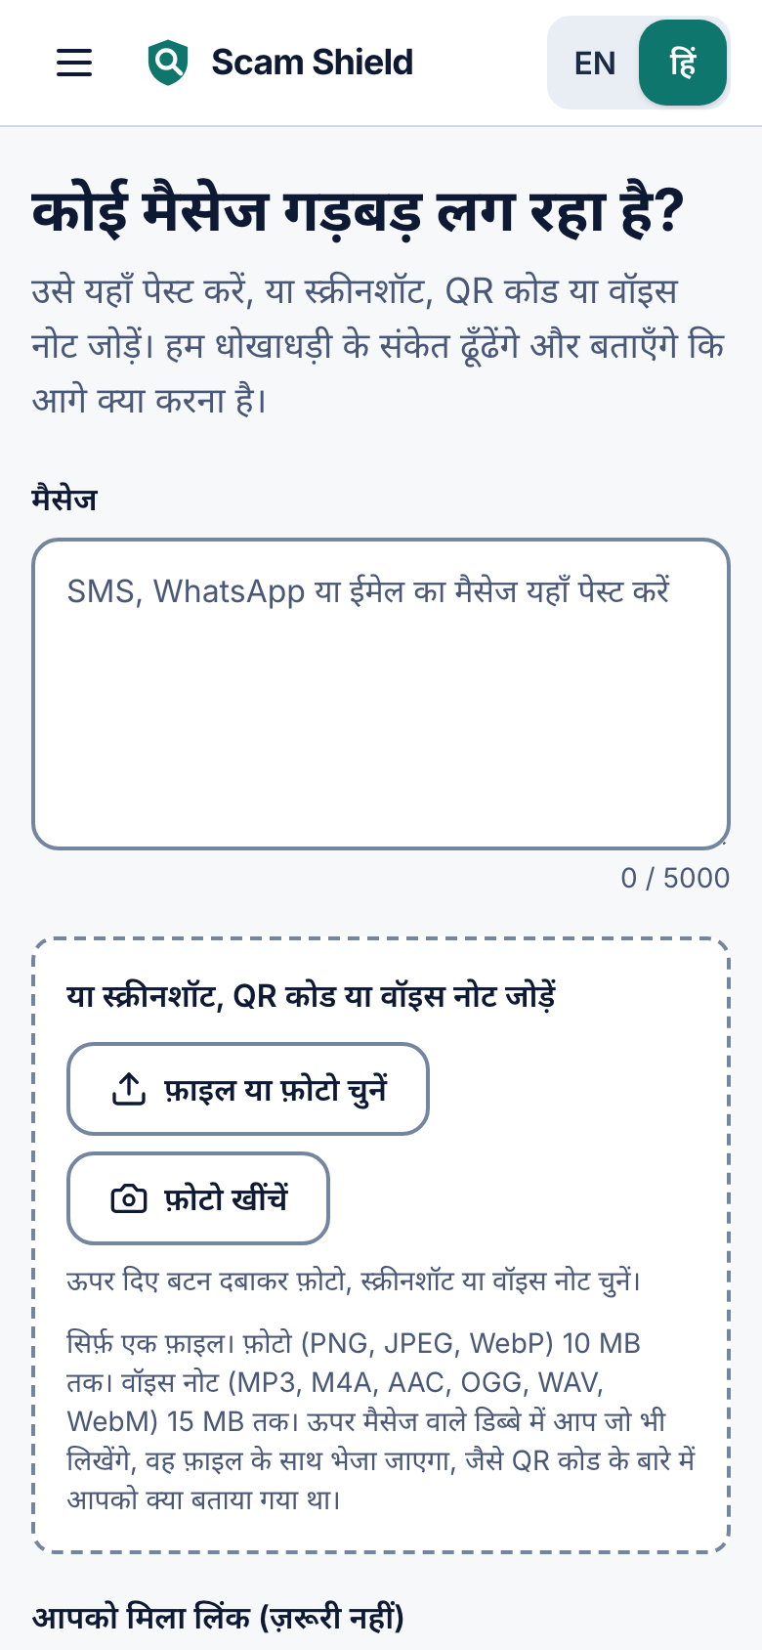
Wireframes/Mock diagrams of the proposed solution (optional)
Web app
The same flow on desktop, with a sidebar.
1 Paste or share
Text, photo, QR or voice note.
2 Act on a scam
A complaint draft ready to file.
3 Hindi
The whole app switches language.
Notes:
These are real screenshots of the running app, not mock-ups: the desktop check page, the mobile check page, the complaint page and the Hindi interface. Captured with scripts/screenshots.ts against the live production site.

Slide 8






Architecture diagram of the proposed solution
Firebase Hosting
Web app; /api/** goes to the API
Gemini on Vertex AI
One multimodal call: text, image or audio in, structured verdict out
Person
Browser or installed app (PWA), English and Hindi, Android share menu. Uploads go straight to Storage.
Firestore
Shared scam list, checks, reports, trend counters
Cloud Run: API
Stateless; 1 to 5 instances, one always warm. Limits, extraction, hard checks
Cloud Run: link scanner (private)
Isolated Chromium; scales to zero; zero-permission service account
Firebase Auth
Anonymous and Google sign-in
Cost guard
30 checks per user per day, 60 per IP per minute, 3,000 per day
Cloud Storage
Uploads, deleted after 7 days
Suspicious site
Opened only in the scanner
Product names and icons are trademarks of Google LLC, shown only to identify the technologies used. No endorsement or affiliation implied.
Notes:
Architecture as deployed (scripts/deploy.sh, region asia-south1): Firebase Hosting serves the React PWA and forwards /api/** to the Cloud Run API. The API is stateless (1 vCPU, 1 GiB, concurrency 20, min 1 and max 5 instances) and calls Gemini on Vertex AI, Firestore and the private link scanner. The link scanner (2 vCPU, 2 GiB, min 0, max 3 instances, private, no unauthenticated access) runs under its own service account with no project roles and can be invoked only by the API's service account. Cloud Storage uploads are deleted after 7 days by a lifecycle rule (scripts/storage-lifecycle.json). Limits: 30 per user per day, 60 per IP per minute, 3,000 per day overall. Product icons are shown only to identify the technologies used; no endorsement by Google is implied (trademark footnote on the slide). The icon files are kept in docs/brand/third-party. Uploads go straight from the browser to Storage.

Slide 9

Technologies to be used in the solution
Gen AI that does real work
Google Cloud and Firebase, built to scale
Gemini 3.7 Flash on Vertex AI, with Gemini 2.5 Flash as automatic fallback
One multimodal call reads text, screenshots and audio (Hinglish voice)
Schema-validated output; every red flag quotes evidence; English or Hindi
Hard checks only raise the verdict: scam list, QR pay-vs-receive
Does what rules cannot: unreported scams, images, voice
WebMCP agent tools: check_message and report_scam
Cloud Run API: stateless and autoscaling
Link scanner: scales to zero, own zero-permission service account
Firestore shared scam list; Firebase Hosting, Auth, Storage
Application
React 18
Vite
Tailwind
Workbox PWA
Node 22
TypeScript
Hono
zod
Playwright
sharp + jsQR
590+ automated tests, plus a 185-case live benchmark
Product names and icons are trademarks of Google LLC, shown only to identify the technologies used. No endorsement or affiliation implied.
Notes:
Meaningful Gen AI: a single multimodal Gemini call on Vertex AI (api/src/gemini.ts; default model gemini-3.7-flash, automatic fallback gemini-2.5-flash, location global) reads text, image or audio. Output is schema-validated (zod schemas in shared/), every red flag quotes evidence, answers come in English or Hindi. Deterministic checks can only raise the verdict. WebMCP tools: check_message and report_scam (web/src/webmcp/registerTools.ts). Scalability: the API is a stateless Cloud Run service (concurrency 20, min 1, max 5 instances); the link scanner scales to zero (max 3) under its own service account with no roles; Firestore holds the shared scam list; Firebase Hosting, Auth and Storage in front. Test count: on 18 Oct 2026 the suites passed 595 tests (shared 14, web 226, linkscan 94, eval 5, api 256); a further 18 api tests need the Firestore emulator (Java) and were not run. Also used: Cloud Build and Artifact Registry for deploys, Cloud Text-to-Speech to generate the voice example. The live benchmark behind the slide-12 numbers: 185 synthetic cases over 3 live runs (eval/results/combined.md).

Slide 10
Estimated implementation cost (optional)
FIXED
PER CHECK
FREE TIERS
about US$13
US$0.004–0.008
Free tiers
per month (estimate)
per text check (estimate)
expected at this volume (estimate)
One Cloud Run API instance kept warm (1 vCPU, 1 GiB, Mumbai) at US$0.0000025 per vCPU-second and per GiB-second, before any free tier.
Gemini 3.7 Flash at about 2,500 input and 500 to 1,500 output tokens. US$0.75 in, US$3.75 out per 1M tokens to 31 Dec 2026; double after.
Firebase Hosting, Auth, Firestore and Storage are expected to stay inside free tiers. The link scanner bills only while it scans.
Limits are the real control
30 checks per user per day, 60 per IP per minute, 3,000 per day overall. These cap spending.
Ceiling at the daily cap
3,000 checks at the per-check estimate is about US$11 to 23 per day for Gemini.
Budget alert: Rs 2,000 a month
Alerts at 50%, 90% and 100% (Rs 1,000, Rs 1,800, Rs 2,000). An alert notifies; it does not stop spending.
Notes:
Every figure on this slide is an ESTIMATE with stated assumptions, read from Google's published pages on 18 Oct 2026; none is a quote. Gemini: Vertex AI pricing page https://cloud.google.com/vertex-ai/generative-ai/pricing lists Gemini 3.7 Flash (global) at US$0.75 per 1M input tokens and US$3.75 per 1M output tokens through 31 Dec 2026, and US$1.50 / US$7.50 from 1 Jan 2027 (input includes text, image, video and audio; output includes reasoning). Assumption (ours, not measured): about 2,500 input and 500 output tokens per text check, up to 1,500 output tokens if reasoning tokens are counted. Low = 2,500 x 0.75/1M + 500 x 3.75/1M = US$0.0038; high = 2,500 x 0.75/1M + 1,500 x 3.75/1M = US$0.0075. Image and audio checks use more input tokens. At the 3,000 checks per day cap that is about US$11 to 23 per day. Cloud Run: https://cloud.google.com/run/pricing , asia-south1 (Mumbai) is Tier 1; idle minimum-instance time is US$0.0000025 per vCPU-second and per GiB-second (request-based billing). 1 vCPU + 1 GiB x 2,592,000 s (30 days) x US$0.0000025 x 2 = US$12.96 per month before any free tier; active request time is billed on top and is small. Deployed API settings (scripts/deploy.sh): 1 vCPU, 1 GiB, min 1, max 5 instances. Free tier claims for Firebase Hosting, Auth, Firestore and Storage are expectations at this volume, not measured bills. Budget alert: Rs 2,000 per month, alerts at 50%, 90% and 100% (Rs 1,000, Rs 1,800, Rs 2,000), set by the owner in Google Cloud Billing (budget name 'Scam Shield', applies to this project). A budget alert only notifies; it does not cap or stop spending. The real cost control is the per-user (30 per day), per-IP (60 per minute) and global (3,000 per day) limits in the API. Currency: USD as listed by Google; no INR conversion is claimed.

Slide 11
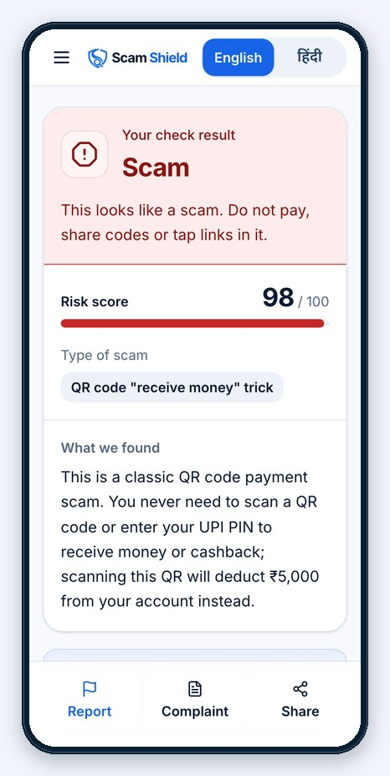
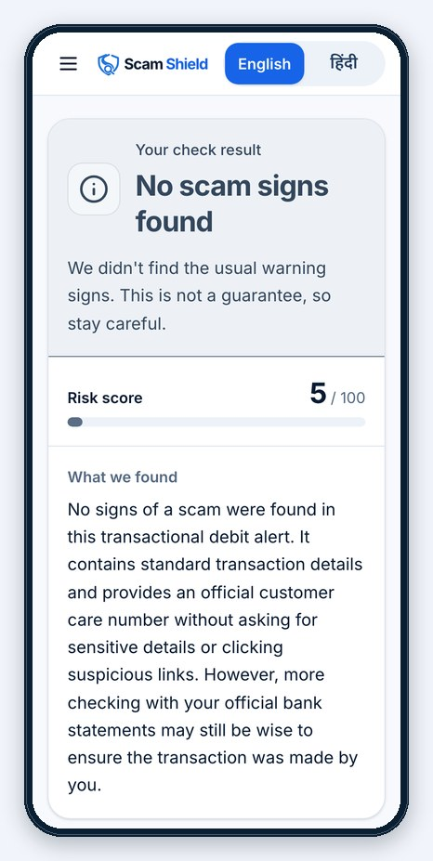
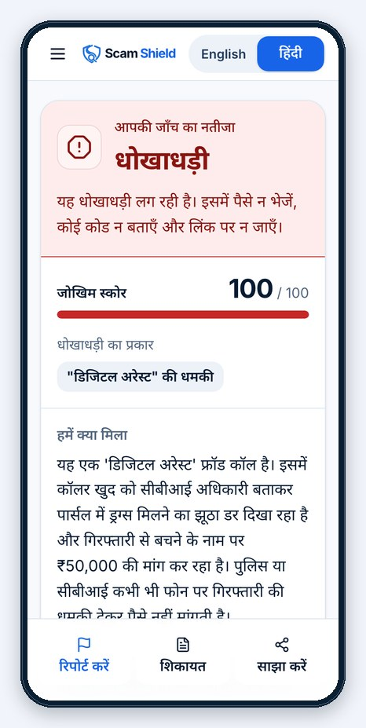
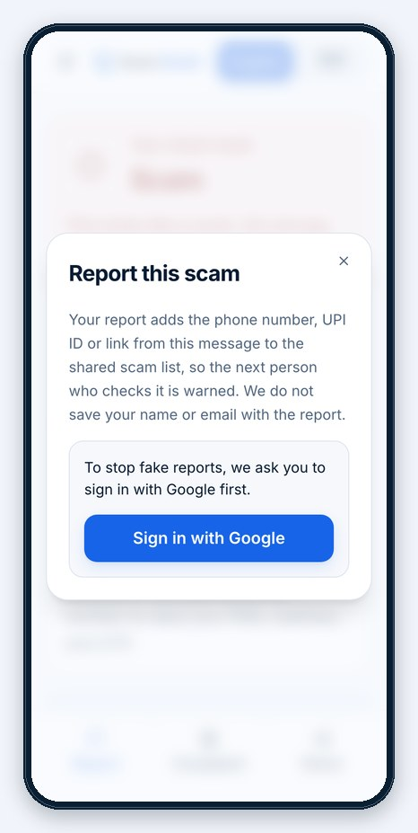
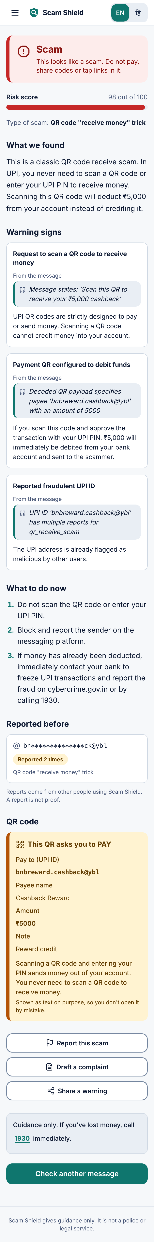
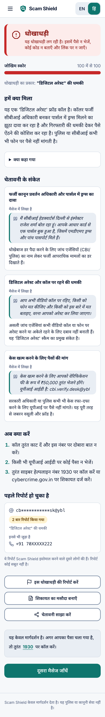
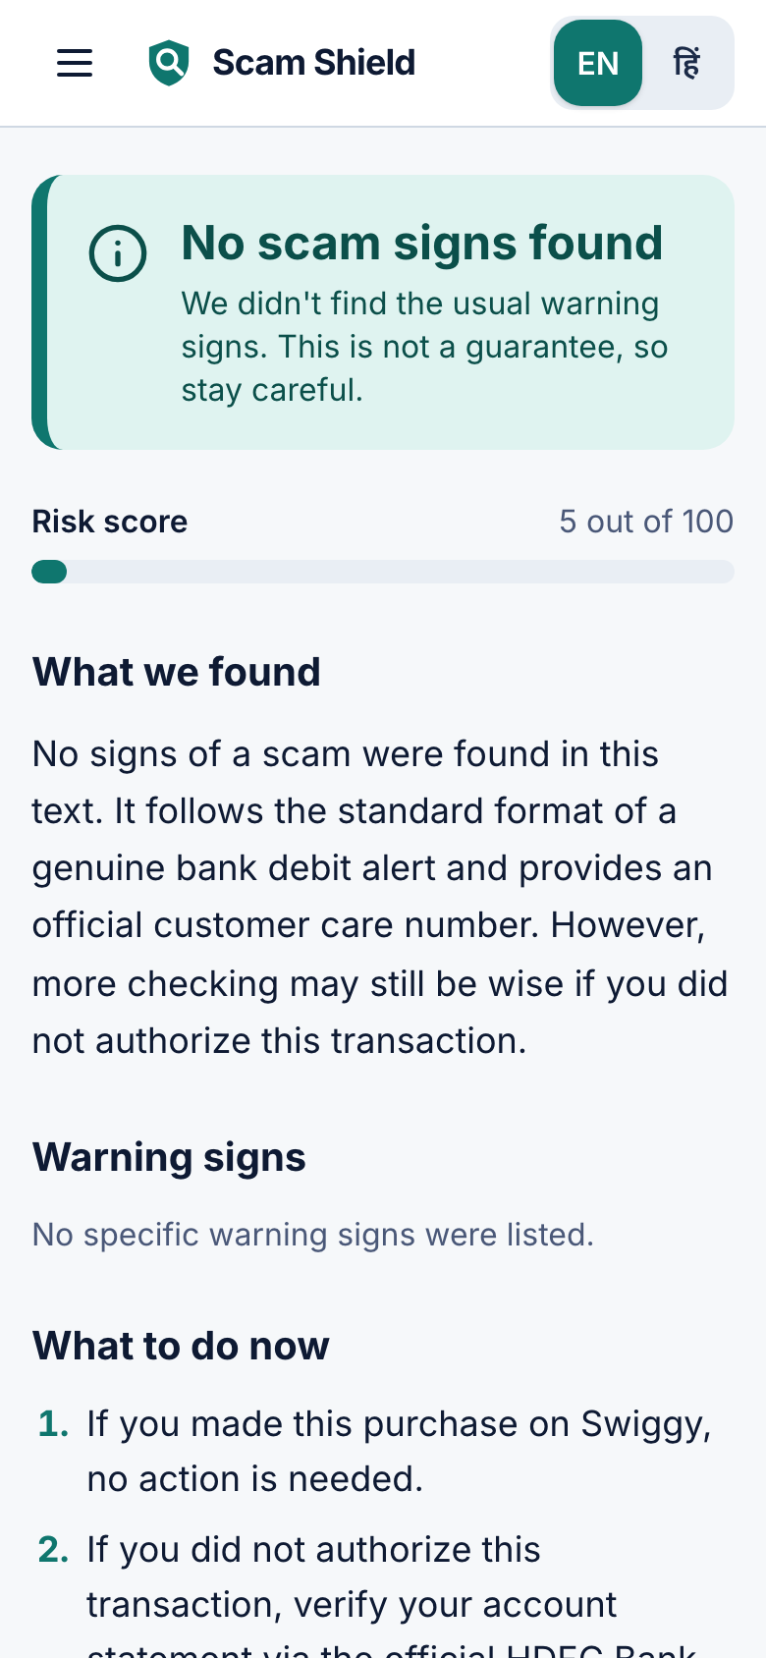
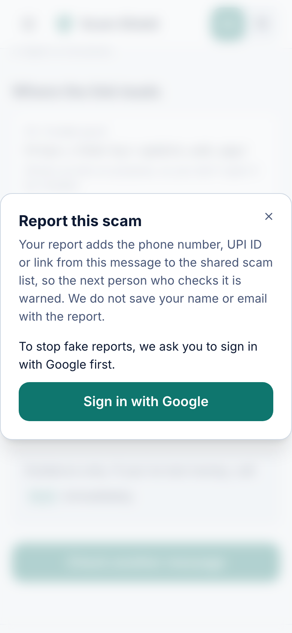
Snapshots of the prototype
Scam
Fake KYC SMS, evidence quoted
Scam
QR asks you to pay, text says receive
No scam signs found
A genuine bank alert; not a guarantee
Scam, in Hindi
Hinglish voice note, fake police call
Report
Adds it to the shared scam list
Live benchmark, 185 cases over 3 runs: 98.3% accuracy, 100% scam recall, 3.3% false positives (3 of 90 genuine)
Notes:
Real screenshots of the production app, captured by scripts/screenshots.ts from live checks (the example buttons run the same API as a typed message). Strip under the screens: live benchmark, 185 cases over 3 runs: 98.3% accuracy, 100% scam recall, 3.3% false positives (3 of 90 genuine) (eval/results/combined.md; details on the next slide). Left to right: a fake KYC SMS with a look-alike bank link; a QR that encodes a payment request while the text says 'receive'; a genuine bank debit alert with 'No scam signs found' (not a guarantee); a Hinglish 'digital arrest' voice note judged in Hindi; the report dialog, which asks for Google sign-in before a report is added to the shared list (to stop fake reports).

Slide 12
Prototype Performance report/Benchmarking
98.3%
100%
3.3%
96.7%
Accuracy
Scam recall
False-positive rate
Scam type correct
185 synthetic cases over 3 live runs: 90 scams, 90 genuine, 5 ambiguous (not scored). Accuracy is 177 of 180 scored.
Run | Cases | Accuracy | Scam recall | False positives
v1 original | 50 | 100% | 100% | 0%
v2 harder cases | 35 | 93.3% | 100% | 12.5%
v3 realistic | 100 | 99.0% | 100% | 2.0%
Combined | 185 | 98.3% | 100% | 3.3%
Read this honestly
185 cases, written by the authors: a test, not a guarantee. 90 scams over 13 types, 90 genuine.
3 false positives: scam-awareness forward that quotes a scam link, delivery update with a tracking link, friend asking for a short loan. All misses and false positives: eval/results/combined.md.
Why gemini-3.7-flash: an earlier 50-case run on gemini-3.8-flash scored 98.0% accuracy with 4.2% false positives, image checks up to 34 s.
Latency: text p50 4.5 s, p95 18.2 s; image p50 6.9 s; voice 10.3 s. Errors: 0. p50 is the median, p95 the slowest 5%.
Keyword baseline: on v2's 34 text cases it scored 94.1%, the same as Gemini, with different mistakes; v3 84.0% accuracy and 72.0% recall (Gemini 99.0% and 100%).
First run, 50 cases: 100% accuracy, 100% recall, 0% false positives. Hindi run, same 50 cases: 100%, 100%, 0%.
Notes:
Benchmark, combined over 3 live runs of the production app (single source: eval/results/combined.md, written by eval/aggregate.ts): 185 synthetic cases over 3 live runs: 98.3% accuracy, 100% scam recall, 3.3% false positives (3 of 90 genuine). Scam type correct 96.7%; errors 0. Accuracy is 177 of 180 scored cases; the 5 ambiguous inputs are not scored as scam or genuine, and none was given a Scam verdict. Per run: v1 50 cases (2026-10-17): accuracy 100%, recall 100%, false positives 0%; v2 35 cases (2026-10-18): accuracy 93.3%, recall 100%, false positives 12.5%; v3 100 cases (2026-10-18): accuracy 99.0%, recall 100%, false positives 2.0%. v1 is the original 50 cases, v2 is 35 adversarial and look-alike cases (14 adversarial scams, 16 benign look-alikes, 5 ambiguous), v3 is 100 realistic cases (50 scams, 50 genuine). Nothing was tuned after v2 and v3 results were seen. The 3 false positives: l03 (scam-awareness forward that quotes a scam link); l08 (delivery update with a tracking link); v3g40 (friend asking for a short loan). Missed scams: none. All misses and false positives are listed in eval/results/combined.md. Latency (successful calls): text p50 4.5 s, p95 18.2 s over 179 cases; image p50 6.9 s, p95 8.6 s; audio 10.3 s (one case). Wall-clock from request to response, concurrency 1. Keyword baseline (eval/baseline.ts, about 30 rules, text only): on v2 94.1% accuracy against Gemini's 94.1% (the same score, with different mistakes; see eval/results/run-v2.md); on v3 84.0% accuracy and 72.0% recall against Gemini's 99.0% and 100% (eval/results/run-v3.md). A keyword filter does well on textbook scams; the harder sets are where the model adds value. History: the first run (2026-10-17, 50 cases, eval/results/latest.md) scored 100% accuracy, 100% recall, 0% false positives; it is a valid earlier run but not the headline, because 50 cases written by the authors could not show the weak spots that v2 and v3 probe. It also exposed a real bug (the model did not know today's date and flagged 2026 dates as future); that was fixed and re-measured. The Hindi run (2026-10-17, eval/results/run-hindi.md) used the same 50 cases with the interface in Hindi: accuracy 100%, recall 100%, false positives 0%, scam type correct 100%. Model choice: an earlier comparison on the first 50 cases with gemini-3.8-flash (2026-10-16) scored accuracy 98.0%, false-positive rate 4.2%, image p95 33.8 s; that is why the default is gemini-3.7-flash, with gemini-2.5-flash as fallback (api/src/index.ts). This is a synthetic sanity check written by the authors, not a guarantee of real-world accuracy.

Slide 13




Additional Details/Future Development (if any)
More Indian languages
Bank & telecom partners
URL reputation feeds
Android app
Tamil, Telugu, Marathi, Bengali and more.
Verified reports feed the shared scam list.
Add Google Web Risk next to the isolated scan.
Share SMS and notifications to a check.
Plans, not shipped. Search grounding is built but off by default.
Google Search grounding
Call-recording upload
Misinformation mode
Switch on for link checks once quota allows.
Check recorded calls, not just voice notes.
The same engine for "is this forward real?"
How it scales
Stateless API
Cloud Run adds instances (1 to 5 today) as traffic grows; the daily cap is a setting, not a rebuild.
Managed data
Firestore, Hosting, Auth and Storage need no servers to run; uploads auto-delete after 7 days.
Cost stays bounded
Per-user, per-IP and global limits rise only as budget allows; App Check adds abuse protection next.
Notes:
Roadmap items are plans, not shipped features. Scale story, from what is deployed today (scripts/deploy.sh): API on Cloud Run, stateless, concurrency 20, min 1 and max 5 instances; link scanner scales to zero (max 3); Firestore for the shared scam list; Firebase Hosting, Auth and Storage; per-user (30 per day), per-IP (60 per minute) and global (3,000 per day) limits; uploads auto-delete after 7 days. Misinformation mode ('is this forward real?') is an idea for the same engine, not built. Raising the cap or max instances is a configuration change. Hardening ideas: Firebase App Check and a stricter per-device limit (DETAILS.md). Google Search grounding is implemented but off by default because of quota errors on this project.

Slide 14
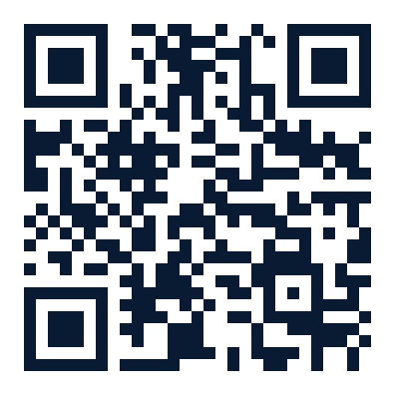
Provide links to your:
GitHub Public Repository
https://github.com/Namans12/scam-shield
Demo Video Link (3 Minutes)
https://youtu.be/a678nAYddq0
Final Product Link
https://scam-shield-live.web.app
Scan to try the live app
Paste a suspicious message and see the verdict.
Pause. Check. Then act.
Notes:
GitHub (public): https://github.com/Namans12/scam-shield . Live product: https://scam-shield-live.web.app (the QR code points here). Demo video (3 minutes): https://youtu.be/a678nAYddq0

Slide 15
Pause. Check. Then act.
Check what you were just sent before you act on it. Free, in English and Hindi.
Gemini reads any input
Evidence for every flag
A scam becomes action
scam-shield-live.web.app
Notes:
Closing slide: Scam Shield, 'Pause. Check. Then act.' The live app address is at the bottom. The template's final 'Thank you' slide follows.

Slide 16

Notes:
Thank you. Team Scam Shield: Naman Shrimal. Live app: https://scam-shield-live.web.app ; code: https://github.com/Namans12/scam-shield .

