Slide 1
An efficient ECG signals denoising technique based on the combination of particle swarm optimisation and wavelet transform

Slide 2
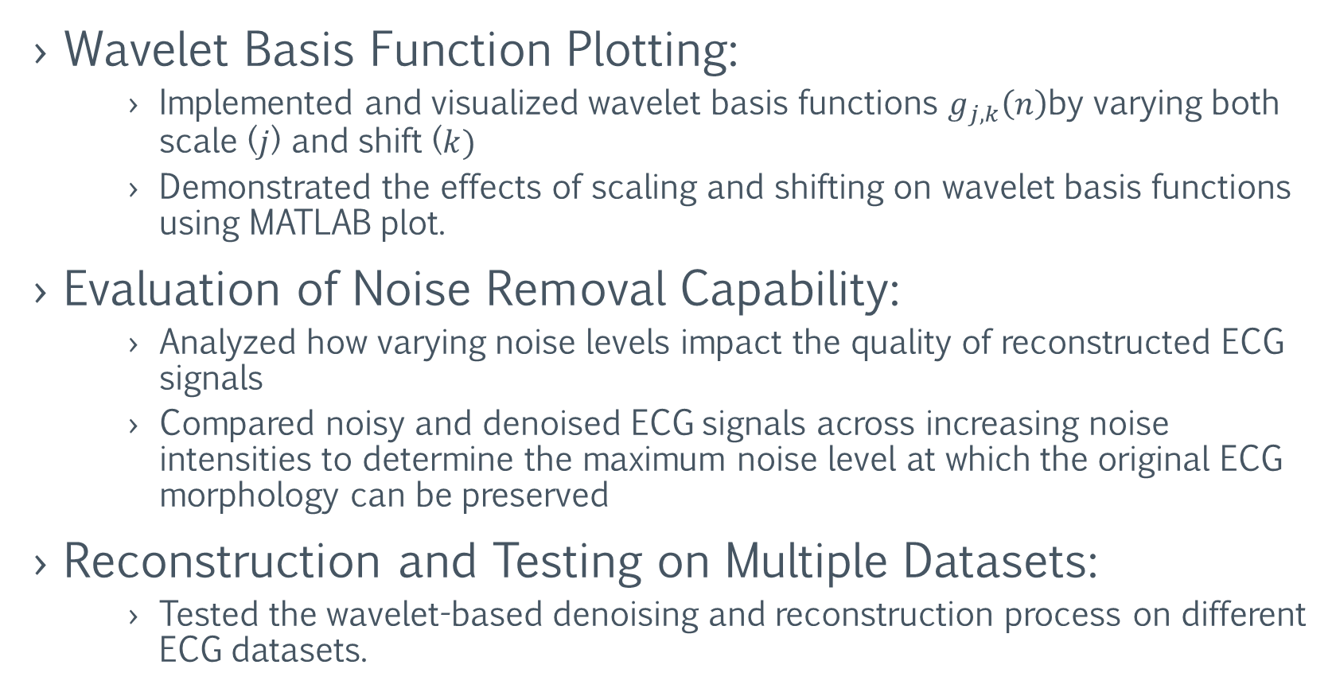
Update:
Wavelet Basis Function Plotting:
Implemented and visualized wavelet basis functions $g_{j,k}\left(n\right)$by varying both scale ($j$) and shift ($k)$
Demonstrated the effects of scaling and shifting on wavelet basis functions using MATLAB plot.
Evaluation of Noise Removal Capability:
Analyzed how varying noise levels impact the quality of reconstructed ECG signals
Compared noisy and denoised ECG signals across increasing noise intensities to determine the maximum noise level at which the original ECG morphology can be preserved
Reconstruction and Testing on Multiple Datasets:
Tested the wavelet-based denoising and reconstruction process on different ECG datasets.

Slide 3
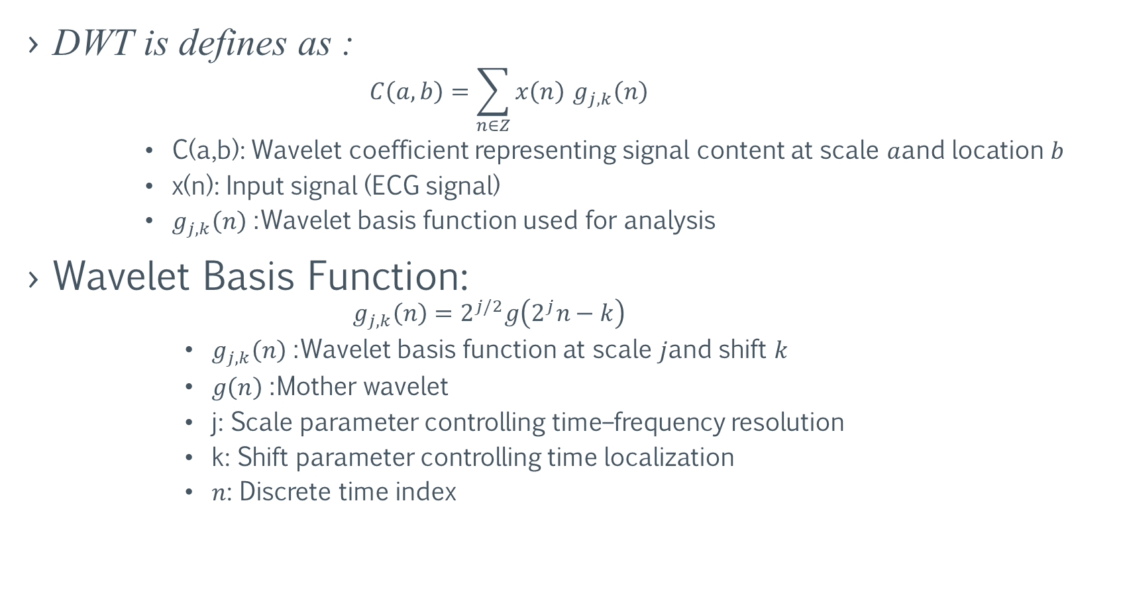
Wavelet Basis Function Plotting:
DWT is defines as :
$$C\left(a,b\right)=\sum_{n∈Z}{x\left(n\right)} g_{j,k}\left(n\right)$$
C(a,b): Wavelet coefficient representing signal content at scale $a$and location $b$
x(n): Input signal (ECG signal)
$g_{j,k}\left(n\right)$: Wavelet basis function used for analysis
Wavelet Basis Function:
$$g_{j,k}\left(n\right)=2^{j/2}g\left(2^{j}n−k\right)$$
$g_{j,k}\left(n\right)$: Wavelet basis function at scale $j$and shift $k$
$g\left(n\right)$: Mother wavelet
j: Scale parameter controlling time–frequency resolution
k: Shift parameter controlling time localization
$n$: Discrete time index

Slide 4
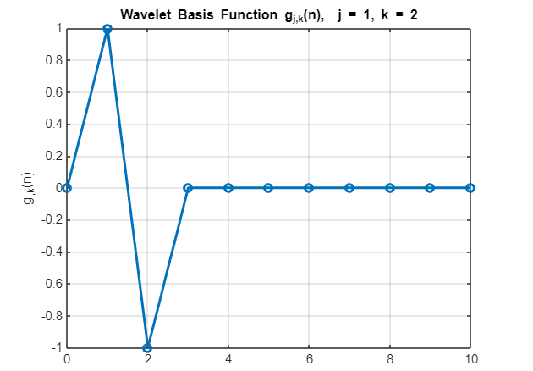
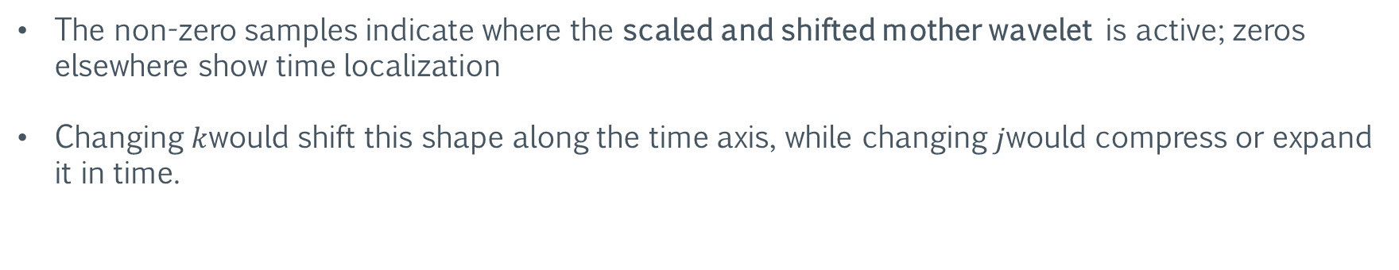
PLOTS: (Basis Function plotting)
The non-zero samples indicate where the scaled and shifted mother wavelet is active; zeros elsewhere show time localization
Changing $k$would shift this shape along the time axis, while changing $j$would compress or expand it in time.

Slide 5
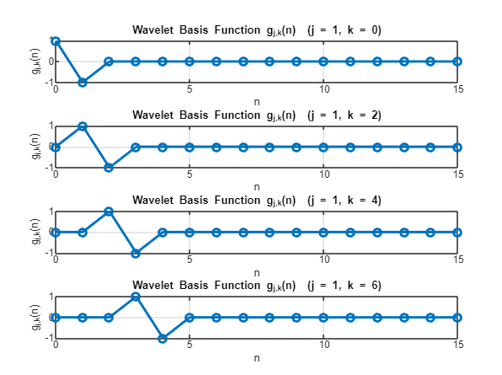
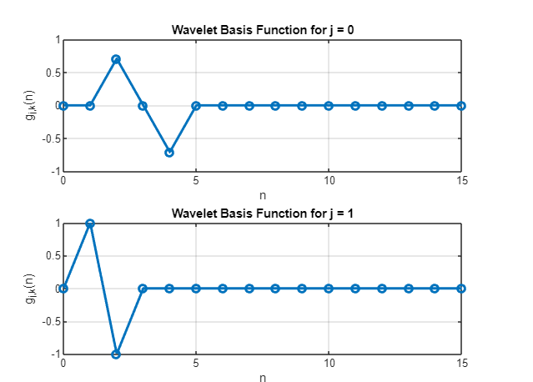
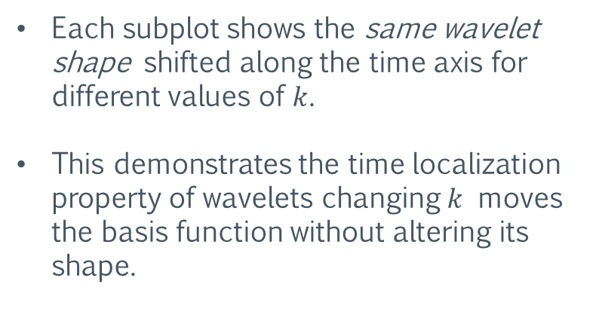
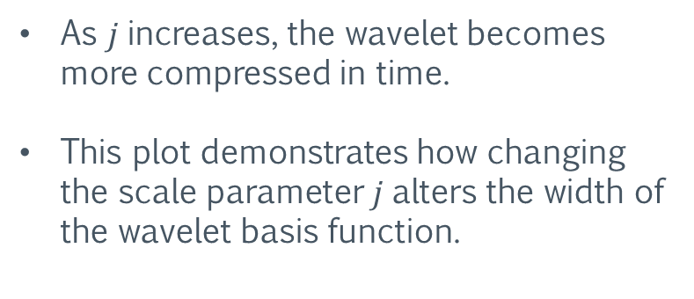
PLOTS: (Shifting and Scaling)
As $j$increases, the wavelet becomes more compressed in time.
This plot demonstrates how changing the scale parameter $j$alters the width of the wavelet basis function.
Each subplot shows the same wavelet shape shifted along the time axis for different values of $k$.
This demonstrates the time localization property of wavelets changing $k$ moves the basis function without altering its shape.

Slide 6
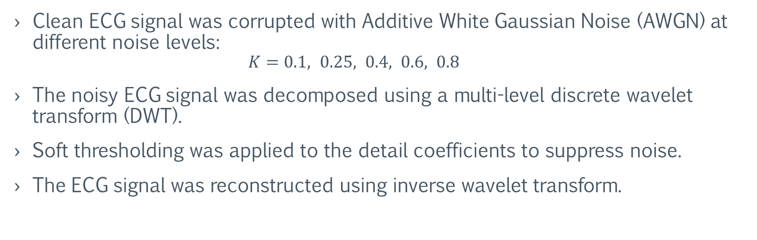
Evaluation of Noise Removal Capability Using Wavelet Denoising
Clean ECG signal was corrupted with Additive White Gaussian Noise (AWGN) at different noise levels:
$$K=0.1, 0.25, 0.4, 0.6, 0.8$$
The noisy ECG signal was decomposed using a multi-level discrete wavelet transform (DWT).
Soft thresholding was applied to the detail coefficients to suppress noise.
The ECG signal was reconstructed using inverse wavelet transform.

Slide 7
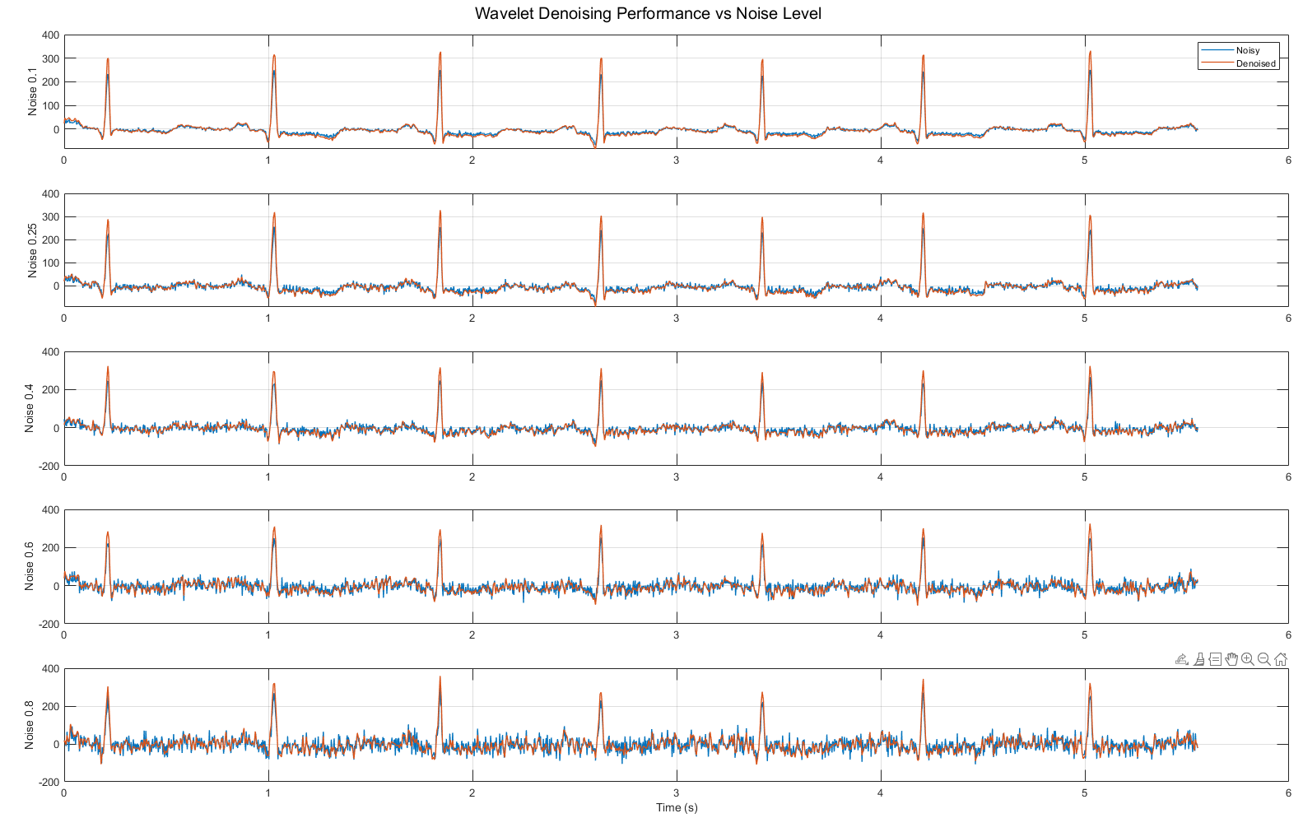
At lower noise levels (0.1–0.25), the denoised ECG closely matches the original morphology, including clear QRS complexes.
As the noise level increases, the noisy signal becomes highly distorted, but the wavelet denoising method still preserves major ECG features.

Slide 8
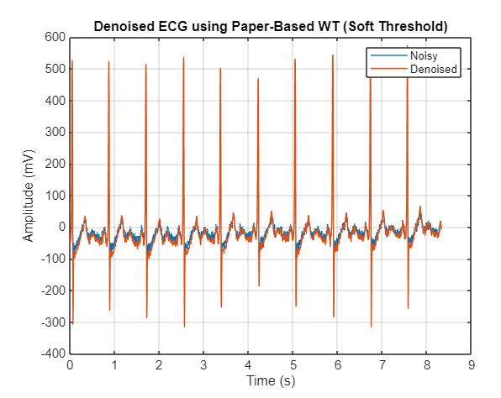
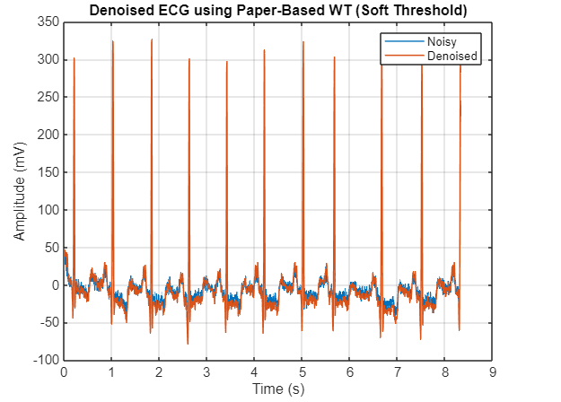
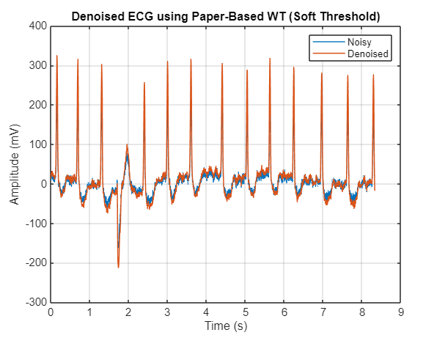
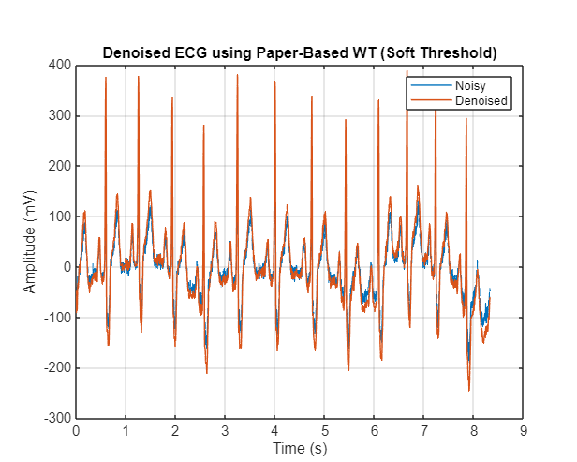
Reconstruction and Testing on Multiple Datasets:

