Slide 1
An efficient ECG signals denoising technique based on the combination of particle swarm optimisation and wavelet transform

Slide 2
Update:
PSO (Particle Swarm Optimization)
Orthogonality demonstration for wavelet basis
Write functions for shifting and Scaling

Slide 3
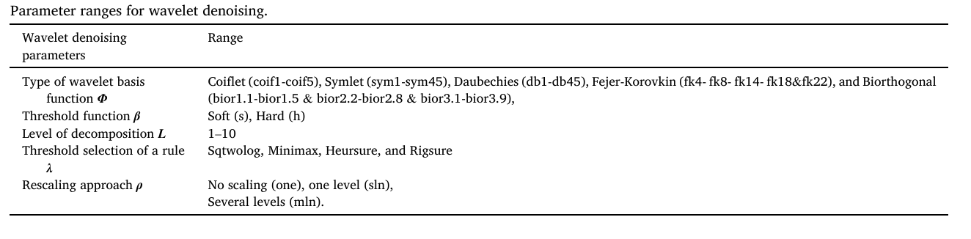
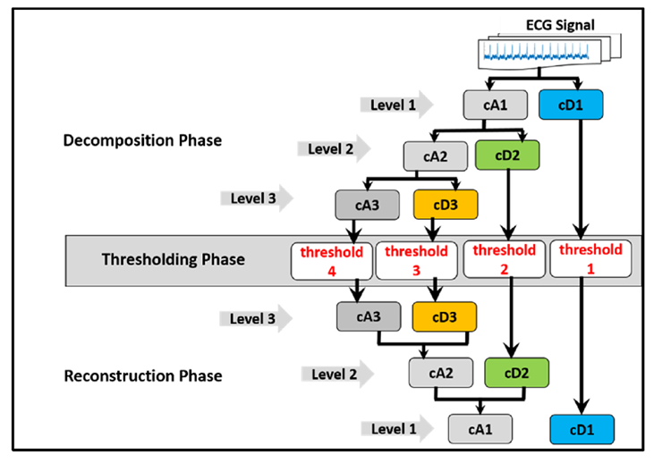
PSO(Particle Swarm Optimization)

Slide 4
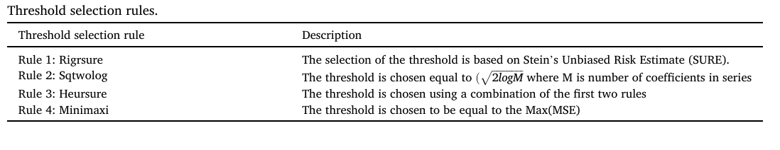
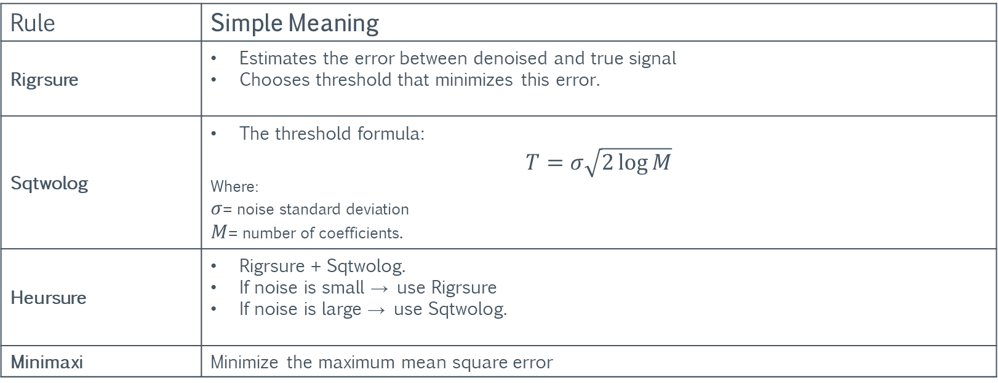
Rule | Simple Meaning
Rigrsure | Estimates the error between denoised and true signal Chooses threshold that minimizes this error.
Sqtwolog | The threshold formula: $$T=σ\sqrt{2\log{M}}$$ Where: $σ$= noise standard deviation $M$= number of coefficients.
Heursure | Rigrsure + Sqtwolog. If noise is small → use Rigrsure If noise is large → use Sqtwolog.
Minimaxi | Minimize the maximum mean square error

Slide 5
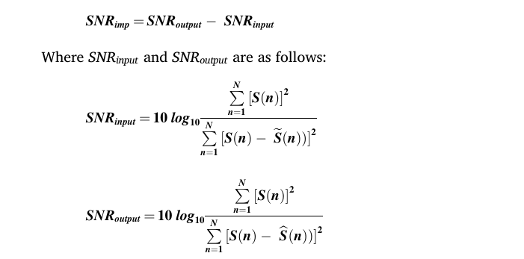

Main Optimization
Here S(n) represents the original ECG signal
is the noisy ECG signal
is the denoised ECG signal
PSO tries to:
Maximize SNR improvement(fitness function)

Slide 6
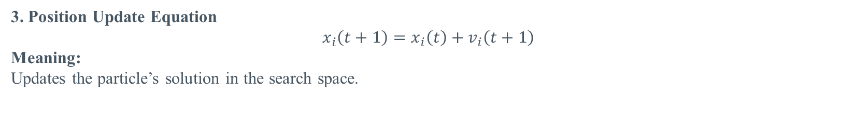
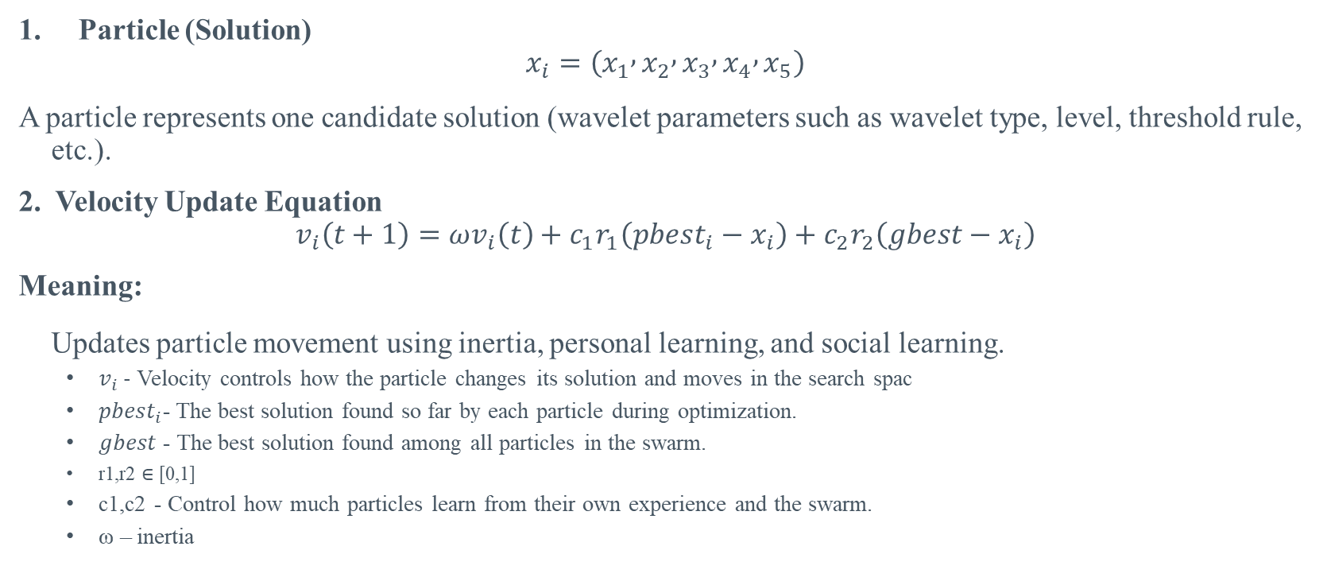
PSO Key Terms and Equations
Particle (Solution)
$$x_{i}=\left(x_{1} , x_{2} , x_{3} , x_{4} , x_{5}\right)$$ A particle represents one candidate solution (wavelet parameters such as wavelet type, level, threshold rule, etc.).
2. Velocity Update Equation
$$v_{i}\left(t+1\right)=ωv_{i}\left(t\right)+c_{1}r_{1}\left(pbest_{i}−x_{i}\right)+c_{2}r_{2}\left(gbest−x_{i}\right)$$
Meaning: Updates particle movement using inertia, personal learning, and social learning.
$v_{i} -$Velocity controls how the particle changes its solution and moves in the search spac
$pbest_{i}$- The best solution found so far by each particle during optimization.
$gbest$ - The best solution found among all particles in the swarm.
r1​,r2​ ∈ [0,1]
c1​,c2​ - Control how much particles learn from their own experience and the swarm.
ω – inertia
3. Position Update Equation
$$x_{i}\left(t+1\right)=x_{i}\left(t\right)+v_{i}\left(t+1\right)$$
Meaning: Updates the particle’s solution in the search space.

Slide 7
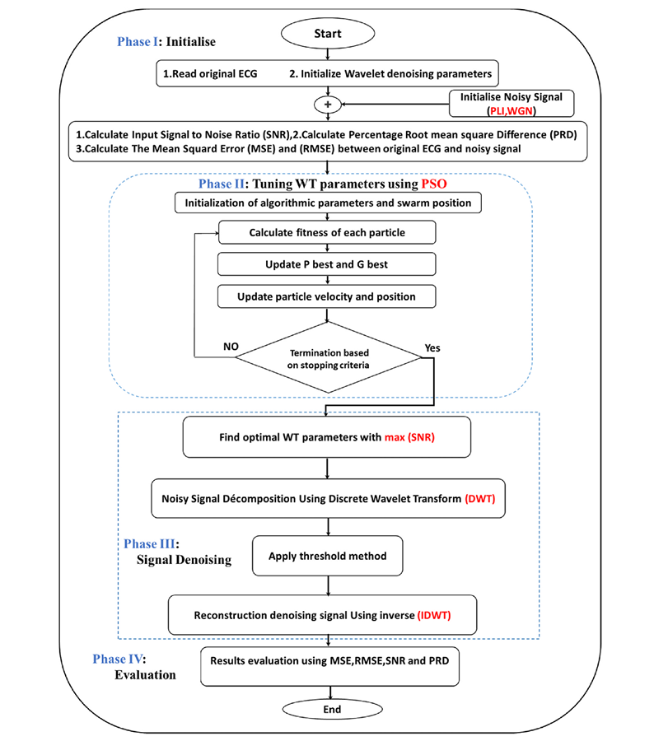
Methodology

Slide 8

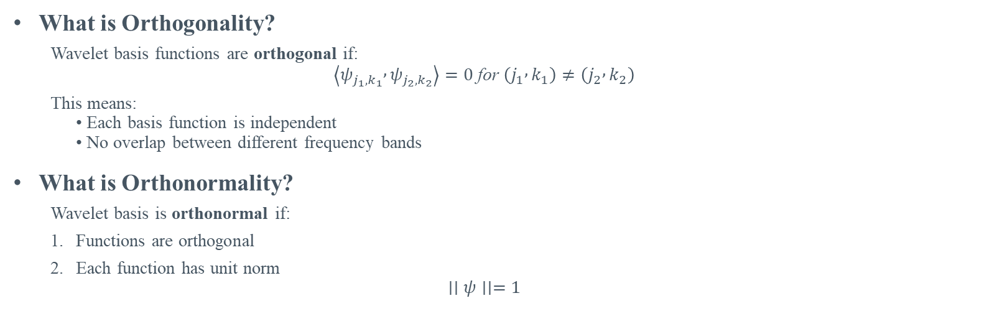

Orthogonal and Orthonormal Demonstration
What is Orthogonality?
Wavelet basis functions are orthogonal if:
$$\left\langle ψ_{j_{1},k_{1}} , ψ_{j_{2},k_{2}}\right\rangle =0 \text{for} \left(j_{1} , k_{1}\right)≠\left(j_{2} , k_{2}\right)$$
This means: • Each basis function is independent • No overlap between different frequency bands
What is Orthonormality?
Wavelet basis is orthonormal if:
Functions are orthogonal
Each function has unit norm
$$∣∣ψ∣∣=1$$
Given Wavelet Filters
You have:
$$φ=\left[0.5 , , 1 0.5\right], ψ=\left[1 , , 0 −1\right]$$
Check Orthogonality (DOT Product):
So compute the dot product:
$$φ⋅ψ=\left(0.5\right)\left(1\right)+\left(1\right)\left(0\right)+\left(0.5\right)\left(−1\right)$$
$$=0.5+0−0.5=0$$

Slide 9
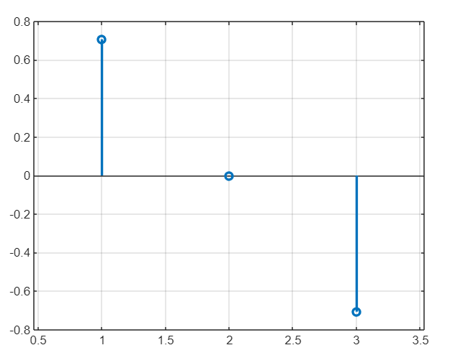
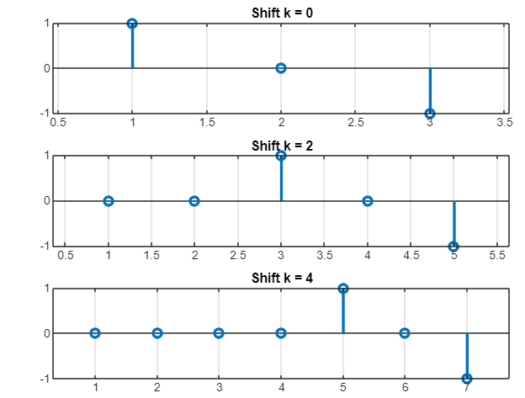
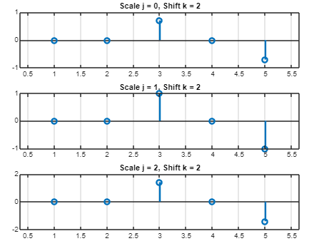
Shifting and Scaling Function

