Slide 1
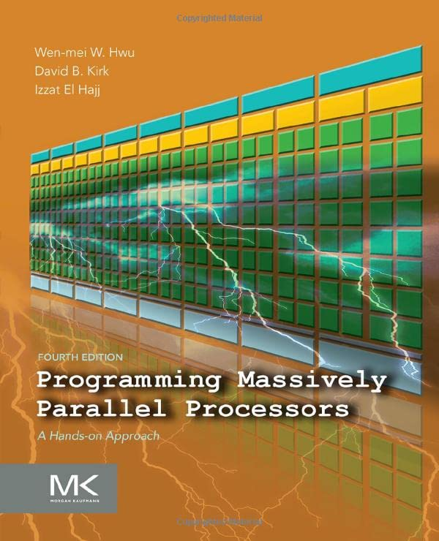
pmpp book ch. 1-3
CUDA-MODE
Lecture 2

Slide 2
Agenda for Lecture 2
1: Introduction
2: Heterogeneous data parallel computing
3: Multidimensional grids and data

Slide 3
Ch 1: Introduction
motivation: GPU go brrr, more FLOPS please
Why? Simulation & world-models (games, weather, proteins, robotics)
Bigger models are smarter -> AGI (prevent wars, fix climate, cure cancer)
GPUs are the backbone of modern deep learning
classic software: sequential programs
higher clock rate trend for CPU slowed in 2003: energy consumption & heat dissipation
multi-core CPU came up
developers had to learn multi-threading (deadlocks, races etc.)

Slide 4
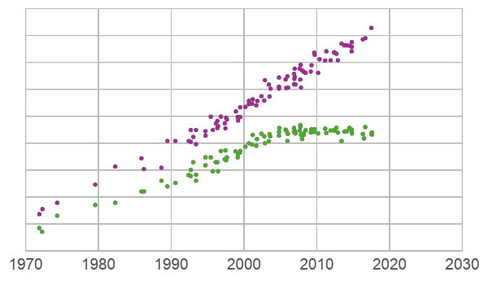
The Power Wall
10⁸
Transistors (thousands)
10⁷
10⁶
10⁵
10⁴
Frequency
(MHz)
10³
10²
10¹
10⁰
Source: M. Horowitz, F. Labonte, O. Shacham, K. Olukotun, L. Hammond, C. Batten (1970-2010 ). K. Rupp (2010-2017).
(increasing frequency further would make the chip too hot to cool feasibly)

Slide 5
The rise of CUDA
CUDA is all about parallel programs (modern software)
GPUs have (much) higher peak FLOPS than multi-core CPUs
main principle: divide work among threads
GPUs focus on execution throughput of massive number of threads
programs with few threads perform poorly on GPUs
CPU+GPU: sequential parts on CPU, numerical intensive parts on GPU
CUDA: Compute Unified Device Architect
GPGPU: Before CUDA tricks were used to compute with graphics APIs (OpenGL or Direct3D)
GPU programming is now attractive for developers (thanks to massive availability)

Slide 6
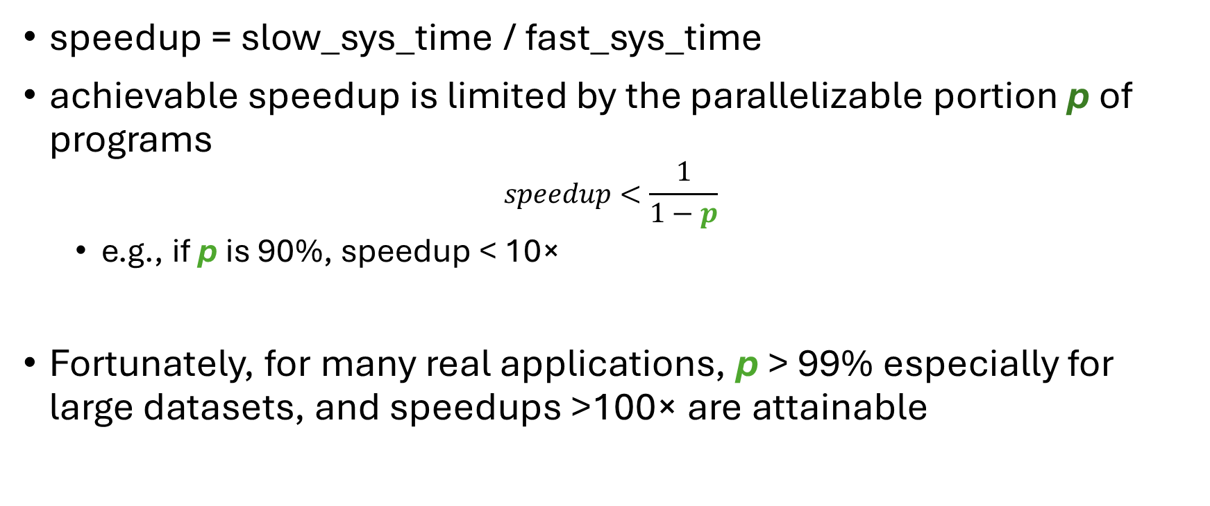
Amdahl's Law

Slide 7
Challenges
"if you do not care about performance, parallel programming is very easy"
designing parallel algorithms in practice harder than sequential algorithms e.g. parallelizing recurrent computations requires nonintuitive thinking (like prefix sum)
speed is often limited by memory latency/throughput (memory bound)
perf of parallel programs can vary dramatically based on input data characterists
not all apps are "embarassingly parallel" - synchronization imposes overhead (waits)

Slide 8
Main Goals of the Book
1. Parallel programming & computational thinking
2. Correct & reliable: debugging function & performance
3. Scalability: regularize and localize memory access
PMPP aims to build up the foundation for parallel programming in general
GPUs as learning vehicle - techniques apply to other accelerators
concepts are introduced hands-on as concrete CUDA examples

Slide 9
Ch 2: Heterogeneous data parallel computing
heterogeneous: CPU + GPU
data parallelism: break work down into computations that can be executed independently
Two examples: vector addition & kernel to convert an RGB image to grayscale
Independence: each RGB pixel can be converted individually
L = r*0.21 + g*0.72 + b*0.07 (L=luminance)
simple weighted sum

Slide 10
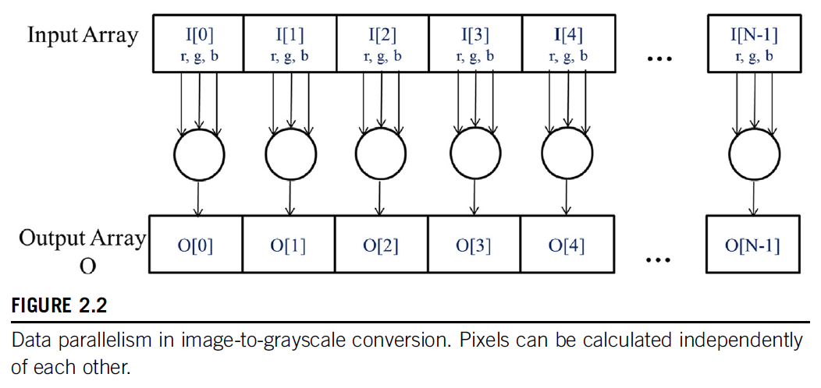
RGB->Grayscale, data independence

Slide 11
CUDA C
extends ANSI C with minimal new syntax
Terminology: CPU = host, GPU = device
CUDA C source can be mixture of host & device code
device code functions: kernels
grid of threads: many threads are launched to execute a kernel
CPU & GPU code runs concurrently (overlapped)
on GPU: don't be afraid of launching many threads
e.g. one thread pre (output) tensor element is fine

Slide 12
Example: Vector Addition
vector addition example:
main concept loop -> threads
Easily parallelizable: all additions can be computed independently
Naïve GPU vector addition:
Allocate device memory for vectors
Transfer inputs host -> device
Launch kernel and perform additions
Copy device -> host back
Free device memory
normally we keep data on the gpu as long as possible to asynchronously schedule many kernel launches

Slide 13
Input Vector x:
Input Vector y:
Output Vector z:
One thread per vector element

Slide 14
CUDA Essentials: Memory allocation
nvidia devices come with their own DRAM (device) global memory (in Ch 5 we learn about other mem types)
cudaMalloc & cudaFree:
float *A_d;
size_t size = n * sizeof(float); // size in bytes
cudaMalloc((void**)&A_d, size); // pointer to pointer!
...
cudaFree(A_d);

Slide 15
cudaMemcpy: Host <-> Device Transfer
Copy data from CPU memory to GPU memory and vice versa
// copy input vectors to device (host -> device)
cudaMemcpy(A_d, A_h, size, cudaMemcpyHostToDevice);
cudaMemcpy(B_d, B_h, size, cudaMemcpyHostToDevice);
...
// transfer result back to CPU memory (device -> host)
cudaMemcpy(C_h, C_d, size, cudaMemcpyDeviceToHost);

Slide 16
CUDA Error handling
CUDA functions return `cudaError_t` .. if not `cudaSuccess` we have a problem ...
always check returned error status ☺

Slide 17
Kernel functions fn<<<>>>
Launching kernel = grid of threads is launched
All threads execute the same code: Single program multiple-data (SPMD)
Threads are hierarchically organized into grid blocks & thread blocks
up to 1024 threads can be in a thread block

Slide 18
Kernel Coordinates
built-in variables available inside the kernel: blockIdx, threadIdx
these "coordinates" allow threads (all executing the same code) to identify what to do (e.g. which portion of the data to process)
each thread can be uniquely identified by threadIdx & blockIdx
telephone system analogy: think of blockIdx as the area code and threadIdx as the local phone number
built-in blockDim tells us the number of threads in a block
for vector addition we can calculate the array index of the thread `int i = blockIdx.x * blockDim.x + threadIdx.x;`

Slide 19
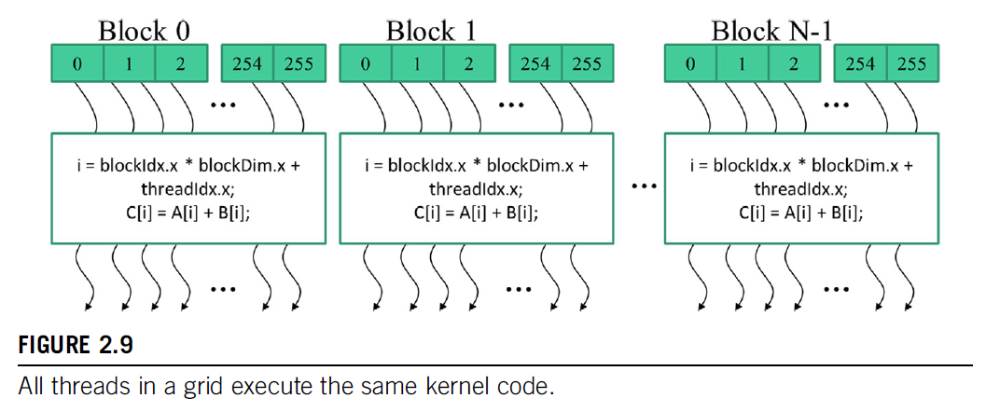
Threads execute the same kernel code

Slide 20
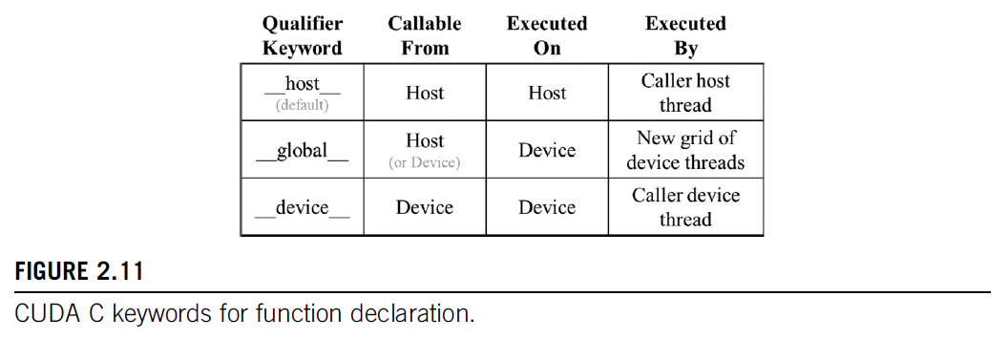
__global__ & __host__
declare a kernel function with __global__
calling a __global__ function -> launches new grid of cuda threads
functions declared with __device__ can be called from within a cuda thread
if both __host__ & __device__ are used in a function declaration CPU & GPU versions will be compiled

Slide 21
Vector Addition Example
general strategy: replace loop by grid of threads!
data sizes might not perfectly divisible by block sizes: always check bounds
prevent threads of boundary block to read/write outside allocated memory
01 // compute vector sum C = A + B
02 // each thread peforms one pair-wise addition
03 __global__
04 void vecAddKernel(float* A, float* B, float* C, int n) {
05 int i = threadIdx.x + blockDim.x * blockIdx.x;
06 if (i < n) { // check bounds
07 C[i] = A[i] + B[i];
08 }
09 }

Slide 22
Calling Kernels
kernel configuration is specified between `<<<` and `>>>`
number of blocks, number of threads in each block
we will learn about additional launch parameters (shared-mem size, cudaStream) later
dim3 numThreads(256);
dim3 numBlocks((n + numThreads - 1) / numThreads);
vecAddKernel<<<numBlocks, numThreads>>>(A_d, B_d, C_d, n);

Slide 23
Compiler
nvcc (NVIDIA C compiler) is used to compile kernels into PTX
Parallel Thread Execution (PTX) is a low-level VM & instruction set
graphics driver translates PTX into executable binary code (SASS)

Slide 24
Ch 3: Multidimensional grids and data
CUDA grid: 2 level hierarchy: blocks, threads
Idea: map threads to multi-dimensional data
all threads in a grid execute the same kernel
threads in same block can access the same shared mem
max block size: 1024 threads
built-in 3D coordinates of a thread: blockIdx, threadIdx - identify which portion of the data to process
shape of grid & blocks:
gridDim: number of blocks in the grid
blockDim: number of threads in a block

Slide 25
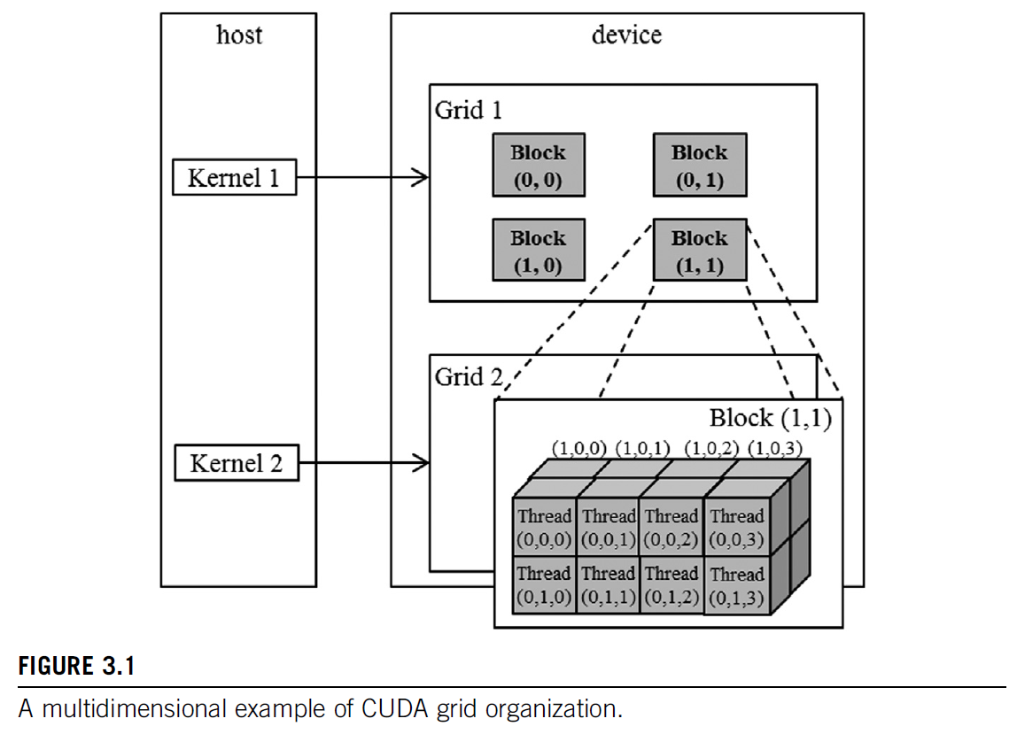

Slide 26
Grid continued
grid can be different for each kernel launch, e.g. dependent on data shapes
typical grids contain thousands to millions of threads
simple strategy: one thread per output element (e.g. one thread per pixel, one thread per tensor element)
threads can be scheduled in any order
can use fewer than 3 dims (set others to 1)
e.g. 1D for sequences, 2D for images etc.
dim3 grid(32, 1, 1);
dim3 block(128, 1, 1);
kernelFunction<<<grid, block>>>(..);
// Number of threads: 128 * 32=4096

Slide 27
Built-in Variables
Built-in variables inside kernels:
(blockDim & gridDim have the same values in all threads)
blockIdx // dim3 block coordinate
threadIdx // dim3 thread coordinate
blockDim // number of threads in a block
gridDim // number of blocks in a grid

Slide 28
nd-Arrays in Memory
Actual layout in memory
Logical view of data
0,0 | 0,1 | 0,2 | 0,3 | 1,0 | 1,1 | 1,2 | 1,3 | 2,0 | 2,1 | 2,2 | 2,3 | 3,0 | 3,1 | 3,2 | 3,3
0,0 | 0,1 | 0,2 | 0,3
1,0 | 1,1 | 1,2 | 1,3
2,0 | 2,1 | 2,2 | 2,3
3,0 | 3,1 | 3,2 | 3,3
memory of multi-dim arrays under the hood is flat 1d
2d array can be linearized different ways:
torch tensors & numpy ndarrays use strides to specify how elements are laid out in memory.
- row-major:
A B C
D E F
G H I
- column-major:
A D G
B E H
C F I

Slide 29
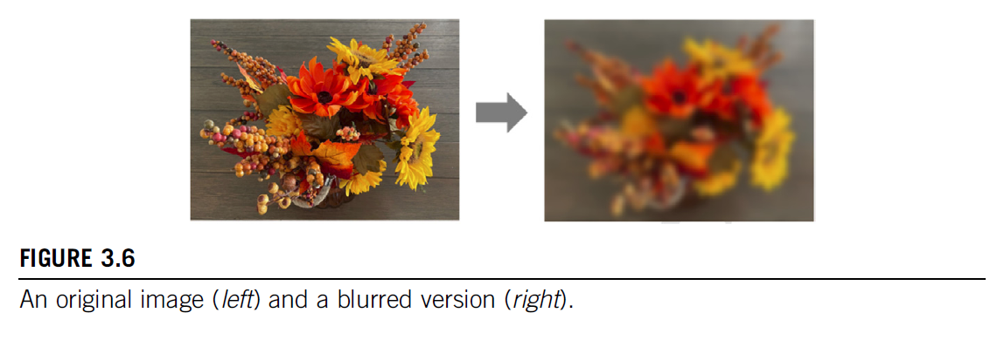
Image blur example (3.3, p. 60)
mean filter example blurKernel
each thread writes one output element, reads multiple values
single plane in book, can be extended easily to multi-channel
shows row-major pixel memory access (in & out pointers)
track of how many pixels values are summed
handles boundary conditions in ln 5 & 25

Slide 30
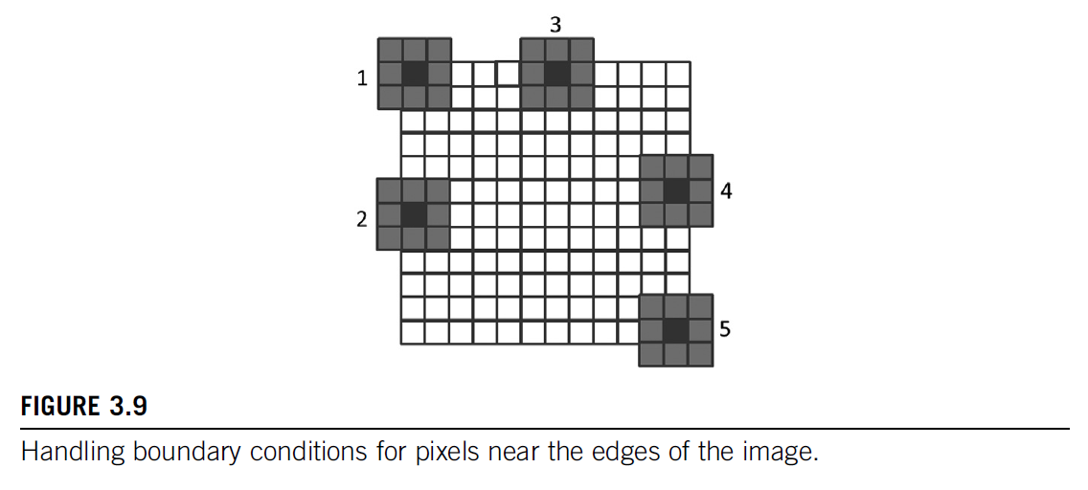
Handling Boundary Conditions

Slide 31
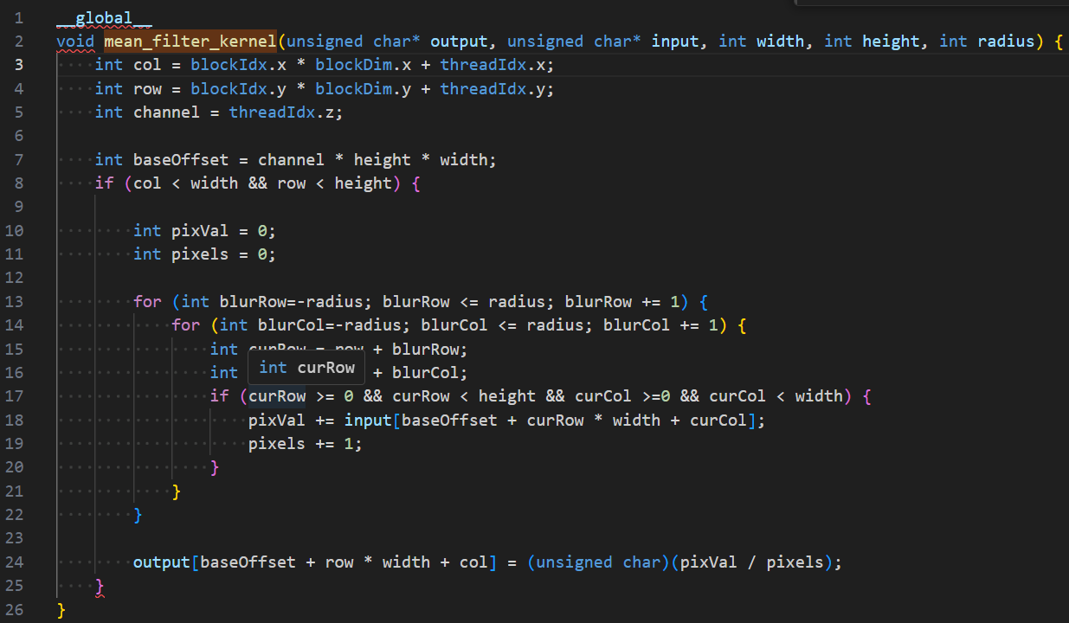

Slide 32
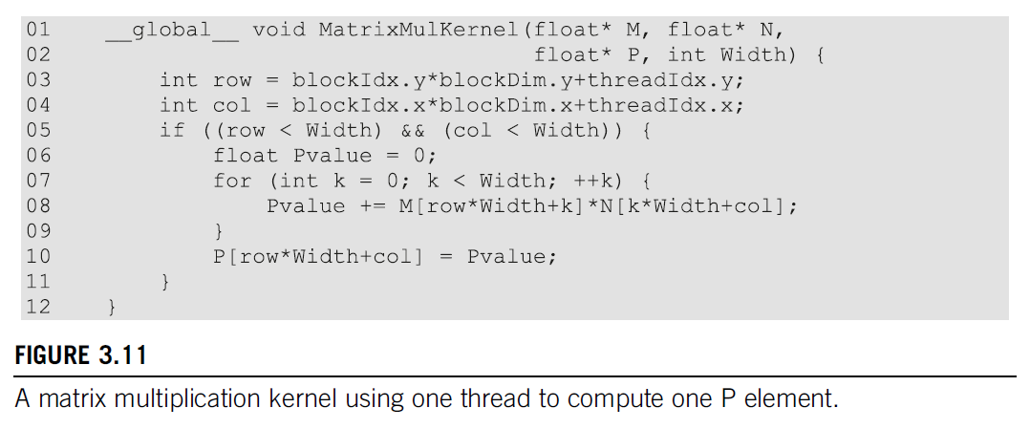
Matrix Multiplication
staple of science & engineering (and deep learning)
compute inner-products of rows & columns
Strategy: 1 thread per output matrix element
Example: Multiplying square matrices (rows == cols)

Slide 33
