Slide 1
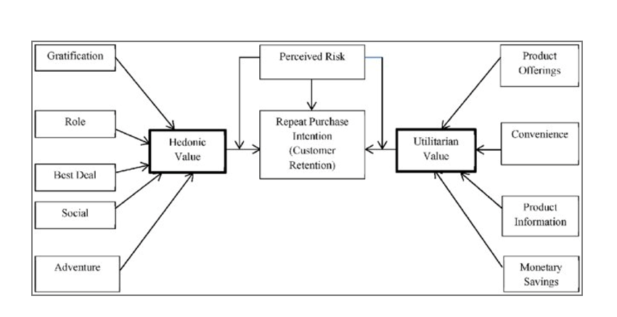
CUSTOMER RETENTION PRESENTATION By-ANURAG RAJ

Slide 2
E-retail factors for customer activation and retention: A case study from Indian e-commerce customers.
Customer satisfaction has emerged as one of the most important factors that guarantee the success of online store; it has been posited as a key stimulant of purchase, repurchase intentions and customer loyalty. A comprehensive review of the literature, theories and models have been carried out to propose the models for customer activation and customer retention. Five major factors that contributed to the success of an e-commerce store have been identified as: service quality, system quality, information quality, trust and net benefit. The research furthermore investigated the factors that influence the online customers repeat purchase intention. The combination of both utilitarian value and hedonistic values are needed to affect the repeat purchase intention (loyalty) positively. The data is collected from the Indian online shoppers. Results indicate the e-retail success factors, which are very much critical for customer satisfaction. Be careful: There are two sheets (one is detailed) and second is encoded in the excel file. You may use any of them by extracting in separate excel sheet. The number of column(s) is more than 47. Read the column header carefully. Note : Data Scientists have to apply their analytical skills to give findings and conclusions in detailed data analysis written in jupyter notebook . Only data analysis is required. Need not to create machine learning models /but still if anybody comes with it that is welcome.

Slide 3
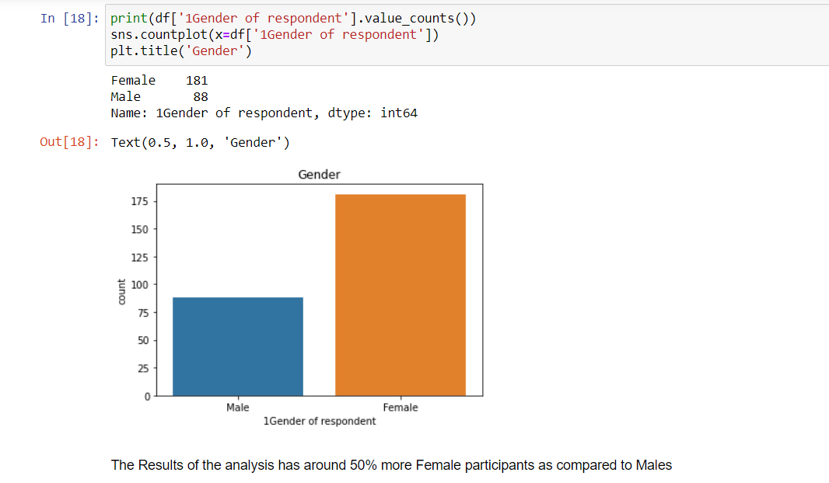

Slide 4
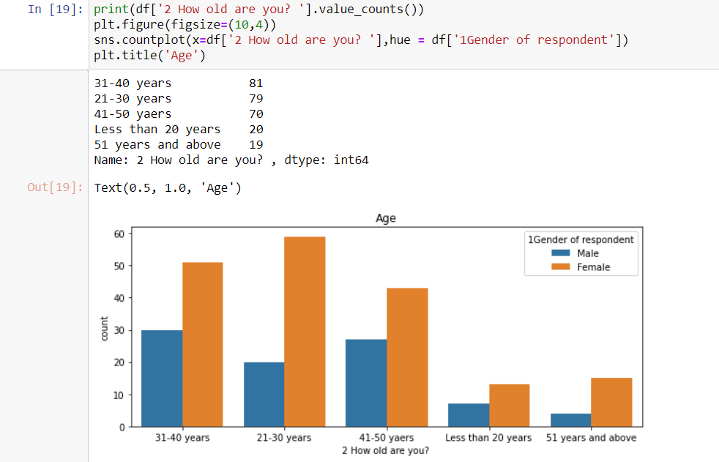

Slide 5
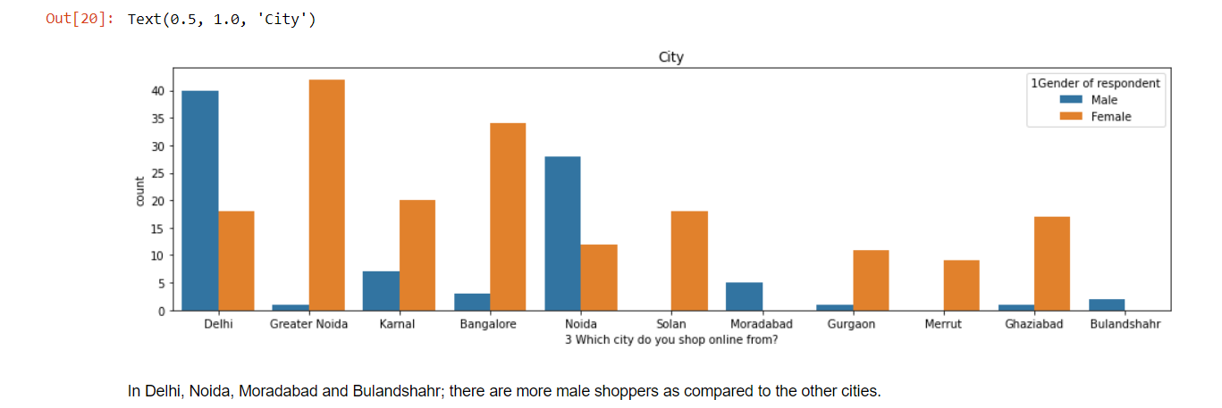

Slide 6
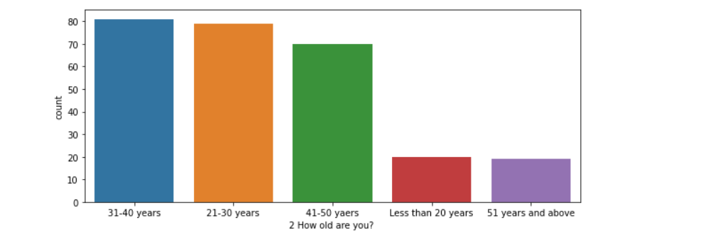

Slide 7
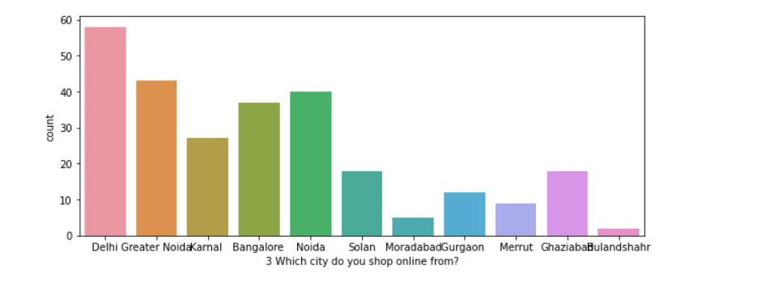

Slide 8
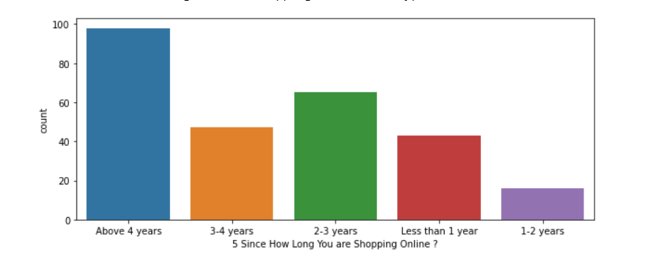

Slide 9
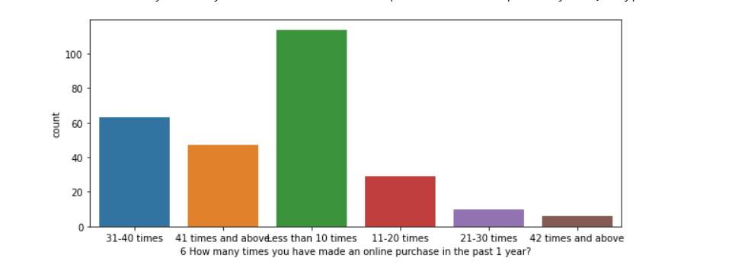

Slide 10
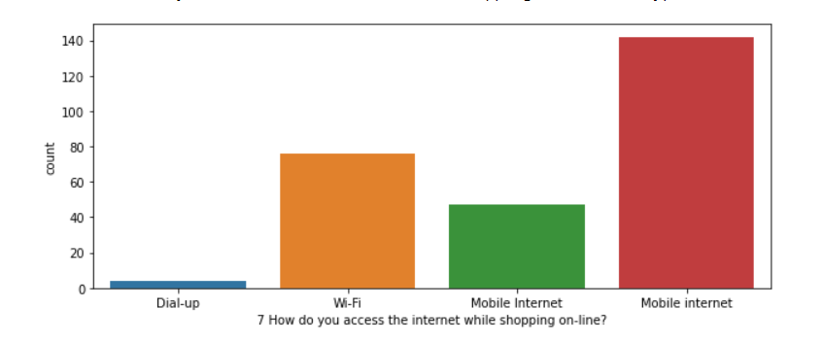

Slide 11
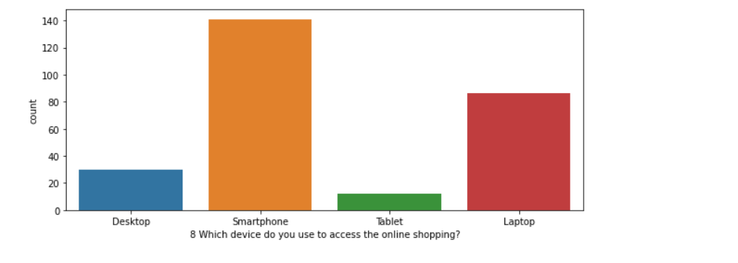

Slide 12
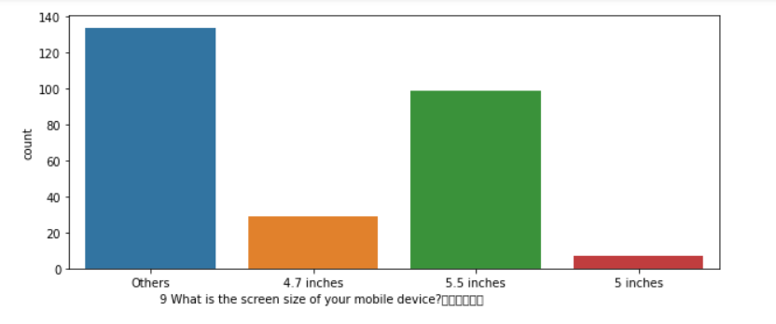

Slide 13
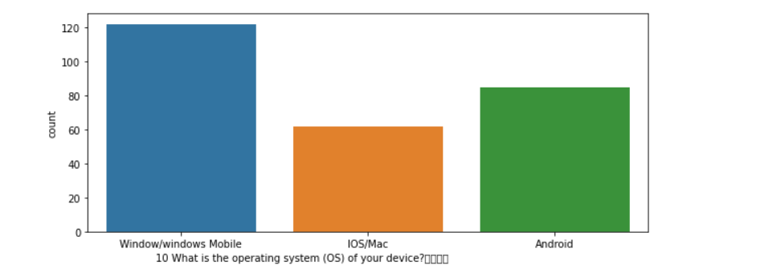

Slide 14
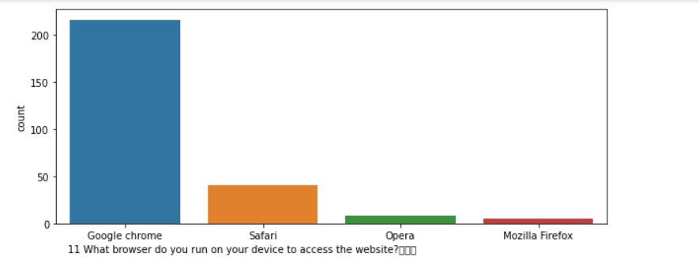

Slide 15
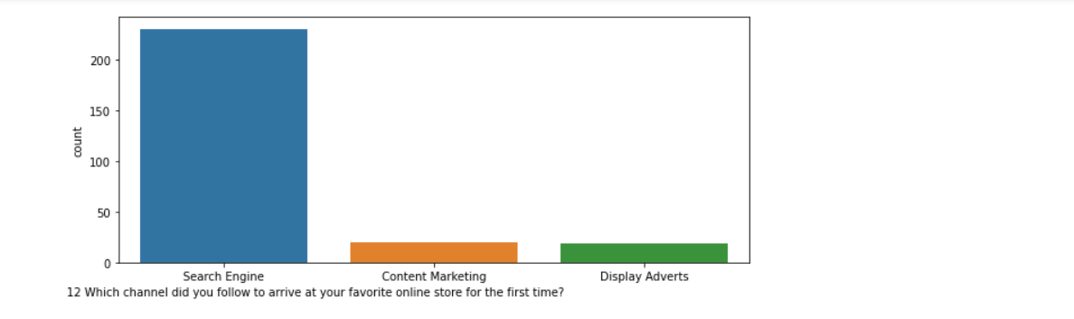

Slide 16
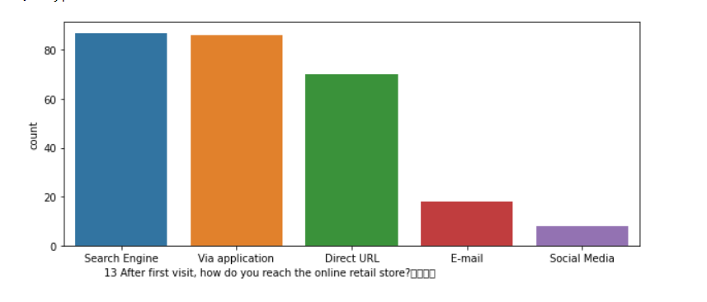

Slide 17
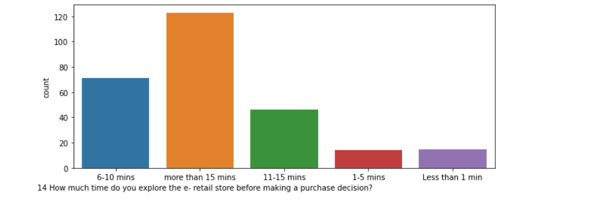

Slide 19
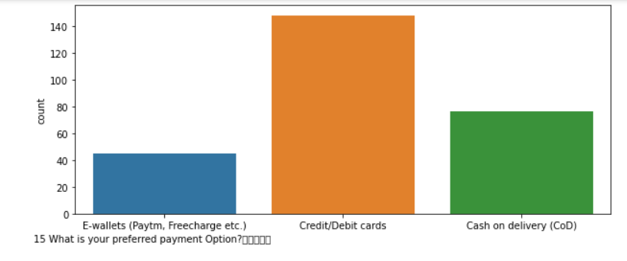

Slide 21
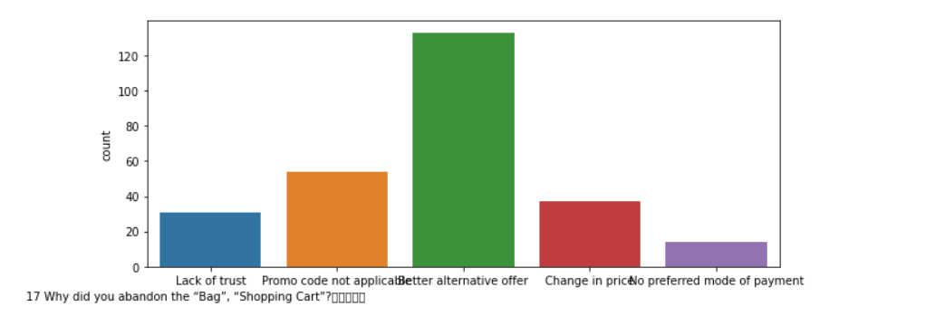

Slide 22
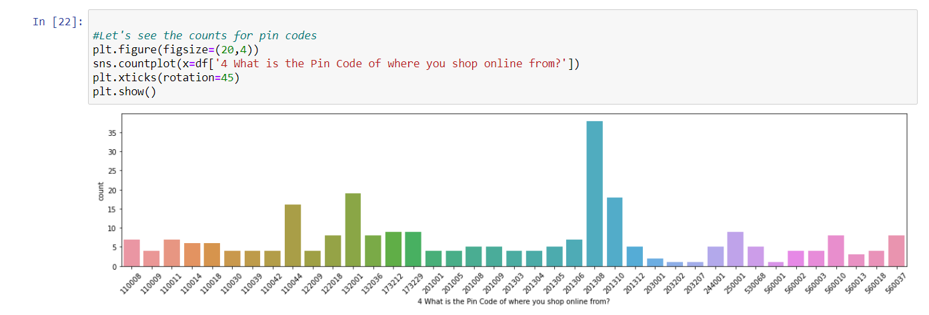

Slide 23
Observations from Multiple Options based Questions
Maximum people have shopped from these 5 companies - Amazon.in, Flipkart.com, Paytm.com, Myntra.com, Snapdeal.com.
Most people find Easy to use website or application are - Amazon.in, Flipkart.com, Paytm.com, Myntra.com, Snapdeal.com Also, Amazon.com and Flipkart.com are the major choices.
In terms of Visual appealing web-page layout also, Amazon.com and Flipkart.com seem to take the lead.
Talking about Wide variety of product on offer: Amazon.com and Flipkart.com are the major choices.
Complete, relevant description information of products: Once again, maximum people have chosen to go with mazon.com and Flipkart.com
Fast loading website speed of website and application: Amazon seems to take the lead in this category, although paytm and Flipkart are not far behind.
Reliability of the website or application: Amazon seems to take the lead in this category too, although Flipkart and paytm are not far behind.
Quickness to complete purchase: Amazon seems to take the lead in this category too, although Flipkart and paytm are not far behind.
Availability of several payment options: Here, Amazon and Flipkart, both are the favourites. Although a lot of people also tend to go towards Myntra
Speedy order delivery: Amazon seems to take the lead in this category too, followed by Flipkart.

Slide 24
Privacy of customers’ information: Amazon has a good reputation for maintaining privacy, followed by Flipkart
Security of customer financial information: Here other than Amazon and Flipkart, Paytm.com, Myntra.com, Snapdeal.com are also trusted by a lot of people. This shows that all compamnies pay special attention to security.
Perceived Trustworthiness: Amazon and Flipkart are winners here as well. Although Myntra.com and Snapdeal.com are also not far behind.
Presence of online assistance through multi-channel: Amazon.in, Flipkart.com, Myntra.com, Snapdeal
Longer time to get logged in (promotion, sales period): Amazon, paytm
Longer time in displaying graphics and photos (promotion, sales period): Amazon.in, Flipkart.com
Late declaration of price: Myntra, Paytm, Snapdeal. These companies should work on this area to improve.
Longer page loading time (promotion, sales period): Myntra and Paytm have bad feedback in this. Flipkart should also have a look into it, as it is at the 3rd place.
Limited mode of payment on most products (promotion, sales period): Snapdeal is the most voted answer for this.
Longer delivery period: Paytm and Snapdeal need to shorten their delivery time.
Change in website/Application design: Amazon.in
Frequent disruption when moving from one page to another: Amazon.in
Website is as efficient as before: Amazon.in
Which of the Indian online retailer would you recommend to a friend?: Amazon/Flipkart

Slide 25
Conclusion
Comparing the Customer's Perceptions and the Company's performance we can conclude that the Companies likely to have
High Customer Satisfaction and Retenton:
Amazon.com Flipkart.com High Risk of Customer Churn:
Myntra.com Snapdeal.com

