Slide 1
Tweets sentiment analysis
Zhuo Yu, Kexin Wang, Jilin Liao, Qingtian Wei
Group 24
Fundamental of Language Processing, 2021/22 ws
Share Task

Slide 2
Overview
Introduction
Related Word
Analysis
Improvement

Slide 3
Introduction
The classifier model was trained based on word vector matrix by Word2Vec embedding. The model was finetuned with heavily preprocessed and data augmented from the train.csv. The labels were determined by majority voting in One-Versus-Rest method.
Related Word
Vectorize sentence
Using word2vec to train word dictionary and average method to vectorize sentence
Preprocessing
Train Classifier
Finetune model
Clean Dataset for simplifying modeling
Using SVM with one versus rest method to make multi-classification
Using GridSearchCV to finetuned model

Slide 4
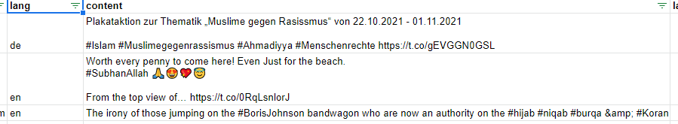
Preprocessing
Before deciding what method and model to use in this task, we performed a detailed observation on the raw dataset and found out some properties which are interesting however will take negative effect on modeling.
Multi-Language
Abbreviation
HashTag
Emoji
Number e.g. Date
URL

Slide 5
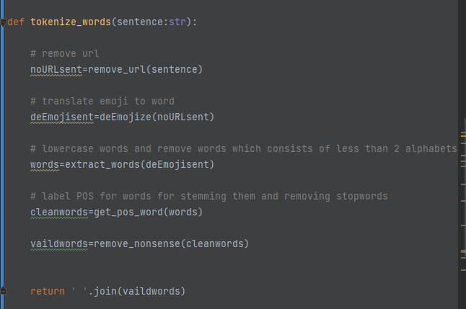
Preprocessing
Methods to clean data and tokenize words. More detail are described at the next slide

Slide 6
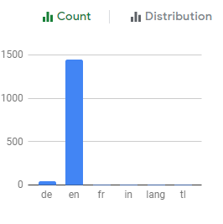
Preprocessing – Techniques to clean data
Multi-Language
In fact, except German tweets other tweets which although were labeled as non-English are English. Hence, only German tweets were translated into English by using a external library call Translator. Plus, because of the limited access of this translation API, the translated tweets were stored in ‘train_translated.csv’ file.

Slide 7
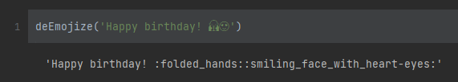
Preprocessing – Techniques to clean data
Emoji
Regarding assignment requirements emojis should be considered in sentiment analysis. In this project, all emoji were converted to a word to describe this emoji in natural language by using a library called emoji. For instance:
Abbreviation
Punctuation
URL
Number e.g. Date
Those components are hard to handle in a proper way, specially abbreviation, which really depends on context. Hence, these noise were all removed by using regular expression.

Slide 8
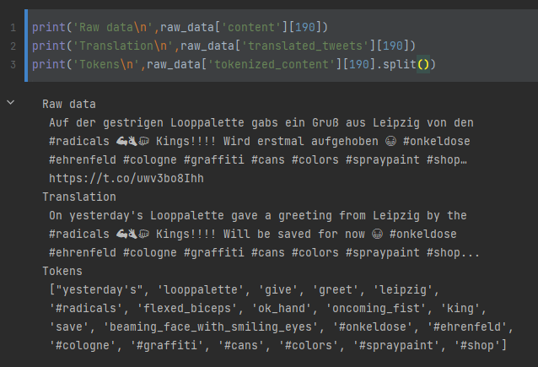
Preprocessing – Techniques to clean data
A example:
>>Input: A German tweet with emojis from dataset
>>Ouput:
Tokenized words

Slide 9
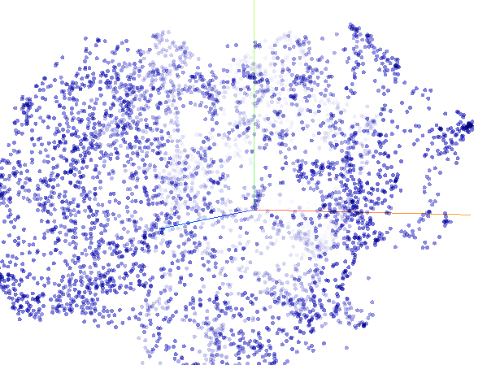
Word Embedding
Train a word2vec model (Vector size=200) for tokenized words. The size of trained w2v model is 2772.
Visualized using t-SNE by Google

Slide 10
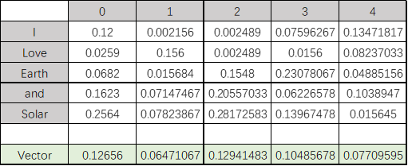
Vectorize Sentence
Features extraction algorithm:
Add up the vectors of each word in a sentence and divide them by the number of tokens in the sentence to obtain a flat vector representing the sentence.
A simple instance: how to vectorize sentence ‘I love earth and solar’

Slide 11
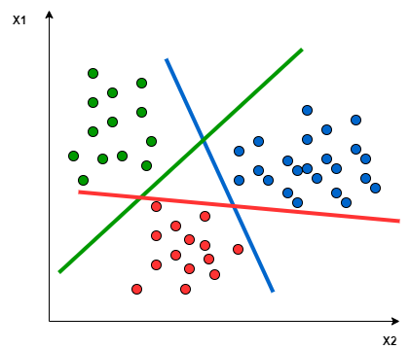
Classifier SVM
Supportive vector machine is designed for binary classification. However, SVM can also support multiclassification by breaking down the multiclassification problem into multiple binary classification problems. An approach is that mapping data points to high dimensional space to gain mutual linear separation between every two classes.
1
?
2
0
Multiclassification
Spilt into N svms

Slide 12
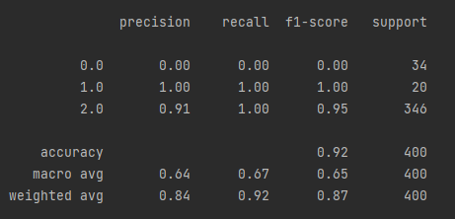
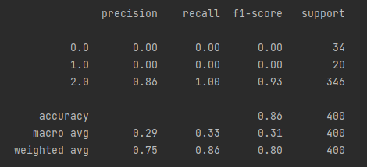
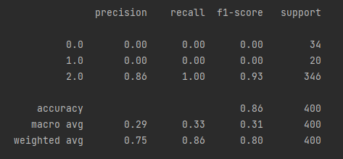
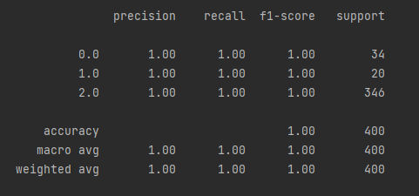
Finetune
Using GridSearchCV to find the best parameters for building svm model
(C=0.07,gamma=0.1，kernel=‘linear’)
(C=0.01,gamma=1, kernel=‘linear’))
(C=1,gamma=1e-6, kernel=‘poly’))
(C=1,gamma=1, kernel=‘rbf’))

Slide 13

Analysis
Can not classify ironic sentence correctly
Was Classified as 1,
Should be 0 (Personal assumption)
Possible reason: Most of words in this sentence are negative like ‘terrorism’ , hence it was classified as anti-solidity.

Slide 14

Analysis
Most of words in some tweets are hashtag.
Was Classified as 0,
Should be 2 (Personal assumption)
Possible reason: Some hashtag are positive. In this case, some hashtag like ‘#wordhave’ occurs rarely one time around the entire dataset.

Slide 15
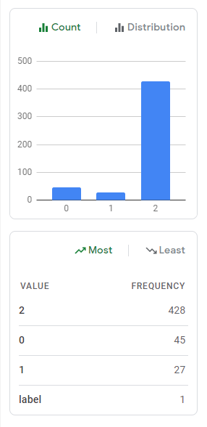
Improvement
Balance dataset
Most of tweet are labeled as 2 (90%)
Make a balanced dataset out of an imbalanced one
Data augmentation
Row dataset is small (2000 rows: train+trival+test)
Some solution:backtranslation, sentence swapping, random inserts, synonym swaps

Slide 16

Conclusions
We test our result, and we got a score of 0.896. This score is higher than 0.83. However, the highest score is 0.9050. And because of the imbalance of the dataset, F1-Macro Scores are more suitable. Our F1-Macro Score is 0.4033, the highest score is 0.5772. These scores represent that there are still many other methods to improve the result.
The method we use is Word2Vec and SVM. All models were finetuned with heavily preprocessed tweets from the train.csv and then the label was determined by majority vote( in OVR model). In this case, Our model is highly preprocessed. However, the accuracy's performance especially on imbalanced data sets is not well.

