Slide 1
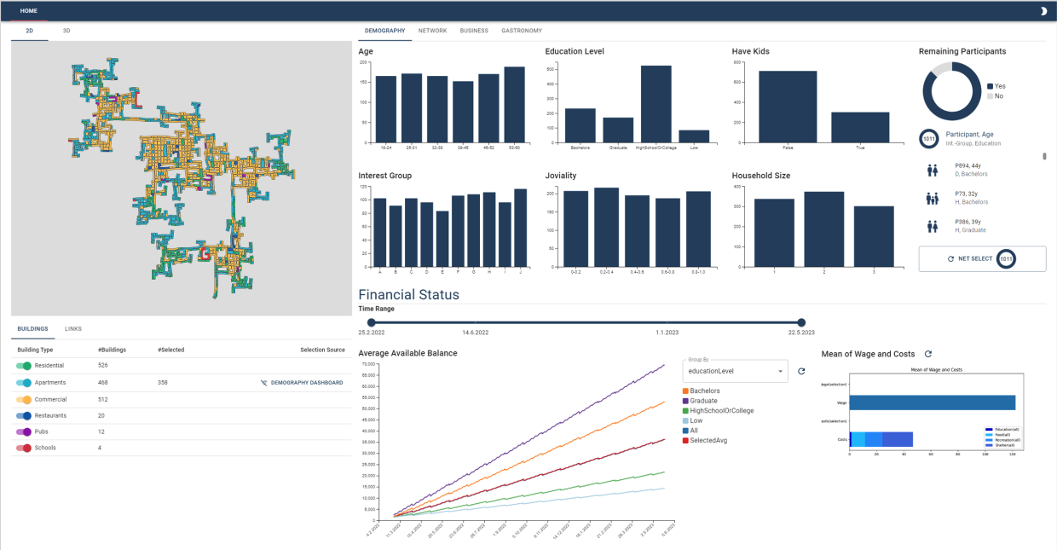

Visual Computing Project
VAST CHALLENGE 2022
Jan Burmeister, Jilin Liao, Jieqing Yang, Qingtian Wei, Kexin Wang
Notes:
Good day everyone, welcome to our presentation about our visual computing project, which also attended the annual competition of the IEEE VIS conference.

Slide 2
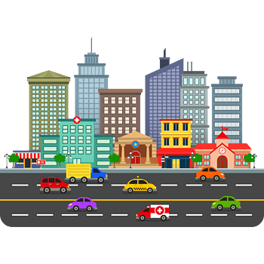
Introduction
Vast Challenge 2022:
Annual competition of the IEEE VIS conference
Apply data science & visual analytics methods on a realistic dataset to answer business questions and drive decisions
Tasks:
Analyze the urban planning for the virtual city Engagement, Ohio.
Given a large, interlinked dataset of its citizens, businesses and activities, assemble a summary of the state of this city to serve as a basis for future investments
Develop an interactive visualization application
Notes:
Firstly we will shortly introduce the Vast Challenge 2022, the task is to analyse a virtual city. We are given a really large dataset, and we have to do selection and do preprocess from it. And finally we have to use tool to visualize the city situation and daily life of residents.

Slide 3
Dataset
Information of 1011 residents in Engagement, Ohio:
Activity Logs: various daily activities and status records
Attributes of participants, building, jobs, restaurants etc.
Journals of travel, check-in, finance and social networks
Records Frequency: every 5 minutes for 15 months (high)
Data volume: 100 million levels (large)
Characteristic: strong linkage between the data
Notes:
this dataset consists of the information of more than 1000 residents in city Engagement. The data are recorded every 5 minutes for 15 months by all residents, it recorded activity logs, attributes of participants, buildings, jobs, restaurants and journals of travel, check-in, finance and social networks. A special characteristic of the dataset is the strong linkage between the observed data due to various social and business relationships.

Slide 4
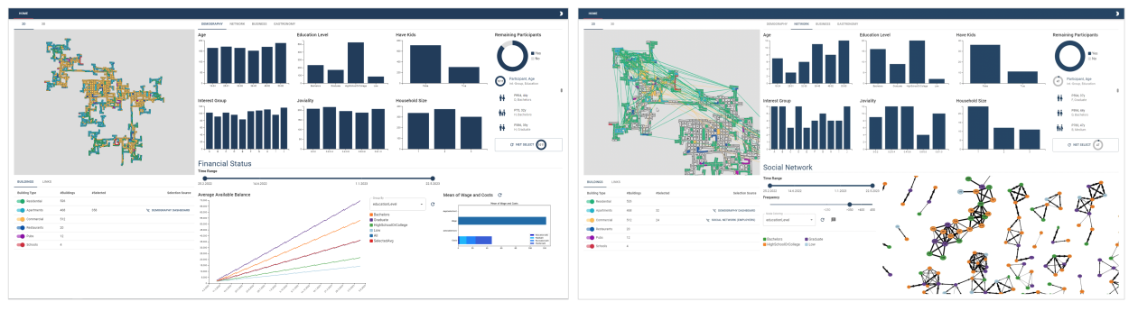
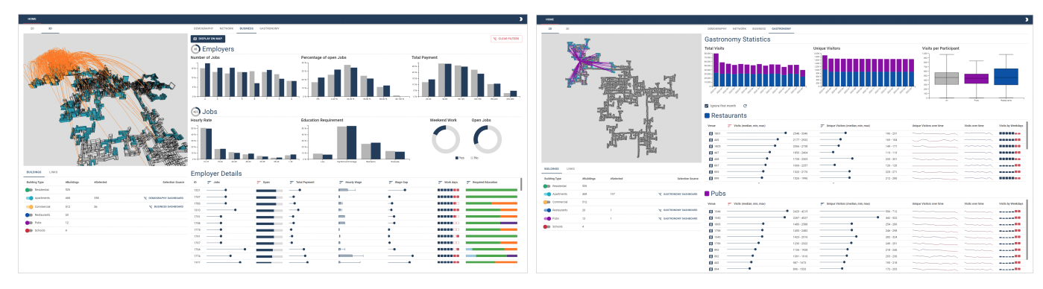
Application Design
Map
4 Dashboards
Demography
Social Network
Business
Gastronomy
Notes:
Here we have a short overview about the layouts of our web application. It contains 2D and 3D maps of the city with four dashboards: Demography, social networks, business and gastronomy. The detailed description of each part will be shown in a short video later.

Slide 5
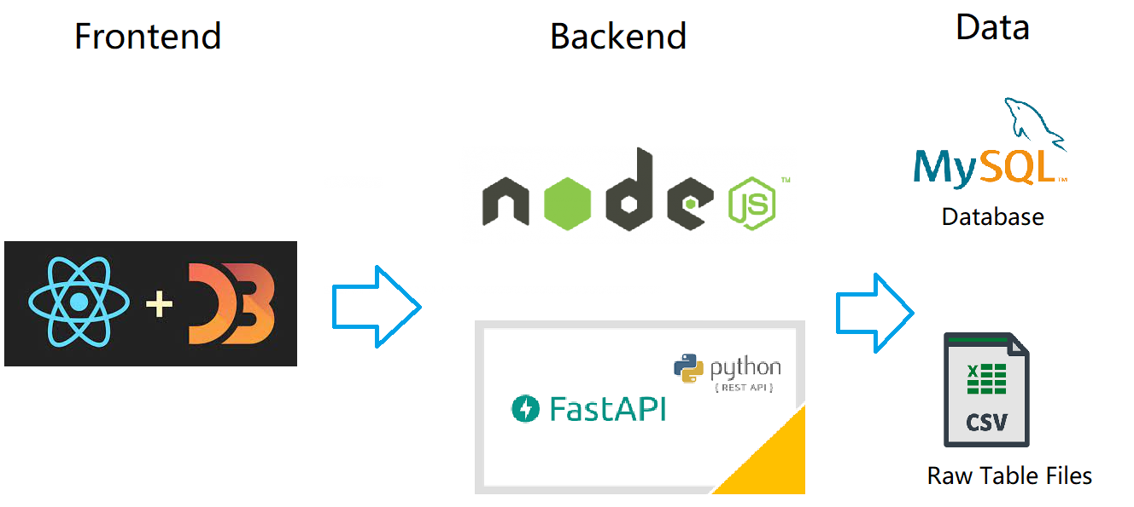
Application Design - Tools Used

Slide 6
Agile Software Engineering
Weekly Stand-Up
Weekly Team-Event (Sprint)
Product Owner: Jan
Notes:
Procrastination

Slide 7
Application Design - Layouts
Videos Introduction 4 mins

Slide 8
Entities should not be multiplied beyond necessity
William of Ockham (c. 1287–1347)
Notes:
in the video we can see, the basic principle of our application is easiness, or as a famous saying of William of Ockham ,blablabla.

Slide 9
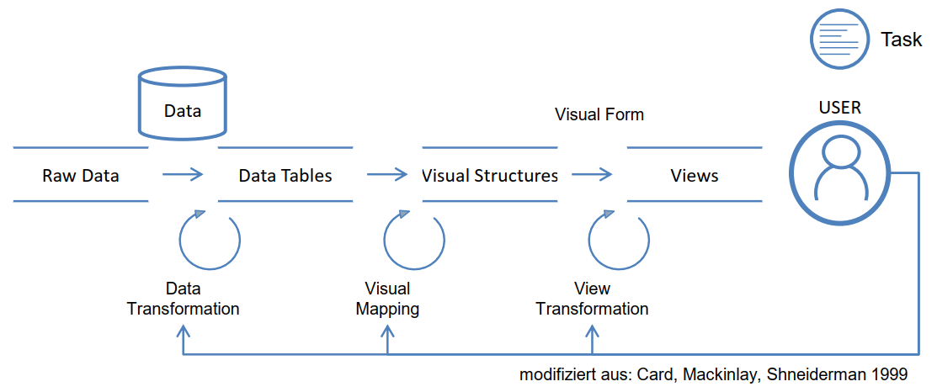
CONCLUSION
What we earned:
User Centered Design
User Interaction
Software Engineering
Network Data Exchange
Notes:
As this project is a challenge, we submit a web application , a report, a paper and a short video. And We are honored to receive Honorable Mention for Extensible Custom Dashboard award of Vast Challenge 2022, and were invited to the Challenge workshop. although we didn’t go, we still appreciate for the invitation.

Slide 10
Contribution
Web Application
Visualization Report 16 Page
Mini Paper (VGTC）2 Page
Short Video 4 mins

Slide 11
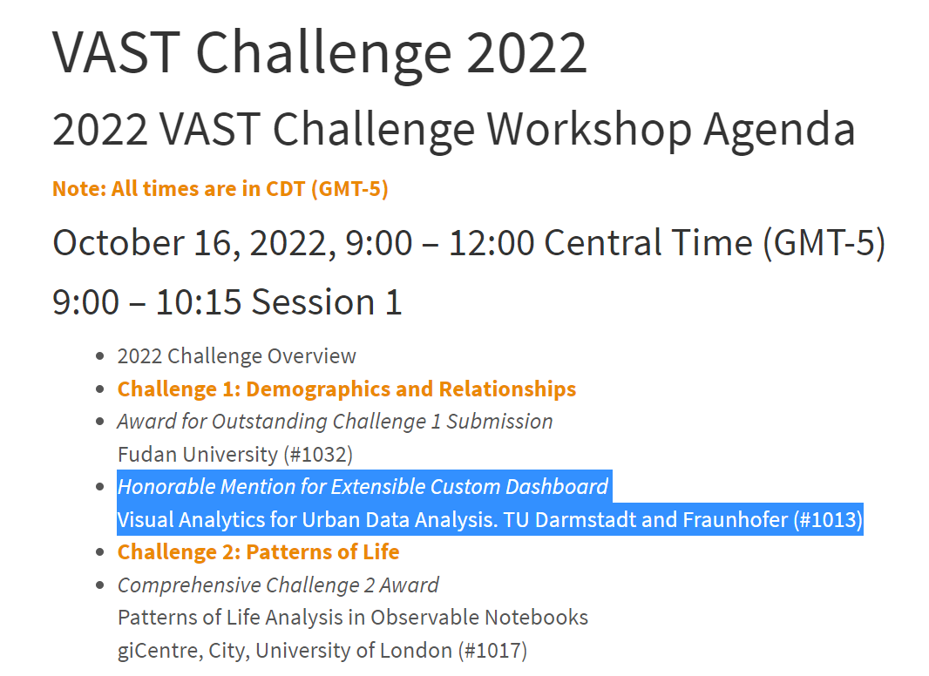
Result
Honorable Mention for Extensible Custom Dashboard

Slide 12
Thank you !

