Slide 1
Reversi Algorithm
Dan Kirby Josh Philips Nick Marzullo

Slide 2
Algorithm
The algorithm uses a MiniMax tree with a depth-limited depth-first-search to determine the best move.
The values of each move are based on three factors, the number of pieces captured, the value of the tile, and the mobility gained. Heuristic= #of Pieces + Value of Tile +Mobility

Slide 3
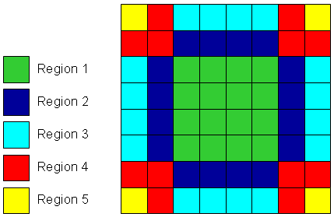
Tile Value
The tiles are broken up into 5 regions, with different values to each piece.
Region 1 = 1 pt
Region 2 = -10 pt
Region = 3 = 10 pt
Region 4 = -50 pt
Region 5 = 100 pt
The value of each region can change, For example
The values of region 4 increases after the corner is captured
Notes:
http://mnemstudio.org/game-reversi-example-2.htm

