Slide 1

AGB1211 – DESIGN THINKING
Department of Artificial Intelligence and Data Science
Academic Year: 2024 – 2025 (Odd Semester)
Year : II
Semester : III
Section : B
Date : 6.12.2024
PRESENTED BY, GUIDED BY
1.MANASA SHREE RM(2303811724322064) JOANY FRANKLIN M.E.,
2.MUTHUMEENA K(2303811724322073) Assistant Professor,
3.NAMETHA K (2303811724322074 ) Department of AI,
K.Ramakrishnan College of Technology.

Slide 2
Title of the Project
PROTECTION
OF
ENDANGERED
SPECIES

Slide 3
Problem Identification
Endangered species face threats primarily from human activities like habitat destruction due to urbanization, deforestation, and agriculture. To combat this, global efforts are needed, including habitat restoration, stronger laws, public awareness, and sustainable practices to ensure their survival.

Slide 4

BrainStorming

Slide 5
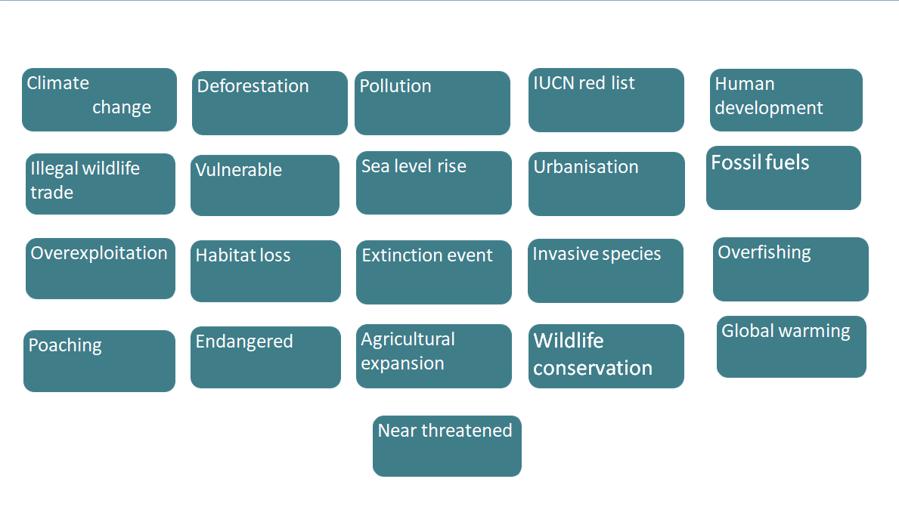
BrainStorming

Slide 6
Objective
The goal of this presentation is to emphasize the need to protect endangered species by addressing threats and exploring conservation strategies. Protecting these species ensures ecological balance, biodiversity, and benefits for both wildlife and humans.

Slide 7
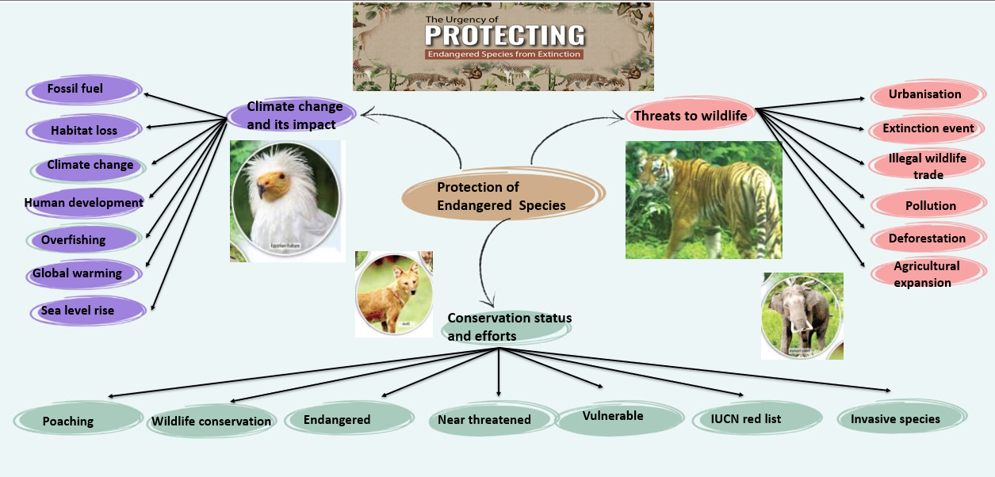
Mind Map

Slide 8
Primary Research
Interviews and Surveys
Target Audience: Conservationists, educators, researchers, and general users.
Key Questions:
1.How do they currently access or share information about endangered species?
2.What challenges do they face in conservation efforts or education?
Methods:
Online surveys, one-on-one interviews, focus groups.
Collaborations
Engage with conservation organizations (e.g., WWF, IUCN, local NGOs).
Discuss their needs for tracking tools, reporting mechanisms, and educational resources.Partner with wildlife
photographers and sound recordists for multimedia content.
Field Observations
Visit conservation sites, zoos, or sanctuaries.
Observe the species' habitats, threats, and conservation strategies.
Record public engagement levels at educational programs or exhibits.

Slide 9
Secondary Research
Literature Review
Research scientific papers, reports, and case studies on endangered species and conservation
efforts.
Study population trends and ecological data from sources like:International Union for
Conservation of Nature (IUCN) Red List.National Geographic, WWF, and government reports.
Competitive Analysis Analyze
similar platforms like iNaturalist, eBird, and WWF's Species Directory.Identify their strengths, weaknesses, and
gaps in functionality.
Habitat and Threats Analysis: Utilize tools like Google Earth Engine for satellite imagery and
habitat monitoring.
Educational Resources
Explore existing biodiversity education materials and programs.Review curricula related to environmental
studies in schools and colleges.
.

Slide 10
Proposed Work
The proposed work aims to develop a platform with modules for species data, tracking, reporting, education, and donations. It will involve research, user-friendly design, and AI-powered tools.
The platform will support real-time tracking, interactive learning, and secure donations, encouraging global participation in conservation efforts.
After testing, the platform will launch on web and mobile, with updates and partnerships to enhance conservation impact.

Slide 11
List of Modules
Species List and Details Module
Tracking Module
Report Module
Donate Module
Education Module

Slide 12
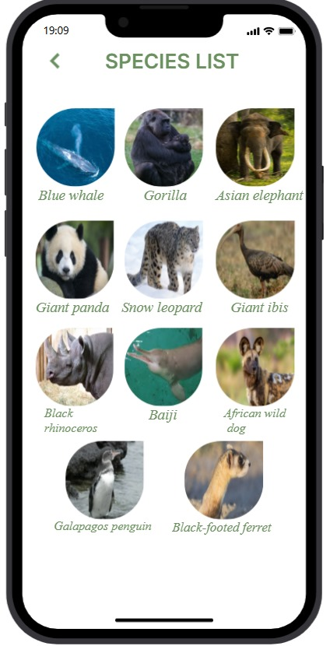
Module 1 Description
MODULE 1: SPECIES LIST MODULE
This module serves as a comprehensive database of endangered species, offering detailed profiles for each species.
It includes information such as scientific and common names, conservation status habitat details, threats, population trends, and ecological significance.

Slide 13
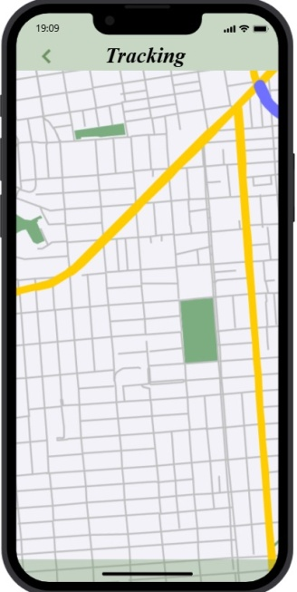
Module 2 Description
MODULE 2:TRACKING MODULE
The Tracking module provides real-time data on the movements and populations of endangered species.
Users can access interactive maps and receive notifications about changes in a species’ status or location.
This feature is particularly valuable for researchers, educators, and communities living near conservation areas.

Slide 14
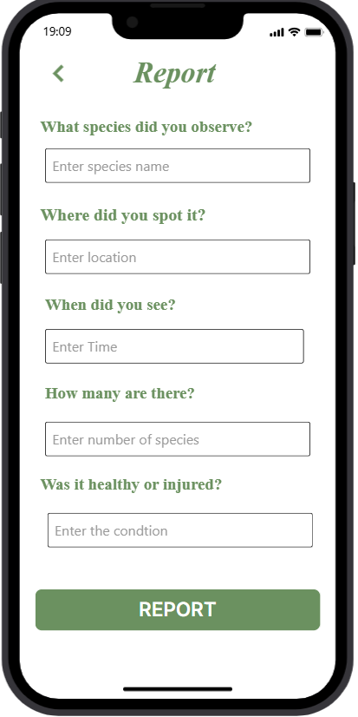
Module 3 Description
MODULE 3: REPORT MODULE
This module helps to contribute to conservation efforts by reporting sightings of endangered species.
This module encourages active user participation and fosters a sense of contribution to the cause.

Slide 15
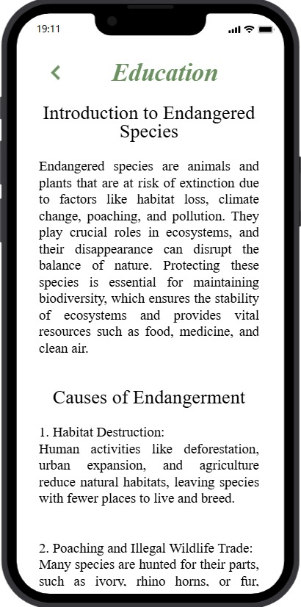
Module 4 Description
MODULE 4 :EDUCATION MODULE
Education module is designed to raise awareness and inspire action by offering engaging and interactive learning resources.
Schools and educators can use this content to integrate biodiversity education into their curriculum.

Slide 16
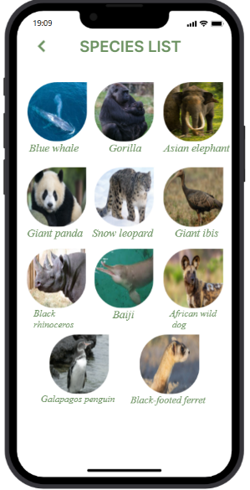
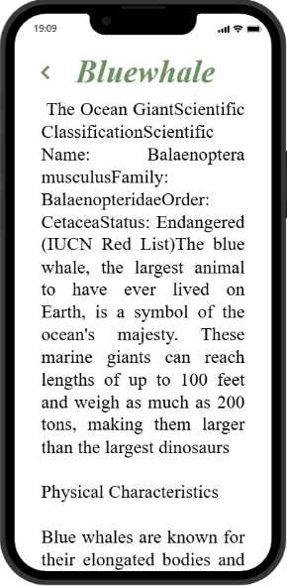
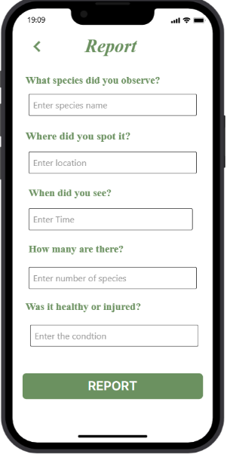
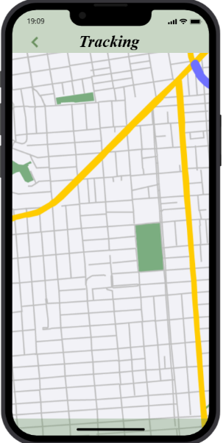
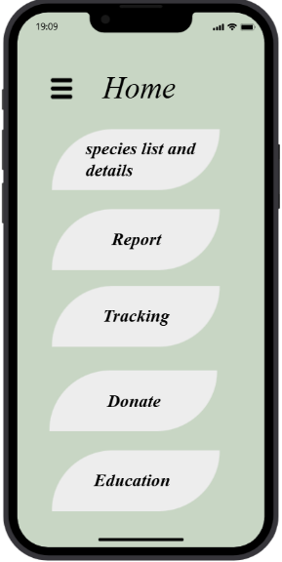
Results
Homepage
Species list
Details
Report
Tracking

Slide 17
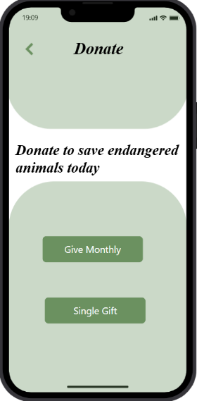
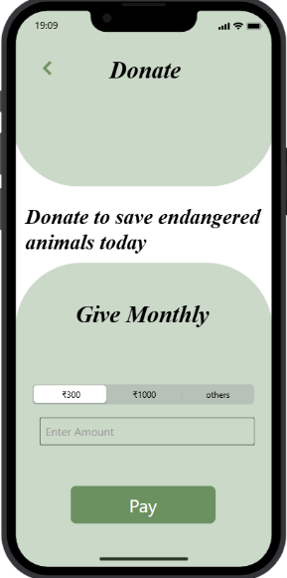
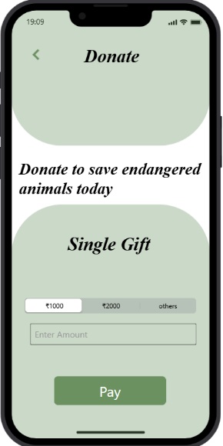
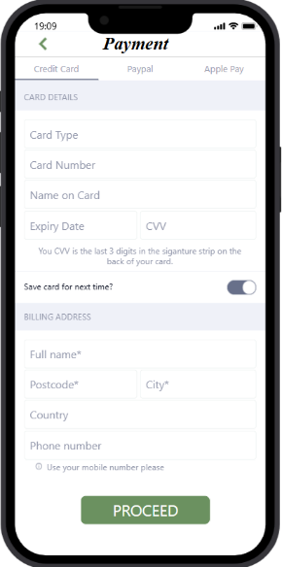
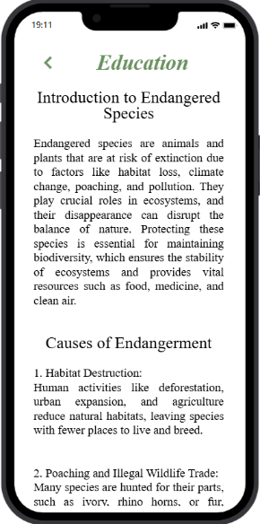
Results
Monthly Donation
Single payment
Donate
Payment
Education

Slide 18
Conclusion
The proposed work focuses on developing a platform with modules for species data, tracking, reporting, education, and donations, supported by AI-powered tools and user-friendly design. It will enable real-time tracking, interactive learning, and secure donations to promote global conservation efforts. After testing, the platform will launch on web and mobile, with regular updates and partnerships to maximize its impact.

Slide 19
Thank You

