Slide 1
Project one: guestbook
2조: 임준철, 김남호

Slide 2
Contents
Main features of guestbook
Architecture (MVC model)
Details
Demo
Q & A

Slide 3
Main features of guestbook
Main page(/guestbooks)
Main page shows list of guestbook from Database.
Post a guestbook(/guestbooks/write)
Write guestbook contents to Database after being submitted by user.

Slide 4
Architecture (MVC model)
Model
Controller
Request
Servlet
DTO
Business
Service
Object
Client
View
DTO
DAO
DB
Response
JSP
Presentation Layer
Business
Layer
Persistence
Layer

Slide 5
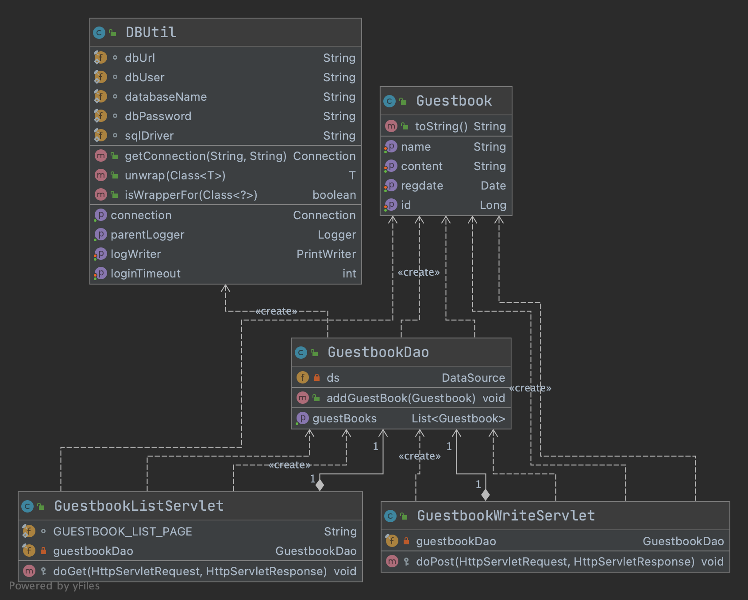
Class Diagram of Guestbook

Slide 6
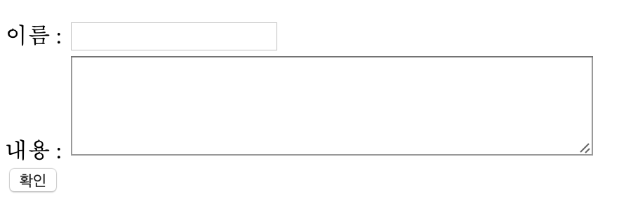
View: jsp
guestbook.jsp
Simply displays list of guestbooks from DB using jstl

Slide 7
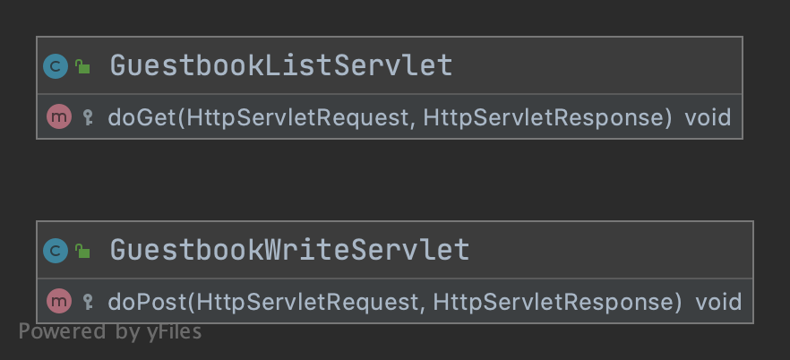
Controller: Servlet
Servlet package
GuestbookListServlet.java
Handles GET request
Read list of guestbook from Database
GuestbookWriteServlet.java
Handles POST request
Writes new guestbook entry to Database

Slide 8
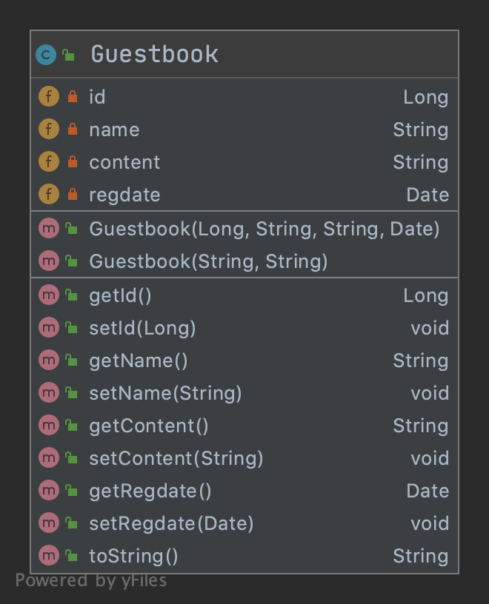
Model: Data Transfer Object
Data Transfer Object (DTO) is an object that carries data between processes.
Guestbook is implemented on Guestbook.java on dto package.

Slide 9
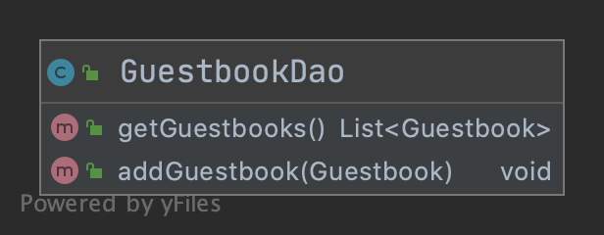
Model: Data Access Object
Data Access Object (DAO) is a pattern that provides an abstract interface to some type of database or other persistence mechanism.
Guestbook DAO is implemented on Guestbook.java under dao package.

Slide 10
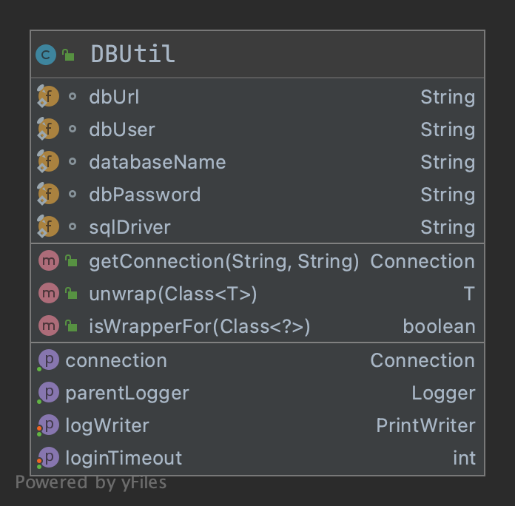
DB Utill
Basically, DBUtill class implements Datasource interface.
Datasource interface is injected to DAO class for DB connection.

Slide 11
Unit test
Simple unit test for both DAO and Servlet classes are also included on test package.
Please refer to our public code repo regarding unit tests.

Slide 12
Demo

Slide 13
Q & A

