Slide 1
Predicting the NBA MVP with Machine Learning
A comparison of Naive Bayes and Logistic Regression
UE24CS352A — Machine Learning Mini Project

Slide 2
Motivation & Problem Statement
The NBA MVP is voted by sportswriters and broadcasters.
Human voters are influenced by popularity, media narratives, and recency bias.
Can machine learning predict the MVP using only objective player statistics?
We compare a generative model (Naive Bayes) with a discriminative model (Logistic Regression).

Slide 3
Dataset
Source: Kaggle dataset scraped from Basketball-Reference
Timeframe: 2000-01 to 2019-20 (20 seasons)
Rows: 60 (top 3 MVP finalists per season)
Train: 2000-01 to 2015-16 → 48 rows
Test: 2016-17 to 2019-20 → 12 rows
Target: MVP = 1 for the winner, 0 for the runners-up

Slide 4
Features Used
Games played (g)
Minutes per game (mp_per_g)
Field goal percentage (fg_pct)
3-point percentage (fg3_pct)
Free throw percentage (ft_pct)
Rebounds per game (trb_per_g)
Assists per game (ast_per_g)
Steals per game (stl_per_g)
Blocks per game (blk_per_g)
Points per game (pts_per_g)

Slide 5
Methodology
Naive Bayes
Generative probabilistic classifier
Assumes features are independent
Fast and works well on small data
No feature scaling needed
Logistic Regression
Discriminative linear classifier
Learns a direct decision boundary
Outputs class probabilities
Features standardized before training

Slide 6
Evaluation Modes
Pure MVP Prediction
Binary classification task
Each finalist independently classified as MVP or not
Threshold on predicted probability: 0.5
Seasonal MVP Prediction
One MVP must be chosen per season
Select the finalist with highest probability in that season
Closer to real-world voting

Slide 7
Results
Naive Bayes — Train (pure): 60.4%, Test (pure): 41.7%, Test (seasonal): 50.0%
Logistic Regression — Train (pure): 79.2%, Test (pure): 50.0%, Test (seasonal): 66.7%
Logistic Regression performs best in seasonal mode.
Small dataset and high voter subjectivity limit accuracy.

Slide 8
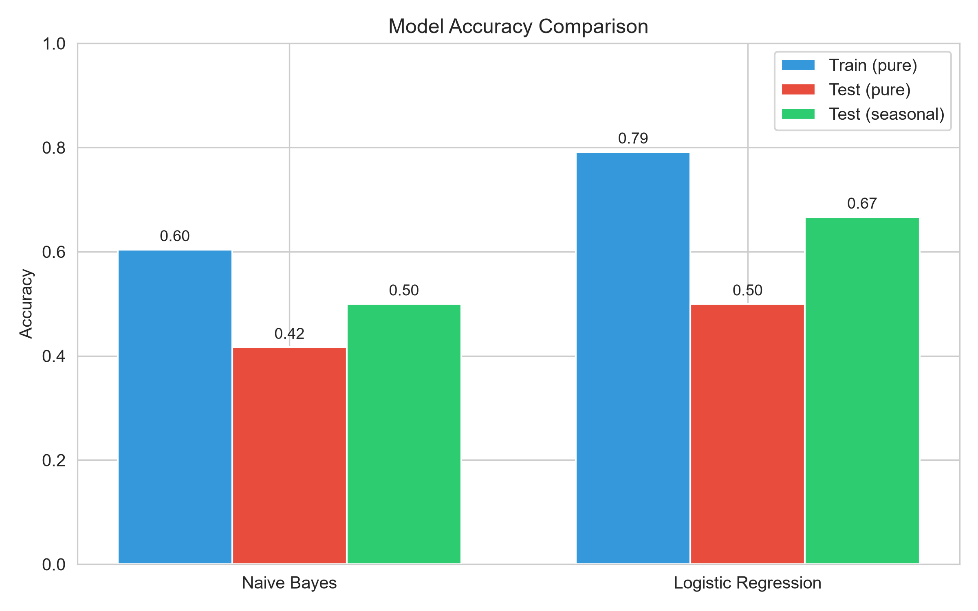
Accuracy Comparison
Logistic Regression generalizes better in seasonal mode.
Naive Bayes struggles with correlated features.
Both models show a train-test gap, indicating limited data.

Slide 9
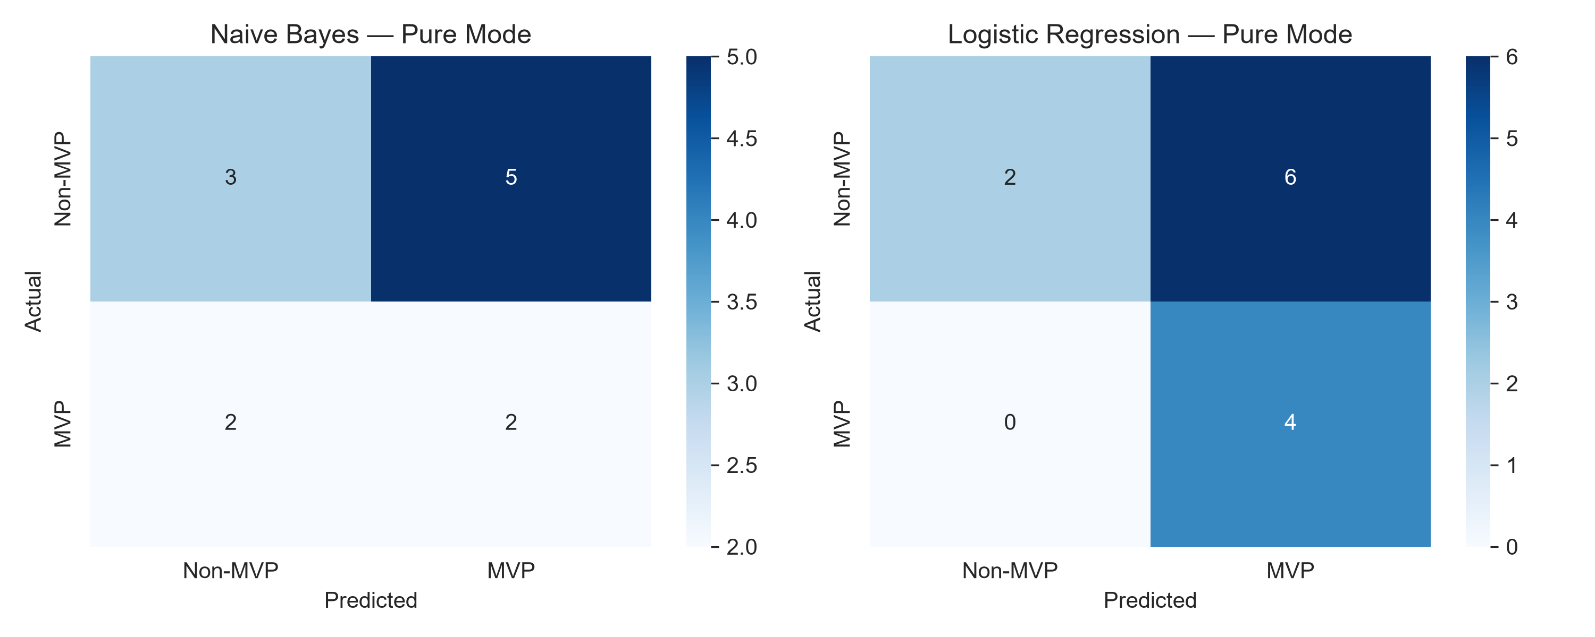
Confusion Matrices (Pure Mode)

Slide 10
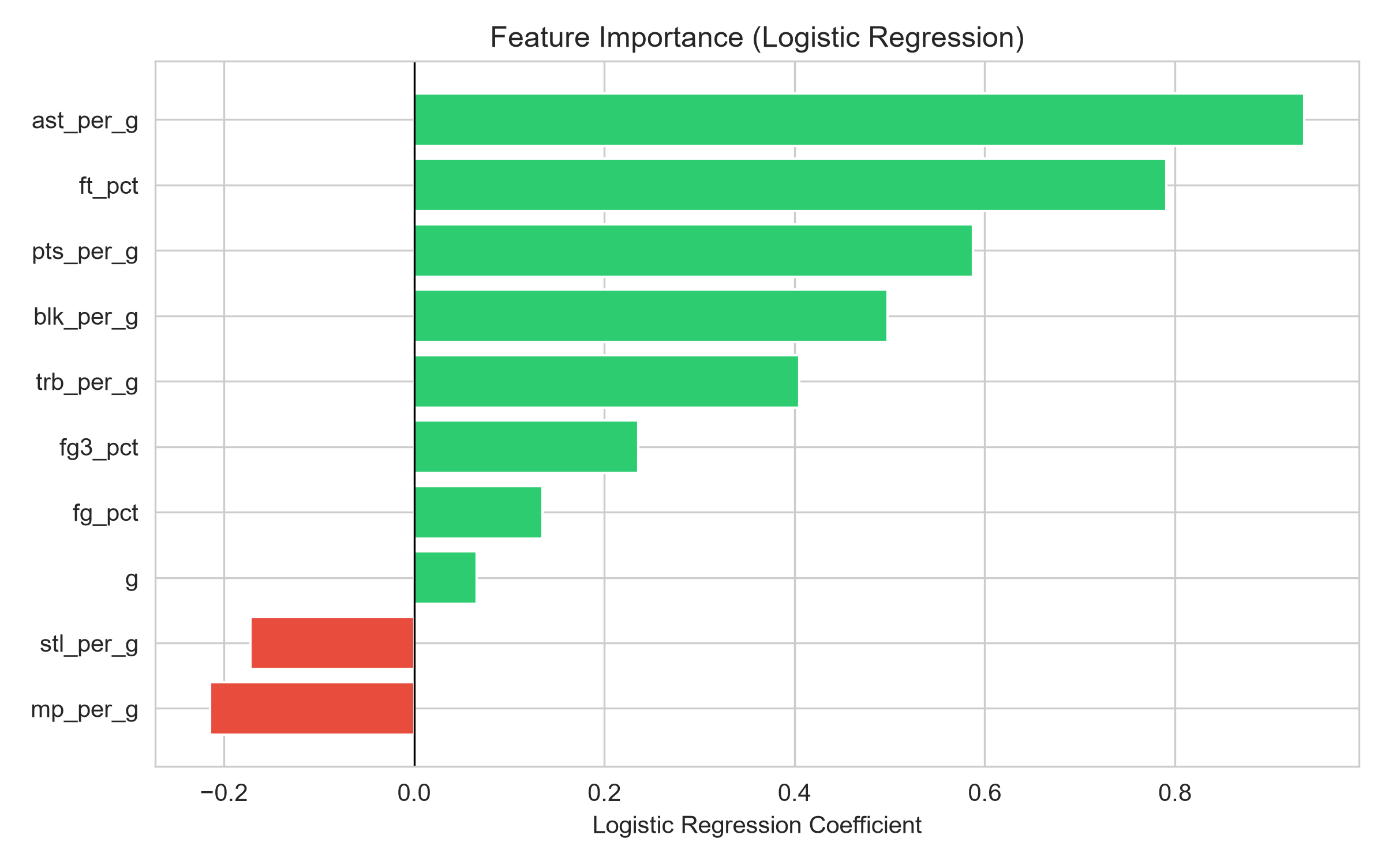
Feature Importance — Logistic Regression
Top positive predictors:
• Assists per game
• Free throw %
• Points per game
• Blocks per game
• Rebounds per game
Negative:
• Minutes per game

Slide 11
Discussion
Logistic Regression outperforms Naive Bayes, especially for seasonal prediction.
Naive Bayes' independence assumption is violated by correlated basketball stats.
The dataset is very small (60 rows), leading to overfitting.
Models miss non-statistical factors: team wins, media narrative, voter bias.
Results are comparable to the reference sample project.

Slide 12
Conclusion & Future Work
ML can partially predict MVP voting, but human bias remains a major factor.
Future improvements:
• Add team-level features (wins, playoff seed, point differential)
• Include advanced metrics (PER, win shares, VORP)
• Expand dataset to more seasons
• Try ensemble models (Random Forest, XGBoost)

Slide 13
Thank You
Questions?

