Slide 1
Da Better Cheddar
By: Kevin Martinez and Brandon Williams

Slide 2
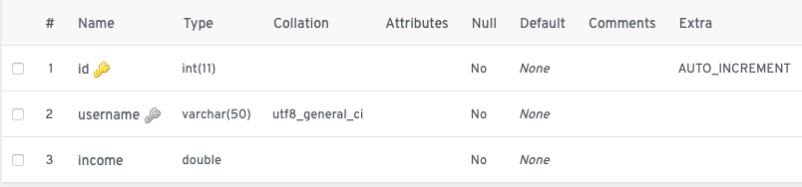
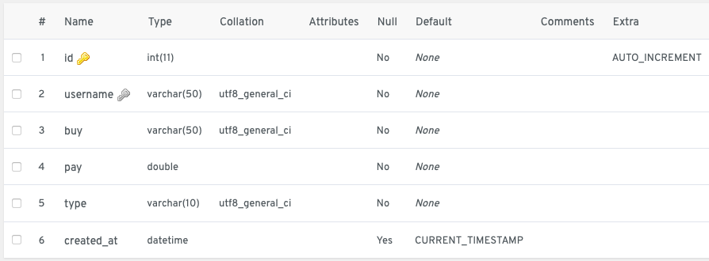
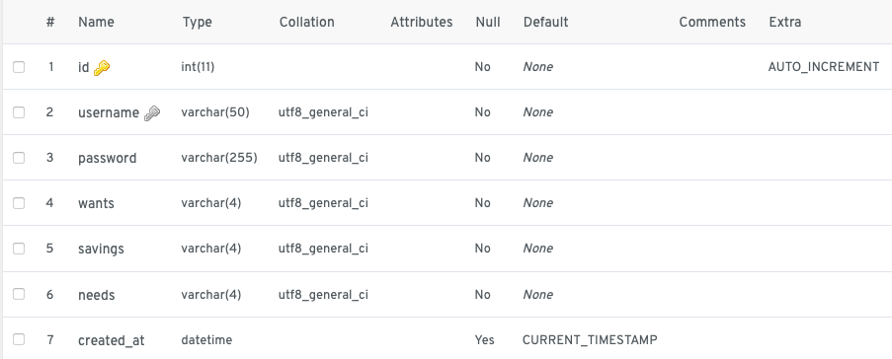
General Description
Our project consists of a monthly budget website that can be used by anyone on any platform. Upon registration users will choose a plan that fits their needs. Users will have the option to insert, edit, and delete information from their budget as they see fit. Calculations for their budget is done automatically and will be shown to the user. Users will be able to check their progress through a progress bar that is located in users welcome page.

Slide 3
Problem
Relevance
The problem we wanted to decrease the amount of people living paycheck to paycheck. There are lots a people who don’t have a budget and out goal was to create a product that was straightforward and easy to use and understand.
Interest rates are rising and you don't want to fall into debt or be apart of the already growing number of people living paycheck to paycheck. Budgeting helps you build better spending habits while also possibly saving you money.

Slide 4
How it was Solved
How our product differs
Pen and paper
Financial advisor
Budgeting applications
Easy Registration
No wait time to start
No payment/personal information required

Slide 5

Strengths
Weaknesses
Simple and easy to use
Free
Usable from any device
Flexibility
Inspiration Text
Simple
User has to do stuff

Slide 6
Future Works
Link bank account
Security
More user feedback
Update Code

