Slide 1

WorkWise

Slide 2
ABSTRACT
The above software is based on the project management system which is proposed in order to make project developments by a group of individuals in an efficient manner by providing the essential tools that make their time in developing the product in a productive manner. The software is focused toward developers who want to create their products in an organized environment where they are able to keep track of all their requirements and are provided with the respective tools to create an effective work pattern.

Slide 3
OBJECTIVES
The software fulfils objectives which are core to project developments these include:
Details about the project development details such as project domain and a brief description of the product developed under it. 2. Providing certain tools that make the development process efficient which could include workspaces for each development team which includes platforms to conduct virtual meets, calendar to schedule events, and storage tools to store all the project requirements and progress.
Scheduling different tasks to be accomplished for a successful project
The details of the individuals who are a part of the project along with their role

Slide 4
OBJECTIVES
Keeping a track of all the tasks assigned and completed by each team member by updating the status of each task.
The work details of the team members such as number of tasks completed, the number of hours spent, pending tasks and deadlines.

Slide 5
PROPOSED SYSTEM - Proposed Problem Definition
Developing a product in the real world environment is a tedious task as it demands a lot of human effort and resources which can make the development of these products difficult and time consuming. The manual gathering of the requirements and the forming the appropriate team for the development can cause human error which could prove costly in the future. The ways of scheduling the tasks required to complete the project and keeping track of the task completions by each team member can sometimes go so out of hand that the end product may not fulfil all what it was meant to do at the initial phase of the project development.

Slide 6

Existing System
Inclined towards Software projects,
Lacks cohesiveness between applications
cumbersome to coordinate all apps.

Slide 7






PROPOSED SYSTEM - Proposed Tools and Platform

Slide 8
PROJECT DESCRIPTION
Users
Head Consultant -
The head consultant is responsible for reviewing the project's details and project budget and selecting the projects which can be assigned for further process. Head consultants can view the completed projects and the team that has done the project and also assign the lead consultant and professor to handle new projects.
Lead Consultants -
The lead consultant is responsible for creating the project, send for review to the head consultant, and confirm, then view work on the project and provide the interns with required information about the project and track the project completion status.

Slide 9
PROJECT DESCRIPTION
Professor -
Professor is the one responsible for reviewing the project progress status, checking if the project has met all the requirements and demanding any changes if necessary. They can also view the whole project files and each intern’s progress.
Senior Interns -
Senior interns can upload their project description, status and the files of the project that is completed.
Interns -
Interns can report their completion status, add a detailed comment to the activity done, receive feedback from professor, also receive project details from lead consultant and submit the required files of the project.

Slide 10
PROJECT DESCRIPTION
Modules
Project Management
Projects: Create a Project with a description of the task which can be assigned faculty in charge responsible for the project. The in charge will be able to create SCRUM activities and sub-activities to be completed for the project.
Analytics: Real-time project progress tracker with graphs and charts showing the current project module working on with the number of hours spent on development and the available resources.
HR Management
Scheduling: Planning and scheduling the project structure by assigning the required number of members which can include assigning a lead consultant who would guid the professors and interns working on the project.
Assigning: The assigning of the essential tasks that initiates the project development .

Slide 11
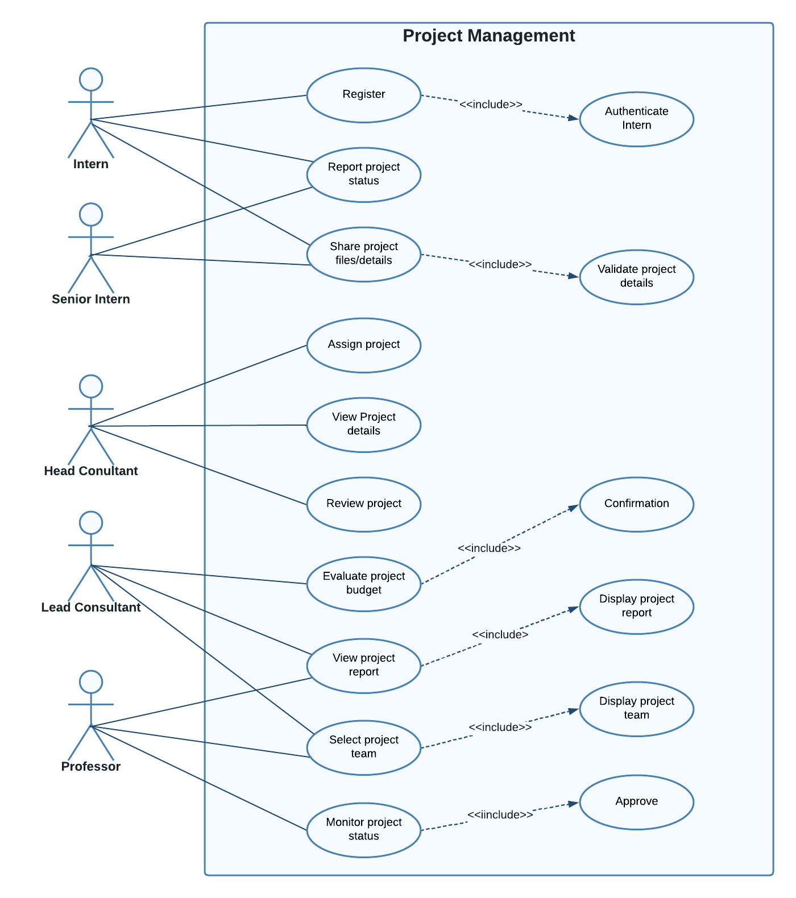
SYSTEM MODEL
Use Case Diagram

Slide 12
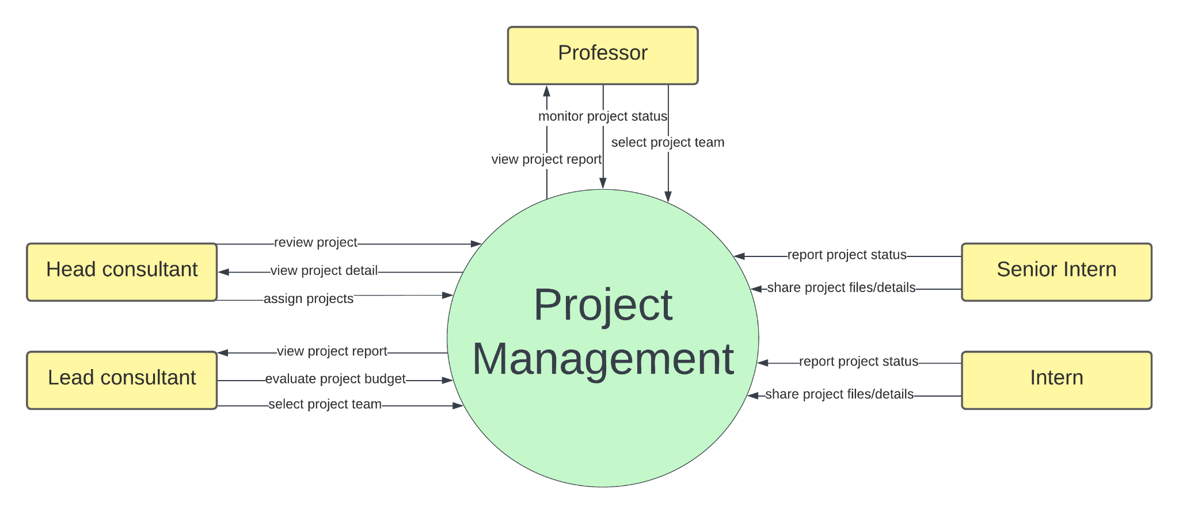
SYSTEM MODEL
Data Flow Diagram – Level 0

Slide 13
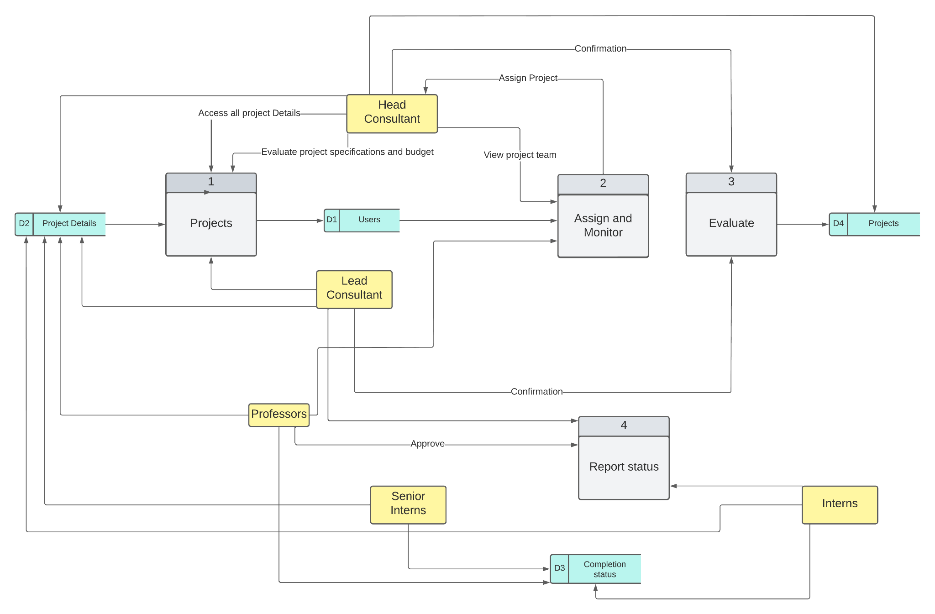
SYSTEM MODEL
Data Flow Diagram – Level 1

Slide 14
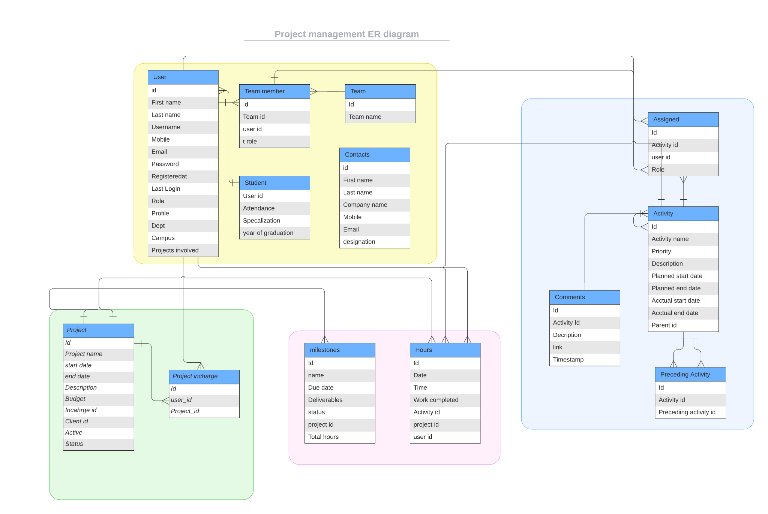
DATABASE DESIGN
Entity Relationship Diagram

Slide 15
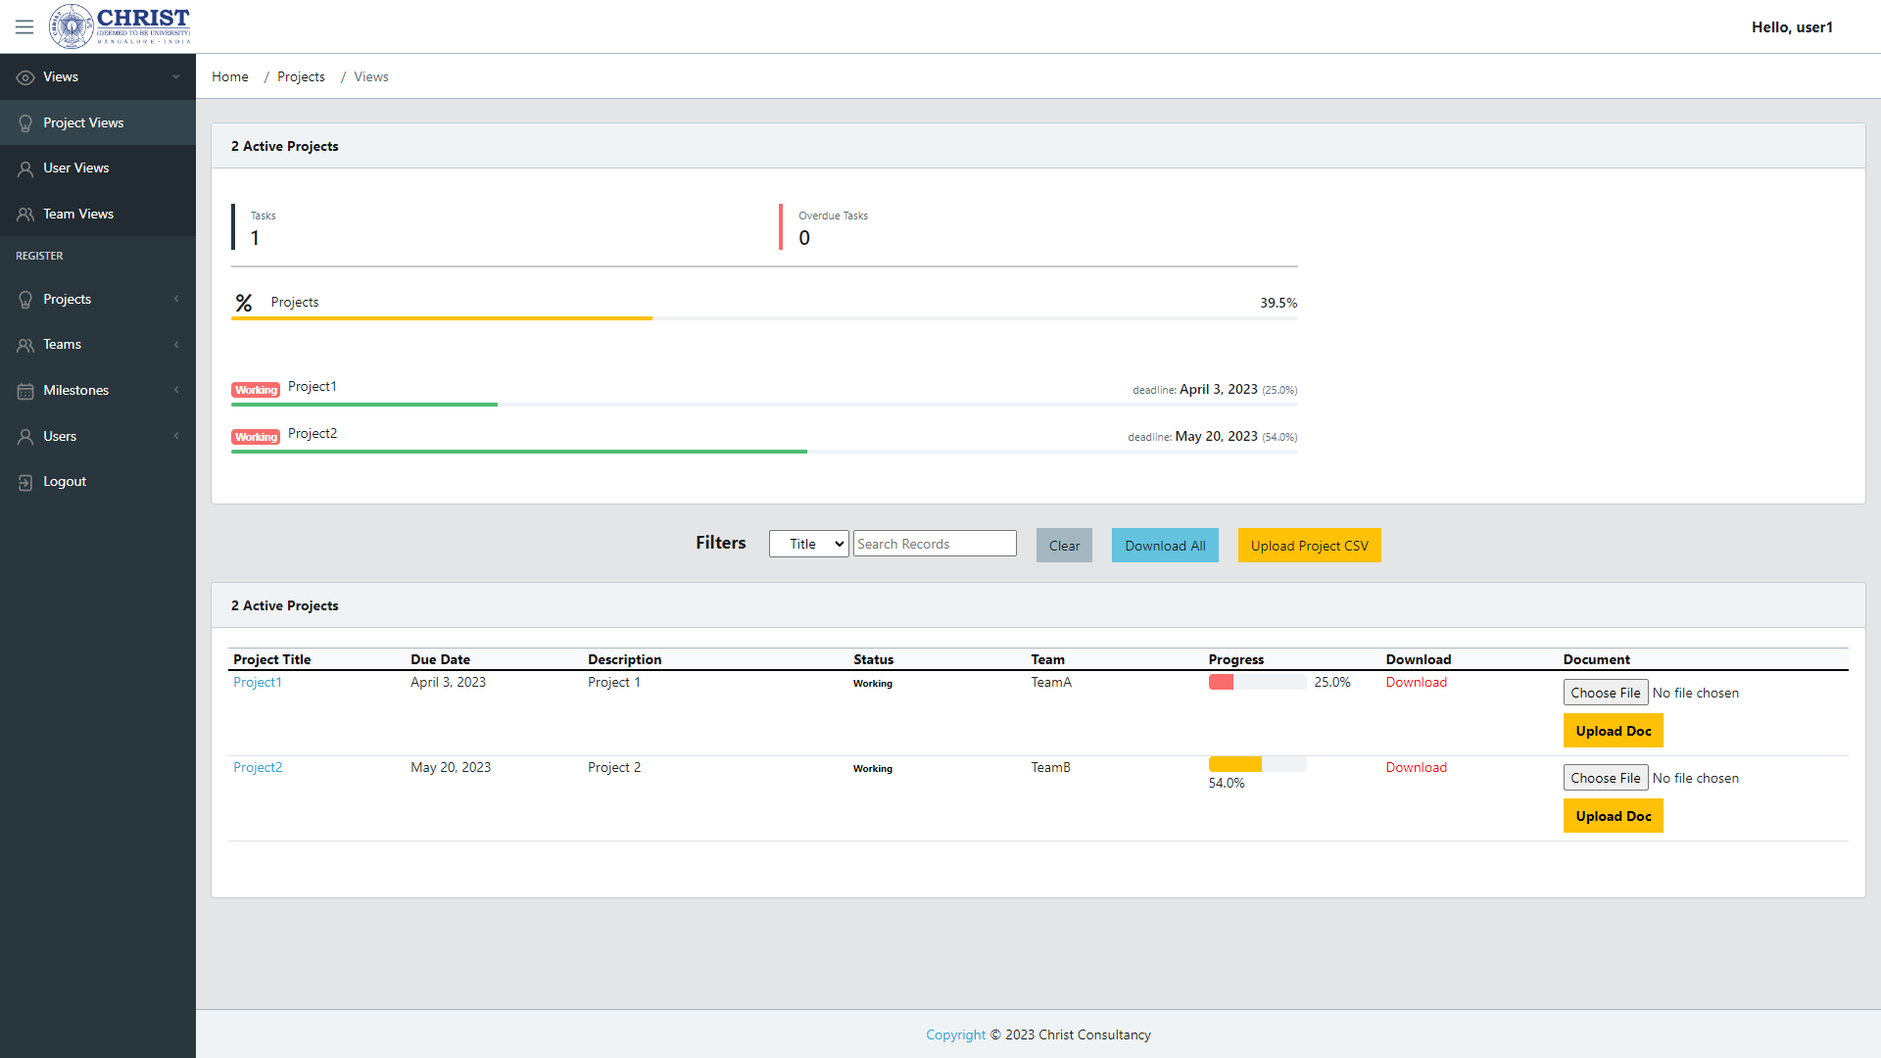
INTERFACE DESIGN

Slide 16
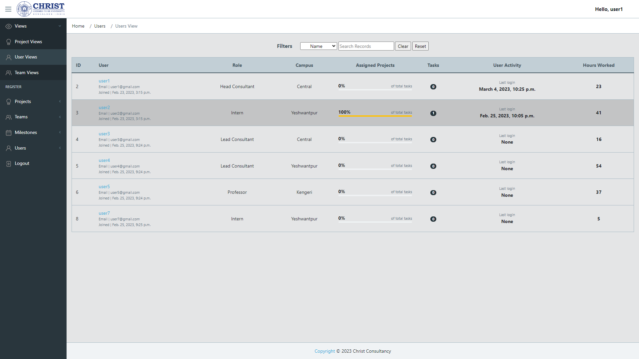
INTERFACE DESIGN

Slide 17
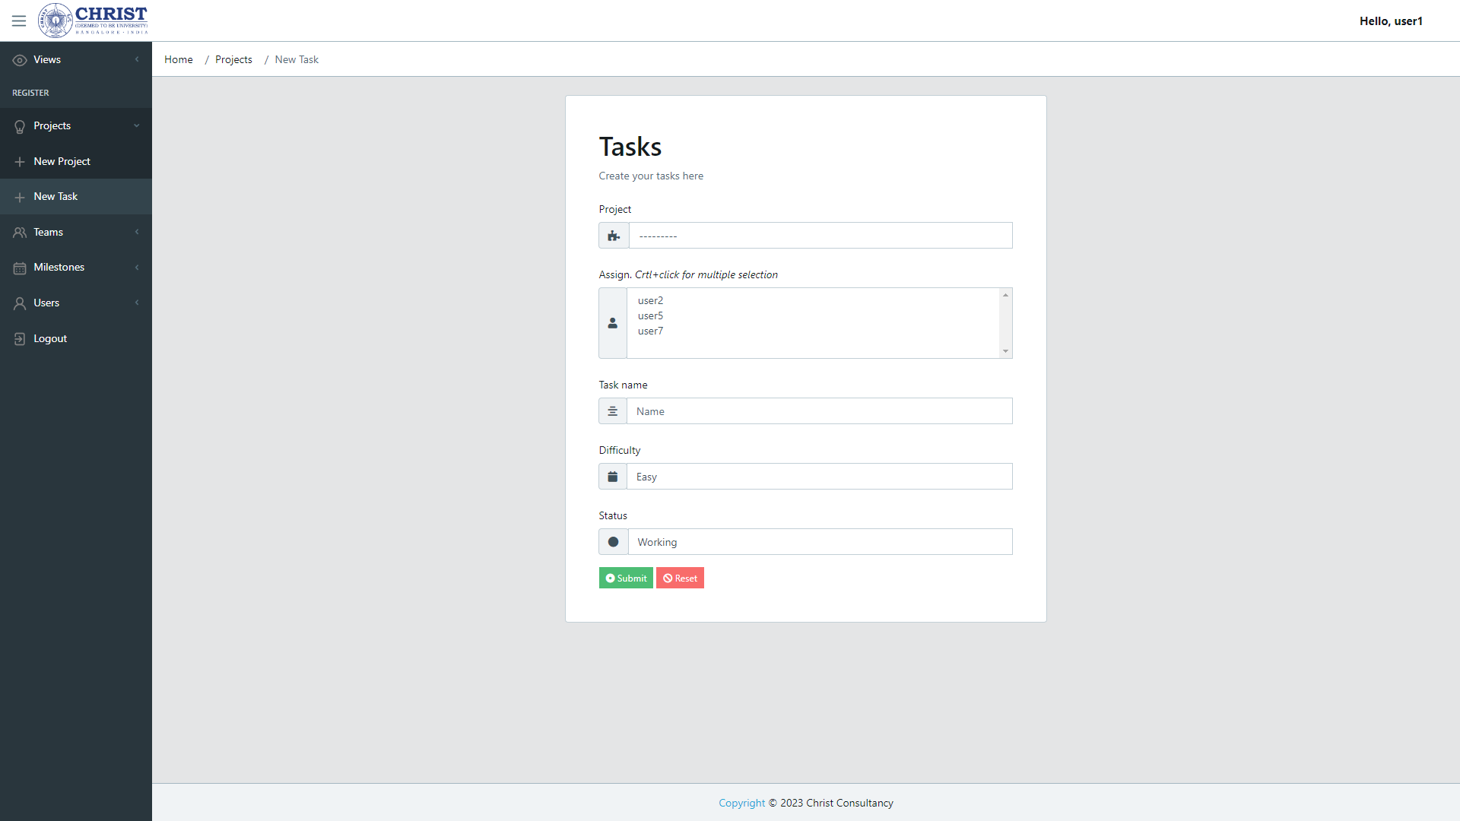
INTERFACE DESIGN

Slide 18
INTERFACE DESIGN

Slide 19
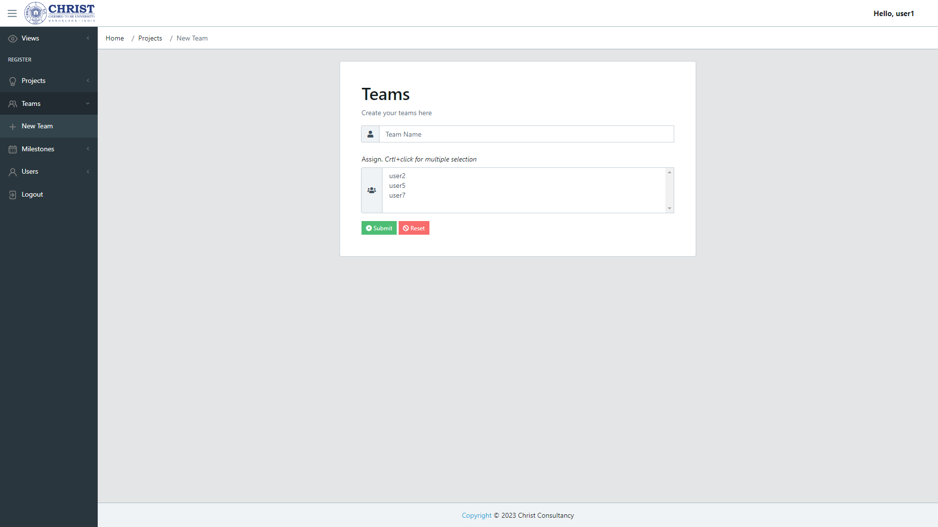
INTERFACE DESIGN

Slide 20
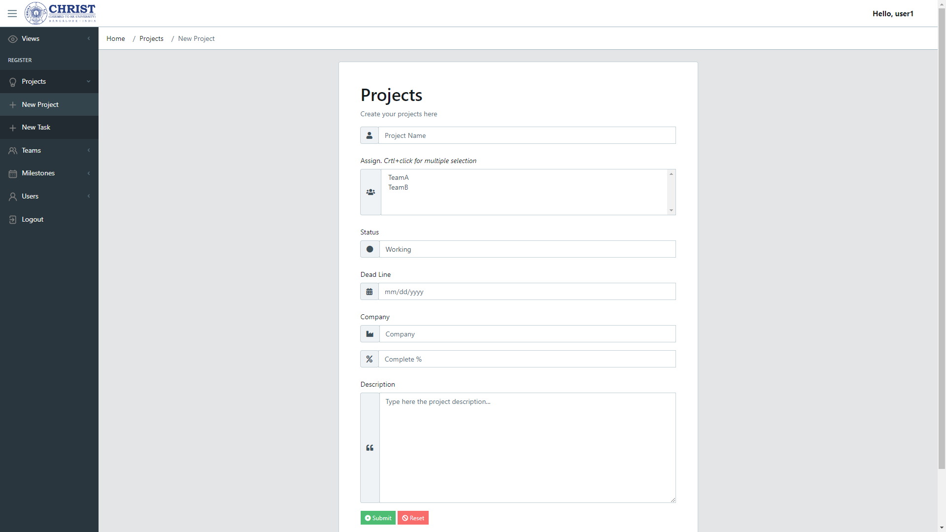
INTERFACE DESIGN

Slide 21
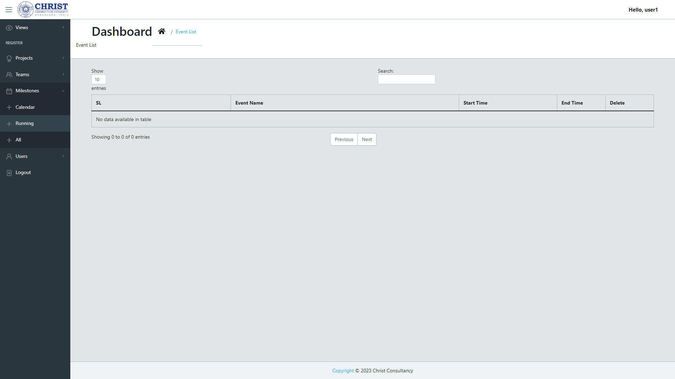
INTERFACE DESIGN

Slide 22
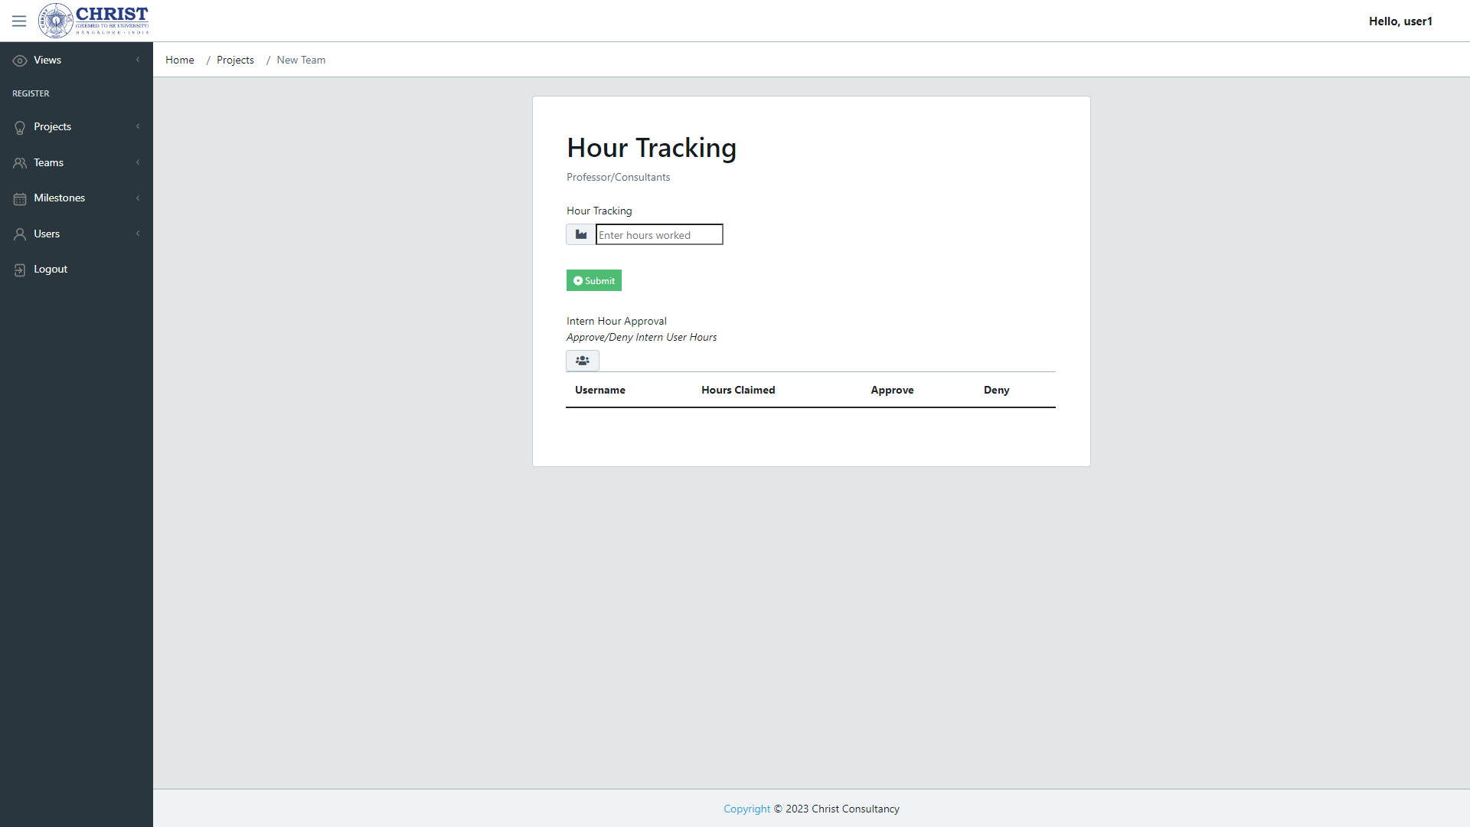
INTERFACE DESIGN

Slide 23
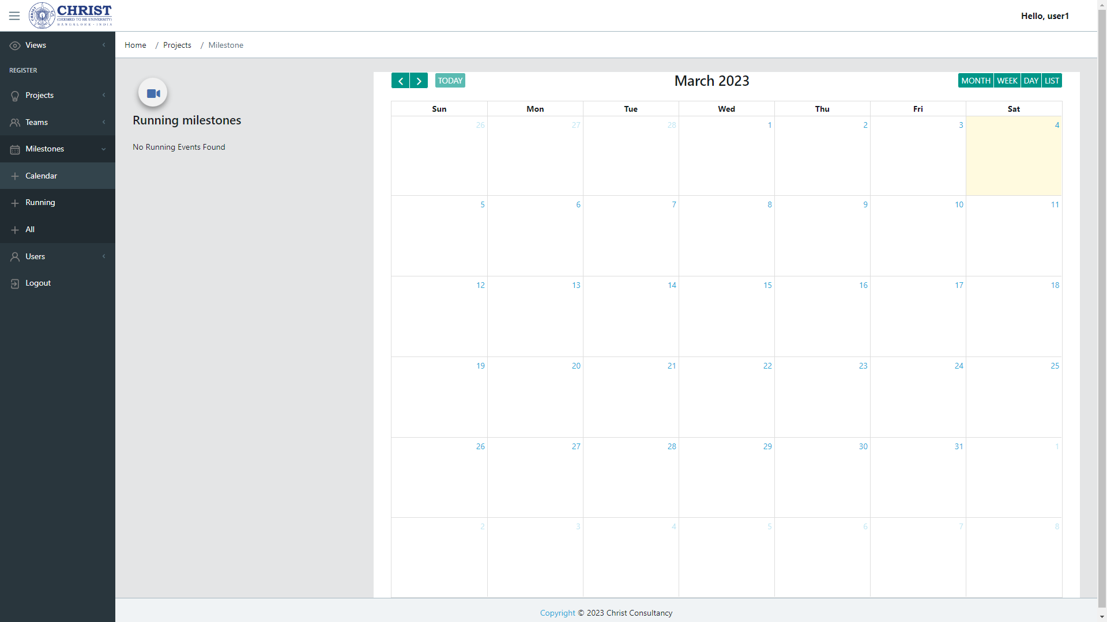
INTERFACE DESIGN

Slide 24
IMPLEMENTATION
MVC (Model-View-Controller) is a software design pattern built around the interconnection of three main component types, in a programming language such as PHP, often with a strong focus on object- oriented programming (OOP) software paradigms. The three component types are loosely termed models, views, and controllers.
Rationale For Choosing MVC
The architecture of implementation adopted was the MVC architectural pattern. This pattern was chosen because the application was to be developed using Django and most Django frameworks are MVC based which proves the power of MVC and its flexibility and robustness.And the list below shows popular MVC frameworks are Flask.

Slide 25
References
https://wrapbootstrap.com/tag/project-management
https://monday.com/lp/projectmanagement/bundle/?utm_medium=cpc&utm_source=adwordssearch&utm_campaign=ww2-en-prm-workos-project-project_management-e-search-desktop-exp-aw&utm_keyword=project%20management&utm_match_type=e&cluster=generic&subcluster=project_management_software&ati=
https://www.atlassian.com/software/jira?&aceid=&adposition=&adgroup=143541078612&campaign=17623646550&creative=607643157113&device=c&keyword=pm%20management%20project&matchtype=e&network=g&placement=&ds_kids=p71904397651&ds_e=GOOGLE&ds_eid=700000001756546&ds_e1=GOOGLE&gclsrc=ds

Slide 26
THANK
YOU

