Slide 1
What Is a VPN & How Does It Work?

Slide 2

A VPN (virtual private network) is one of the best tools for ensuring your internet privacy. A VPN encrypts your connection and keeps you hidden while surfing, shopping, and banking online. Keep reading for a full VPN definition, including how VPNs work and why you need one. A VPN establishes a secure, encrypted connection between your computer and the internet, providing a private tunnel for your data and communications while you use public networks.
While VPNs were once novel tech solutions, they are now necessary tools. At the basic level, VPNs protect your privacy online so you cannot be targeted or discriminated against based on location.

Slide 3
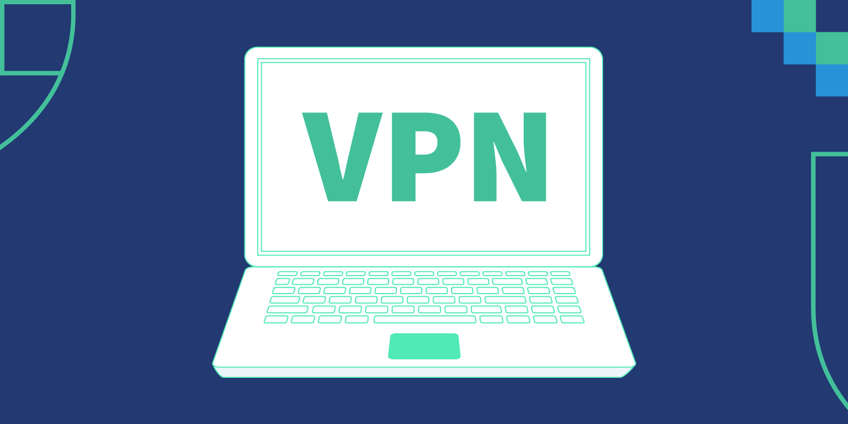
Sitting on a motorcycle, you’re completely visible. Anyone with a mind to do so can follow you along these digital highways, see who you are, and peek into your private life. To view your online activity, who you are, where you like to visit, and more, all anyone has to do is look. Worse, they can follow you home. You’re traceable.
Instead of riding on the wide open internet highway, you can use a private tunnel instead: a virtual private network. A VPN acts as your own personal tunnel that encircles you, masking you in anonymity and blocking anyone from seeing where you’re going or what you’re doing. To abandon the metaphor, a VPN encrypts your connection and hides your IP address.

Slide 4
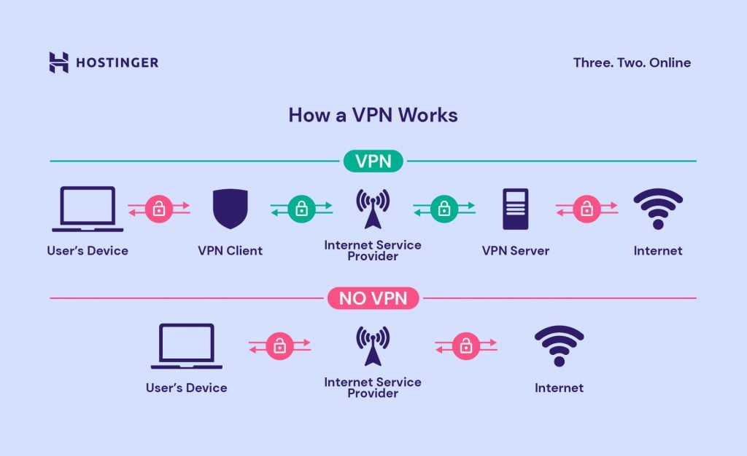
What does a VPN hide?
VPNs work on the operating system level, so they reroute all your traffic through other servers. That means all of your online traffic, along with your physical location, stays hidden while you surf the web. When you access a site through a VPN server, the source of your connection is shown as one of the many VPN routers — called a proxy server — not your own. So the owners of the site, and anyone else trying to spy on you, cannot deduce who you are.
A VPN is the closest you can get to true anonymity online without using the Tor network, which bounces your connection around a widely distributed network of volunteer relays, basically keeping your web activity in constant motion so nobody can focus on it. VPNs do not use this (very slow) protocol, but they do offer sufficient — and essential — protection as you cruise through today’s deregulated and hacker-lined cyber highways.

Slide 5
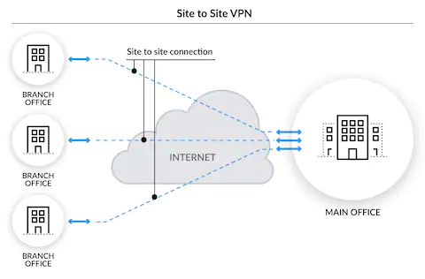
How do VPNs work?
The Virtual Private Network was first developed by Microsoft in 1996 as a way for remote employees to securely access the company’s internal network. Once it doubled company productivity, other companies began to adopt the practice. Corporate VPNs that allow remote work are now a standard feature of the global business landscape.
Developers then realized that this secure “tunnel” could be utilized by average people who wanted to securely connect to the largest network on the planet: the world wide web. VPNs are now the cornerstone of online privacy in the consumer sector.

Slide 6
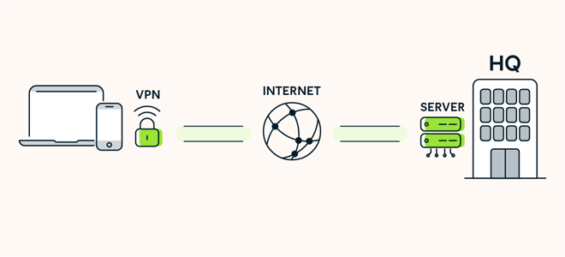
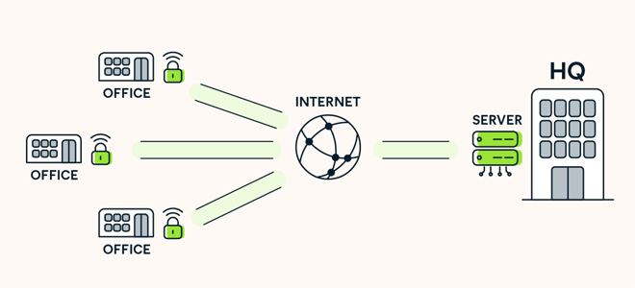
Different types of VPN
There are two basic types of VPNs. A remote-access VPN allows users to connect to another network, be it the internet or their company’s internal system, through a private encryption tunnel.
The other type, a site-to-site VPN, is also called a router-to-router VPN. This type of VPN is mostly used within corporate environments, specifically when an enterprise has headquarters in several different locations. The site-to-site VPN creates a closed, internal network where the various locations can all connect with each other. This is known as an intranet.

Slide 7
Additional benefits of a VPN
Stream from anywhere: If you’re abroad and you try to access a streaming account you use in the US, you may find some shows are not available in that region. But if you choose a US-based IP address, all your favorites are at your fingertips, just as if you were home.
Access blocked websites: Certain institutions — schools, libraries, companies — restrict access to specific web pages such as social media, but the encrypted connection provided by your VPN will tunnel right through.
Avoid censorship: Every government has an agenda, and some go to extremes to control information. While circumventing government restrictions could certainly be considered illegal in some of these countries, we believe in unadulterated free speech.
Beat price discrimination: Price discrimination can hit you two ways. One is by your location — people in San Francisco or New York have a higher cost of living and therefore higher incomes. Clever businesses know this and program their sites to display a higher cost of goods, such as airline tickets, to users based in those areas.

Slide 8
VPN disadvantages
As with any type of technology, there are also some disadvantages to using a VPN.
Potentially slower speed: Your web traffic goes through more steps than usual when connected via VPN, so there could be a perceptible slowdown. Since this has always been the #1 complaint about VPNs, developers have taken notice. Many have had success optimizing speed and performance, so much so that their VPN users can stream and game fluidly without a hiccup. Plus, see our extra tricks to speed up your VPN connection.
QoS challenges: QoS stands for “quality of service” and describes the performance of a service or network. VPNs do not yet have a standard in place to gauge and report such measurements. With no metrics to analyze, you need to rely on professional reviews and word-of-mouth to learn what’s most reliable.
VPN blocks: Some businesses are getting wise to the fact that VPNs give their users carte blanche to access content. To fight back, companies are beginning to block access from known VPN IP addresses. Not to be so easily defeated, VPNs can simply turn on new IP addresses to trick them again.
No cookie protection: While the VPN does its job of keeping you private and encrypted, it’s not possible for a VPN to block cookies, some of which are necessary to make sites work properly. The bad kind of cookies, tracking cookies, can still be stored in your browser and identify who you are. Luckily you can delete tracking cookies easily. Or better yet, use a private browser like Avast Secure Browser that prevents tracking cookies from following you around the internet.

