Slide 1
Apple M1 CPU

Slide 2
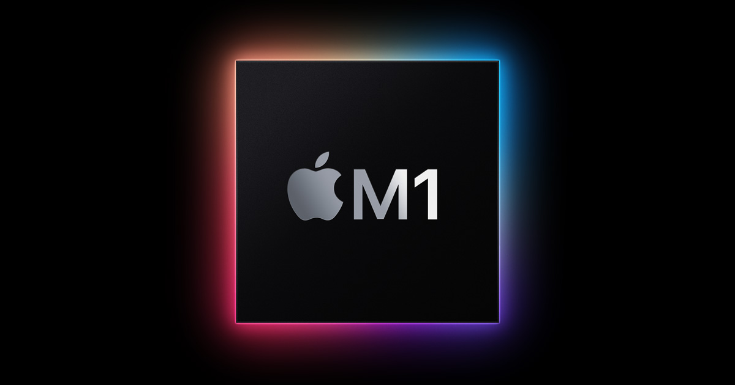
Apple M1 is a series of ARM-based systems-on-a-chip (SoCs) designed by Apple Inc. as a central processing unit (CPU) and graphics processing unit (GPU) for its Mac desktops and notebooks, and the iPad Pro and iPad Air tablets. The M1 recorded competitive performance and efficiency in popular benchmarks.
The 2020 M1-equipped Mac Mini draws 7 watts when idle and 39 watts at maximum load, compared with 20 watts idle and 122 watts maximum load for the 2018, 6-core Intel i7 Mac mini. The energy efficiency of the M1 increases battery life of M1-based MacBooks by 50% compared to previous Intel-based MacBooks.

Slide 3
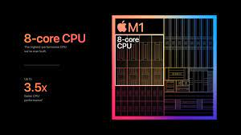
The M1 has four high-performance "Firestorm" and four energy-efficient "Icestorm" cores, first seen on the A14 Bionic. It has a hybrid configuration similar to ARM DynamIQ and Intel's Lakefield, Alder Lake and Raptor Lake processors. This combination allows power-use optimizations not possible with previous Apple–Intel architecture devices. Apple claims the energy-efficient cores use one-tenth the power of the high-performance ones.
The high-performance cores have an unusually large192 KB of L1 instruction cache and 128 KB of L1 data cache and share a 12 MB L2 cache; the energy-efficient cores have a 128 KB L1 instruction cache, 64 KB L1 data cache, and a shared 4 MB L2 cache.

Slide 4
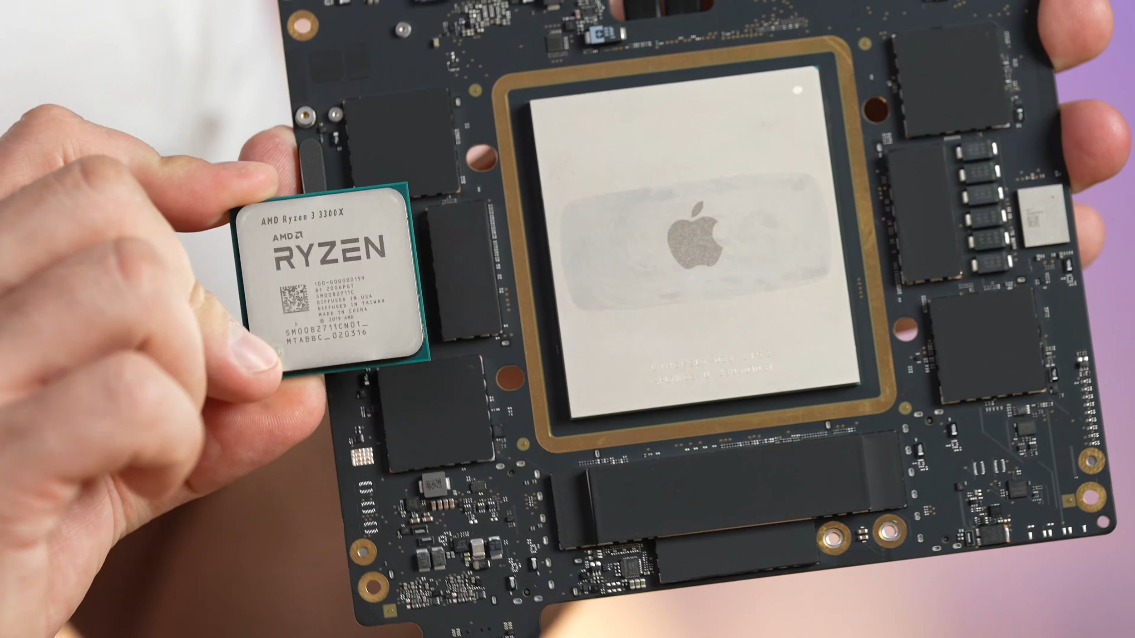
The M1 Pro and M1 Max use the same ARM big.LITTLE design as the M1, with eight high-performance "Firestorm" (six in the lower-binned variants of the M1 Pro) and two energy-efficient "Icestorm" cores, providing a total of ten cores (eight in the lower-binned variants of the M1 Pro).The high-performance cores are clocked at 3228 MHz, and the high-efficiency cores are clocked at 2064 MHz. The eight high-performance cores are split into two clusters. Each high-performance cluster shares 12 MB of L2 cache. The two high-efficiency cores share 4 MB of L2 cache. The M1 Pro and M1 Max have 24 MB and 48 MB respectively of system level cache

Slide 5
The four high-efficiency cores deliver outstanding performance at a tenth of the power. By themselves, these four cores deliver similar performance as the current-generation, dual-core MacBook Air at much lower power. They are the most efficient way to run lightweight, everyday tasks like checking email or browsing the web, and preserve battery life like never before. And all eight cores can work together to provide incredible compute power for the most demanding tasks and deliver the world’s best CPU performance per watt.

Slide 6
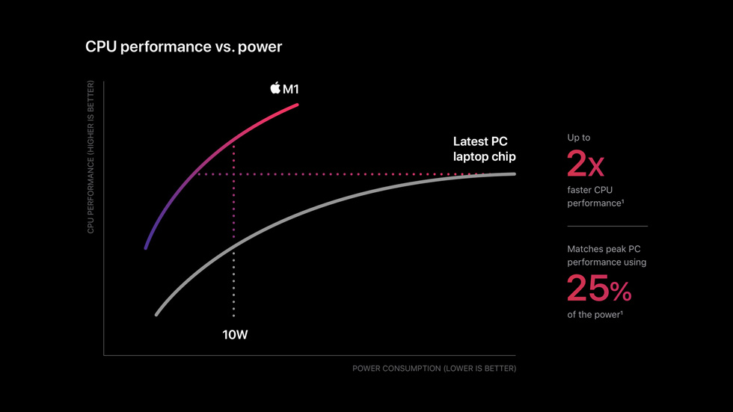
Macs and PCs have traditionally used multiple chips for the CPU, I/O, security, and more. Now with M1, these technologies are combined into a single SoC, delivering a whole new level of integration for greater performance and power efficiency. M1 also features a unified memory architecture that brings together high-bandwidth, low-latency memory into a single pool within a custom package. This allows all of the technologies in the SoC to access the same data without copying it between multiple pools of memory, further improving performance and efficiency

