Slide 1
Quantum processors and computing

Slide 2
What is quantum computing?
Quantum computing is a rapidly-emerging technology that harnesses the laws of quantum mechanics to solve problems too complex for classical computers.
Today, IBM Quantum makes real quantum hardware -- a tool scientists only began to imagine three decades ago -- available to thousands of developers. Our engineers deliver ever-more-powerful superconducting quantum processors at regular intervals, building toward the quantum computing speed and capacity necessary to change the world.
These machines are very different from the classical computers that have been around for more than half a century. Here's a primer on this transformative technology.

Slide 3
Why quantum computers are faster?
Quantum algorithms take a new approach to sorts of complex problems -- creating multidimensional spaces where the patterns linking individual data points emerge. In the case of a protein folding problem, that pattern might be the combination of folds requiring the least energy to produce. That combination of folds is the solution to the problem.
Classical computers can not create these computational spaces, so they can not find these patterns. In the case of proteins, there are already early quantum algorithms that can find folding patterns in entirely new, more efficient ways, without the laborious checking procedures of classical computers. As quantum hardware scales and these algorithms advance, they could tackle protein folding problems too complex for any supercomputer.

Slide 4
There are several models of quantum computation with the most widely used being quantum circuits. Other models include the quantum Turing machine, quantum annealing, and adiabatic quantum computation. Most models are based on the quantum bit, or "qubit", which is somewhat analogous to the bit in classical computation. A qubit can be in a 1 or 0 quantum state, or in a superposition of the 1 and 0 states. Though current quantum computers are too small to outperform usual (classical) computers for practical applications, larger realizations are believed to be capable of solving certain computational problems, such as integer factorization, substantially faster than classical computers. The study of quantum computing is a subfield of quantum information science.

Slide 5
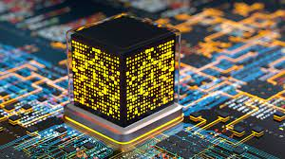
KEY TAKEAWAYS
Quantum computing uses phenomena in quantum physics to create new ways of computing.
Quantum computing involves qubits.
Unlike a normal computer bit, which can be either 0 or 1, a qubit can exist in a multidimensional state.
The power of quantum computers grows exponentially with more qubits.

Slide 6
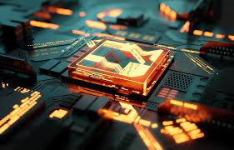
Here are some potential benefits of quantum computing:5
Financial institutions may be able to use quantum computing to design more effective and efficient investment portfolios for retail and institutional clients.
The healthcare industry could use quantum computing to develop new drugs and genetically-targeted medical care.
For stronger online security, quantum computing can help design better data encryption and ways to use light signals to detect intruders in the system.

