Slide 1
The Rakshak app– to keep a vigil eye
SIH 2020
Ministry/ Organization name: Ministry of Communications Problem Statement Number : PJ 240 Team Name : Rakshak Team Leader Name : Sweta Vooda
College Code : C-19946
Problem Statement: Development of platform for dialing single emergency no SDC (short digit code).
Notes:
Delete this slide when you finish preparing the other slides.

Slide 2
Problem/Idea:
With so many apps in the market for each region/state disaster management team serving the same purpose there comes a need to have a common national platform for citizens to easily report their problem during emergency which can be integrated with any disaster management server to take appropriate action.
SOLUTION:
To develop a common platform for all the citizens to report during emergency on a single click of the button which can be integrated with any server across the nation to help reach out any part of the society. Our app will give the data about the users information and location which can be pulled by the corresponding disaster management team to take appropriate action.
We also aim to provide data enrichment to analyze the already happened incident and profiling situations and locations accordingly to alert the users.

Slide 3
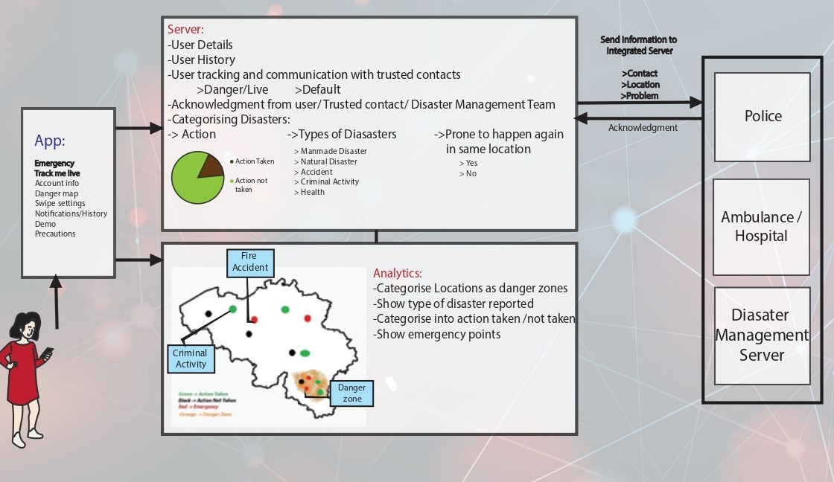
Features

Slide 4

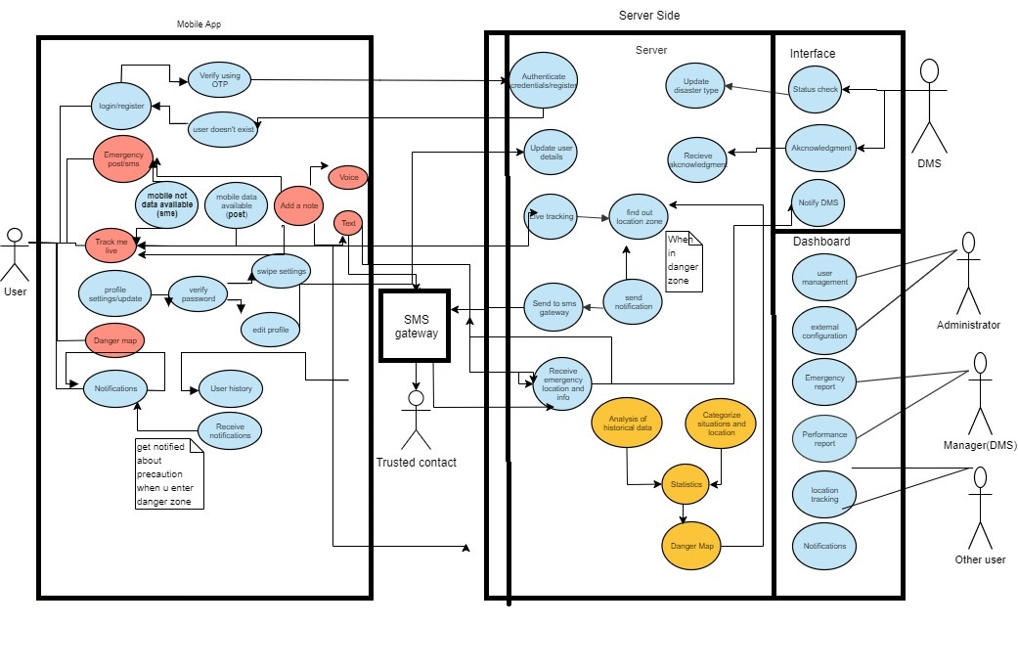
Use case diagram

Slide 5

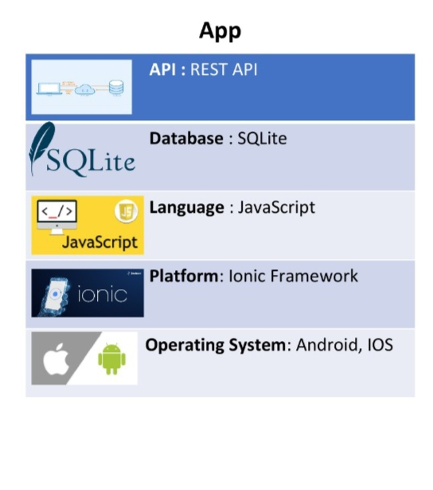
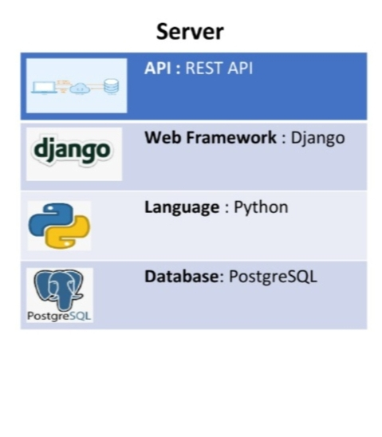
TECHNOLOGY STACK

Slide 6

DEPENDENCIES AND SHOW STOPPER
DEPENDENCIES:
if government can provide our app with a unique SDC then the app can work without cellular network.
For information enrichment we need government information regarding danger areas.
SHOW STOPPER: The application is designed to transmit information of the user via internet or using other network services. The idea of trying to transmit the user’s live location and other necessary information in case of very weak or no network conditions is yet to be overcome.

Slide 7


