Slide 1
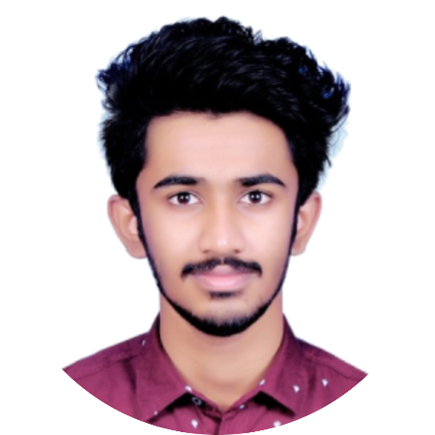


SWOT ANALYSIS
Aswin Benny
(12205631)
/in/aswinbenny
/aswinbennyofficial

Slide 2

SOFTWARE DEVELOPMENT ENGINEER (SDE)

Slide 3

ROLES:
Design and maintenance of softwares
Evaluate and test new softwares and assure quality
Optimize the software for speed and scalability
Track down bugs and fix it within the time frame

Slide 4

SKILLS REQUIRED:
Bachelor’s degree in Computer Science, related technical field, or equivalent practical experience
Experience working in software development with one or more of the following programming languages; Java, C/C++ etc..
Proficiency in data structure and algorithm and OOPS concept
Understanding the basic concepts of networking, source control, databases etc.. is beneficial
Excellent communication, analytical and problem solving skills

Slide 5
STRENGTH
THREAT
WEAKNESS
OPPURTUNITIES

Slide 6

STRENGTH:
Plan before acting - does research
Good at money management
Basic JAVA skills
Basic skills in Linux
Leadership quality

Slide 7

WEAKNESS:
Social anxiety issues
Lacks certification
Lacks Industry experience
Lacks certain communication skills
Weak at DSA

Slide 8
ROADMAP:
Improve
connections
on Linkedin and contribute to OSS
Practice on Leetcode & Interviewbit
Learn DSA
Improve JAVA, DB, OS, git basics

Slide 9

OPPURTUNITIES:
Tech clubs and fests - P2P learning
MOOCs, YouTube, Stack Overflow
Github and open source contribution
LinkedIn connections
Resources in college

Slide 10

THREATS:
Over use of social media
Toxic people
Peer pressure
Competition
Nepotism
Quicker upgrades in tech
Growth of AI and ML

Slide 11

THANK YOU

