Slide 1

Business Insights
~OTT Platforms
A Submission by Team Quarantino.
~ Namita Goyal
~ Ujjwal Gupta

Slide 2

Solution Overview
Case Scenario: Let us have a view at two people Ajay and Reema.
Reema is the marketing head of PVR solutions and is looking for a potential platform for advertising products of her firm.
Ajay is a very busy person, he is an employee in a company and is always short of time, although tired from his daily routine, he wants to take a break and decides to watch something on OTT platform to refresh his mind but he neither knows what to watch nor want to spend ample time on internet searching for a match.
Aim of this presentation is to help Ajay and Reema through data-oriented approach.

Slide 3




Data Sets Used and Their Summary
Type of Data
Title, Genre, Director, Language, Country, IMDB ratings https://www.kaggle.com/unanimad/disney-plus-shows
Type, Director, Release Year, Duration https://www.kaggle.com/shivamb/netflix-shows
Title, Year, Age Type, IMDB Ratings, OTT platforms, Genre, Language
Title, Year, Age Type, IMDB Ratings, OTT platforms.
Time and Data consumption of Netflix and Amazon. https://www.kaggle.com/jsrojas/user-ott-consumption-profile-2019
Disney+
Netflix
Movies on all Platforms
https://www.kaggle.com/javagarm/movies-on-ott-platforms
TV Shows
https://www.kaggle.com/javagarm/tv-shows-on-ott-platforms
Consumption

Slide 4

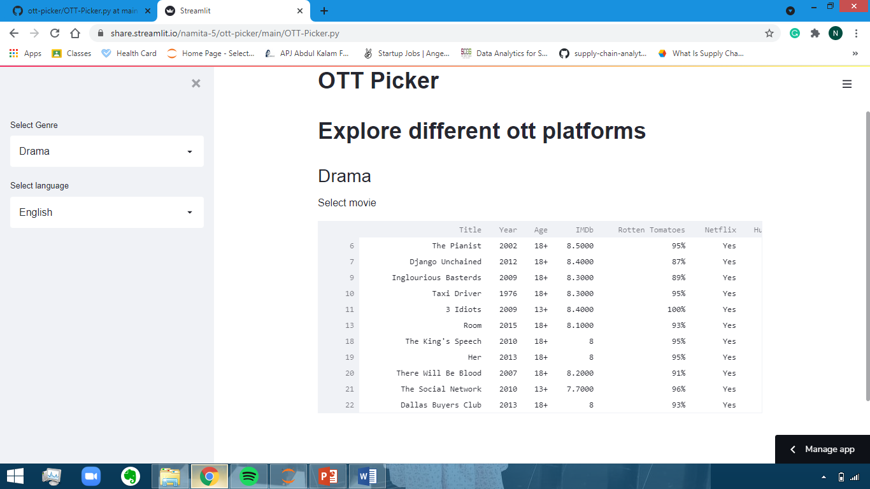
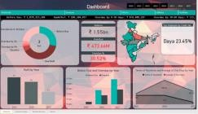

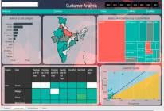
Solution At A Glance
Dataset
(Movies/OTT)
Business Insights
OTT Picker App
Analytics Modeling
Application Designing
Cleaning of data from raw sources
Using python open source libraries and Streamlit to design an “OTT Picker“ app,
which requires Genre and Language as input and gives output based on user preferences.
Graphical Representation
Data is visualized using Power BI platform for quick business insights.
Using python to perform EDA and extracting useful Insights.

Slide 5

Insights Inferred
There is an exponential growth in the number of Movies launching on OTT platforms in past two decades, indicating the shift from traditional cinema to OTT platform due to extremely high consumer engagement.
The average duration of a Movie/TV Show on OTT platform is high for USA, India (163 and 126 minutes respectively) while it is low for other countries.
Director Jay Chapman has directed the most TV shows/Movies launched on OTT platforms.
Directors like Anees Bazmee, Cathy Garcia, Nagesh and Wilson are the ones who have delivered hits on a consistent basis.
Age group of 18+ section has the most number of movies/TV shows.
Amongst OTT platforms, Netflix has more adult centric content while Disney+ has more
kids oriented content.
With respect to highest cumulative screen time and overall data consumption, Amazon is way
too ahead of all other competitors.
Amazon Prime has the highest Retention Ratio while Netflix has better market reach.
Europe, India and South Africa are the best market for OTT platforms and can also be considered as potential penetrators.

Slide 6

Conclusions
Since, consumer engagement on Amazon is more hence the Consumer Acquisition Cost will be less; amongst other OTT platforms Amazon would be the best platform for Reema to advertise her firm’s products.
But if products of Reema’s firm are children oriented (say, some wafers brand) then Disney+ would be
the best decision to market her firm’s product.
Also, if Reema’s primary focus is on Europe, she must do marketing on Netflix, else if her focus is on India then
she should go with Amazon Prime.
The OTT Picker Application can be used by Ajay to pick a Movie/TV Show ,
with his preference of genre and language.
By means of the app he will be better off, as it would save his time in searching for a movie with
high ratings, availability on OTT platforms, runtime etc.

Slide 7

THANK YOU!

