Slide 1
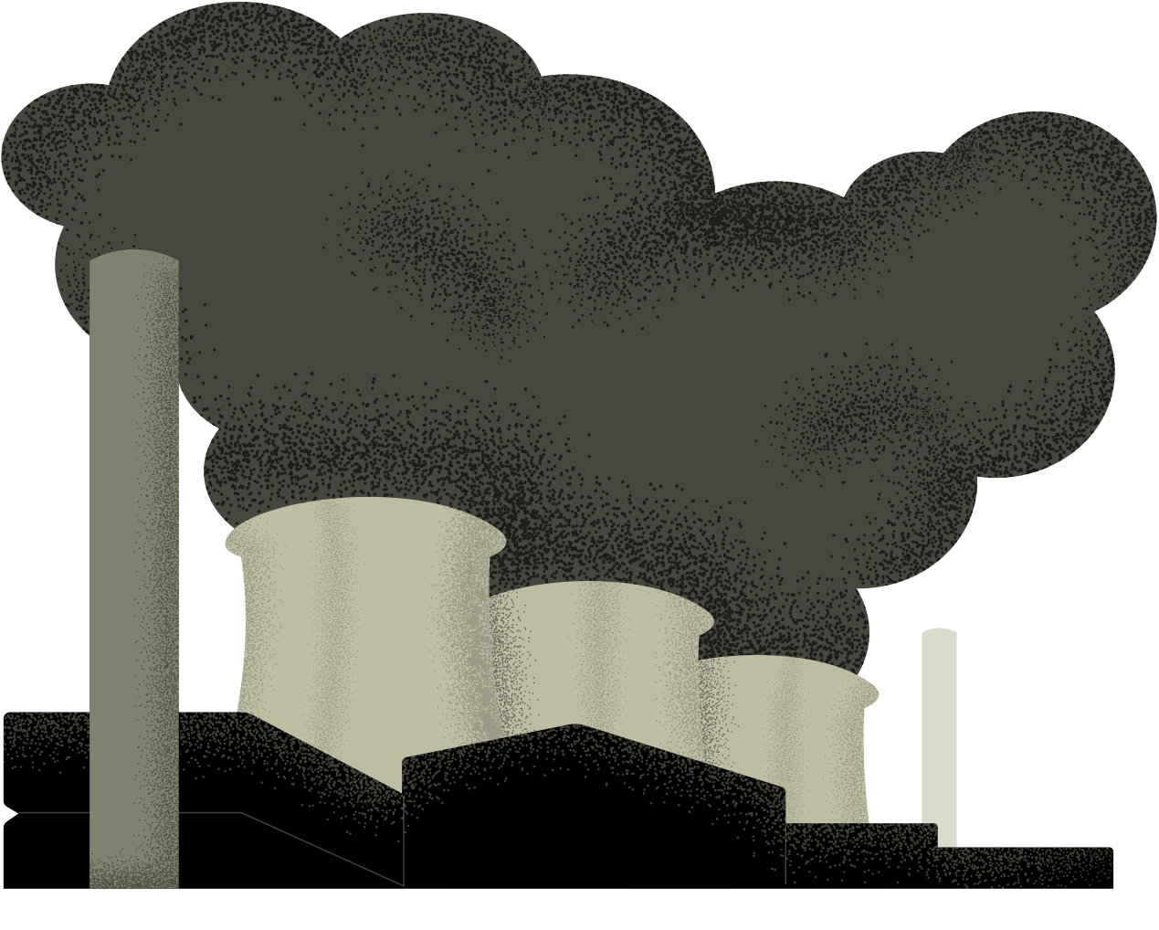

ENVIRONMENTAL
POLLUTION
REPORTING
GROUP MEMBERS:
NAMITA JINESH
NAMITHA THOMAS
NANDHANA SUNIL
NANDITHA MANOJ
NATASHA SHAJI VARGHESE

Slide 2
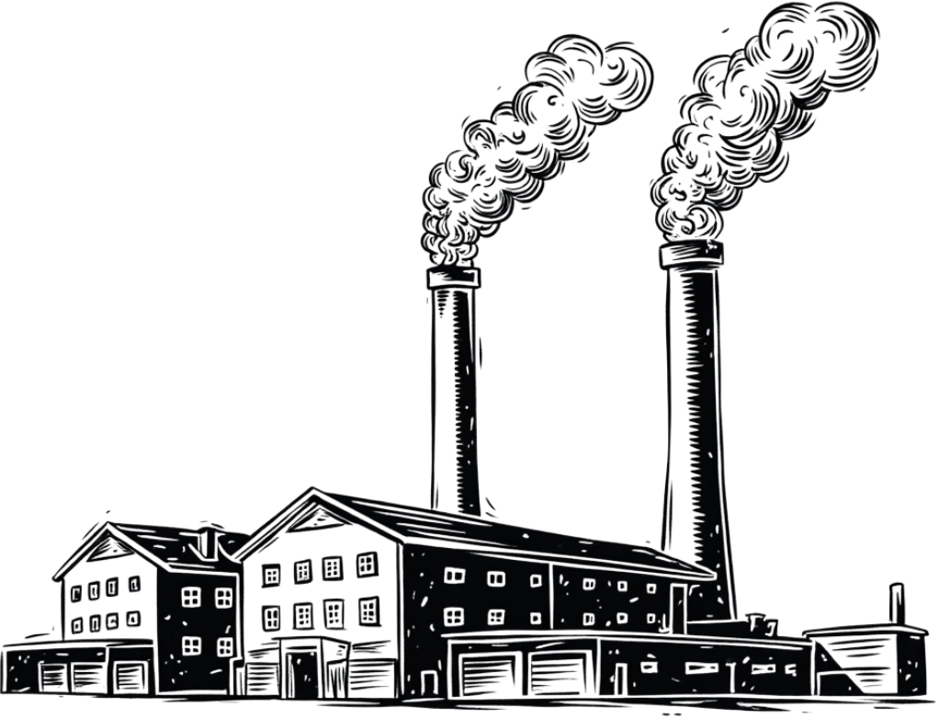
PROBLEM STATEMENT
  Lack of a centralized platform for reporting pollution incidents.
  Difficulty in providing accurate location and evidence.
  Pollution reports may be distributed across different departments.
  Limited ability to track complaint progress.
  Difficulty in identifying recurring pollution hotspots.
  Delays in verification and response to reported incidents.

Slide 3
SUSTAINABILITY ANALYSIS
Environmental Impact
  Early identification of pollution
  Supports faster corrective action
  Helps protect natural resources
Social Impact
  Encourages citizen participation
  Increases environmental awareness
  Promotes healthier communities
Economic Impact
  Reduces monitoring costs
  Improves resource allocation
  Supports cost-effective management
Technical Impact
  Enables digital monitoring
  Improves data collection and analysis
  Supports scalable solutions

Slide 4
Main features :
  AI Image Analysis – analyzes uploaded pollution images
  Pollution Classification – identifies the type of pollution
  Source Identification – determines the probable source
  Severity Assessment – provides a preliminary severity level
  Report Categorization – organizes pollution data automatically
  Action Recommendation – suggests suitable follow-up actions
  Data Storage – maintains structured records for future analysis
1.AI-Based Pollution Source Identification & Classification System
💡 Solution:
The system uses AI and image processing to analyze pollution evidence and automatically determine its type, probable source, and severity. It reduces the need for manual classification, minimizes ambiguity in pollution reports, and converts raw evidence into structured and actionable environmental information.
Natasha Shaji Varghese

Slide 5

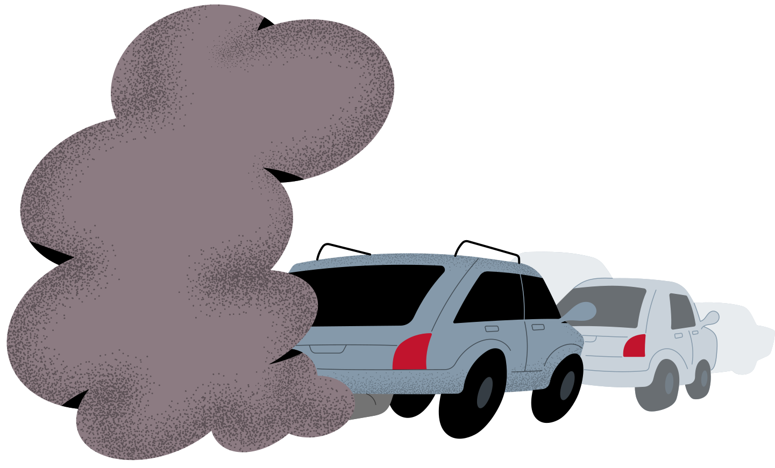
2. ECOALERT-Smart Environmental Pollution Reporting & Monitoring System
What is EcoAlert?
EcoAlert is a web-based platform that connects citizens with environmental authorities. It allows citizens to report pollution incidents with their location, category, description and photographic evidence, while authorities can verify and manage these complaints.
Main FEATURES:
  GPS-Based Reporting
Records the location of reported pollution incidents, making them easier for authorities to investigate.
  Pollution Analytics
Helps authorities understand pollution trends, affected areas and recurring incidents.
  Smart Prioritization
Ranks complaints based on severity, location and potential environmental impact.
  Hotspot Identification
Uses previous reports to identify areas experiencing repeated pollution.
  Complaint Tracking
Allows citizens to follow the progress of their submitted complaints.
NAMITA JINESH

Slide 6
Main features :
  Users report pollution with location.
  Pollution incidents appear as map markers.
  Frequently reported areas become pollution hotspots.
  Users can view pollution problems near their area.
  Authorities can identify areas requiring immediate attention.
3.Location-Based Pollution Hotspot Mapping
💡 Solution:
Develop a portal that collects pollution complaints and displays them on an interactive map.
Unique idea:
A map-based visualization system helps identify locations where pollution repeatedly occurs.
NANDHANA SUNIL

Slide 7

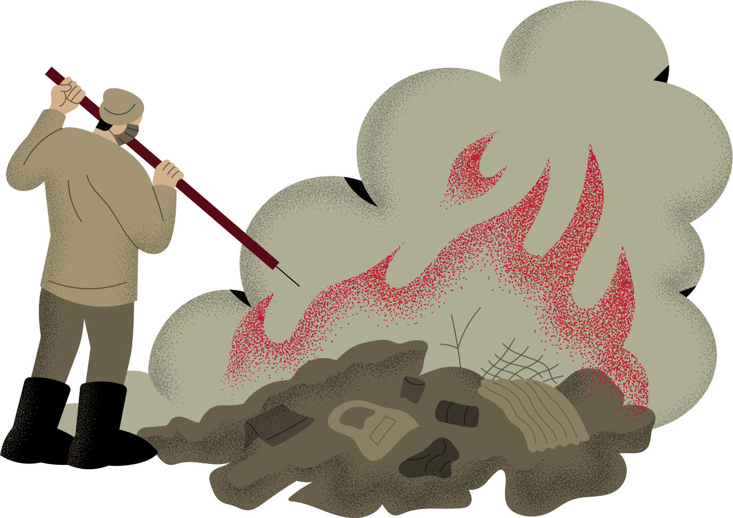
4.GEO-TAGGED ENVIRONMENTAL COMPLAINT & REPORTING PORTAL
  The Geo-Tagged Environmental Complaint & Reporting Portal is designed to make environmental pollution reporting easier, faster, and more accurate.
  It allows users to report issues such as illegal dumping, water pollution, air pollution, and excessive waste by providing a description and the exact location of the pollution using geo-tagging.
  Users can also upload photographic evidence and indicate the severity of the problem. Each complaint receives a unique ID so that its progress can be tracked.
  The system helps authorities verify complaints, prioritize serious cases, identify pollution hotspots, and take appropriate action.
  This can improve the accuracy of environmental reporting, enable faster response, and encourage citizen participation in protecting the environment.
NAMITHA THOMAS

Slide 8
Main features :
  Users report pollution incidents with location.
  Nearby users receive pollution alerts.
  Alerts show pollution type and severity.
  Users get safety and precaution information.
  Authorities verify and manage incidents.
  Previous incidents are stored for monitoring.
  Frequently affected areas can be identified.
5.SMART POLLUTION ALERT AND LOCATION-BASED ENVIRONMENTAL NOTIFICATION SYSTEM
💡 Solution:
A web-based system that collects pollution reports, identifies affected locations, and sends alerts to nearby users, helping authorities monitor and manage pollution incident.
NANDITHA MANOJ

Slide 9
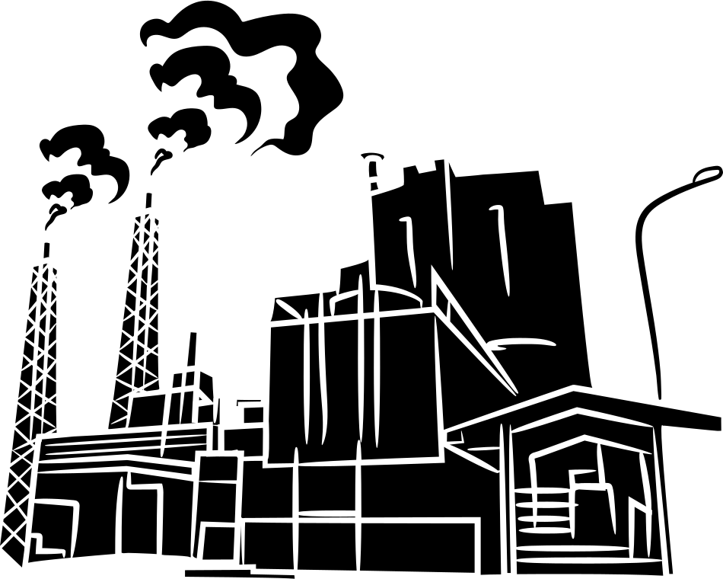
FINAL SOLUTION & Justification
Why we choose geo-tagging?
We chose geo-tagging because it provides the exact location of pollution incidents, making reports more accurate and easier to verify. It helps authorities identify affected areas and recurring pollution hotspots, prioritize serious cases, and take appropriate action. This makes pollution reporting more accurate, efficient, and location-specific.

Slide 10
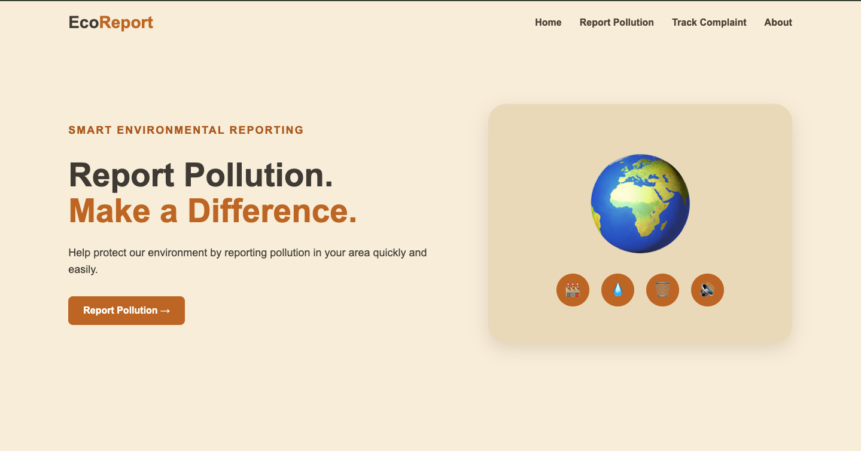
WEBSITE SCREENSHOTS

Slide 11
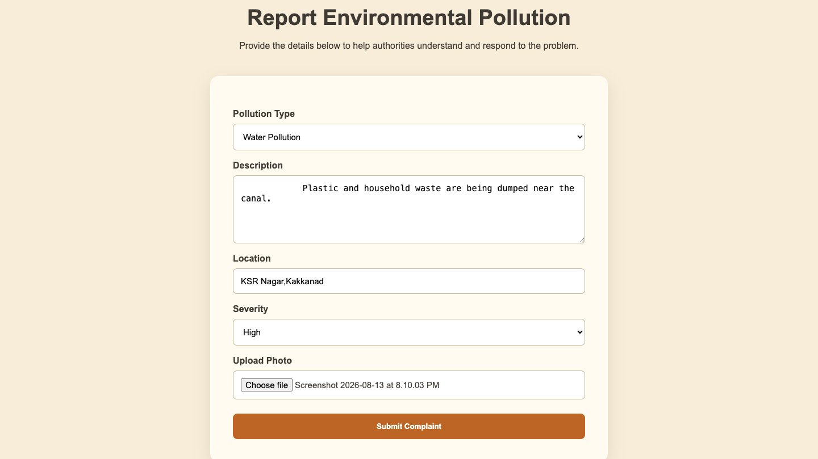

Slide 12
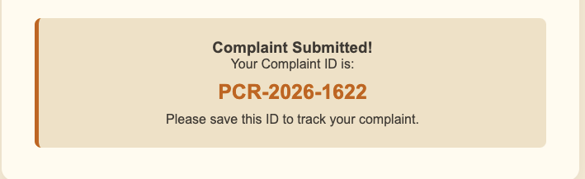

Slide 13



Slide 14
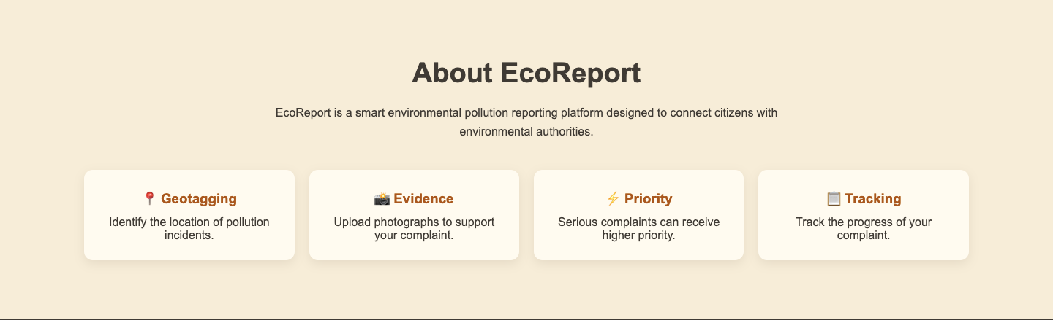

Slide 15
THANKYOU

