Slide 1
CSCI 544 NLP Research Project : Anaphoric Resolution for Pronominal Entities
Manisha Kampasi
Mayuri Mehrotra
Pavan Lupane
Namitha GS

Slide 2
Introduction
ANAPHORA RESOLUTION:
Anaphora is an expression whose interpretation is dependent upon another expression in context.
When two or more expressions in a text refer to the same person or thing; they have the same referent (co-reference)
e.g. Bill said he would come; Bill and he refer to the same entity.
Anaphoric Resolution is the task of identifying this reference/antecedent.
CORPUS/TOOLS:
ICON 2011 Data Set
Sampark Morphological Analyser
CRF++ Suite

Slide 3
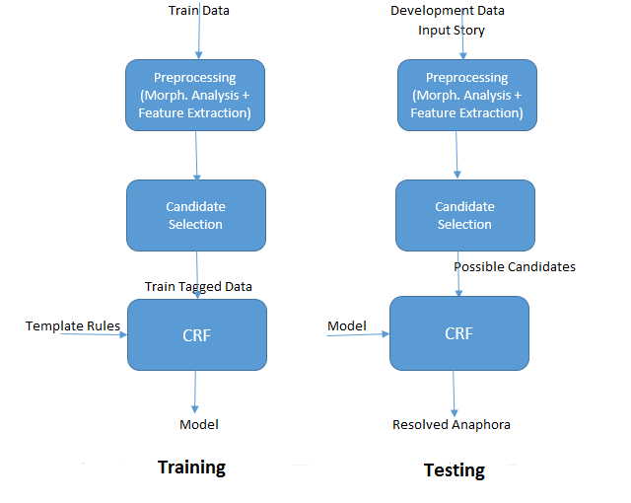
Approach

Slide 4
Tasks Completed/In-progress
Add morphological analysis for train, dev and test files from the Sampark Morphological analyzer
Mentions Detection:
Annaphora selection - Ongoing. Needs refinement.
Candidate Selection – Ongoing. Needs refinement.
Feature selection - Ongoing. Needs refinement.
Train the CRF++ tool based on these selected features – Ongoing.
Create evaluation script for using Precision, Recall and F1 measure

Slide 5
Pending Tasks
Annaphora selection – Currently it is selecting additional pronouns other than entity pronouns as well.
Candidate Selection – Need to reduce the set of candidates selected. We are selecting an average of 20 right now. This needs to be reduced further for CRF++ to perform better.
Feature selection – We need to play around with feature selection to get better evaluation results.
Manually annotate the Test data and perform inter-annotator reliability study.

Slide 6
Candidate selection
SELECTION OF ANNAPHORA
This is done by picking pronouns with POS tag "PRP" which are at the head of the noun chunk B-NP. Also, only pick pronouns from a given set of pronoun categories.
SELECTION OF CANDIDATES
For each annaphora, select all the candidates based on a set of rules like:
Candidate should be a NN or a NNP present in the current sentence or in the previous sentence relative to the annaphora.
Gender and number of the annaphora and antecedent should match.

Slide 7
Feature selection
Currently used features:
POS tag of the Candidate
Gender of Anaphora
Gender of Candidate
Number (Singular/Plural) of Anaphora
Number (Singular/Plural) of Candidate

Slide 8
Feature selection - Extension
Distance of Candidate from Anaphora
Named Entity information
NE categories like ‘Person’, ‘Organization’, ‘Location’ etc and can help the classifier to learn which pronominal forms more preferably refers to NP‘s of which NE category
Category of pronoun
There is an exhaustive list of pronouns in categories like Reflexive, Locative, Relative and Personal. These categories can be used for better learning as well.
Using combinations of features in CRF
Also planning to add some Hindi grammar rules.
For example, The referent of a reflexive pronoun is the ‘subject’ or ‘karta’ of the same sentence. Postposition (‘ne’) gives an approximation of the dependency relation ‘karta’. Hence, for reflexive pronouns, we will select that nearest NP as the referent, which has post-position n (‘ne’) attached with it.

Slide 9
Evaluation
F1
Precision
Recall
We plan to evaluate combination of different feature rules

Slide 10
Proposal – Open questions
Size of articles? Number of words and mentions?
Average number of words in articles – 350+ words
TRAINING: 835 pronouns, 547 annaphoras
DEVELOPMENT: 375 pronouns, 258 annaphoras
TESTING: 507 pronouns, 344 annaphoras (as per a reference paper). However, we plan to do manual annotation.

Slide 11
THANK YOU

