Slide 1

June 2026
MUTUAL FUND ANALYTICS CAPSTONE PROJECT
Bluestock Fintech
Prepared By:
Namitha Theresa VJ

Slide 2
Table of
CONTENT
01.
02.
03.
04.
Problem Statement & Objectives
Data Sources
Project Architecture
EDA Highlights
05.
06.
07.
08.
Fund Performance Analytics
Advanced Analytics
Dashboard
Key Findings

Slide 3
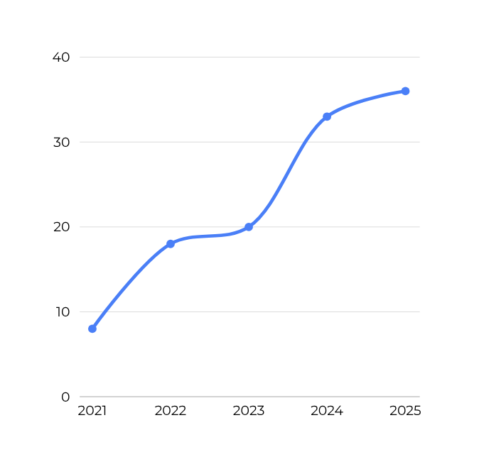
PROBLEM STATEMENT & OBJECTIVES
Problem Statement
The mutual fund industry generates large volumes of financial and investor data. Analyzing this data manually is challenging and may lead to inefficient investment decisions.

Slide 4

OBJECTIVES
Clean and validate mutual fund datasets
Analyze industry and investor trends
Evaluate fund performance
Calculate risk metrics
Build recommendation system
Develop interactive dashboard

Slide 5
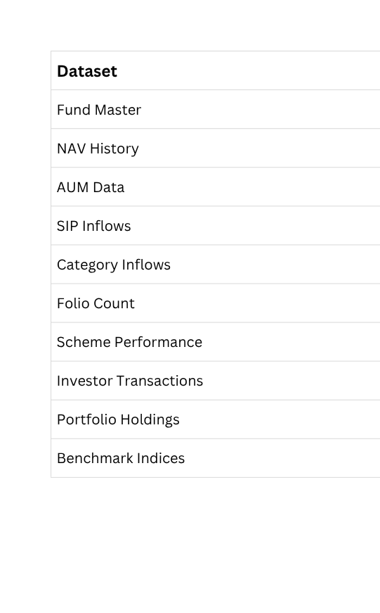
DATA SOURCES

Slide 6
PROJECT ARCHITECTURE
W
O
R
K
F
L
O
W
Raw CSV Data
↓
Data Cleaning & Validation
↓
SQLite Database
↓
EDA & Analysis
↓
Performance Metrics
↓
Risk Analytics
↓
Power BI Dashboard
↓
Insights & Recommendations
Your paragraph text

Slide 7
EDA HIGHLIGHTS – INDUSTRY ANALYSIS
Analysis Performed
NAV Trend Analysis
AUM Growth Analysis
SIP Inflow Analysis
Category Inflow Analysis
Key Insights
Industry AUM showed continuous growth
SIP inflows increased significantly
SBI Mutual Fund maintained highest AUM
Insert:
AUM Chart
SIP Trend Chart

Slide 8
EDA HIGHLIGHTS – INVESTOR ANALYSIS
Analysis Performed
Age Group Distribution
Geographic Distribution
Folio Growth Analysis
Key Insights
26–35 age group was the largest investor segment
Strong participation across multiple states
Investor folios increased steadily
Insert:
Age Group Chart
State-wise Chart

Slide 9
FUND PERFORMANCE ANALYTICS
Metrics Calculated
Daily Returns
CAGR
Sharpe Ratio
Sortino Ratio
Alpha
Beta
Maximum Drawdown
Key Results
Moderate-risk funds achieved highest Sharpe Ratios
Several funds outperformed benchmark indices
Insert:
Sharpe Ratio Table
Fund Scorecard

Slide 10
ADVANCED ANALYTICS & RISK METRICS
Implemented
Value at Risk (VaR)
Conditional VaR (CVaR)
Rolling Sharpe Ratio
Cohort Analysis
SIP Continuity Analysis
HHI Sector Risk Analysis
Key Insights
Identified high-risk funds
Evaluated sector concentration risk
Built fund recommendation model
Insert:
Rolling Sharpe Chart
HHI Chart

Slide 11
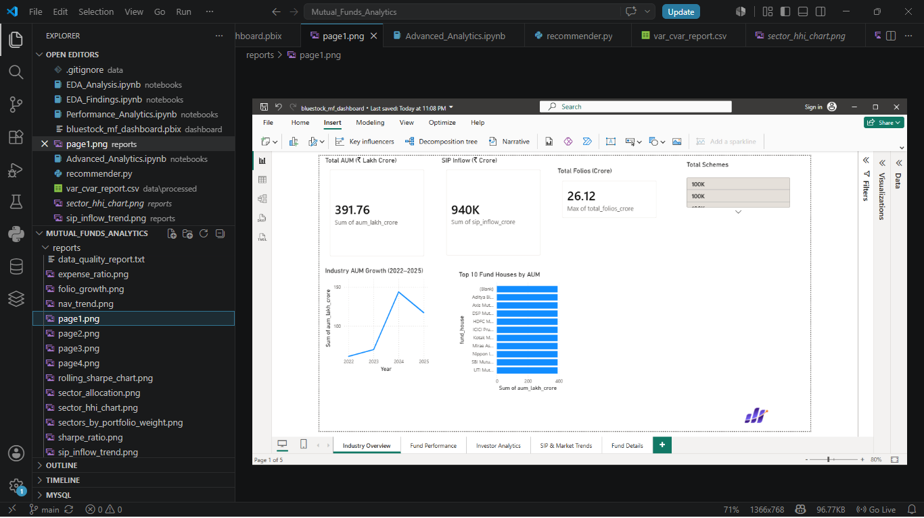
DASHBOARD – INDUSTRY & FUND PERFORMANCE
Page 1: Industry Overview
Total AUM
SIP Inflows
Folios
Industry Trends

Slide 12
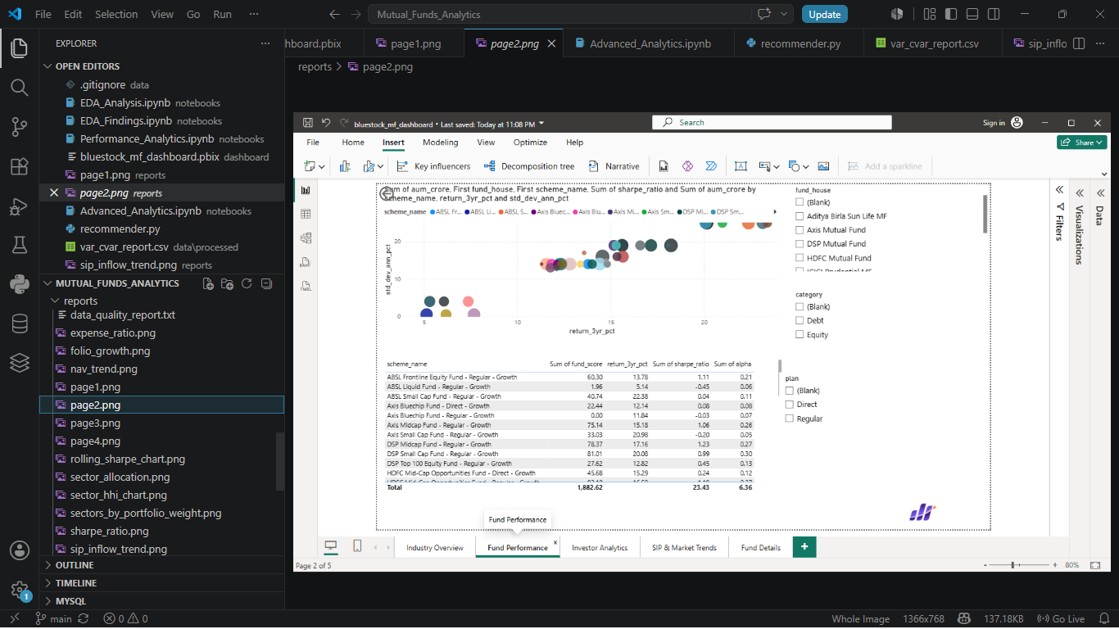
Page 2: Fund Performance
Return vs Risk Analysis
Fund Scorecard
Performance Comparison

Slide 13
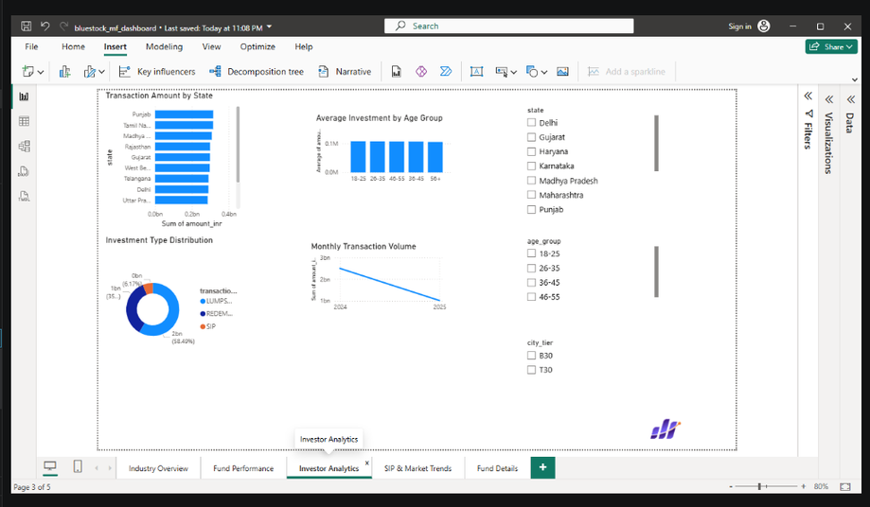
Page 3: Investor Analytics
Transaction Analysis
Demographics
Geographic Distribution

Slide 14
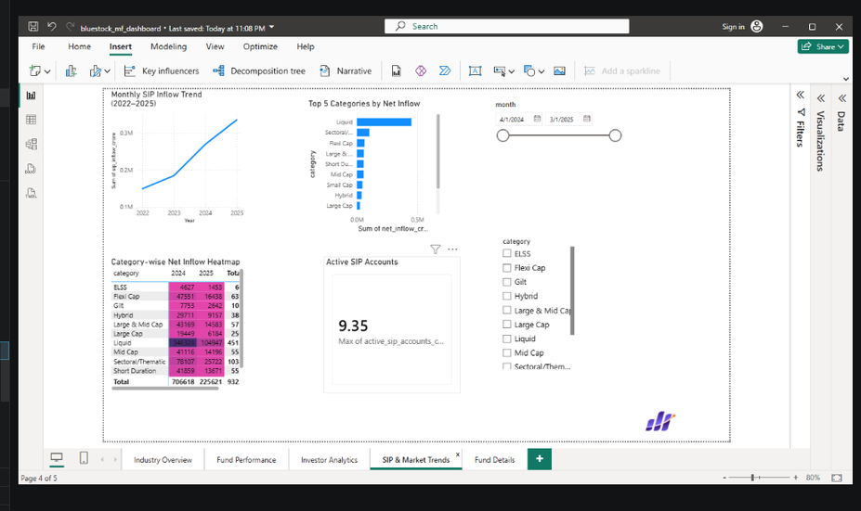
Page 4: SIP & Market Trends
SIP Growth
Category Inflows
Market Trends

Slide 15
KEY FINDINGS
# SIP participation increased steadily
# Moderate-risk funds delivered strong risk-adjusted returns
# ndustry AUM showed significant growth
# Some portfolios exhibited concentration risk

Slide 16
THANK
YOU
by, Namitha Theresa VJ

