Slide 1
K MEANS CLUSTERING PROJECT
By Namitha Suresh K- 5270

Slide 2
AIM
For this project we will attempt to use KMeans Clustering to cluster Universities into to two groups, Private and Public.

Slide 3
Libraries
NumPy: It is a Python library used for working with arrays.
Pandas: It is defined as an open-source library that provides high-performance data manipulation in Python.
Matplotlib and Seaborn: It is used for visualization

Slide 4
DATA EXTRACTION
Read in the College_Data file using read_csv. Figure out how to set the first column as the index.
“df = pd.read_csv('College_Data', index_col = 0)”
Check the head of the data :
df.head() : Give first 5 rows
Check the tail of the data:
df.tail(): Give last 5 rows

Slide 5
To get statistical data like mean, percentile, count etc…
df.describe()
To get concise summary about dataset
df.info()

Slide 6
VISUALIZATION

Slide 7
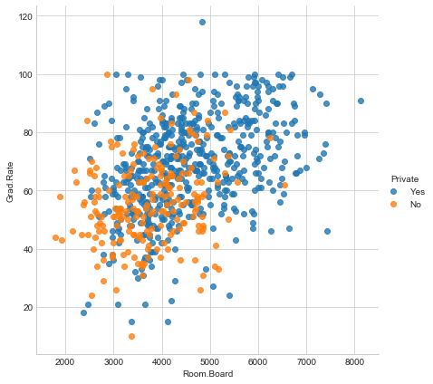
Scatterplot

Slide 8
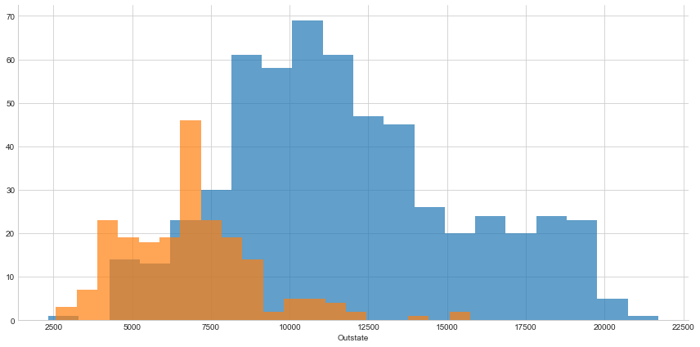

Slide 9
DATA ANALYSIS
K means clustering analysis:
It is an iterative algorithm that divides the unlabeled dataset into k different clusters in such a way that each dataset belongs only one group that has similar properties.
Determines the best value for K center points or centroids by an iterative process.
Assigns each data point to its closest k-center. Those data points which are near to the particular k-center, create a cluster.

Slide 10
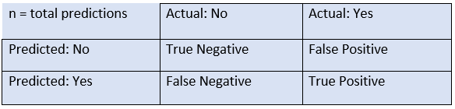
EVALUATION
Confusion Matrix
The confusion matrix is a matrix used to determine the performance of the classification models for a given set of test data.
The matrix is divided into two dimensions, that are predicted values and actual values along with the total number of predictions.

Slide 11
In this project confusion matrix:
[ [138 74]
[531 34] ]
True positive: 34
True Negative: 138
False negative: 531
False positive: 74

Slide 12
Classification Report
precision recall f1-score support
0 0.21 0.65 0.31 212
1 0.31 0.06 0.10 565
avg / total 0.29 0.22 0.16 777

Slide 13
THANK YOU

