Slide 1
TABLEAU FINAL PROJECT
Who Does the Work?
How generative AI is reshaping the division of labor
between humans and machines
Central question
How is generative AI reorganizing the division of work between people and machines?
AUGUST 2026
AI AS EXECUTOR
AI AS COPILOT
Notes:
Open with the distinction between AI presence and AI role. The project asks how work is divided, not simply whether a job is exposed.
[Sources]
- AI_at_Work_Four_Question_Research_Story.docx (internal project narrative)
- figures/AI_at_Work_Unified_Dataset_Documentation.docx (internal metric definitions)

Slide 2
THE PROBLEM
02
AI exposure does not tell us whether it replaces
or supports work.
Exposure
The question is not only where AI appears.
It is whether AI executes the task, supports the worker, or does both inside the same occupation.
How much AI is used
Role
What AI does when it is used
01
02
03
04
WHERE
ROLE
TASKS
CONTEXT
Locate AI
Executor or copilot?
Open the job black box
Preparation and occupation
AI AT WORK / TABLEAU FINAL PROJECT
Notes:
Use the sequence to frame the dashboard: locate AI, identify its role, inspect variation across tasks, then place the pattern in occupational context.
[Sources]
- AI_at_Work_Four_Question_Research_Story.docx (internal research-question map)

Slide 3
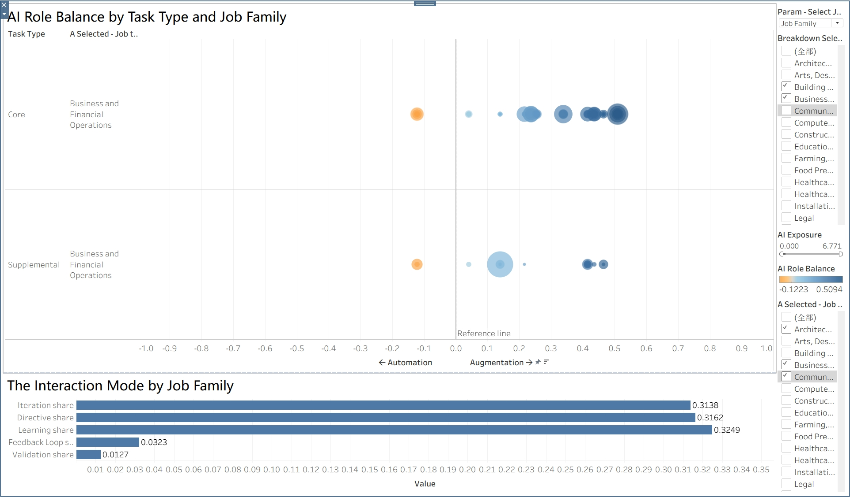
HOW WE ANSWER IT
03
One occupation-task dataset connects AI presence to AI's role.
3,963
occupation-task pairs
731 occupations / 5 interaction modes
Automation
directive + feedback loop
Augmentation
iteration + validation + learning
Role balance = augmentation - automation
Grain: one unique soc_code x task_id pair
AI AT WORK / TABLEAU FINAL PROJECT
Notes:
Explain that exposure answers how much AI is observed, while the five interaction modes classify what AI is doing. Valid role observations require complete interactions, positive exposure, and the quality filter.
[Sources]
- figures/AI_at_Work_Unified_Dataset_Documentation.docx (dataset grain and metric definitions)
- analysis_dataset.csv (3,963 rows; 731 distinct occupations)
- figures/20260812-005545.jpeg (team-provided Tableau export)

Slide 4
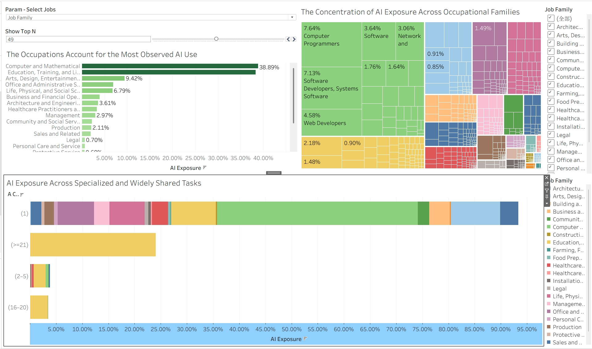
FINDING 1 - WHERE AI ENTERS WORK
04
Observed AI use is concentrated in a small set
of occupational families.
~39%
of observed AI exposure comes from Computer & Mathematical occupations.
Concentration continues inside families: a few occupations and tasks account for much of the total.
Observed AI conversations - not employment share
AI AT WORK / TABLEAU FINAL PROJECT
Notes:
Lead with concentration, then point to the treemap: AI enters the workplace through specific occupations and tasks rather than diffusing evenly across all work.
[Sources]
- figures/20260812-013036.jpeg (team-provided Tableau export; 38.89% shown in the view)
- analysis_dataset.csv (occupation-family exposure verification)

Slide 5
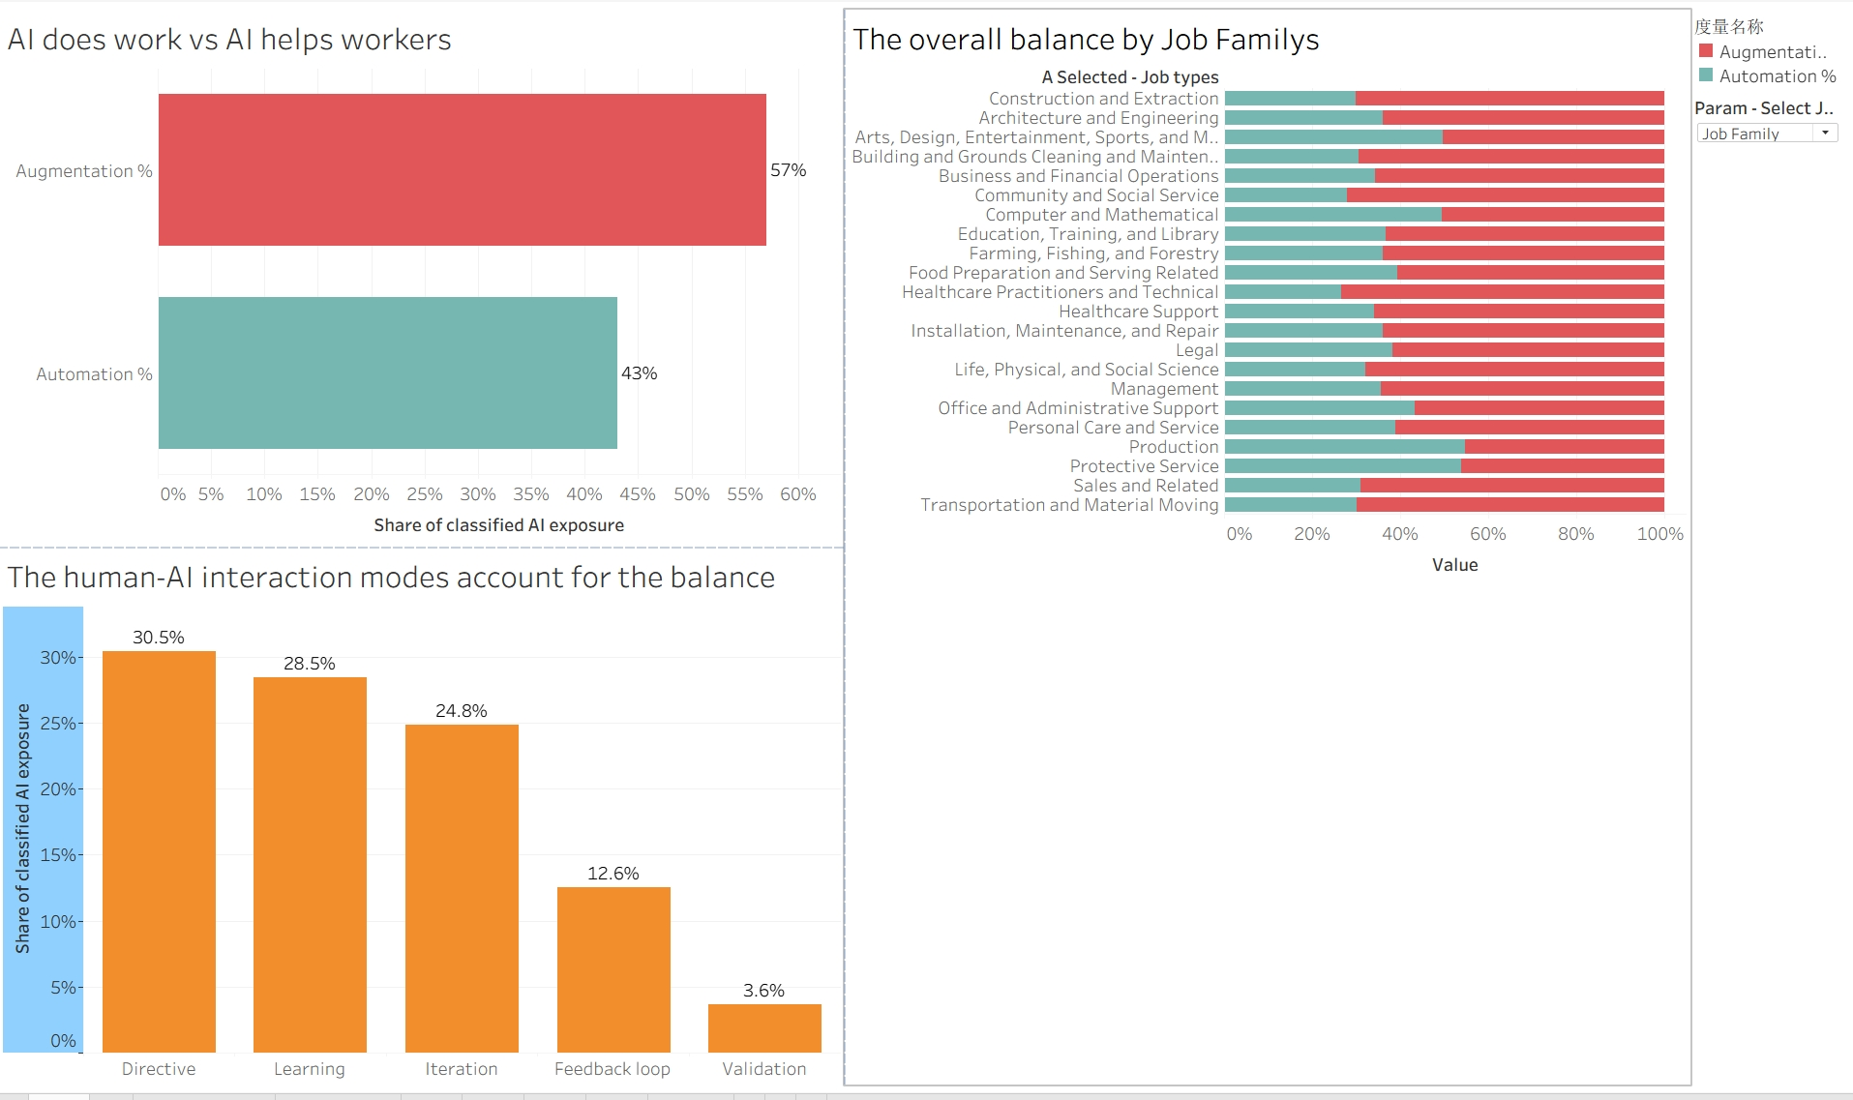
FINDING 2 - WHAT ROLE AI PLAYS
05
Across observed AI use, augmentation leads
automation 57% to 43%.
57%
augmentation / copilot
43%
automation / executor
Directive is the largest single mode (30.5%), while learning + iteration contribute 53.3% together.
AI behaves more like a copilot overall, even though direct execution remains the largest single interaction mode.
AI AT WORK / TABLEAU FINAL PROJECT
Notes:
Emphasize the distinction between the largest single mode and the overall grouped result: directive is the largest mode, but augmentation modes together produce the 57% majority.
[Sources]
- figures/20260812-005601.jpeg (team-provided Tableau export)
- analysis_dataset.csv (56.98% augmentation; 43.02% automation; interaction-mode shares)

Slide 6
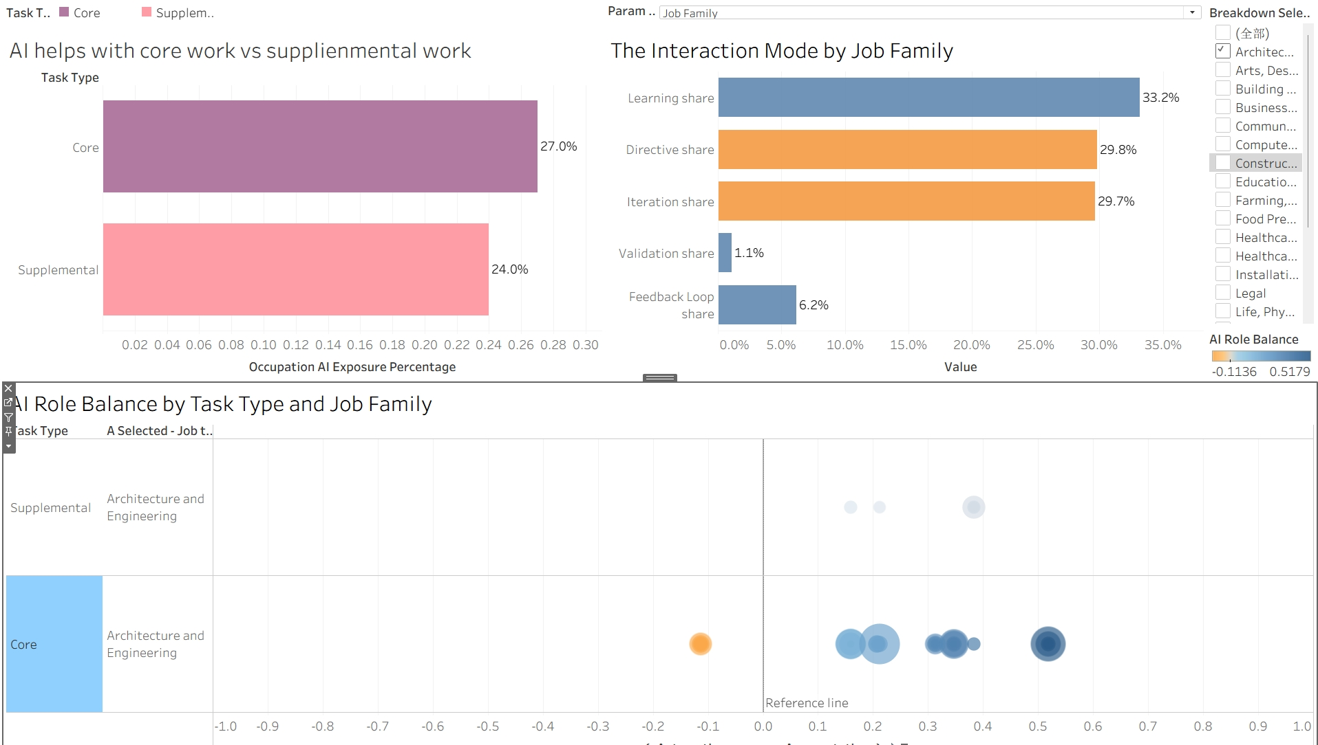
FINDING 3 - OPEN THE JOB BLACK BOX
06
Task-level variation breaks the idea of one AI role
per job family.
ARCHITECTURE & ENGINEERING
Mostly copilot
Most displayed tasks sit to the right of the zero line.
Not uniform
One Core task falls on the automation side.
Different profiles
Core and Supplemental tasks show different exposure and mode mixes.
A family average can hide the task mix.
AI AT WORK / TABLEAU FINAL PROJECT
Notes:
Use the selected Architecture and Engineering view as an example. The core point is methodological: task-level marks reveal variation that a single family or occupation average can hide.
[Sources]
- figures/20260812-005613.jpeg (team-provided Tableau export)
- AI_at_Work_Four_Question_Research_Story.docx (internal task-reconfiguration narrative)

Slide 7
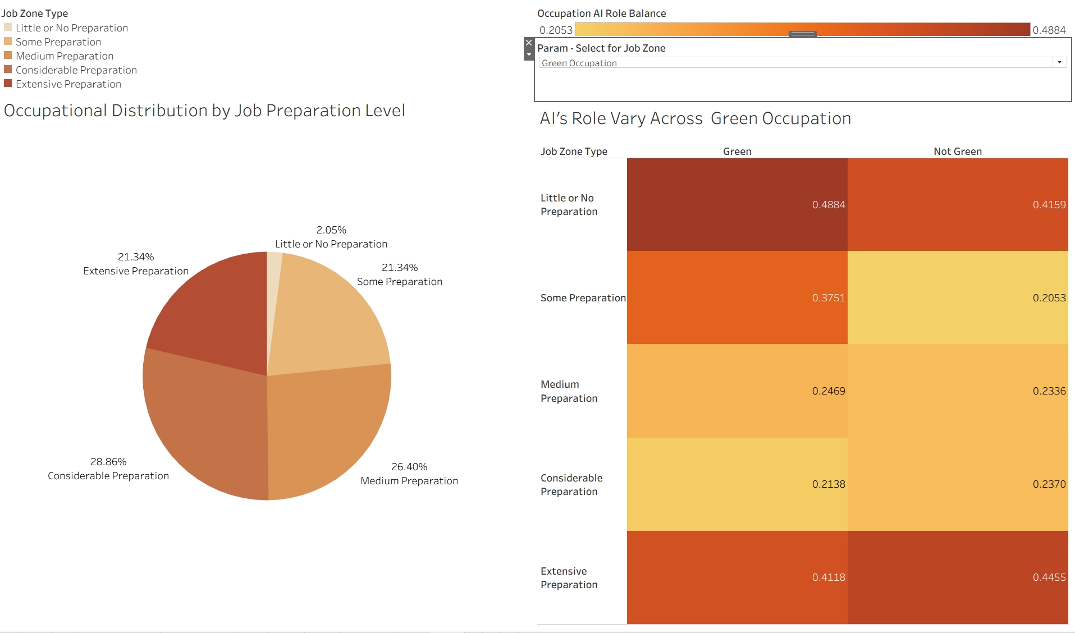
FINDING 4 - OCCUPATIONAL CONTEXT
07
Occupational context shifts the balance,
but the evidence is descriptive.
WHAT THE VIEW SUGGESTS
Preparation matters
The strongest augmentation balances appear at the lowest and highest preparation levels.
Direction changes
Green versus non-Green differences change direction across levels.
Interpret carefully
These are descriptive associations, not causal effects.
AI is redistributing tasks - not uniformly replacing entire occupations.
Notes:
Frame these results as descriptive patterns. The strongest synthesis is that context matters, but no single occupational label determines whether AI is an executor or copilot.
[Sources]
- figures/20260812-005637.jpeg (team-provided Tableau export)
- analysis_dataset.csv (Job Zone role-balance verification)
- AI_at_Work_Four_Question_Research_Story.docx (internal conclusion language)

Slide 8
LESSONS LEARNED
08
Clearer metrics made the story
more trustworthy.
01
Match measure to grain
Use MIN/AVG for repeated occupation/task fields; SUM exposure components.
02
Separate exposure from role
Ask how much AI appears and what it does as separate questions.
03
Choose charts by relationship
Use bars to rank, 100% bars for balance, and heatmaps/scatters for association.
04
Make confidence visible
Show exposure, task count, and coverage; label controls; remove nulls; lock semantic colors.
The better question is not "Will AI replace jobs?"
It is "How is AI reallocating tasks between humans and machines?"
AI AT WORK / TABLEAU FINAL PROJECT
Notes:
Close by connecting the analytical lessons to the substantive conclusion. The project became clearer once data grain, aggregation, semantic color, and chart purpose were treated as part of the argument.
[Sources]
- figures/Final Presentation-fianl .pdf (internal structural reference for a lessons-learned close)
- figures/AI_at_Work_Unified_Dataset_Documentation.docx (aggregation and coverage rules)
- AI_at_Work_Four_Question_Research_Story.docx (internal closing narrative)

