Slide 1

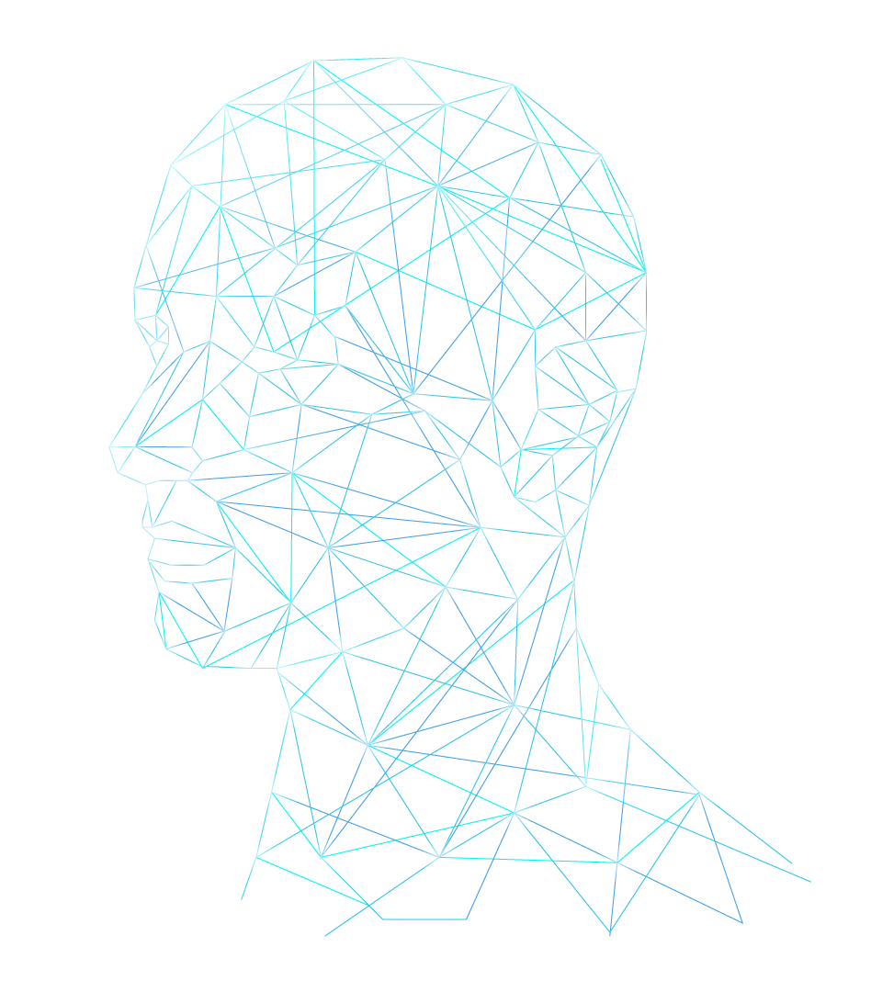
CECS 327 End-to-End IoT System Namra Chaklashiya

Slide 2

System Objective & Queries
Built an IoT system that connects a TCP client to a server
Fetches live IoT sensor data from NeonDB (via Dataniz)
Queries supported:
1) What is the average moisture inside my kitchen fridge in the past three hours?
2) What is the average water consumption per cycle in my smart dishwasher?
3) Which device consumed more electricity among my three IoT devices?"

Slide 3
Functionality
Client Input in natural-language query
Server Processing: Recognizes query from predefined list, Maps it to a handler function, Connects to NeonDB using psycopg2, Targets the correct device table and sensor key via metadata
Data Conversion: Moisture → RH%, Water (liters) → gallons, Electricity (amps) → kWh (based on 120V)
Server Response: Constructs a human-readable message, Sends it back to the client over TCP
Error Handling: If the user enters any query outside the predefined supported set, the client detects it and responds with a clear, polite message guiding the user to re-enter one of the valid queries.

Slide 4
Challenges
Had to Restart from Scratch
Rebuilt NeonDB from Scratch
Custom Device Creation
Improved Structure Helped Debugging
High Attention to Detail in Code (server.py)

Slide 5
Feedback on Dataniz
While working with Dataniz, I encountered several validation or configuration errors during device setup and testing. However, the error messages were often too generic. More detailed or specific error descriptions (e.g., pointing to a missing field, an invalid sensor, or a broken connection) would help users resolve issues more efficiently
When duplicating IoT devices, the automatically generated names are not very intuitive. Instead of assigning long UUID-like strings, a sequential naming pattern such as Fridge Copy 1, Fridge Copy 2, etc. — similar to how operating systems name duplicate files — would make it easier to organize and identify virtual devices in complex setups

