Slide 1


MediClassify Automatic Ticket Classification for Healthcare Support
By
Sahil Kumar
Namrata Patel

Slide 2
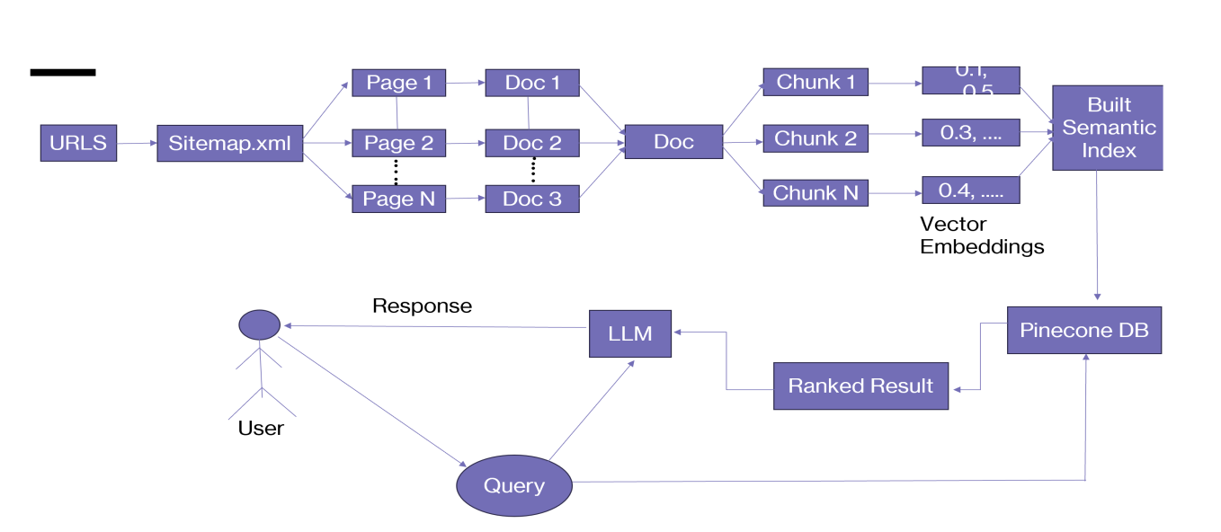
Methodology : Question Answer Bot
Flowchart illustrating the use of a sitemap to segment documents for vector embeddings and semantic indexing in a Vector DB, managed by a Large Language Model (LLM) for query response

Slide 3







Methodology : Classification Task
Chat Bot
Query
Ticket
Classification
Not Happy ?
Human
Machine Learning Model
SVC
Assigned ticket to particular department
Happy ?
Diagram depicting a customer service chatbot workflow that uses human queries to deliver responses and utilizes a
machine learning model for ticket classification when dissatisfaction is detected.

Slide 4
Demo and Metrics
Part 1 – Upload to Vector Store
Performance Metrics of Ticket Classification Models
Part 2 - Question Answer
Model | Accuracy | Precision | Recall | F1 Score
SVM Classifier | 74.14% | 0.70 | 0.74 | 0.71
RF Classifier | 63.79% | 0.67 | 0.64 | 0.61
XGB Classifier | 58.62% | 0.56 | 0.59 | 0.56
Part 3 – Ticket Classification

