Slide 1
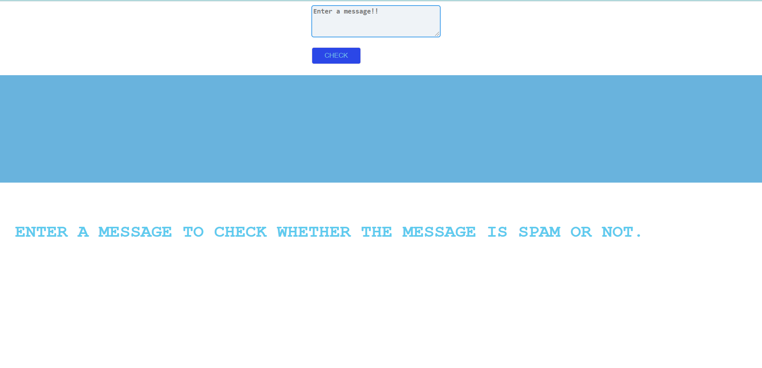
Spam Ham Classifier

Slide 2
Contents:
*Objective
*Benefits
*Architecture
*Data Preprocessing & Model Selection Steps

Slide 3
Objective:
In recent times, unwanted commercial bulk emails called spam has become a huge problem on the internet. Spam prevents the user from making full and good use of time, storage capacity and network bandwidth. The huge volume of spam mails flowing through the computer networks have destructive effects on the memory space of email servers, communication bandwidth, CPU power and user time.Therefore,to prevent this spam-ham model is introduced.

Slide 4
Benefits:
Detects whether the message is spam or not.
Saves time.
Saves storage.
Protects from any kind of fraud.

Slide 5
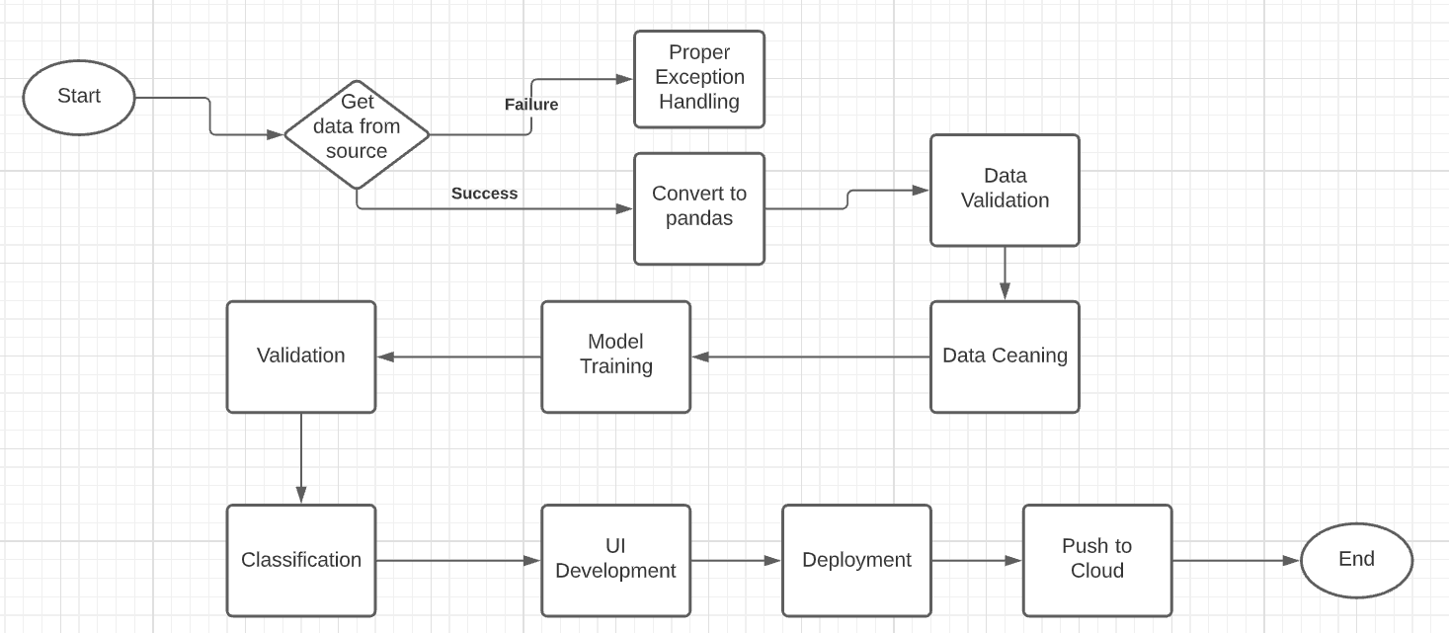
Architecture:

Slide 6
Data Preprocessing & Model Selection Steps:
1)Reading data in the form of csv file.
2)Preprocessing the data.
3)Splitting data into train and test split.
4)Applying CountVectorizer.
5)Creating MultinomialNB Model.
6)Creating Pipeline.
7)Creating pickle file.
Note: spam.log file is also created along with app.py file
and config.py file.

Slide 7
THANK YOU!

