Slide 1



HACKERWAR 4.0
ORGANISED BY
DEPARTMENT OF COMPUTER SCIENCE AND ENGINEERING FACULTY OF ENGINEERING AND TECHNOLOGY (ITER) SIKSHA ‘O’ ANUSANDHAN (DEEMED TO BE) UNIVERSITY, BHUBANESWAR, ODISHA

Slide 2
Basic Details of the Team and Problem Statement
Ministry/Organization Name/Student Innovation: Ministry of coal
PS Code:1312 Problem Statement Title: Chatbot to respond to text queries pertaining to various Acts, Rules, and Regulations applicable to Mining industries
Team Name: Code-techies
Team Leader Name: Aditi Raj Institute Code (AISHE): C-42709
Institute Name: Institute of Technical Education & ResearchFaculty of Engineering and Technology)
Theme Name:Smart Automation

Slide 3
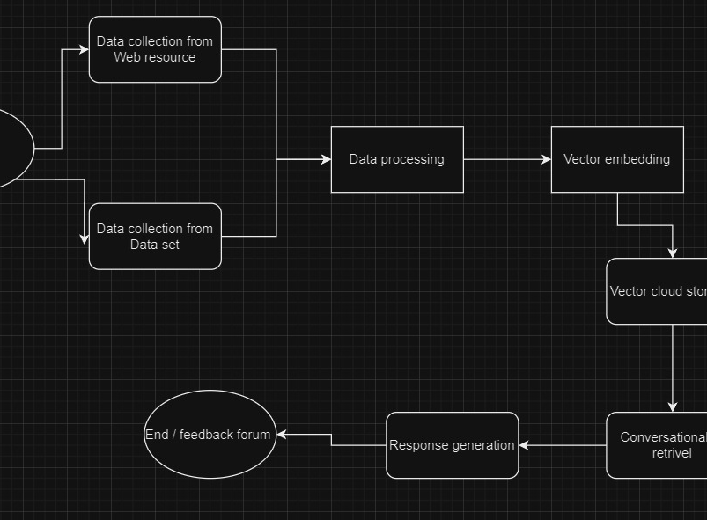
Idea/Approach Details
Describe your idea/Solution/Prototype here:
Collect the data from the dataset
Embedding the data
Vector storage using AI
Conversational AI using LLM for customized data
Prompt generation
Describe your Technology stack here:
Python
Langchain
OpenAI
Q-drant
Streamlit

Slide 4
Idea/Approach Details
Describe your Use Cases here
Describe your Dependencies / Show stopper here
The User ask the question from the web app
Using conversational AI and relational vector data fetch the data
Using prompt the bot response to the user
Storage of data on cloud
Vector embedding and vector retrieval
Chatbot fine tuned for the data
Custom llm model for chat

Slide 5
Team Member Details
Team Leader Name: ADITI RAJ
Branch (Btech/Mtech/PhD etc): Btech Stream (ECE, CSE etc): CSE Year (I,II,III,IV): III
Team Member 1 Name: PRABIN KUMAR RAJAK
Branch (Btech/Mtech/PhD etc):Btech Stream (ECE, CSE etc):CSE Year (I,II,III,IV): III
Team Member 2 Name: NAMRATA PADHI
Branch (Btech/Mtech/PhD etc):Btech Stream (ECE, CSE etc):CSE Year (I,II,III,IV): III
Team Member 3 Name: FAIZAN SIDDIQUE
Branch (Btech/Mtech/PhD etc):Btech Stream (ECE, CSE etc):CSE Year (I,II,III,IV): III
Team Member 4 Name: ADITYA CHAUHAN
Branch (Btech/Mtech/PhD etc):Btech . Stream (ECE, CSE etc):CSE Year (I,II,III,IV): III
Team Member 5 Name: ANIKET DEY
Branch (Btech/Mtech/PhD etc):Btech Stream (ECE, CSE etc):CSE Year (I,II,III,IV): III
Team Mentor 1 Name: Type Your Name Here
Category (Academic/Industry): Expertise (AI/ML/Blockchain etc): Domain Experience (in years):
Team Mentor 2 Name: Type Your Name Here
Category (Academic/Industry): Expertise (AI/ML/Blockchain etc): Domain Experience (in years):

Slide 6
Important Pointers
Please ensure below pointers are met while
Kindly keep the maximum slides limit to 4 pages
All the topics should be utilized for description of your idea
Try to avoid paragraphs and post your idea in points
Keep your explanation precisely and easy to understand
Idea should be unique and novel. If it has a business potential more weightage will be given.
Apart from this PPT abstract of your idea will be asked separately while submitting
You need to save the file in PDF and upload the same on portal. No PPT, Word Doc or any other format will be supported
You can delete this slide (Important Pointers) when you upload the details of your idea on SIH portal.

