Slide 1
Verilog Project
FIFO CONTROLLER

Slide 2
Block Diagram
FIFO
Write
Pointer
Counter
Reset
Write
control
RAM
000
001
010
011
100
101
110
111
Full
Write Clk
Flag Logic
Empty
Read clk
write_en
Read Control
read_en
Data_out 8
Data i/p 8
Static
memory
Read Counter

Slide 3
Components
FIFO contains:
• RAMs
• Counters (write, read pointers)
• Flag Logic (status)
• static Memory (initial Addr=0,FULL =0, EMPTY =1)

Slide 4
Working
FIFO contain RAM & Logic for Address generation
In a writing process data will loading start point of RAM (i.e.static Memory, Address =0, FULL=0, EMPTY=1)
Write & Read Counters working with write clock and read clock.
Each write process there is increase in Address in a counter( i.e. Address = Address +1), at every write clock edge,when write enable is highEach read process there is decrease in Address in a counter( i.e. Address = Address -1), at every read clock edge,when read enable is high

Slide 5
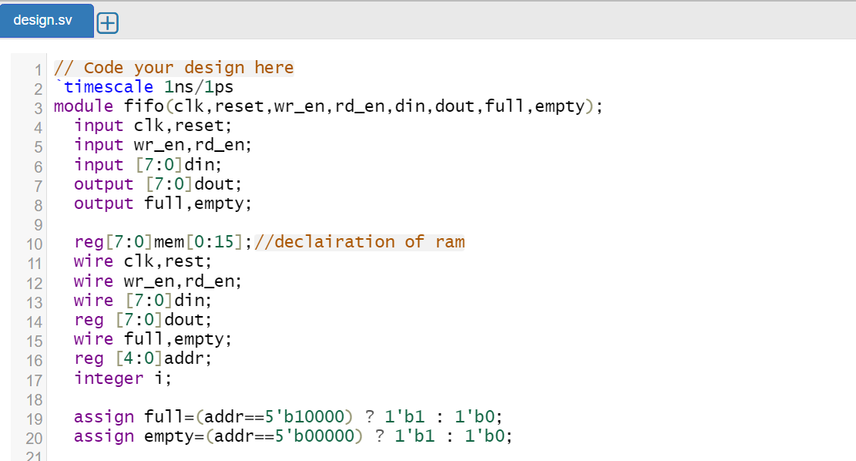
Verilog code-Initialisation

Slide 6
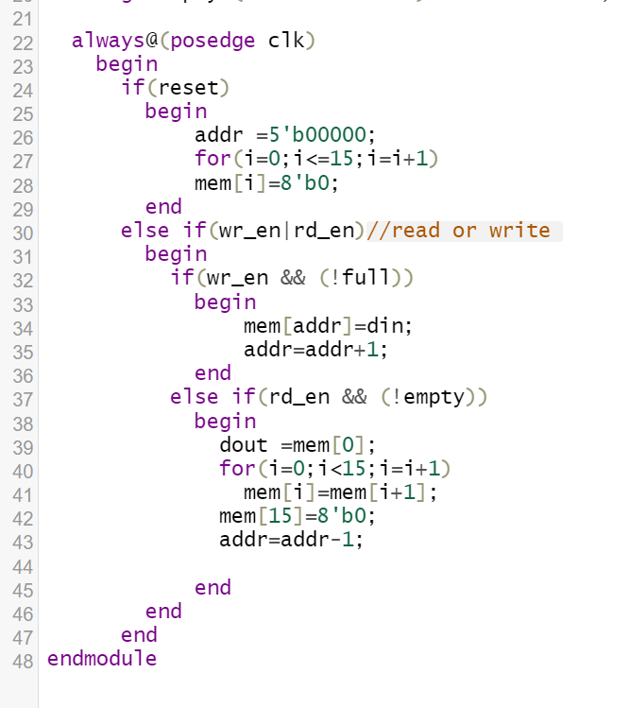
Verilog code-always block

Slide 7
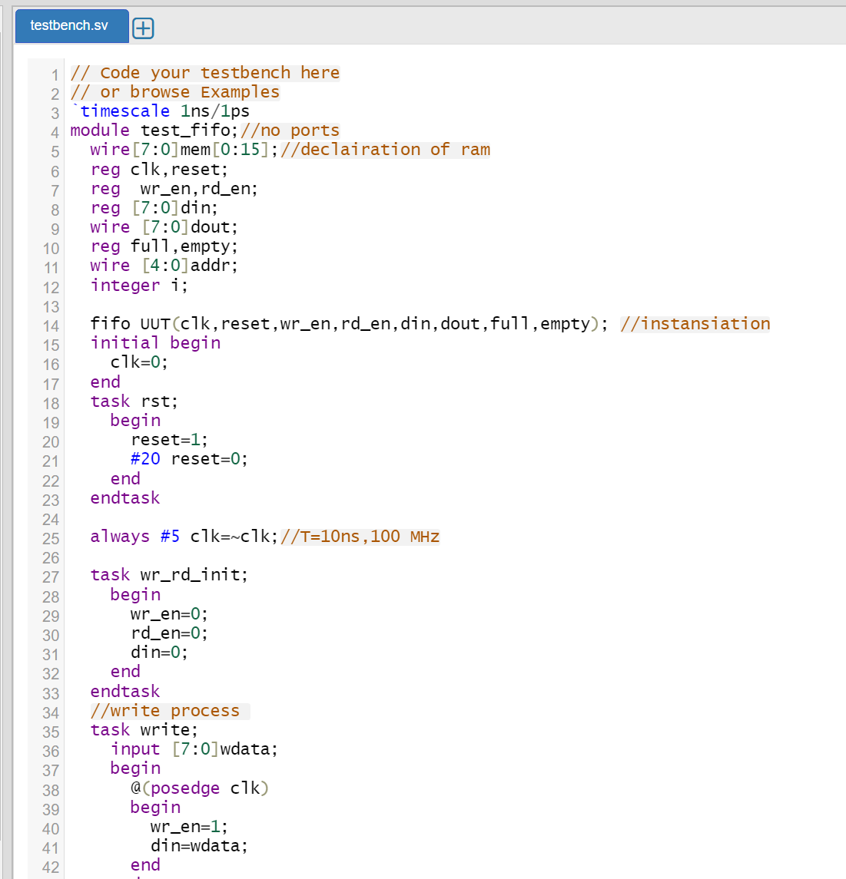
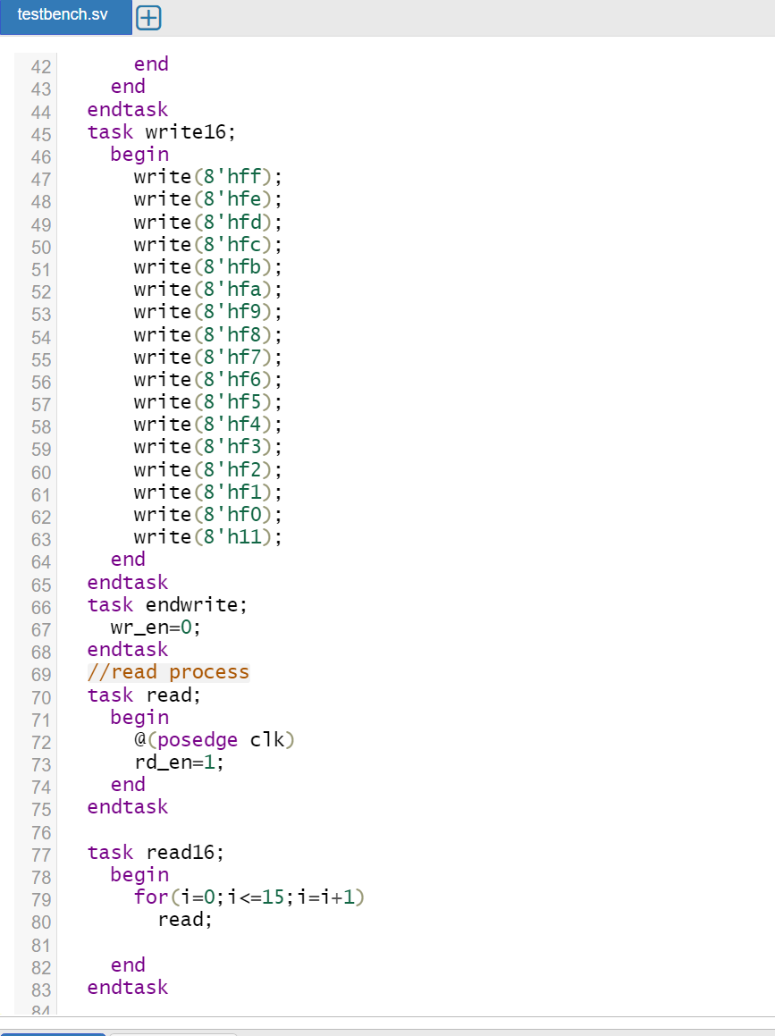
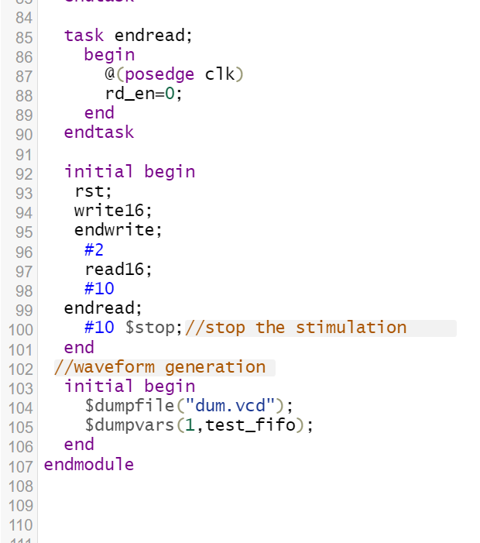
Verilog code-Testbench

Slide 8
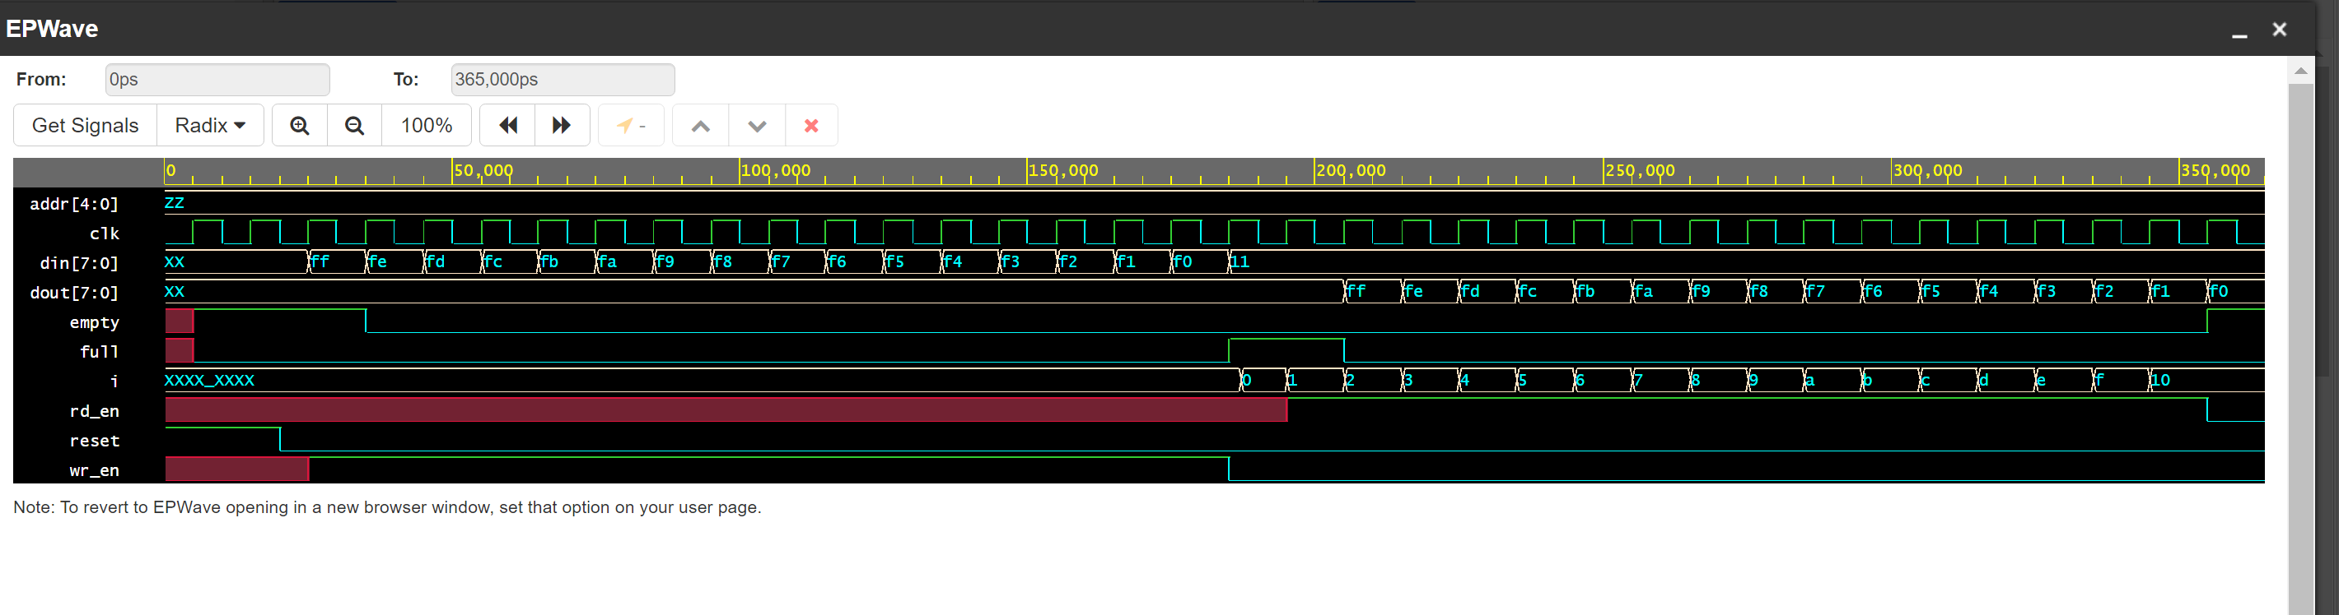
Verilog Output

Slide 9
Verilog code
https://www.edaplayground.com/x/u4Ub

Slide 10
Thank You

