Slide 1

Clone

Slide 2
INDEX
About NETFLIX
What does OTT mean?
Front-End Developer :tools(HTML,CSS)
Advantages

Slide 3
NetFlIX
Netflix is an American subscription video on-demand over-the-top streaming service. The service primarily distributes original and acquired films and television shows from various genres, and it is available internationally in multiple languages.

Slide 4
Type of site
OTT streaming platformAvailable in45 languagesshowList of languages
HeadquartersLos Gatos, California, U.S.Country of originUnited StatesArea servedWorldwide
(except China, Crimea, North Korea, Russia, and Syria) IndustryEntertainment
mass media
ProductsStreaming media
video on demand
digital distribution
ServicesFilm production
film distribution
television production

Slide 5
television distribution
ParentNetflix, Inc.URLnetflix.com
ProductsStreaming media
video on demand
digital distribution
ServicesFilm production
film distribution
television production
television distribution
ParentNetflix, Inc.URLnetflix.com

Slide 6
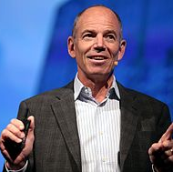
founder
Marc Randolph, co-founder of Netflix and the first CEO of the company

Slide 7
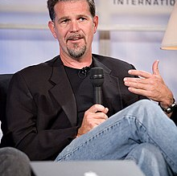
Reed Hastings, co-founder and Executive Chairman

Slide 8
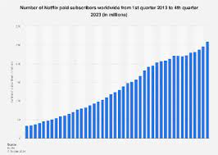
Netflix quarterly revenue 2011 to 2023 ($mm)
quarterly revenue 2011 to 2023 ($mm)

Slide 9
What does OTT mean?
OTT stands for “over-the-top” and refers to technology (OTT services or platforms) that delivers streamed content via internet-connected devices.
In mobile marketing, OTT is often discussed specifically within the context of video content.
In the recent past, viewers consumed all video content from a TV set connected to a cable TV or satellite provider.

Slide 10
Development

Slide 11
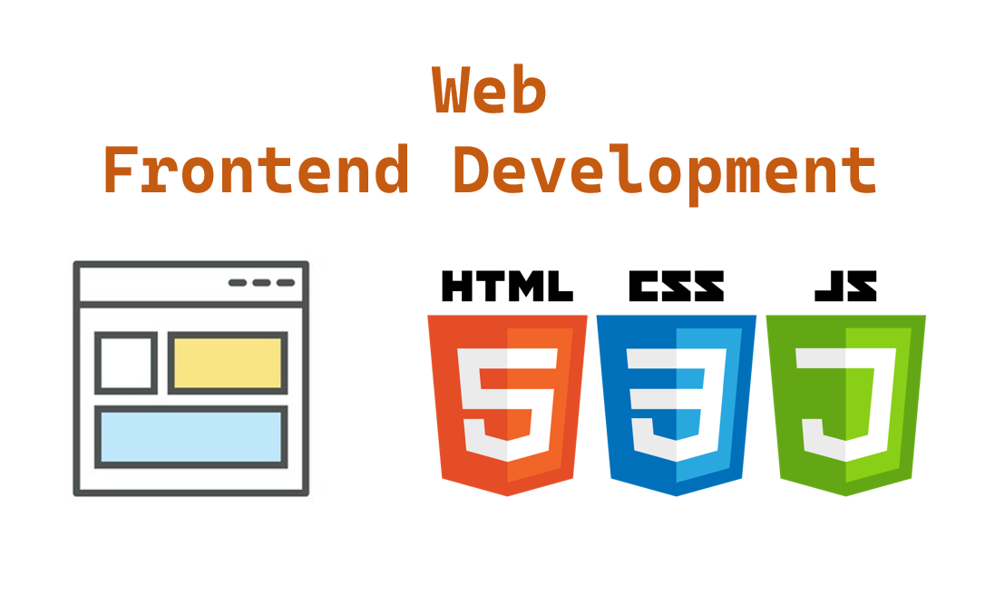
Front-End Developer :tools

Slide 12
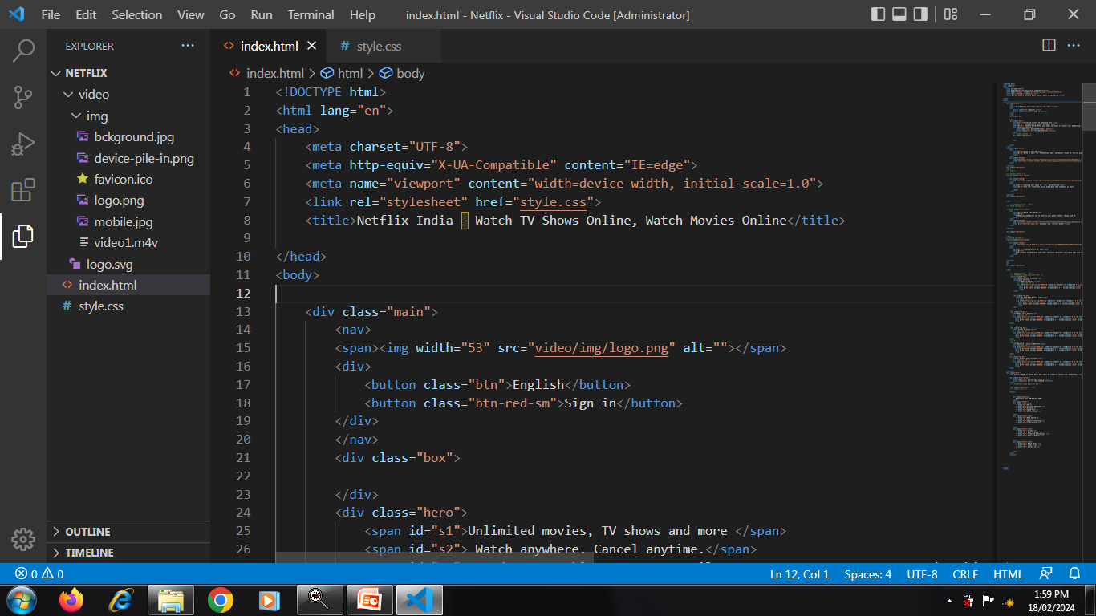
Html code

Slide 13
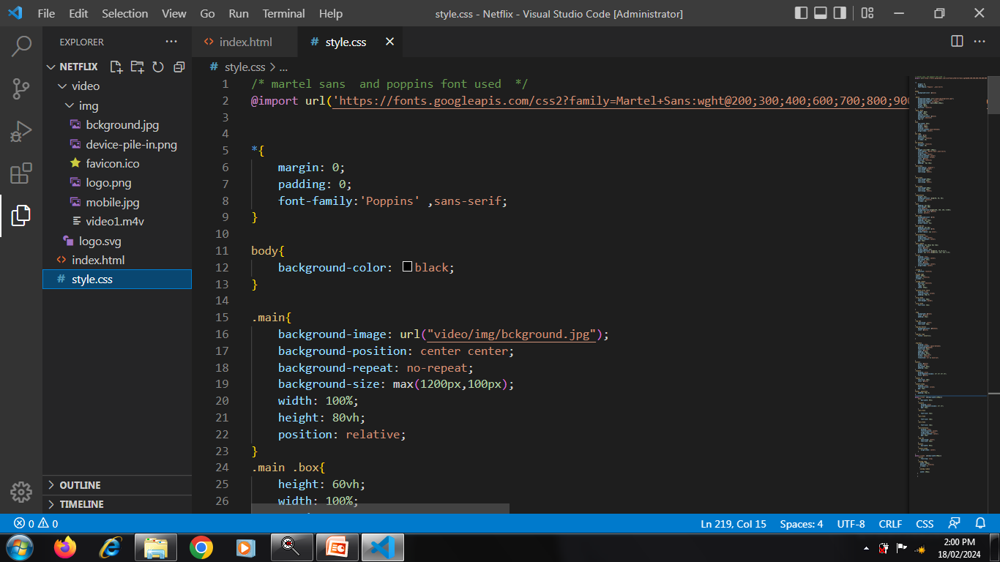
Css code

Slide 14
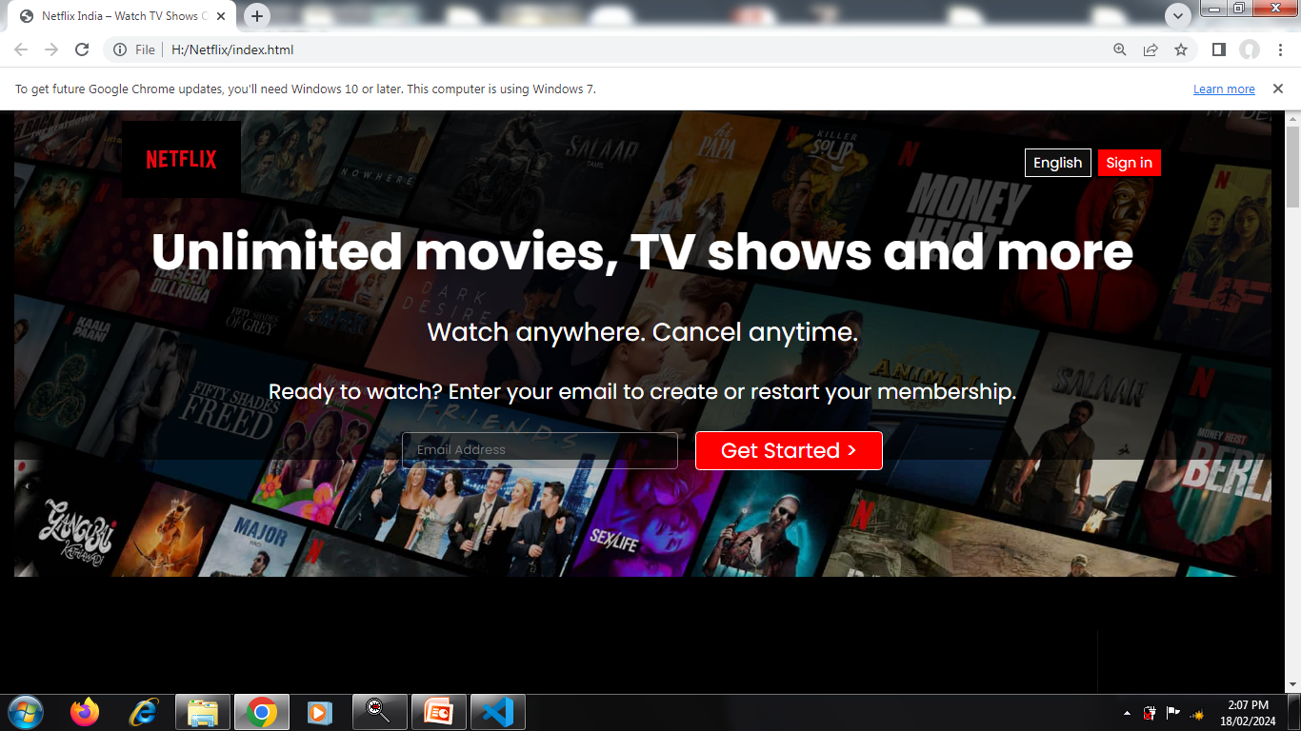
OUTPUT

Slide 15
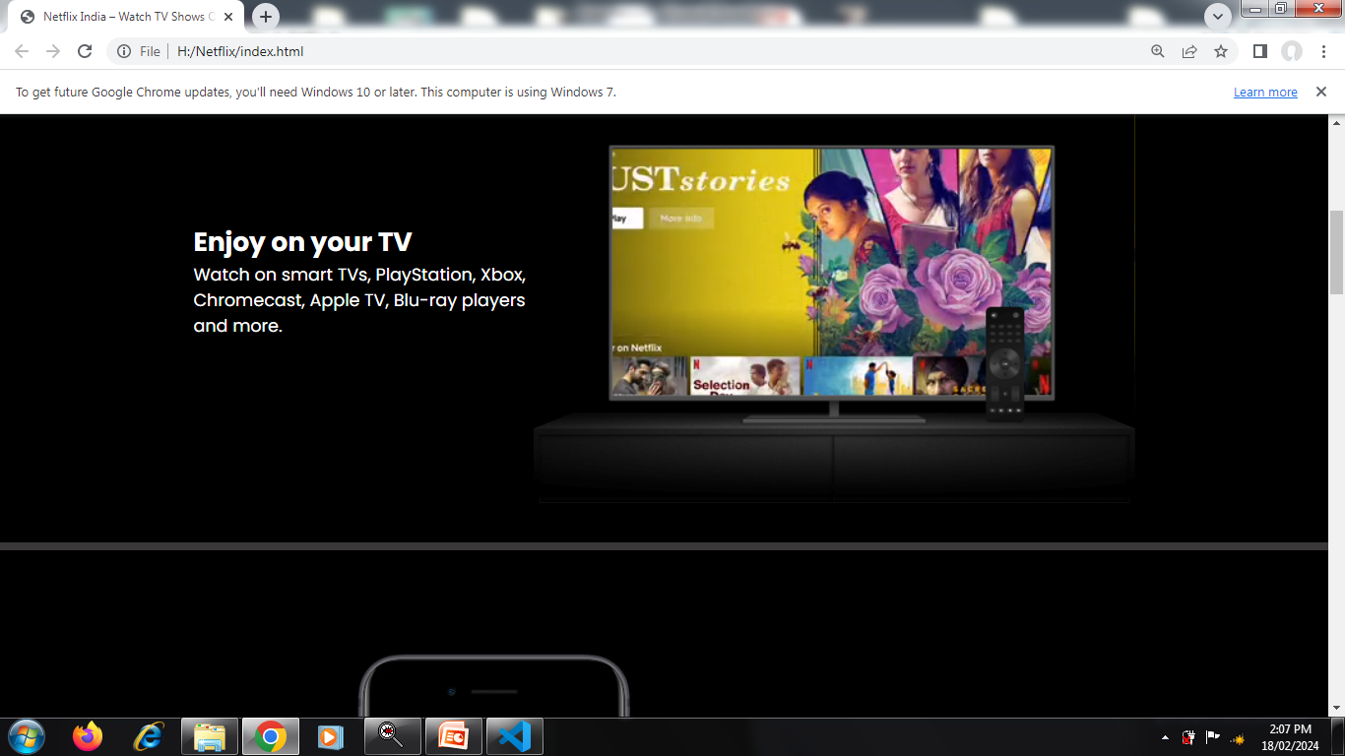

Slide 16
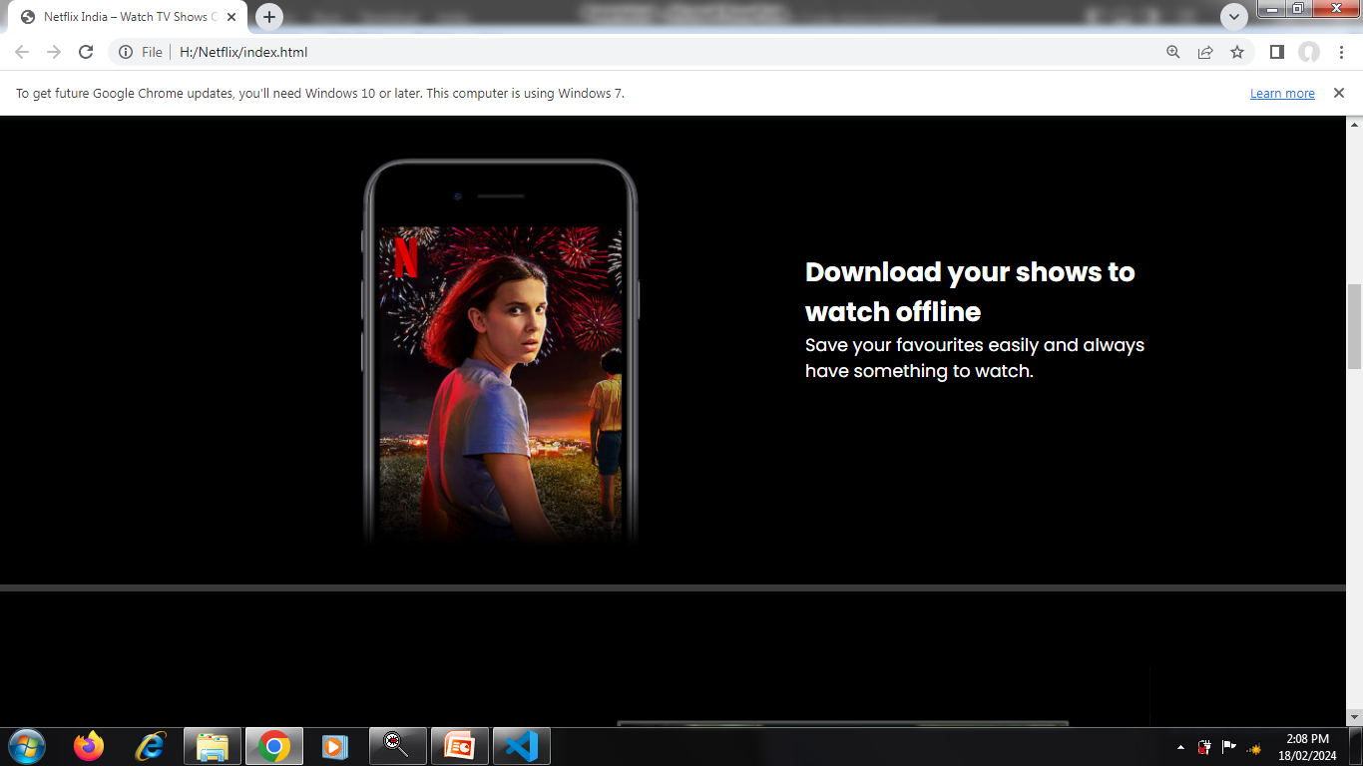

Slide 17
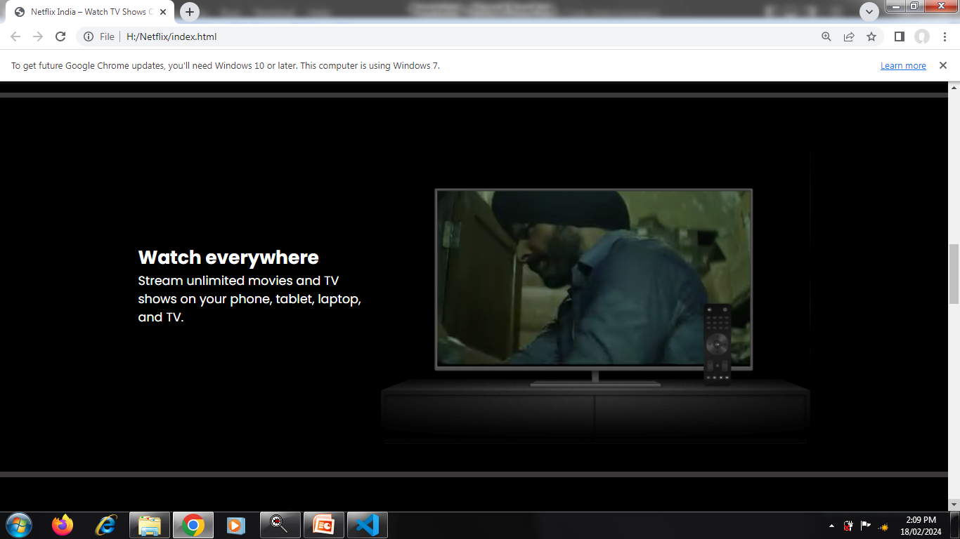

Slide 18
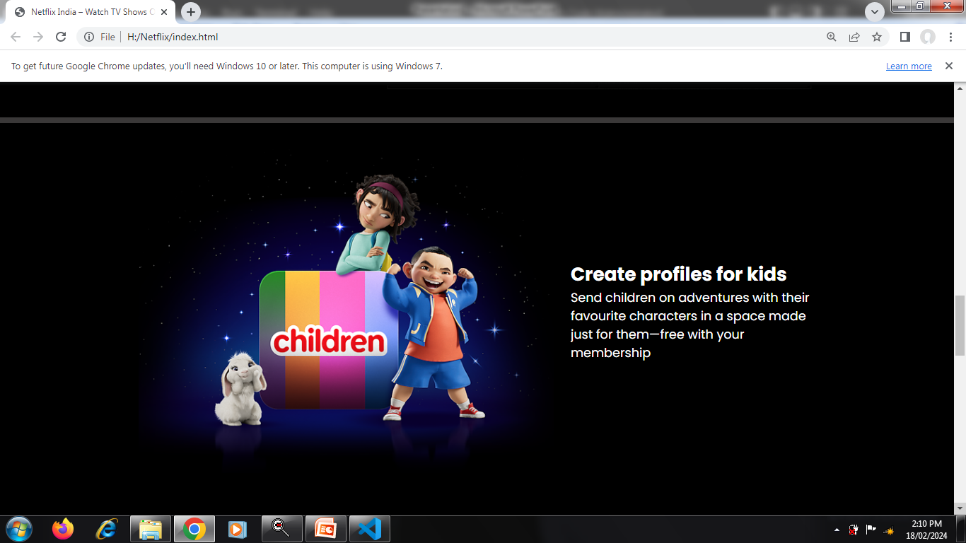

Slide 19
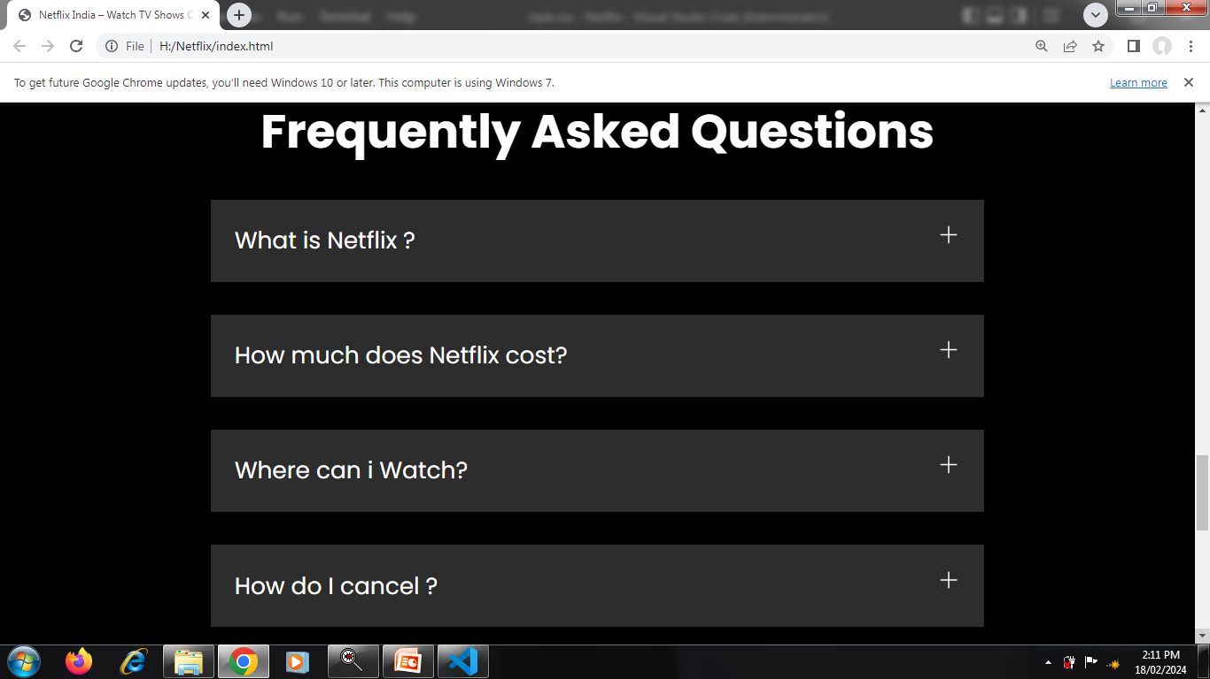

Slide 20
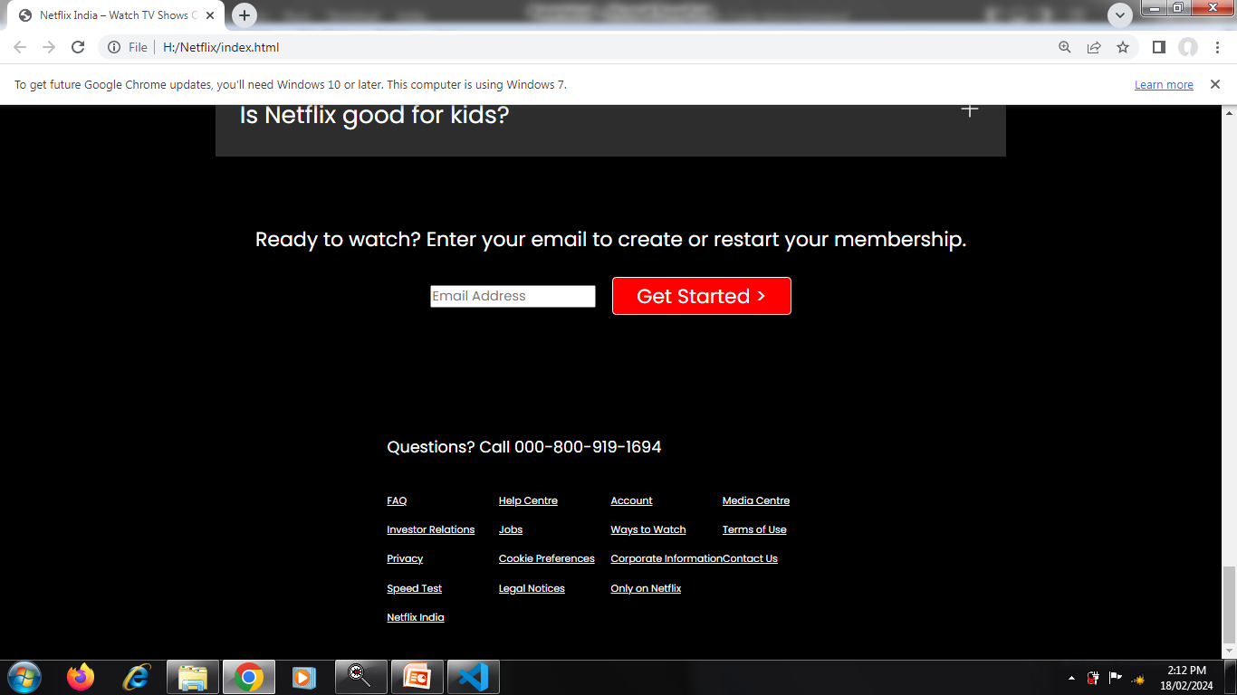

Slide 21
Advantages :-
Netflix Boasts Original Content.
Netflix Allows Educational Screenings.
Netflix Offers More Than Movies and TV Series.
Netflix Offers Flexible Plans.
One Subscription, Multiple Viewers.
It's Easy to Search Through the Netflix Library.
Netflix Is Still Relatively Affordable.
You Can Easily Discover Foreign Content.
Netflix Brings Independent Creators to the Global Stage.

Slide 22


