Slide 1
CODEBASICS RESUME CHALLENGE 7 in association with
OPEN DATA TELANGANA

Slide 2
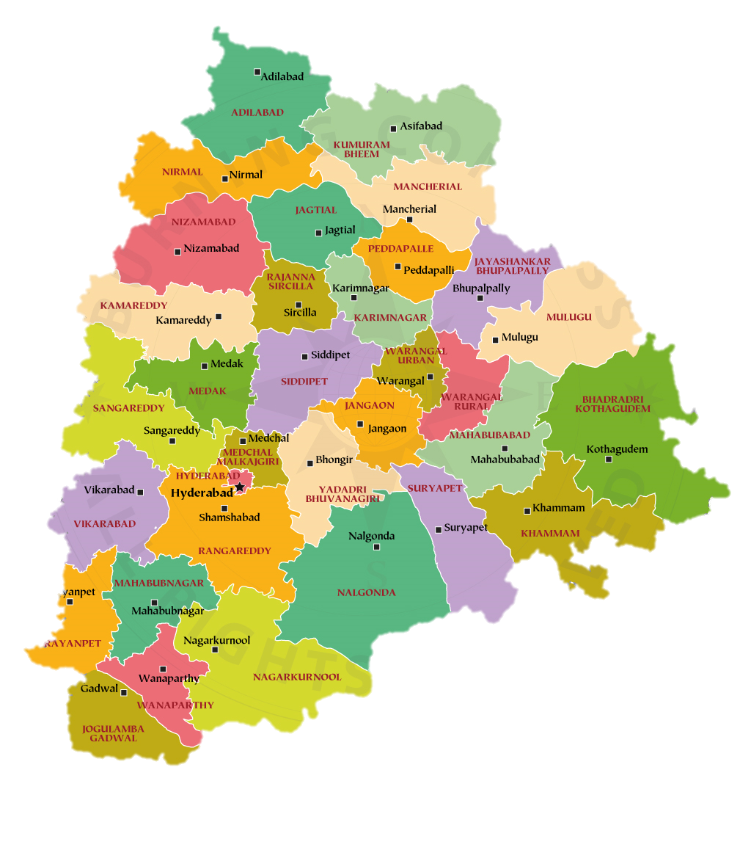
About the State: TELANGANA
Telangana is a state in southern India, known for its rich cultural heritage and historical significance. It was officially recognized as India's 29th state on June 2, 2014, following a long-standing demand for statehood. Hyderabad, one of the major cities in India, serves as the joint capital of Telangana and Andhra Pradesh.
Telangana's economy is diverse, with agriculture, information technology, and manufacturing sectors playing significant roles. The state is known for its agricultural products like rice, cotton, and red chillies. Hyderabad, in particular, is a major hub for the IT industry, housing several multinational companies and research institutions.
Culturally rich and economically vibrant, Telangana continues to thrive as an integral part of India's growth story.

Slide 3
PRIMARY INSIGHTS : Stamp Registration
1. Mulugu, Adilabad, Karimnagar, Mancherial, Wanaparthy are the top 5 districts that showed the highest document registration revenue growth between FY 2019 and 2022.
2. In FY 2022, Medchal Malkajgir, Hyderabad, Hanumakonda, Yadadri Bhuvanagiri, Khammam are the top 5 districts where e-stamps revenue contributes significantly more to the revenue than the documents in FY 2022.
3. The e-Stamp challan count has shown a steep increase pattern since its implementation, and for the years 2021, 2022, 2023, its count is more than the document registration count.
Note: E-stamp challans and document registration are closely related because documents that require registration often need to have the appropriate stamp duty paid before they can be registered. The e-stamp challan provides proof that the necessary stamp duty has been paid, ensuring that the document is legally valid and can be registered. The e-stamp certificate is often attached to the document being registered to demonstrate that the stamp duty has been properly paid.
4. Categorization of districts into segments based on their stamp registration revenue generation during the fiscal year 2021 to 2022:
- High Revenue -> Medchal Malkajgiri, Hyderabad, Sangareddy, Rangareddy, Hanumakonda, Khammam, Yadadri Bhuvanagiri, Nalgonda, Nizamabad, Karimnagar
- Moderate Revenue -> Mahabubnagar, Suryapet, Siddipet, Peddapalli, Medak, Mancherial, Jagtial, Vikarabad, Kamareddy, Nagarkurnool, Adilabad, Wanaparthy
- Low Revenue -> Rajanna Sircilla, Nirmal, Jogulamba Gadwal, Mahabubabad, Jangoan, Bhadradri Kothagudem, Narayanpet, Warangal, Mulugu, Kumurambheem Asifabad

Slide 4




PRIMARY INSIGHTS : Transportation
5. For the month of October, vehicle sales go up as consumers drive home their dream vehicles amid festive fervor after muted celebrations in the past two years on account of the pandemic.
6. Nalgonda, Siddipet, Suryapet are the districts which have shown a predominant preference towards agricultural vehicles.
- Nalgonda district is an agricultural district with good sources of irrigation and favorable climatic conditions.
- Siddipet district is a major agriculture-producing district in Telangana, India.
- Suryapet's economy is predominantly agricultural.
7. Rangareddy, Karimnagar, Hyderabad are the top 3, and Mahabubabad, Jagtial, Warangal are the bottom 3 districts that have shown the highest and lowest vehicle sales growth during FY 2022 compared to FY 2021.

Slide 5
PRIMARY INSIGHTS : TS-iPASS
8. Plastic and Rubber, Pharmaceuticals and Chemicals, Real Estate, Industrial Parks, and IT Buildings, Solar and Other Renewable Energy, Engineering are the top 5 sectors that have witnessed the most significant investments in FY 2022.
9. Rangareddy, Sangareddy, Medchal Malkajgiri are the top 3 districts that have attracted the most significant sector investments during FY 2019 to 2022.
10. Based on the provided data, there appears to be a positive correlation between district investments and both vehicle sales and stamp revenue within the same district in the state of Telangana, India. This means that as district investments increase, both vehicle sales and stamps revenue tend to increase as well.
11. Top 3 sectors that have shown substantial investment in multiple districts:
a) Food Processing: This sector has received substantial investments in the highest number of districts across Telangana, indicating its importance and potential for economic growth.
b) Engineering: The Engineering sector has also attracted significant investments in multiple districts, highlighting its contribution to the economic development of the region.
c) Pharmaceuticals and Chemicals: The Pharmaceuticals and Chemicals sector ranks third in terms of substantial investments in various districts, reflecting its significance in the industrial landscape of Telangana.

Slide 6

PRIMARY INSIGHTS : TS-iPASS
12. After analysing the investment trends for specific sectors, we can identify some seasonal patterns or cyclicality in the investment trends. Here are the observations for certain sectors that experience higher investments during particular months:
- Wood and Leather: This sector experiences higher investments in September and October, followed by a decrease in November and December. This seasonal pattern indicates notable cyclicality.
- Textiles: Textiles see a substantial increase in investment in September, suggesting a strong seasonal pattern likely related to textile production cycles.
- Paper and Printing: There is a significant increase in investment in July, indicating a strong seasonality in this sector.

Slide 7
SECONDARY INSIGHTS :
13. Hyderabad, Medchal Malkajgiri, Rangareddy, Sangareddy, Nizamabad are the top 5 districts to buy commercial properties in Telangana. This depends on two factors - purchasing power of that district and the investment made in that district.
14. Policies and Sectors:
- Electric Vehicle & Energy Storage Policy 2020-2030: It is clear from the data that there is an increase in investments with the years for this sector. To create a policy framework for the accelerated development of an Electric Vehicle and Energy Storage Systems' ecosystem, comprehensively addressing both the demand and supply side gaps and laying emphasis on charging infrastructure creation.
- T-FAPP 2021: Policy for the development of a world-class ecosystem for a quality-focused and globally competitive food processing and preservation industry in Telangana state. The Food Processing sector has received increased investment in the coming years from FY 2019-2022. Creation of 10,000 acres of special food processing zones across the state to support the additional 53 lakh acres area brought under irrigation till 2024-25.
- Solar Power Policy: Solar and Other Renewable Resources sector comes fourth in terms of investment during FY 2019-2022. Realize and harness the vast solar power potential of the state. Contribute to the long-term energy security of the state and promote a sustainable fuel mix in generation through the higher contribution of solar energy. To promote solar parks.

Slide 8
TOP 5 INSIGHTS :
District Revenue Growth
E-Stamp Revenue Impact
Mulugu, Adilabad, Karimnagar, Mancherial, and Wanaparthy experienced the highest document registration revenue growth between FY 2019 and 2022.
In FY 2022, Medchal Malkajgir, Hyderabad, Hanumakonda, Yadadri Bhuvanagiri, and Khammam had significantly higher e-stamp revenue contributions compared to document revenue.
E-Stamp Challan vs. Document Registration
District Categorization
Seasonal Vehicle Sales
E-stamp challan counts surpassed document registration counts in 2021, 2022, and 2023, indicating a growing preference for electronic stamping methods..
Districts were categorized into High Revenue (e.g., Medchal Malkajgiri, Hyderabad), Moderate Revenue (e.g., Mahabubnagar, Adilabad), and Low Revenue (e.g., Rajanna Sircilla, Nirmal) segments based on stamp registration revenue generation.
October saw a surge in vehicle sales due to festive celebrations, marking a rebound from subdued sales during the pandemic years..

Slide 9
RECOMMENDATIONS
Promote Digital Transformation
Encourage and facilitate the adoption of digital stamping methods across districts. Invest in user-friendly platforms and awareness campaigns to make the transition from physical to electronic stamping seamless for businesses and individuals.
01
Invest in Specific Sectors
Targeted Economic Development
Thermal Power Plant and Fertilizers (Organic and Inorganic), Pesticides, Insecticides, and Other Related sectors need more investments to flourish fully and make the best contribution to society.
Focus on districts with low revenue growth, such as Rajanna Sircilla and Nirmal. Implement targeted economic development initiatives, provide incentives for businesses, and invest in infrastructure to stimulate growth in these areas.
04
02
03
Enhance Vehicle Sales Strategies
Leverage festive seasons and local cultural events to boost vehicle sales. Collaborate with dealerships and manufacturers to offer special promotions and discounts during these periods, capitalizing on increased consumer spending.

Slide 10
THANK YOU

