Slide 1

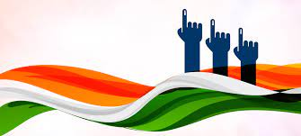

CODEBASICS RESUME CHALLENGE 11
Lok Sabha Elections
2014 & 2019
Presented by : Namrata Panigrahi

Slide 2
Overview of 2014 Election
Problem Statement
AtliQ Media is a private media company and they wanted to telecast a show on Lok Sabha elections 2024 in India.
Unlike other channels they do not want to have a debate on who is going to win this election, they rather wanted to present insights from 2014 and 2019 elections without any bias and discuss less explored themes like voter turnout percentage in India.
The task is to generate meaningful insights from data according to the list of primary and secondary questions.
Key highlights and summary of the 2014 Lok Sabha Election.

Slide 3

Overview of 2014 Election
Overview of Data
The sample dataset was provided in the form of CSV files.
The CSV format based files are constituency_wise_results_2014, constituency_wise_results_2019 and dim_states_codes.
The first two files contain details about candidates, their state and constituency, and the votes they received out of the total electors.
‘dim_states_codes’ consist of names and standard two-letter codes assigned to each state and union territory.
Key highlights and summary of the 2014 Lok Sabha Election.

Slide 4
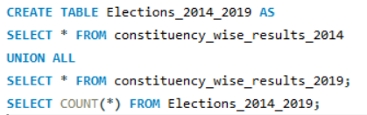
Overview of 2014 Election
Data Cleaning and Transformation
Proper validation have been done for constituencies spelling mismatches and identical names of the constituencies have been removed.
For the year 2014, Andhra Pradesh underwent bifurcation and all the constituencies from that year has been attributed to Telangana state.
I have added a new column named ‘election_year’ and combined the election data for the years 2014 and 2019 into one table ‘Elections_2014_2019’ to facilitate generating insights.
Key highlights and summary of the 2014 Lok Sabha Election.

Slide 5


Overview of 2014 Election
Tools Used
Key highlights and summary of the 2014 Lok Sabha Election.

Slide 6
Overview of 2014 Election
Key highlights and summary of the 2014 Lok Sabha Election.
PRIMARY INSIGHTS

Slide 7
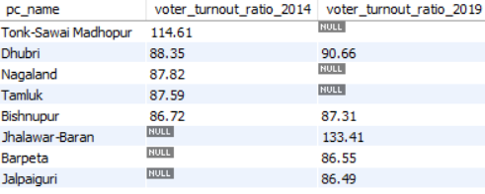
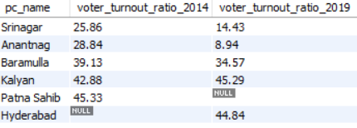
Overview of 2014 Election
1. List top 5 / bottom 5 constituencies of 2014 and 2019 in terms of voter turnout ratio?
Among the top constituencies in terms of voter turnout ratio, Dhubri and Bishnupur have maintained their positions in both election years. Conversely, Srinagar, Anantnag, Baramulla, and Kalyan have consistently shown low voter turnout ratios.
Voter Turnout Ratio is the percentage of eligible voters who cast a ballot in an election.
Key highlights and summary of the 2014 Lok Sabha Election.
Top 5 Constituencies
Bottom 5 Constituencies

Slide 8
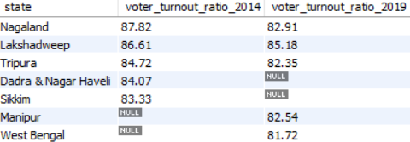
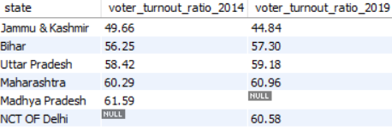
Overview of 2014 Election
2. List top 5 / bottom 5 states of 2014 and 2019 in terms of voter turnout ratio?
Nagaland, Lakshadweep, and Tripura are topping the charts in terms of voter turnout ratio, while Jammu & Kashmir, Bihar, Uttar Pradesh and Maharashtra have the lowest voter turnout ratios.
Key highlights and summary of the 2014 Lok Sabha Election.
Top 5 States
Bottom 5 States

Slide 9
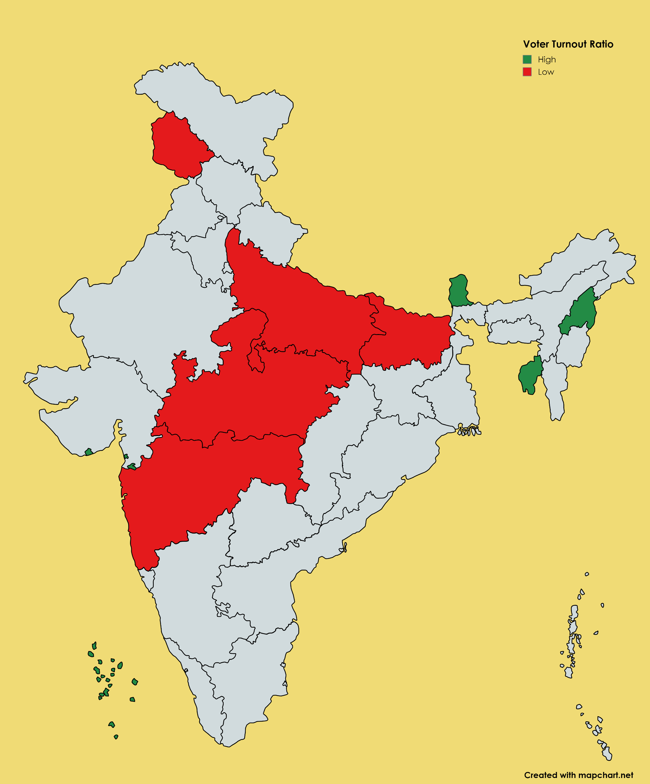
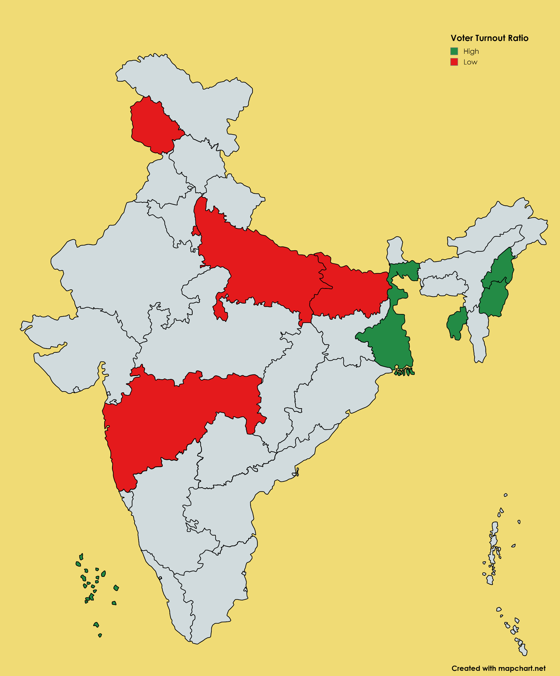
Overview of 2014 Election
Comparison of Voter Turnout Ratio Between 2014 and 2019 Using Map Visualization
2014
2019
Key highlights and summary of the 2014 Lok Sabha Election.

Slide 10
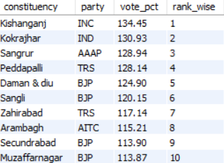
Overview of 2014 Election
3. Which constituencies have elected the same party for two consecutive elections, rank them by % of votes to that winning party in 2019 ?
Key highlights and summary of the 2014 Lok Sabha Election.
Among the constituencies which have voted for the same party in both election years, ‘BJP’ party has notably maintained its position.
Out of 332 constituencies that have voted for the same party in both election years, 235 constituencies have consistently supported the ‘BJP’.

Slide 11
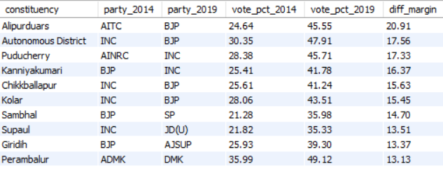
Overview of 2014 Election
4. Which constituencies have voted for different parties in two elections (list top 10 based on difference (2019-2014) in winner vote percentage in two elections) ?
Key highlights and summary of the 2014 Lok Sabha Election.
We can identify significant shifts in voter preferences and political dynamics within those constituencies. Understanding these shifts is crucial for future political planning and targeted campaigning.

Slide 12
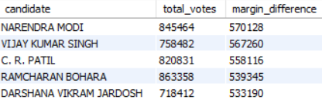
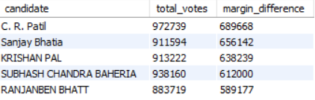
Overview of 2014 Election
5. Top 5 candidates based on margin difference with runners in 2014 and 2019
Narendra Modi and C. R. Patil both from the ‘BJP’ party have been on top based on margin difference with runners in 2014 and 2019.
Key highlights and summary of the 2014 Lok Sabha Election.
2014
2019

Slide 13
Overview of 2014 Election
6. % Split of votes parties between 2014 vs 2019 at national level
Key highlights and summary of the 2014 Lok Sabha Election.
‘BJP’ and ‘INC’ have clearly seen an increase in vote percentage in the election year 2019. While BJP saw a growth of around 20%, INC saw a growth of around 5% in 2019.

Slide 14
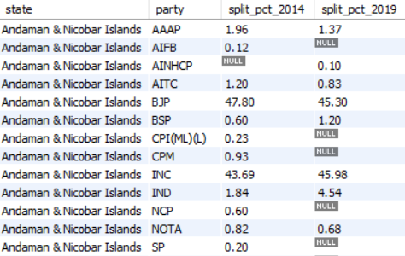
Overview of 2014 Election
"
7. % Split of votes parties between 2014 vs 2019 at state level
For the Union Territory of Andaman & Nicobar Islands, the ‘BJP’ experienced a decrease in the % Split of votes from 2014 to 2019, while the ‘INC’ saw an increase.
Key highlights and summary of the 2014 Lok Sabha Election.
Note: Considered a small segment of the result set for analysis purposes.

Slide 15
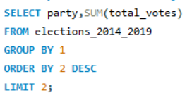
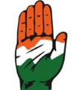
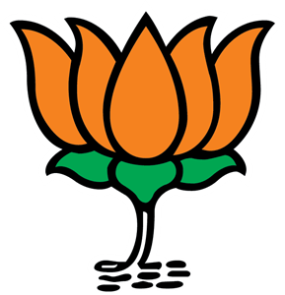
Overview of 2014 Election
Two Major National Parties of the Country
Key highlights and summary of the 2014 Lok Sabha Election.
We can find out about the two major national parties of the country by executing this query.
Turns out ‘BJP’ and ‘INC’ are the two major national parties of the country.
BJP
INC

Slide 16

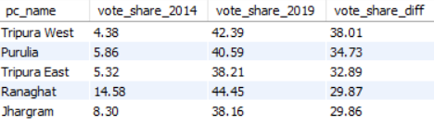
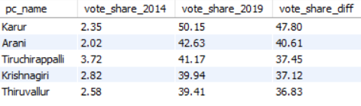
Overview of 2014 Election
8. List top 5 constituencies for two major national parties where they have gained vote share in 2019 as compared to 2014.
As it is clearly evident that for both the parties the vote share has increased in 2019 as compared to 2014 from these constituencies.
‘INC’ has performed well with a whopping vote share difference of 47.80, compared to ‘BJP’ which has a highest vote share difference of 38.01.
Key highlights and summary of the 2014 Lok Sabha Election.
BJP
INC

Slide 17
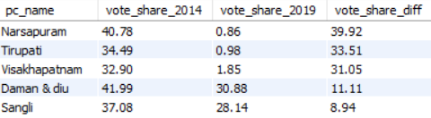
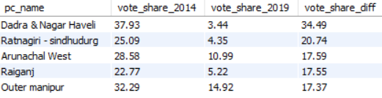
Overview of 2014 Election
9. List top 5 constituencies for two major national parties where they have lost vote share in 2019 as compared to 2014
‘BJP’ has seen a drop in vote share in 2019 in the constituencies of Narsapuram, Vishakhapatnam and Tirupati which are cities in Andhra Pradesh. Daman and Diu, a Union Territory, has also shown a dip.
Key highlights and summary of the 2014 Lok Sabha Election.
Dadra & Nagar Haveli, Ratnagiri – Sindhudurg, Arunachal West, Raiganj, Outer manipur are the constituencies for ‘INC’ where they have lost vote share in 2019 as compared to 2014.

Slide 18
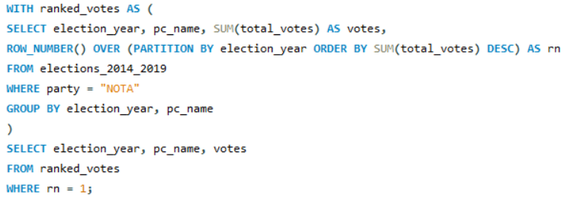

Overview of 2014 Election
10. Which constituency has voted the most for NOTA?
By executing this query we can find out which constituency has voted the most for NOTA.
It turns out Nilgiris from Tamil Nadu state in 2014 and Gopalganj (SC) from Bihar state in 2019 have voted the most for NOTA.
Key highlights and summary of the 2014 Lok Sabha Election.
NOTA – None of the Above

Slide 19
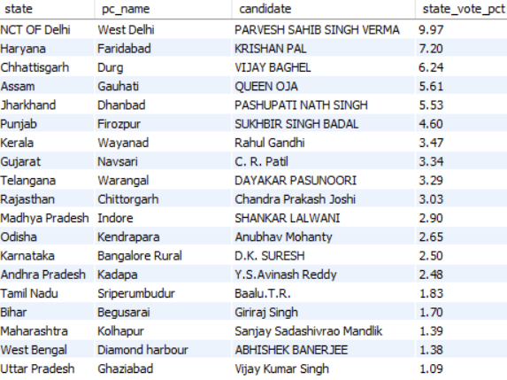
Overview of 2014 Election
11. Which constituencies have elected candidates whose party has less than 10% vote share at state level in 2019?
These are the constituencies that have elected candidates whose party has less than 10% vote at state level in 2019.
It becomes crucial to identify these areas where minor or less dominant parties have strong local support despite having a minimal overall impact at the state level for detailed political analysis or strategic planning for future elections.
Key highlights and summary of the 2014 Lok Sabha Election.

Slide 20
Overview of 2014 Election
Key highlights and summary of the 2014 Lok Sabha Election.
SECONDARY INSIGHTS

Slide 21
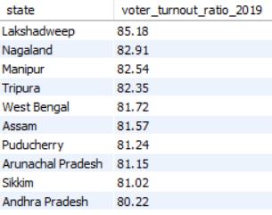
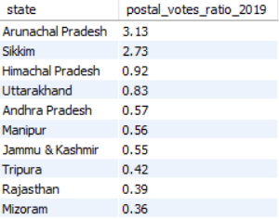
Overview of 2014 Election
12. Is there a correlation between postal votes % and voter turnout % ?
Key highlights and summary of the 2014 Lok Sabha Election.
We can clearly see that Arunachal Pradesh, Sikkim, Andhra Pradesh, Manipur, and Tripura are among the top 10 states with the highest postal vote ratios. This is also the case for voter turnout ratios. The availability and efficiency of postal voting tend to positively correlate with voter turnout ratios.
Note: For analysing this correlation, we are taking the result set from the election year 2019.

Slide 22
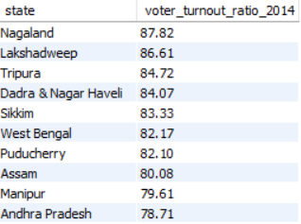
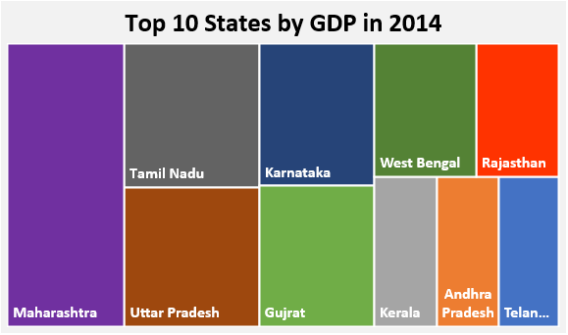
Overview of 2014 Election
13. Is there a correlation between GDP of a state and voter turnout % ?
Only West Bengal and Andhra Pradesh align with the top 10 states by GDP. The relationship between a state's GDP and voter turnout percentage is complex and influenced by various social, economic, and political factors, requiring context-specific analysis for a comprehensive understanding.
Key highlights and summary of the 2014 Lok Sabha Election.
Note: For analysing this correlation, we are taking the result set from the election year 2014. For more information please visit : https://en.wikipedia.org/wiki/List_of_Indian_states_and_union_territories_by_GDP

Slide 23

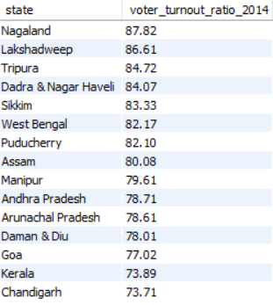
Overview of 2014 Election
14. Is there any correlation between literacy % of a state and voter turnout % ?
Lakshadweep, Tripura, Sikkim, Puducherry, Daman & Diu, Goa, Kerala, and Chandigarh are among the top 15 states for both voter turnout in 2014 and literacy rates in India.
Key highlights and summary of the 2014 Lok Sabha Election.
Note: For analysing this correlation, we are taking the result set from the election year 2014.

Slide 24
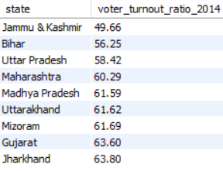
Overview of 2014 Election
14. Is there any correlation between literacy % of a state and voter turnout % ? (Contd.)
Key highlights and summary of the 2014 Lok Sabha Election.
Jammu & Kashmir, Bihar, Uttar Pradesh, Madhya Pradesh, and Jharkhand have the lowest voter turnout ratios and literacy rates in India.
Higher literacy rates tend to correlate with higher voter turnout ratios and vice versa. So the correlation is often positive.
Note: State wise literacy rate data is according to the 2011 Census. Please visit this site for more information : https://www.mospi.gov.in/data

Slide 25

Overview of 2014 Election
15. Provide 3 recommendations on what the election commission/government can do to increase the voter turnout % ?
Key highlights and summary of the 2014 Lok Sabha Election.
Ensure that all eligible voters are aware of and can easily use postal voting options, especially in high turnout states. This can further boost turnout and set an example for other states.
Enhance Postal Voting and Accessibility
Incentivize Voting
Provide incentives such as tax benefits, discounts on public services, or recognition awards to encourage voter participation.
Targeted Awareness Campaigns
Implement educational campaigns that highlight the importance of voting and how it impacts local communities. Use local languages and culturally relevant materials to ensure the message resonates with the population.

Slide 26
Overview of 2014 Election
Key highlights and summary of the 2014 Lok Sabha Election.
THANK YOU

