Slide 1
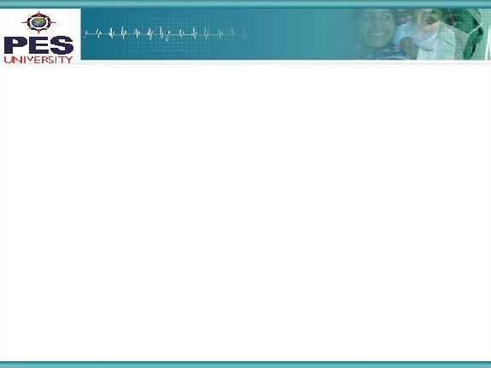

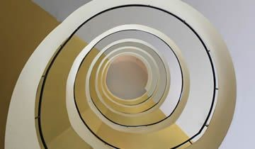
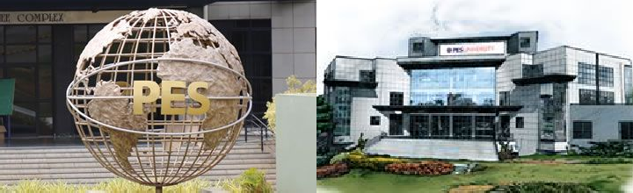
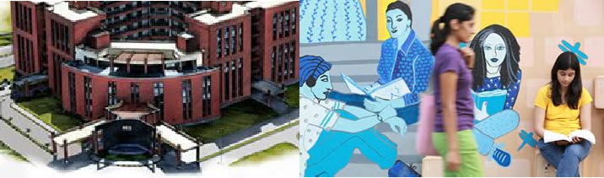

Project Presentation
(Final - ESA)
Project Title
: Automatic Code Generation from Screenshot
Project Team : Namrata Ramesh PES1201700921
Pragnya Sridhar PES1201701342
Sarang Ravindra PES1201700972
‹#›

Slide 2
Project Abstract and Scope
This project was developed to cut down development time for HTML pages for client-specified layouts. Given a screenshot of a web page layout this model generates an intermediate representation called the Domain Specific Language which can subsequently be converted into HTML pages with the help of a compiler.
This project was taken up to help developers cut down on development time by generating the HTML skeleton code for them.
We have chosen this project with the intention of developing a monetizable application for developers to use to implement client design.
‹#›

Slide 3
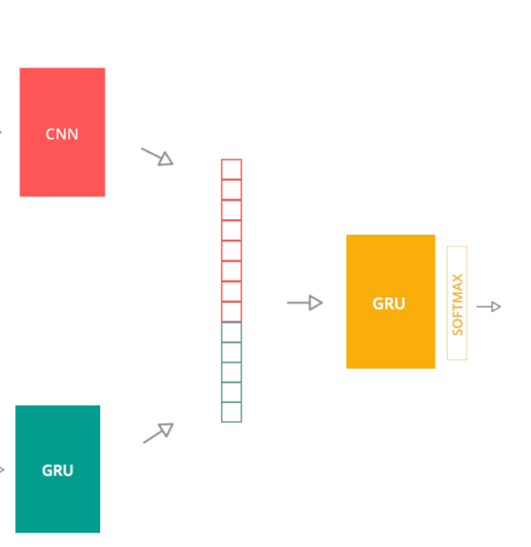
Solution Architecture
Visual Model: CNN for feature engineering
Language Model: A word-2-vec like layer to learn numerical representation of elements in our vocabulary. along with GRU to learn sequence in our DSL
Decoder RNNs (GRU) :
Learning token sequences for the respective images
Predicting next token given features extracted from CNN and tokens predicted thus far
Compiler : To interpret the DSL and produce the respective HTML code
Prediction
“header”
‹#›

Slide 4
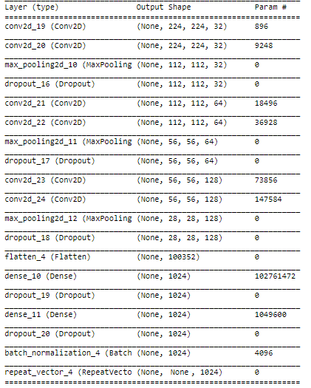
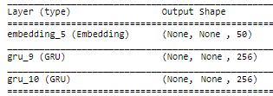
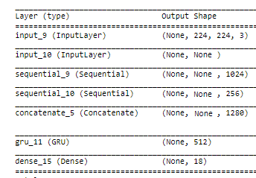
Respective Model architecture
Encoder CNN Architecture for Visual Model
Encoder RNN Architecture for Language Model
Decoder RNN Architecture

Slide 5
Algorithm
Preprocess and render image
Feed image into CNN
Send processed input sequences into the Encoder RNN
Send decoder the outputs from the encoder to give set of token
Train the model with abundant Data, tweak hyper-parameters to get best result
Test and validate the model
Predict by providing sample images as inputs
Pass the DSL output to the Compiler to produce equivalent HTML code

Slide 6
Detailed Algorithm
Preprocessing the Dataset
Resizing image to to 3 x 224 x 224
Creating in-sequence where caption is prepended with <START>
Creating out-sequence where caption is appended with <END> tag
Tokenizing and changing into its respective one hot encoding.
Implementing Encoder CNN
Input preprocessed Images into CNN and train through all the layers
Implementing Encoder RNN
Input preprocessed in sequence and outsequence and train through the layers
Implementing Decoder RNN
Input the feature vector from CNN and the result obtained from encoder RNN
concatenate the 2 layers
Pass as input to final GRU
Predicting tokens for new images
Feed Sample image to trained model
Feed <START> tag to the encoder RNN
Generate tokens till <END> tag is encountered
Running the compiler
Feed the generated tokens into compiler
Run the html file to test results

Slide 7
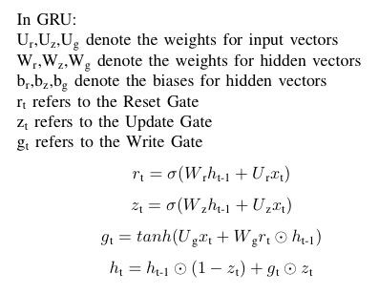
Math Behind the Solution

Slide 8
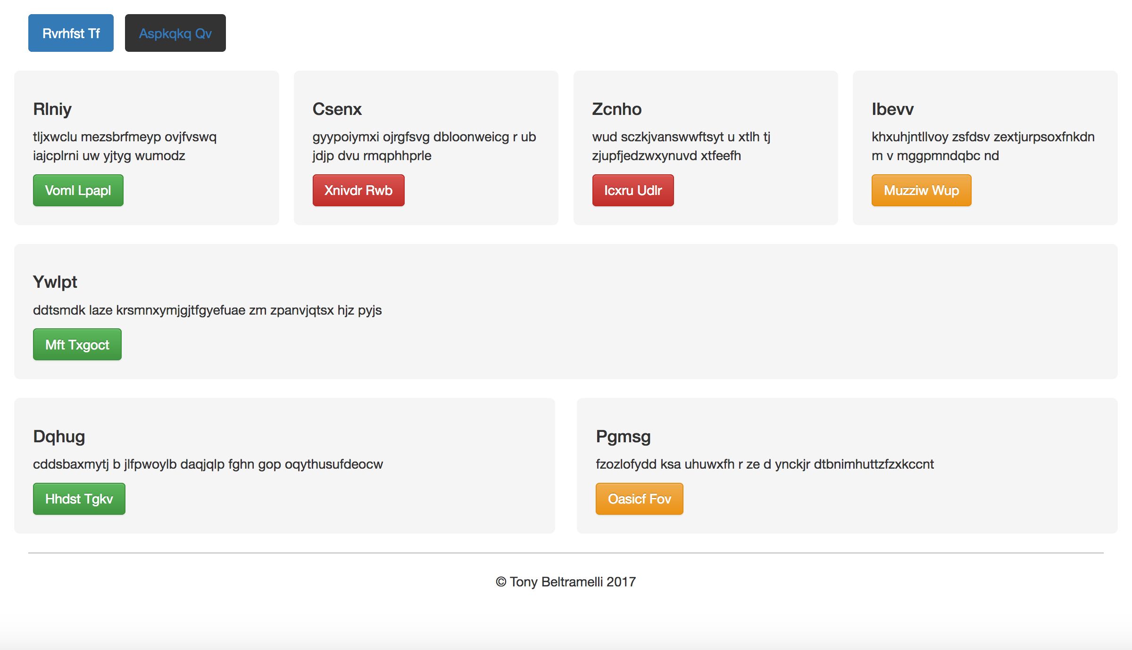
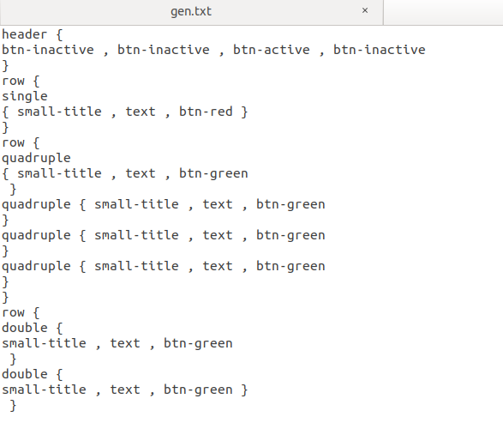
Testing and Criteria
Testing:
The loss decreased consistently during the training phase to about 6 from 110 indicating that the network is learning.
The model is able to produce a syntactically correct DSL. This is fed into the compiler. BLEU score of around 0.84
Our compiler seemed to work well to produce the right HTML code given the correct DSL. The given project can be looked at as a proof of concept.
Criteria for “goodness” of our model:
Our most significant improvement to the pic2code concept is the GRU. As GRU’s learn 3 sets of weights the training time would be lesser than if an LSTM cell was used.

Slide 9
Constraints, Assumptions & Dependencies
Assumptions:
Input images are of a resolution as expected from a webpage viewed on a desktop/laptop screen.
This model generates can generate one of many solutions while taking into consideration basic HTML5 conventions.
Each HTML element has only few children as due to the bottleneck that is the memory of GRUs and LSTMs
Difficulties Faced
The dataset used has limited number of images.
Most of the image captioning models use pretrained weights
Each model should be trained individually for best results but since only the final DSL output is available, the entire model needs to be trained as one.
The lack of resources in terms of time and compute also contributed to the poor performance of the model
‹#›

Slide 10
Future work plan
Using pre-trained feature extraction models such as ResNet 152 or the Inception-V3 would give the model a significant headstart when it comes to training.
The vocabulary of our model being as limited as it is, is not equipped to handle the rich websites
Enabling the model to label elements with IDs and classes by adding text in a recognised area
input also DOM tree specifications and then have the model come out with a design which is in compliance with user requirements.
Look into responsive web pages as well.
Converting handwritten layouts to webpages.
‹#›

Slide 11
References
T. Beltramelli, pix2code: Generating code from a graphical user interface screenshot, CoRR, vol.abs/1705.07962, 2017
[online] Available: https://machinelearningmastery.com/develop-
a-deep-learning-caption-generation-model-in-python/

Slide 12
Thank You

