Slide 1
Strategic Hospital Management with QR code System
Group ID: G13
Namrata Sanger - 17162101037 Priya Jain - 17162101049
Under the guidance of Prof. Flevina Dsouza. Institute of Computer and Technology, Ganpat University.

Slide 2
Table of Contents
Problem Statement
Flow chart
Time line chart
Design & Diagrams
Conclusion
References

Slide 3



1.
Problem Statement

Slide 4









Problem Statement
Create an application to facilitate information storage and sharing between doctor and patient over cloud. This information includes prescriptions, referrals, patient’s medical history etc. The information exchange must occur even without internet connectivity.

Slide 5
2. Flow chart & Algorithm

Slide 6




Flowchart (Login Module)
For better view of the flow chart visit:
Landing page
https://lucid.app/invitations/accept/0661da0c-21c4-46d5-9c09-82be01918867
Dashboard
https://lucid.app/invitations/accept/0f90eb93-434e-46aa-b524-64c2f79f33d3
Prescription
https://lucid.app/invitations/accept/5bd1cf46-97bc-40b6-b4a6-27ceb756da45

Slide 7
3. Timeline

Slide 8
Time line
Requirement Gathering
July(2020)
August(2020)
September(2020)
October(2020)
14th
21st
28th
14th
16th
23rd
14th
21st
30th
5th
12th
19th
Research Paper
Defining Problem Statement
Login and Logout Module
Doctor’s and Patient Module(FrontEnd)
Doctor’s and Patient Modile(Backend)

Slide 9
4. Design/Diagrams

Slide 10
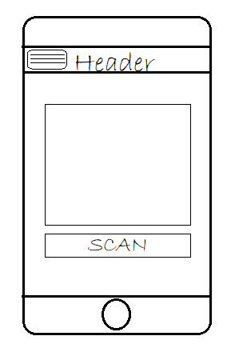
Mobile App View
The view get changed with the final output of the application.

Slide 11
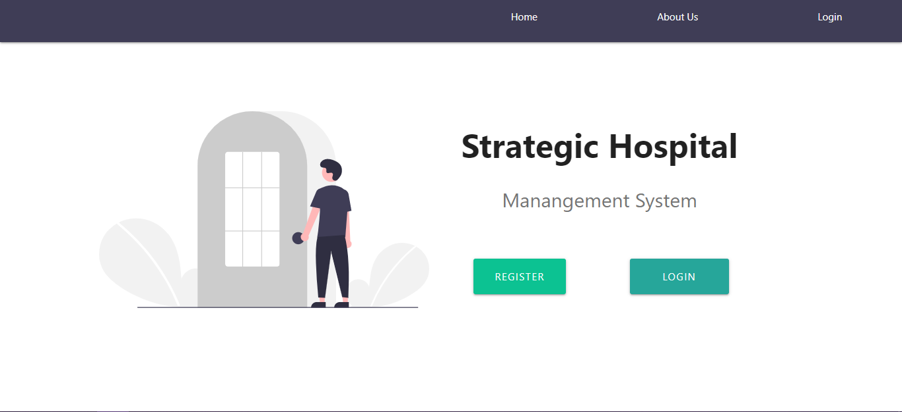
Desktop View

Slide 12
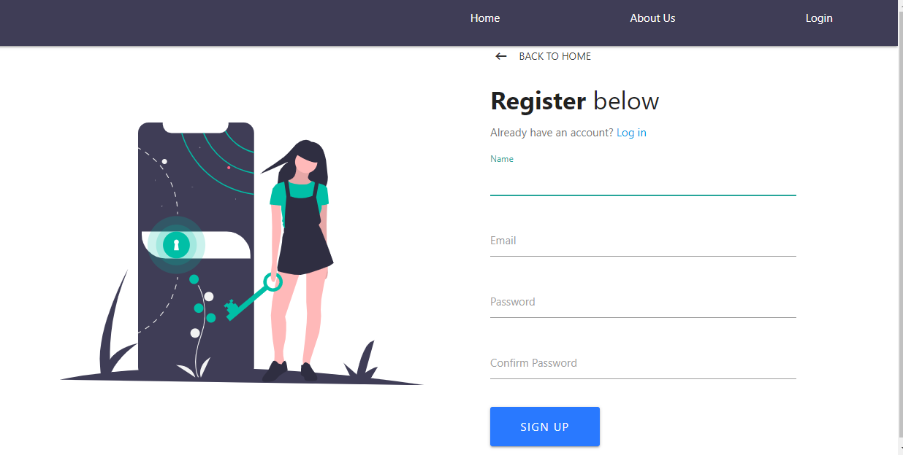
Desktop View

Slide 13
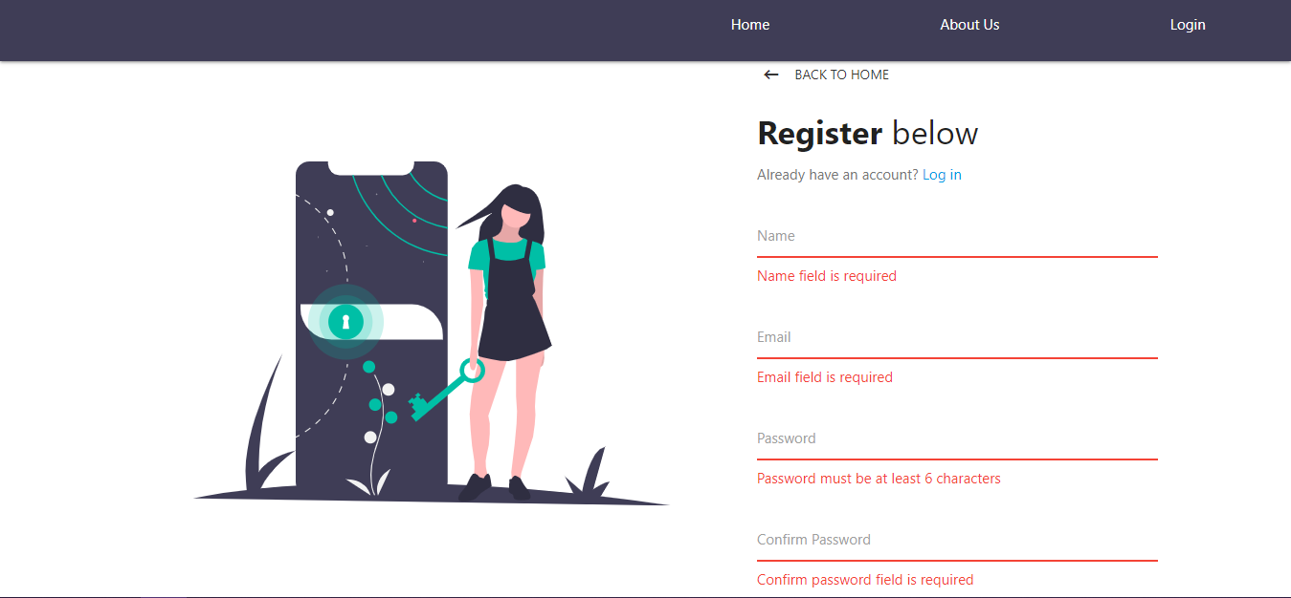
Desktop View

Slide 14
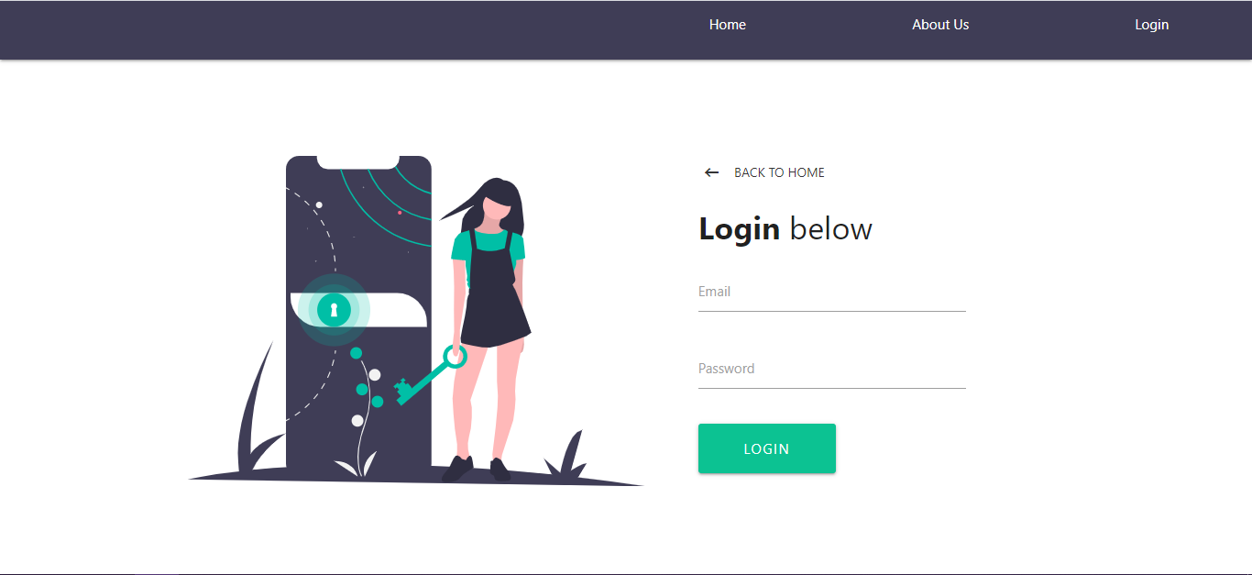
Desktop View

Slide 15
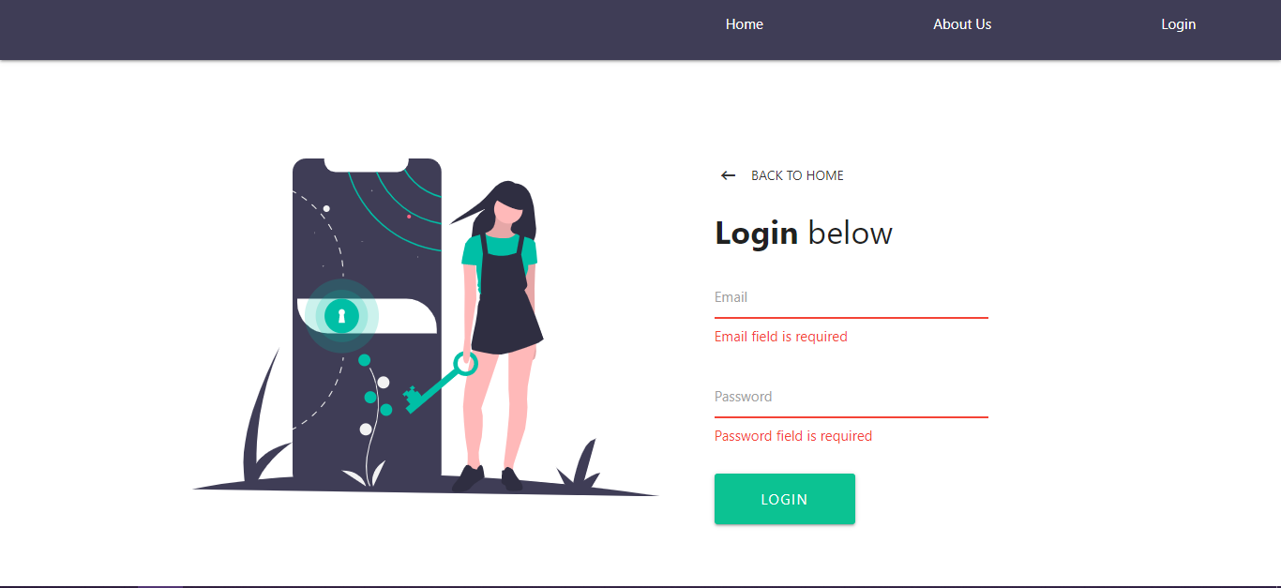
Desktop View

Slide 16

Desktop View

Slide 17
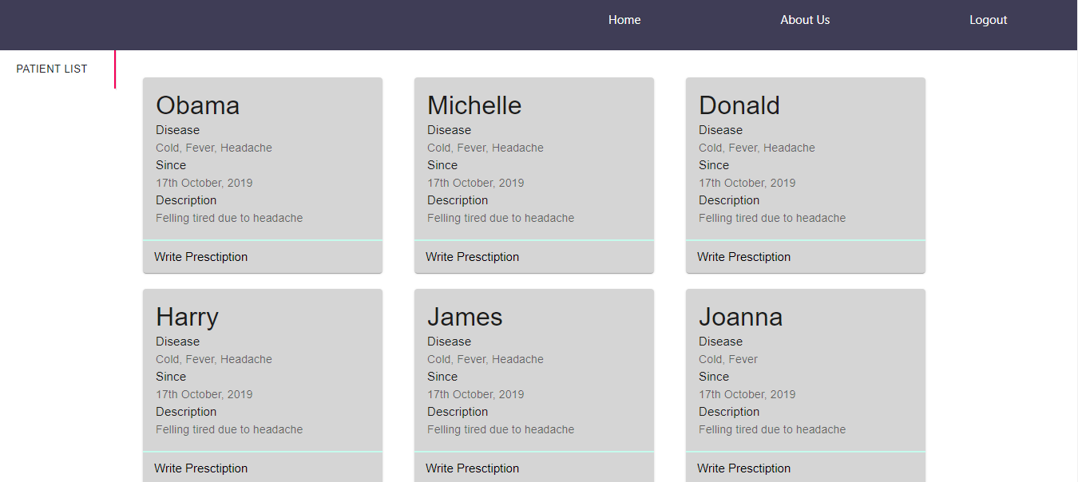
Desktop View

Slide 18
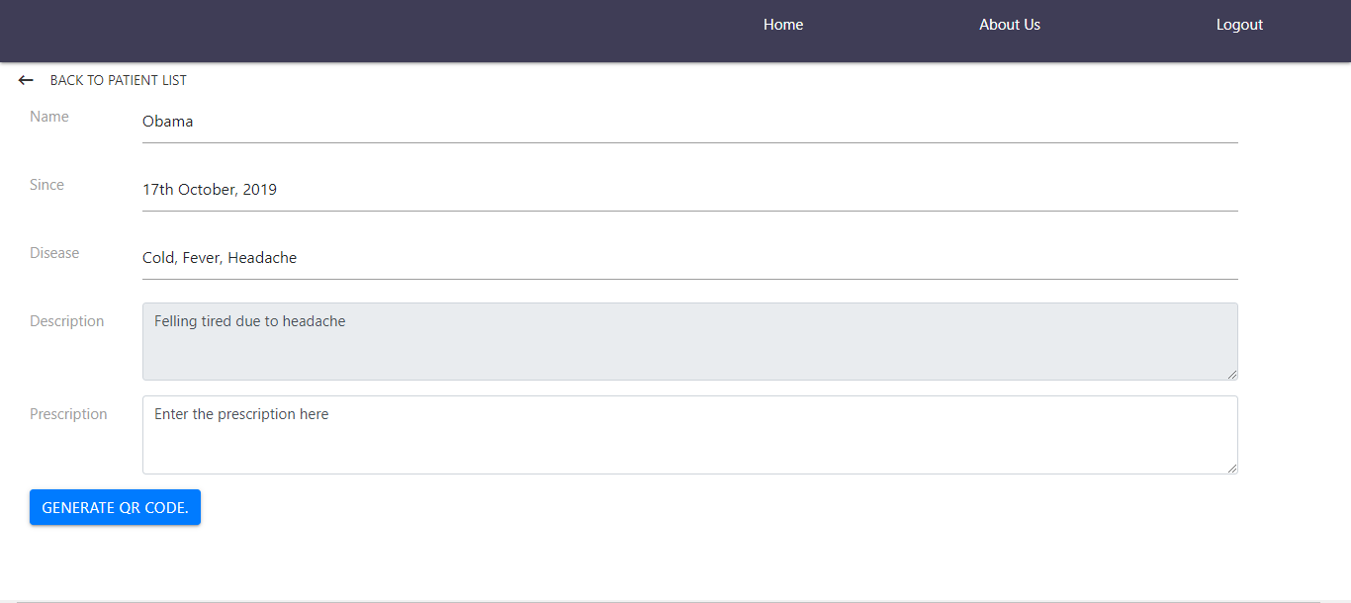
Desktop View

Slide 19
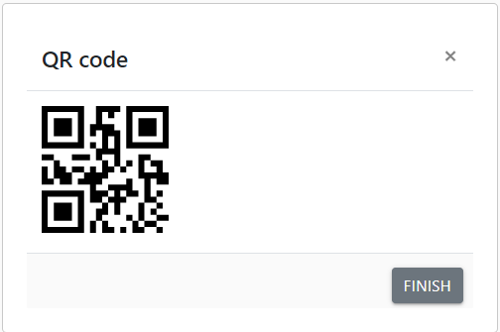
Desktop View

Slide 20
5. Conclusion

Slide 21
Conclusion
As per our problem statement, to create the application that eases the way for sharing information between a doctor and a patient, we will create an application that is easy to use and works as shown in the flow charts and can be used by anyone with a browser with internet or an android phone. We hope this will resolve the problem of data storage and access leading to better treatments for people.

Slide 22
6. References

Slide 23
References
P. Mersini, E. Sakkopoulos and A. Tsakalidis, "APPification of hospital healthcare and data management using QRcodes," IISA 2013, Piraeus, 2013, pp. 1-6, doi: 10.1109/IISA.2013.6623716.
M. D. Lakshmi and J. P. M. Dhas, "An open source private cloud solution for rural healthcare," 2011 International Conference on Signal Processing, Communication, Computing and Networking Technologies, Thuckafay, 2011, pp. 670-674, doi: 10.1109/ICSCCN.2011.6024635.
Nagarajan, Dr.Karthikeyan & Sukanesh, R. (2012). Case Study on Software as a Service (SaaS) Based Emergency Healthcare in India. European Journal of Scientific Research. 69.

Slide 24

Thanks!
Any questions?
You can find us at:
namrata.cba1737@ict.gnu.ac.in
priya.cba1749@ict.gnu.ac.in

